Slide 1
Project #7: IoT augmented physical scale model of a suburban home REU Students: Wahub Ahmed, Abraam Youssef Faculty mentors: Damla Turgut, Lotzi Bölöni Graduate mentor: Furkan Cimen
Week 3 (May 28 – June 3, 2022)
Accomplishments:
Leveled the studs
Controlled speed with motor driver
Coded the sun simulation for the experiment
Extended sun path and motor axis for model
Created a GitHub repository for the code
Problem & Solutions
Motor driver was not reliable and functional when experimenting
Restart and remove the short for the enable
Speed was too high or too low
Reprogrammed the model to discrete values rather continuous
Sun path was too short to cover the ScaledHome
Extended the sun path
Raspberry Pi did not produce enough voltage
Connected 12V power supply to motor driver
Plans for next week:
Complete the model of the Sun and test the code for simulating the days
Complete the calculation of the temperature gradients to simulate the relative temperatures in the home
Change the code for the ScaledHome to add a variety of Sun positions that correlate with the change in temperatures
Add trees and possibly clouds to the home
NSF REU Research Experience on Internet of Things 2022

Slide 2
Accomplishments
NSF REU Research Experience on Internet of Things 2022

Slide 3
Accomplishments
NSF REU Research Experience on Internet of Things 2022

Slide 4
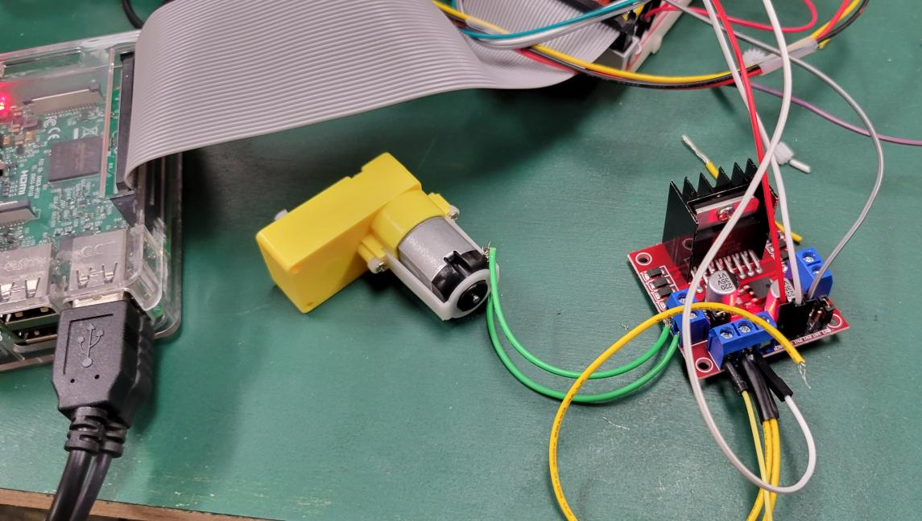
Accomplishments
NSF REU Research Experience on Internet of Things 2022

Slide 5
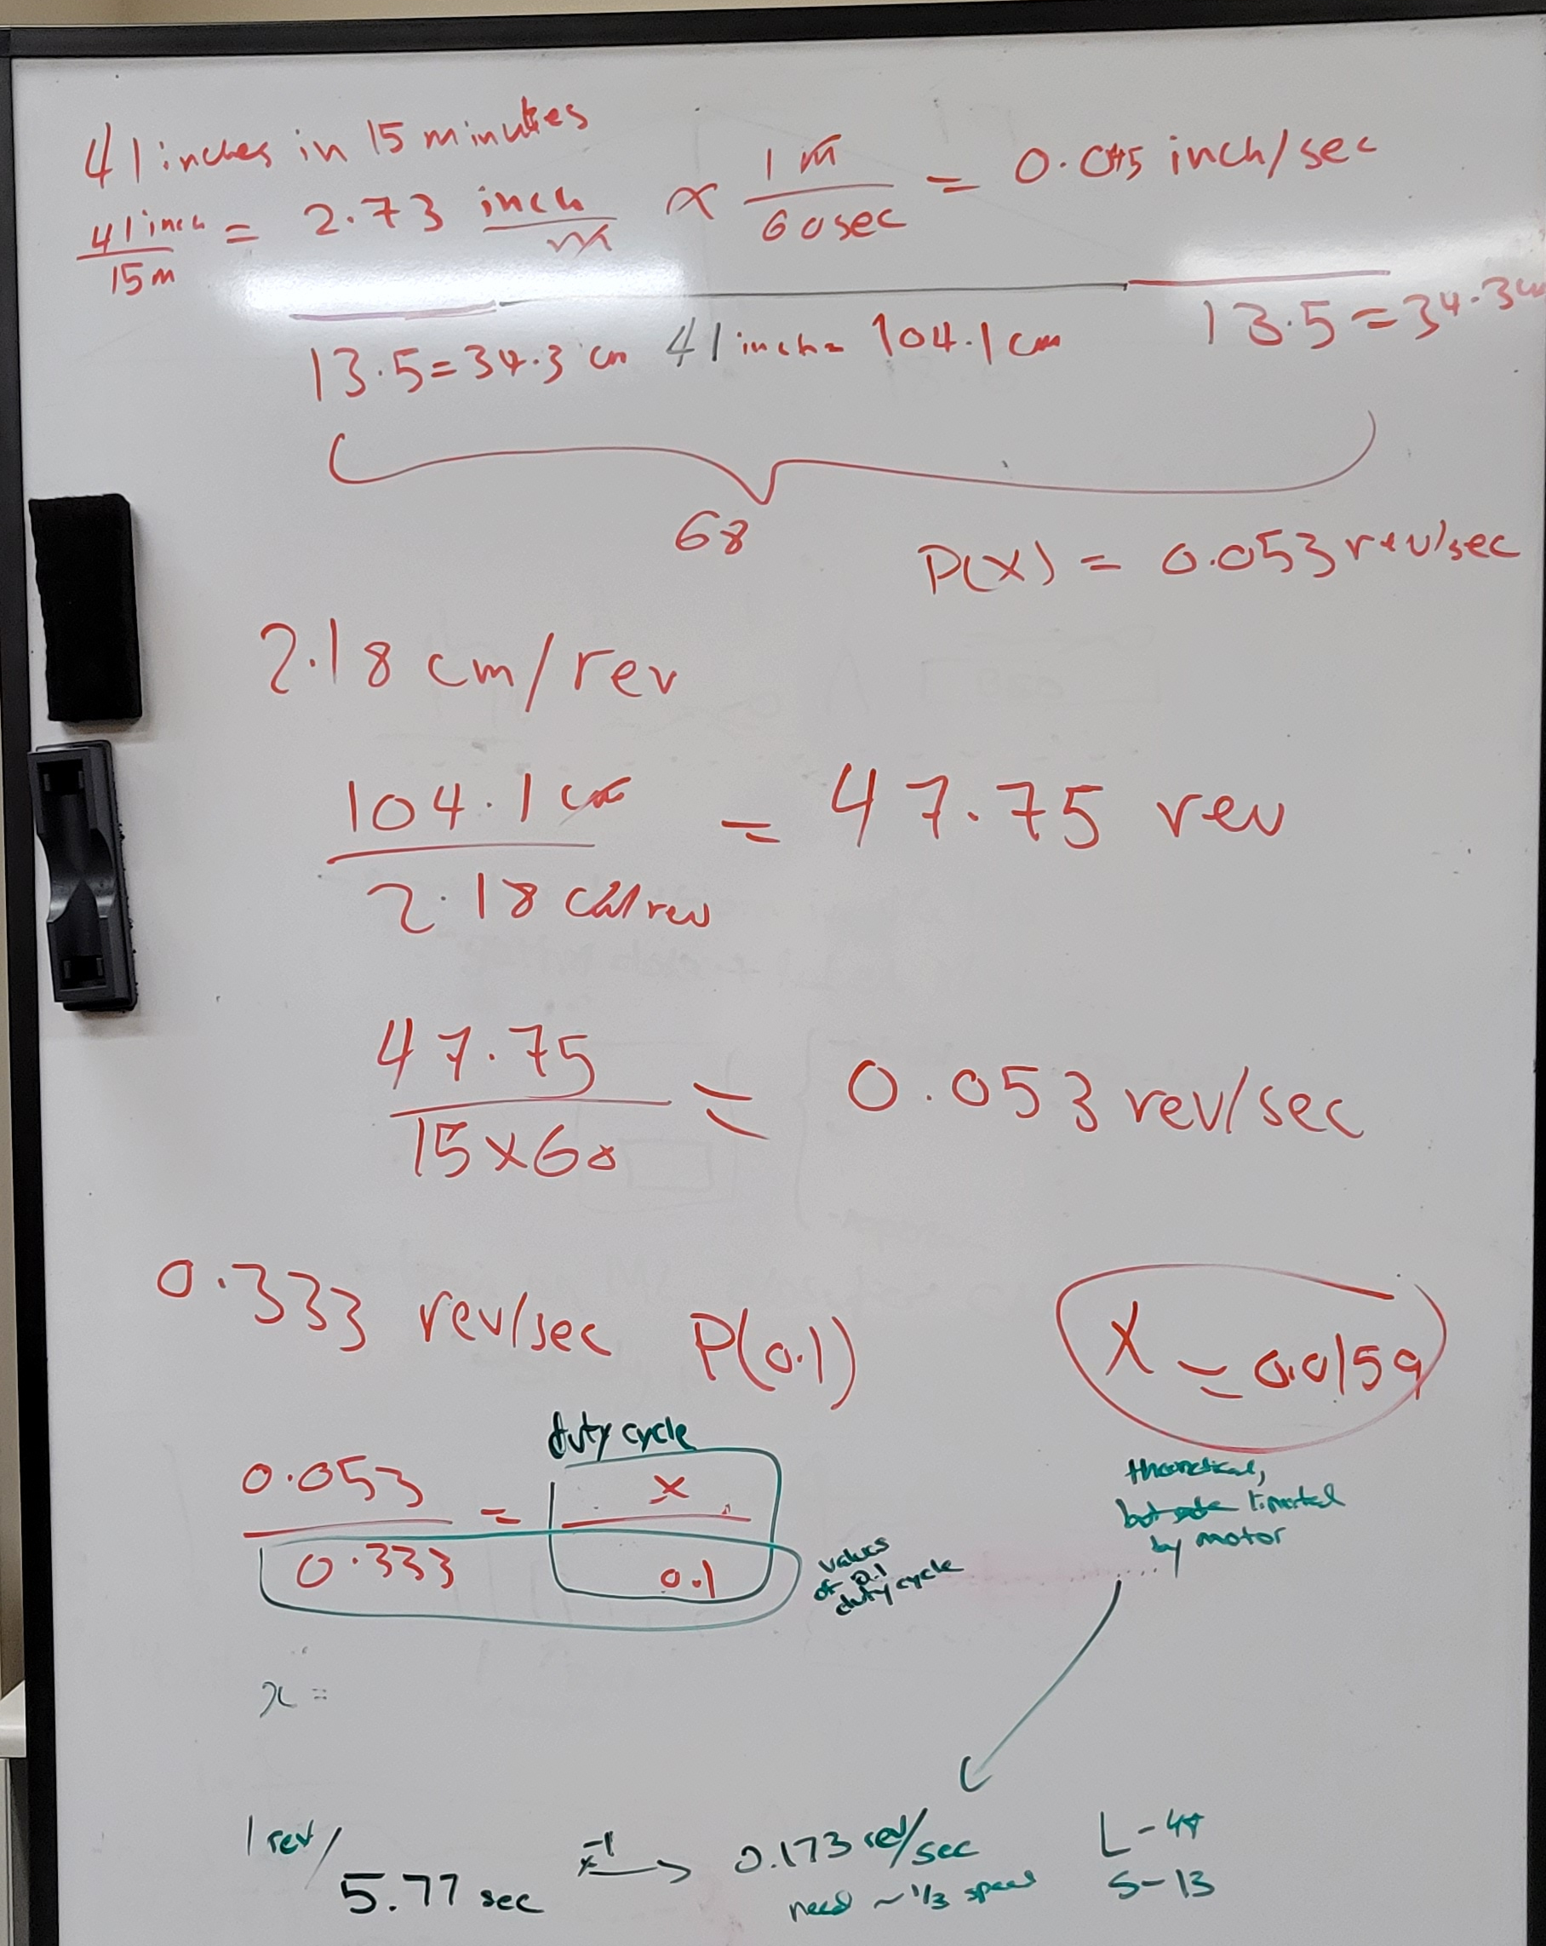
Accomplishments
NSF REU Research Experience on Internet of Things 2022

Slide 6
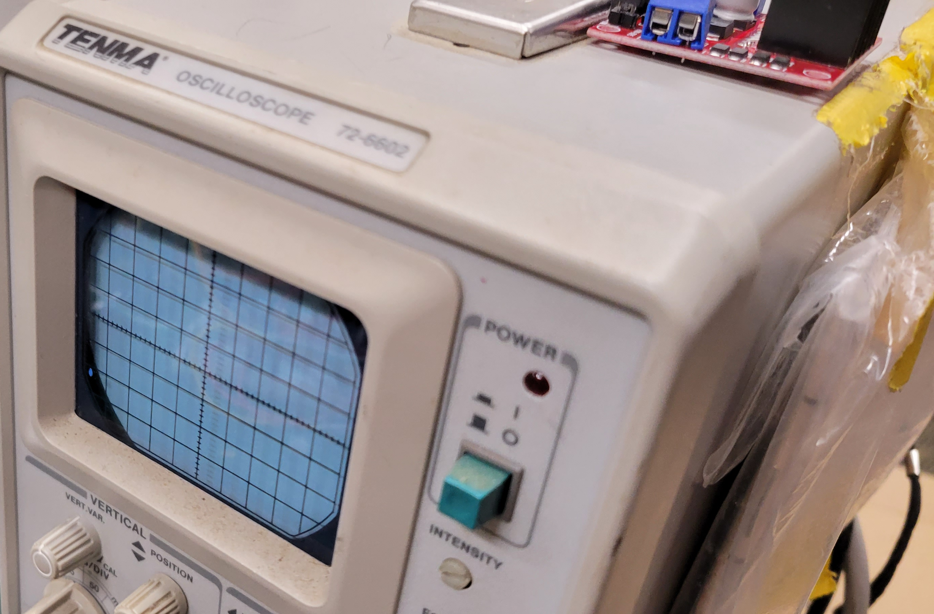
Problems
NSF REU Research Experience on Internet of Things 2022

Slide 7
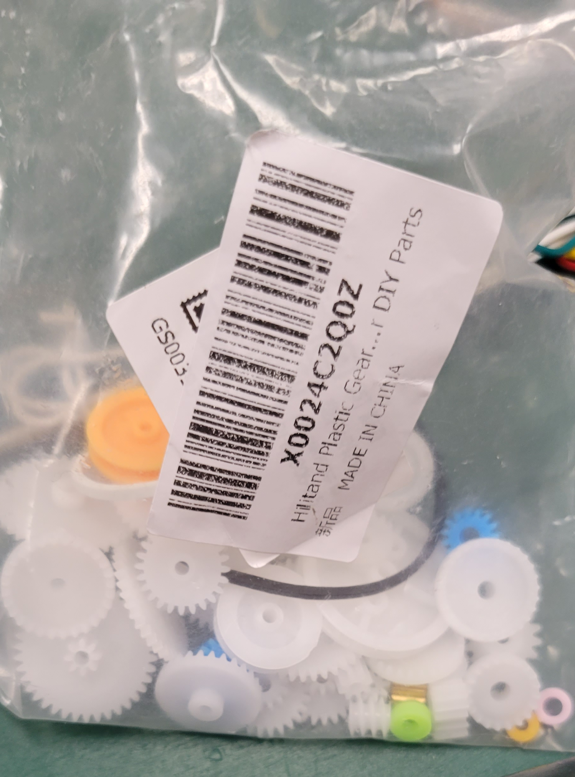
Problems
NSF REU Research Experience on Internet of Things 2022

Slide 8
Problems
NSF REU Research Experience on Internet of Things 2022

