Slide 1
Project #7: IoT augmented physical scale model of a suburban home REU Students: Wahub Ahmed, Abraam Youssef Faculty mentor(s): Damla Turgut, Lotzi Bölöni Graduate mentor(s): Furkan Cimen
Week 2 (May 22 – May 27, 2022)
Accomplishments:
Coded the Raspberry Pi for simulating the Sun
Constructed and painted roof dark green
Cut out and leveled ceiling out of plywood
Bought the materials for the ScaledHome
Problem & Solutions
The back EMF poses a challenge of directly connecting the Raspberry Pi to the DC motor
We found an accessory relay motor driver to regulate the current online on Amazon
Wiring of the circuit is undocumented
We will work with Furkan to rewire the circuit
The motor has no grip to reel the twine back and forth, causing the model of the Sun to sag
We will tie the rope to the motor axis and exend the axis so that it will not coil up when it moves back and forth
Plans for next week:
Complete the model of the Sun and test the code for simulating the days
Complete the calculation of the temperature gradients to simulate the relative temperatures in the home
Change the code for the ScaledHome to add a variety of Sun positions that correlate with the change in temperatures
Add trees and possibly clouds to the home
NSF REU Research Experience on Internet of Things 2022

Slide 2
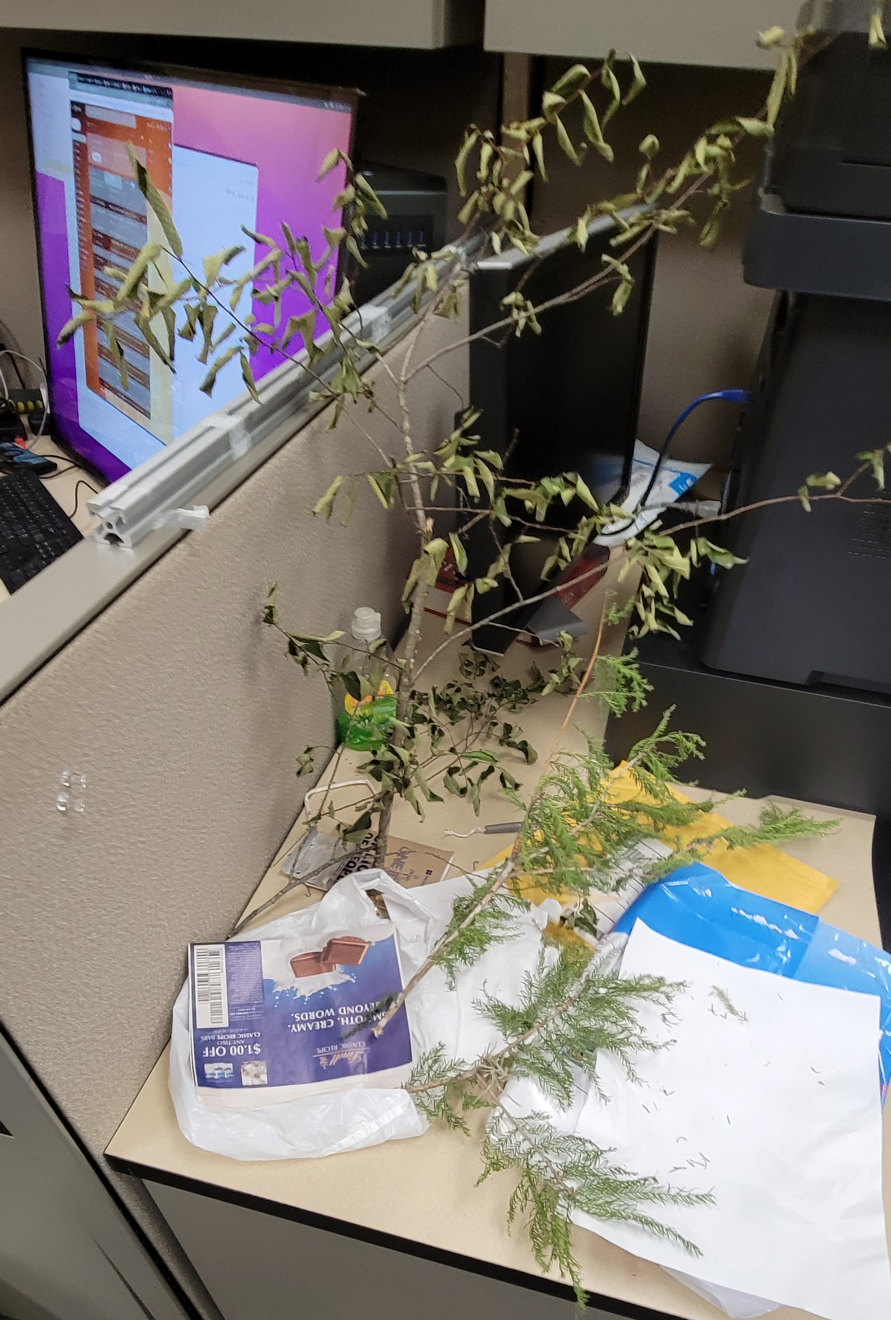
Accomplishments
NSF REU Research Experience on Internet of Things 2022

Slide 3
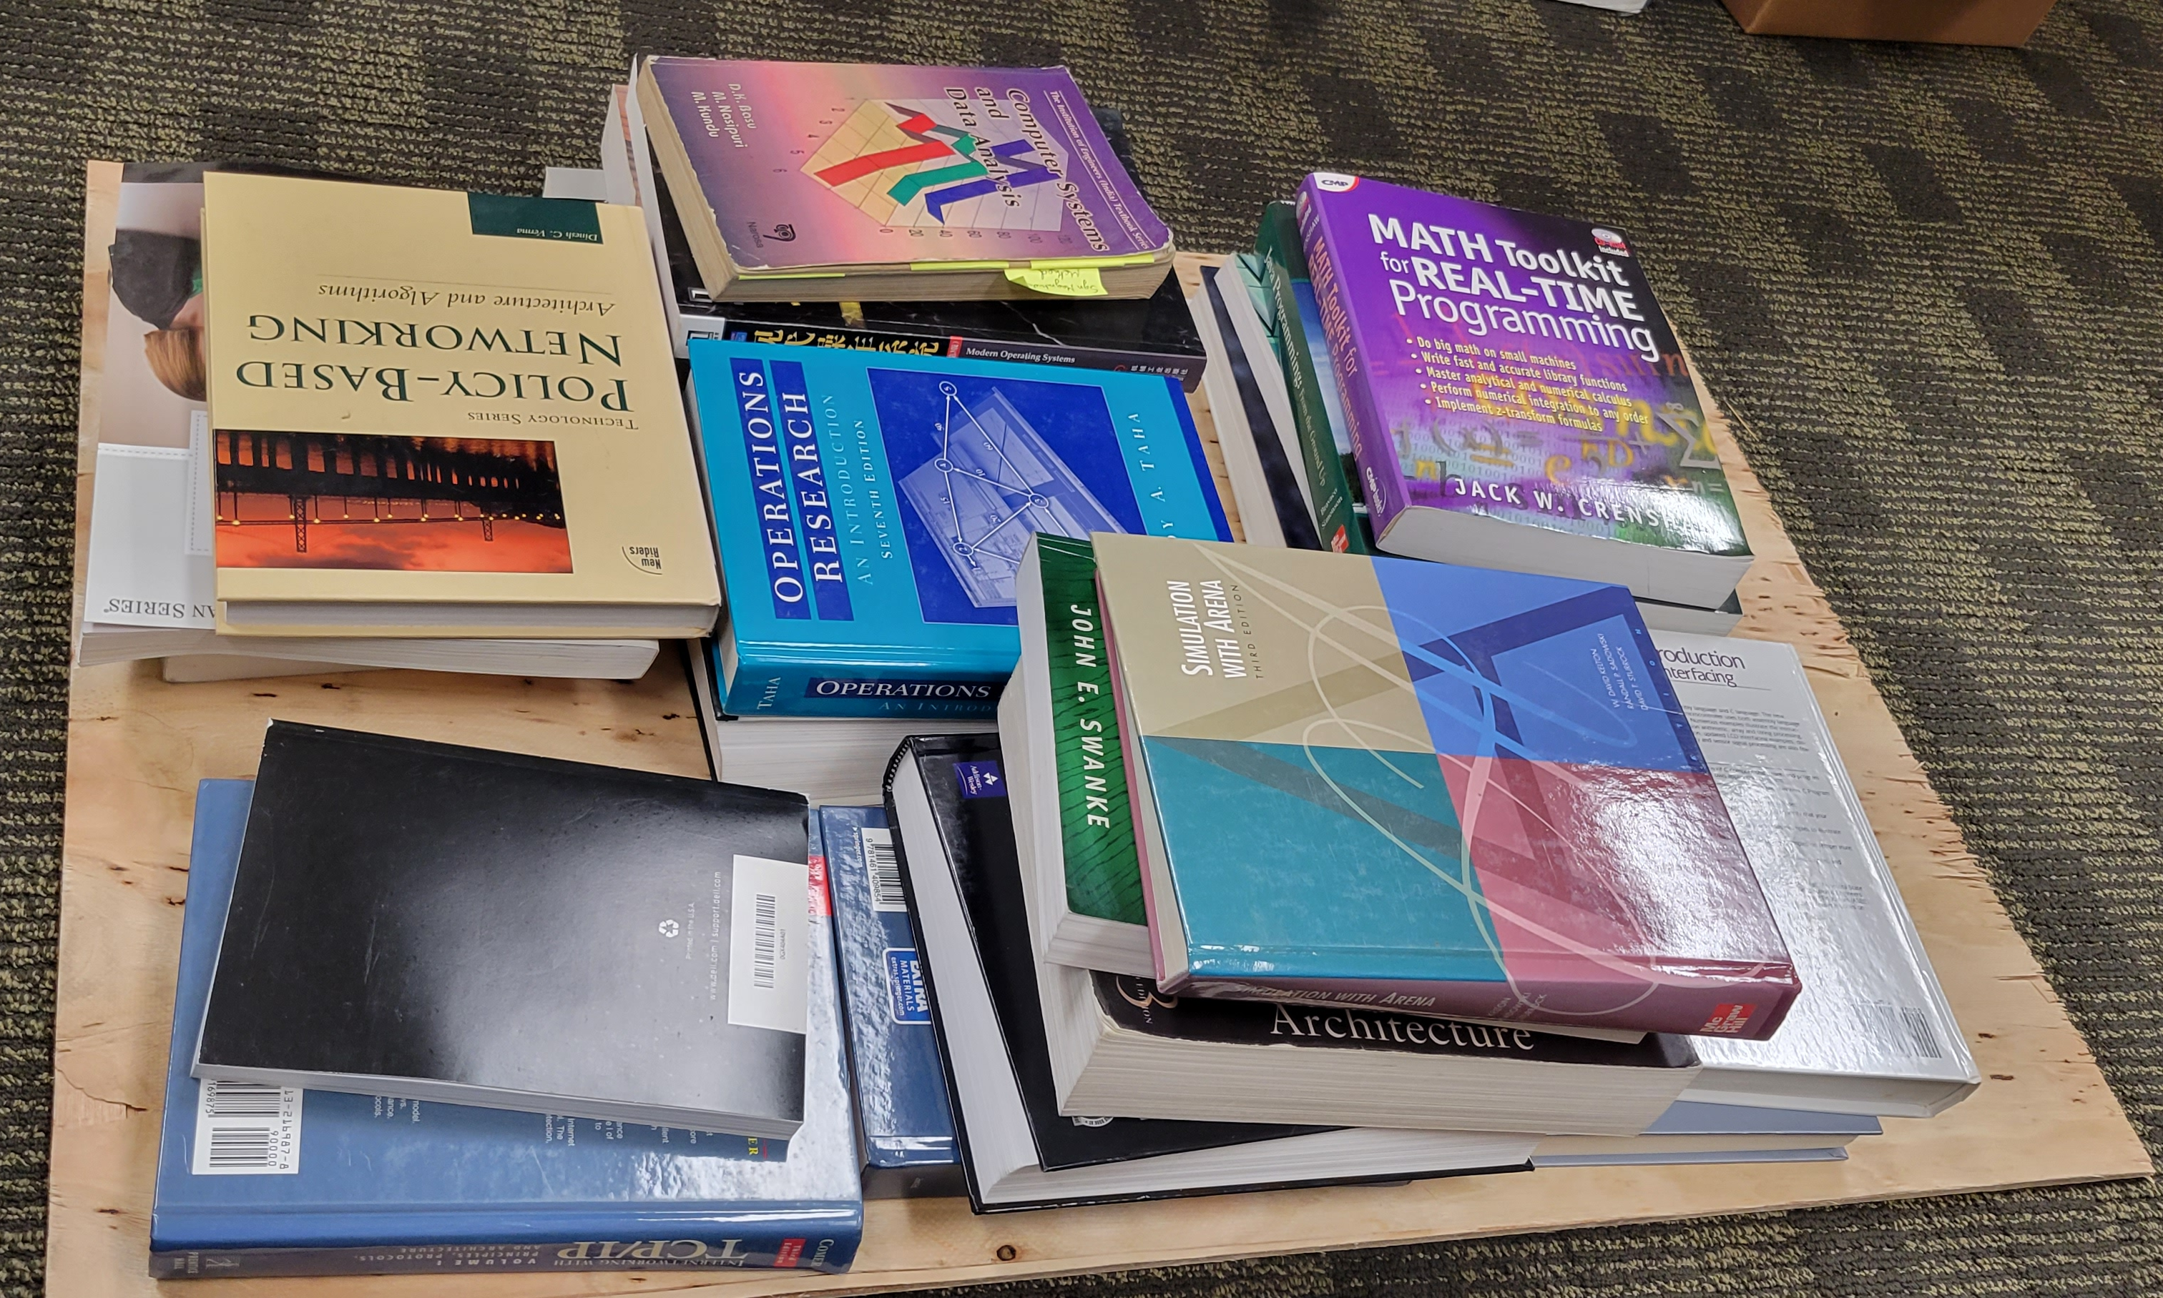
Accomplishments
NSF REU Research Experience on Internet of Things 2022

Slide 4
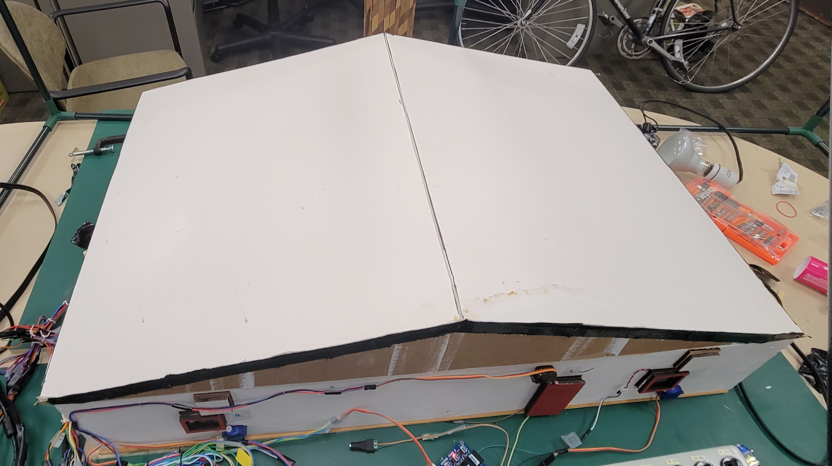
Accomplishments
NSF REU Research Experience on Internet of Things 2022

Slide 5
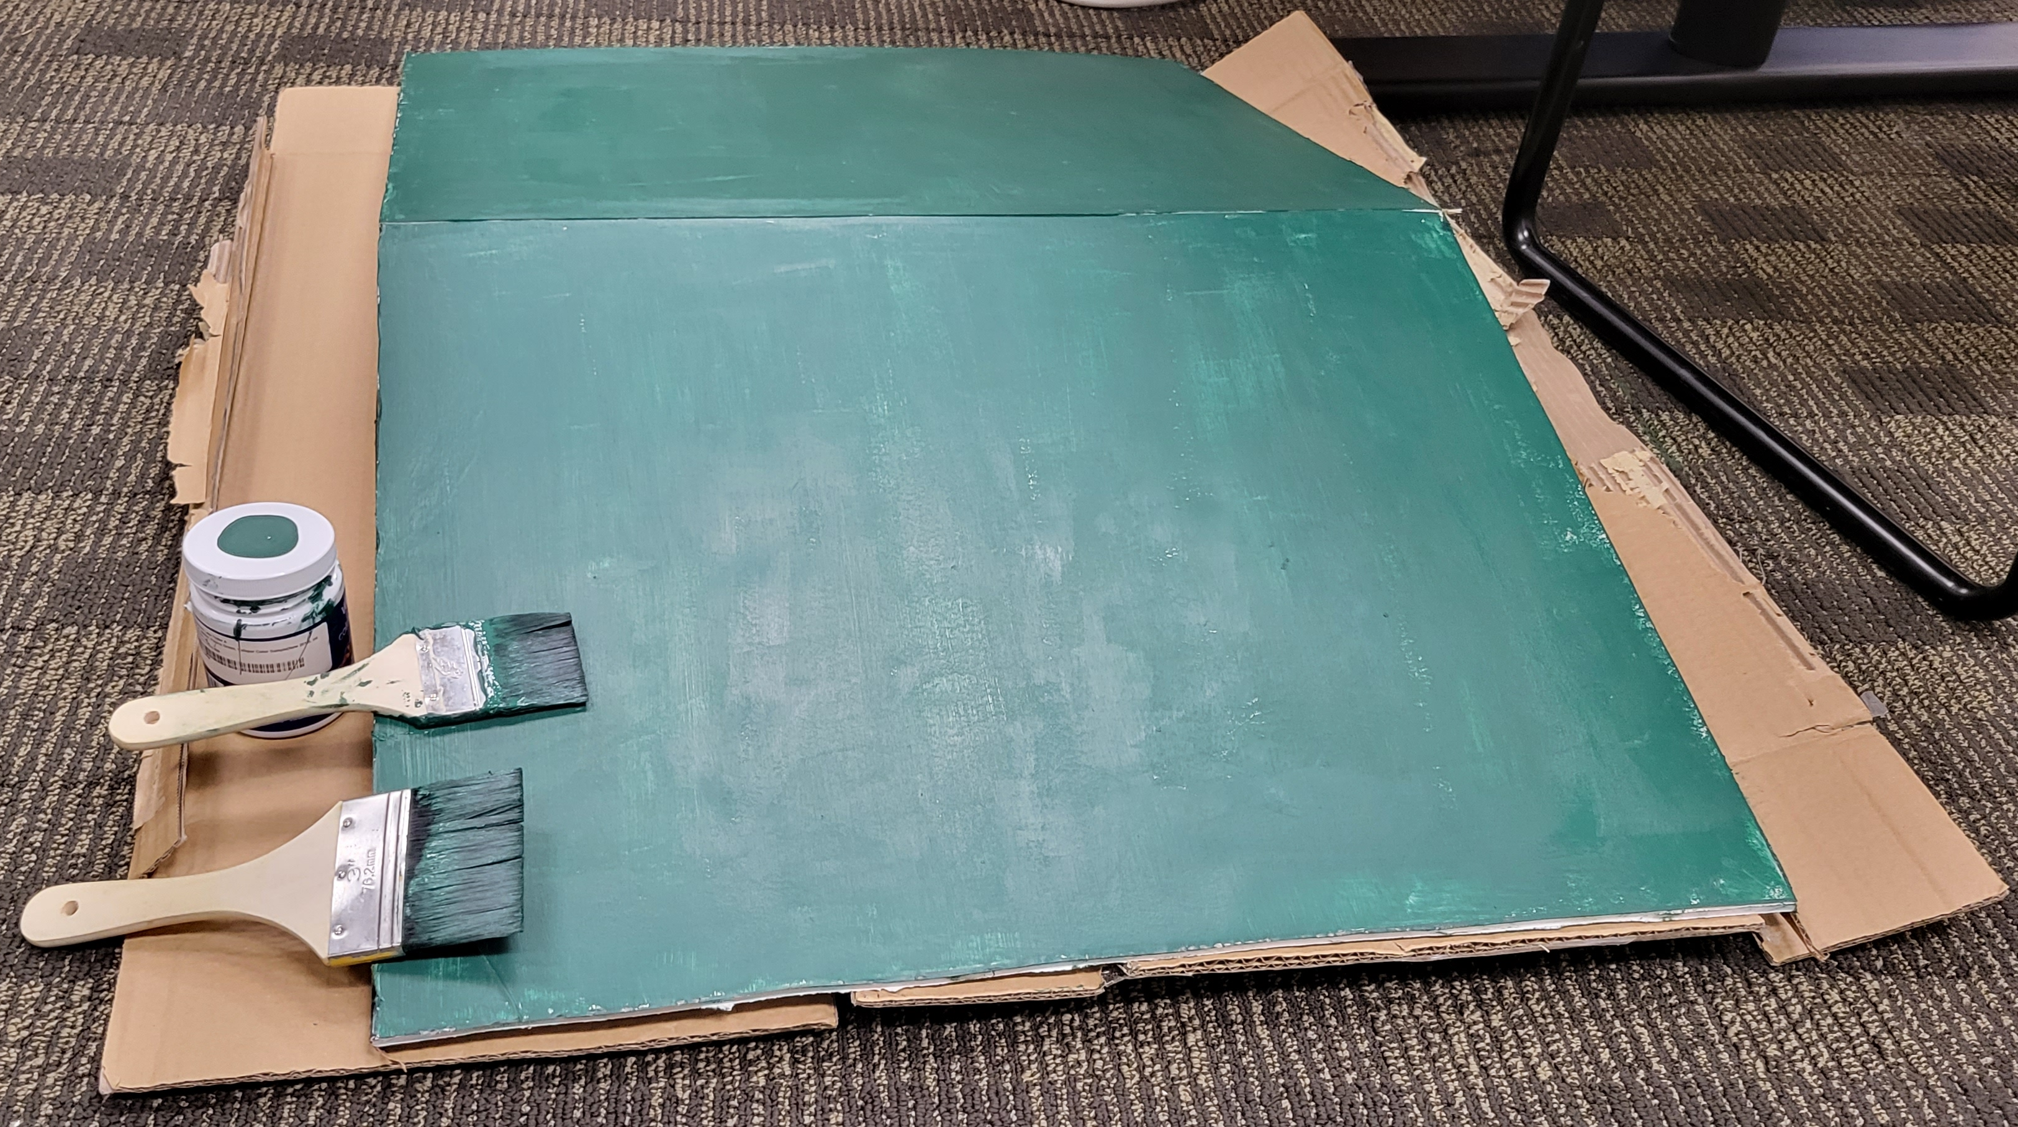
Accomplishments
NSF REU Research Experience on Internet of Things 2022

Slide 6
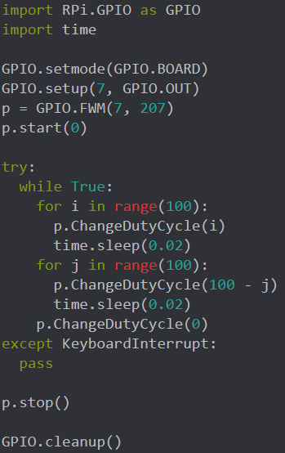
Accomplishments
NSF REU Research Experience on Internet of Things 2022

Slide 7
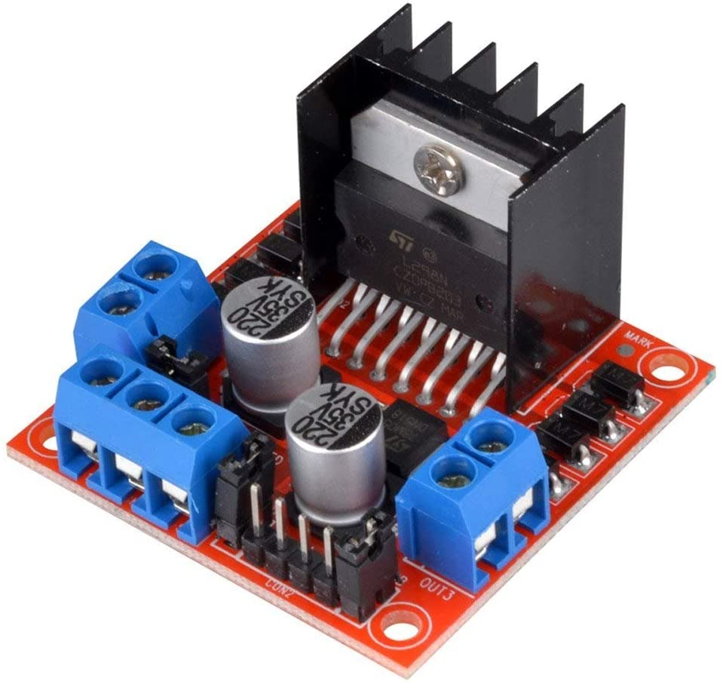
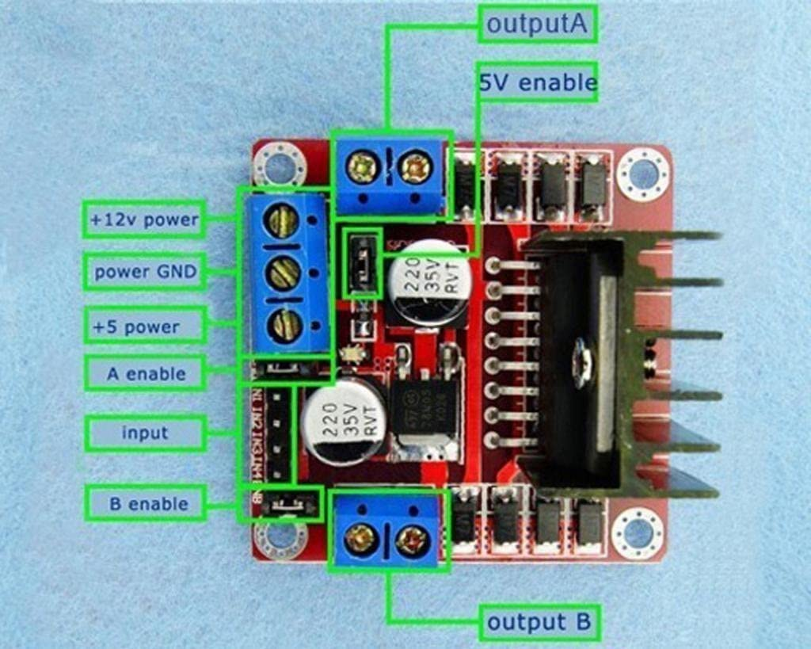
Accomplishments
NSF REU Research Experience on Internet of Things 2022

Slide 8
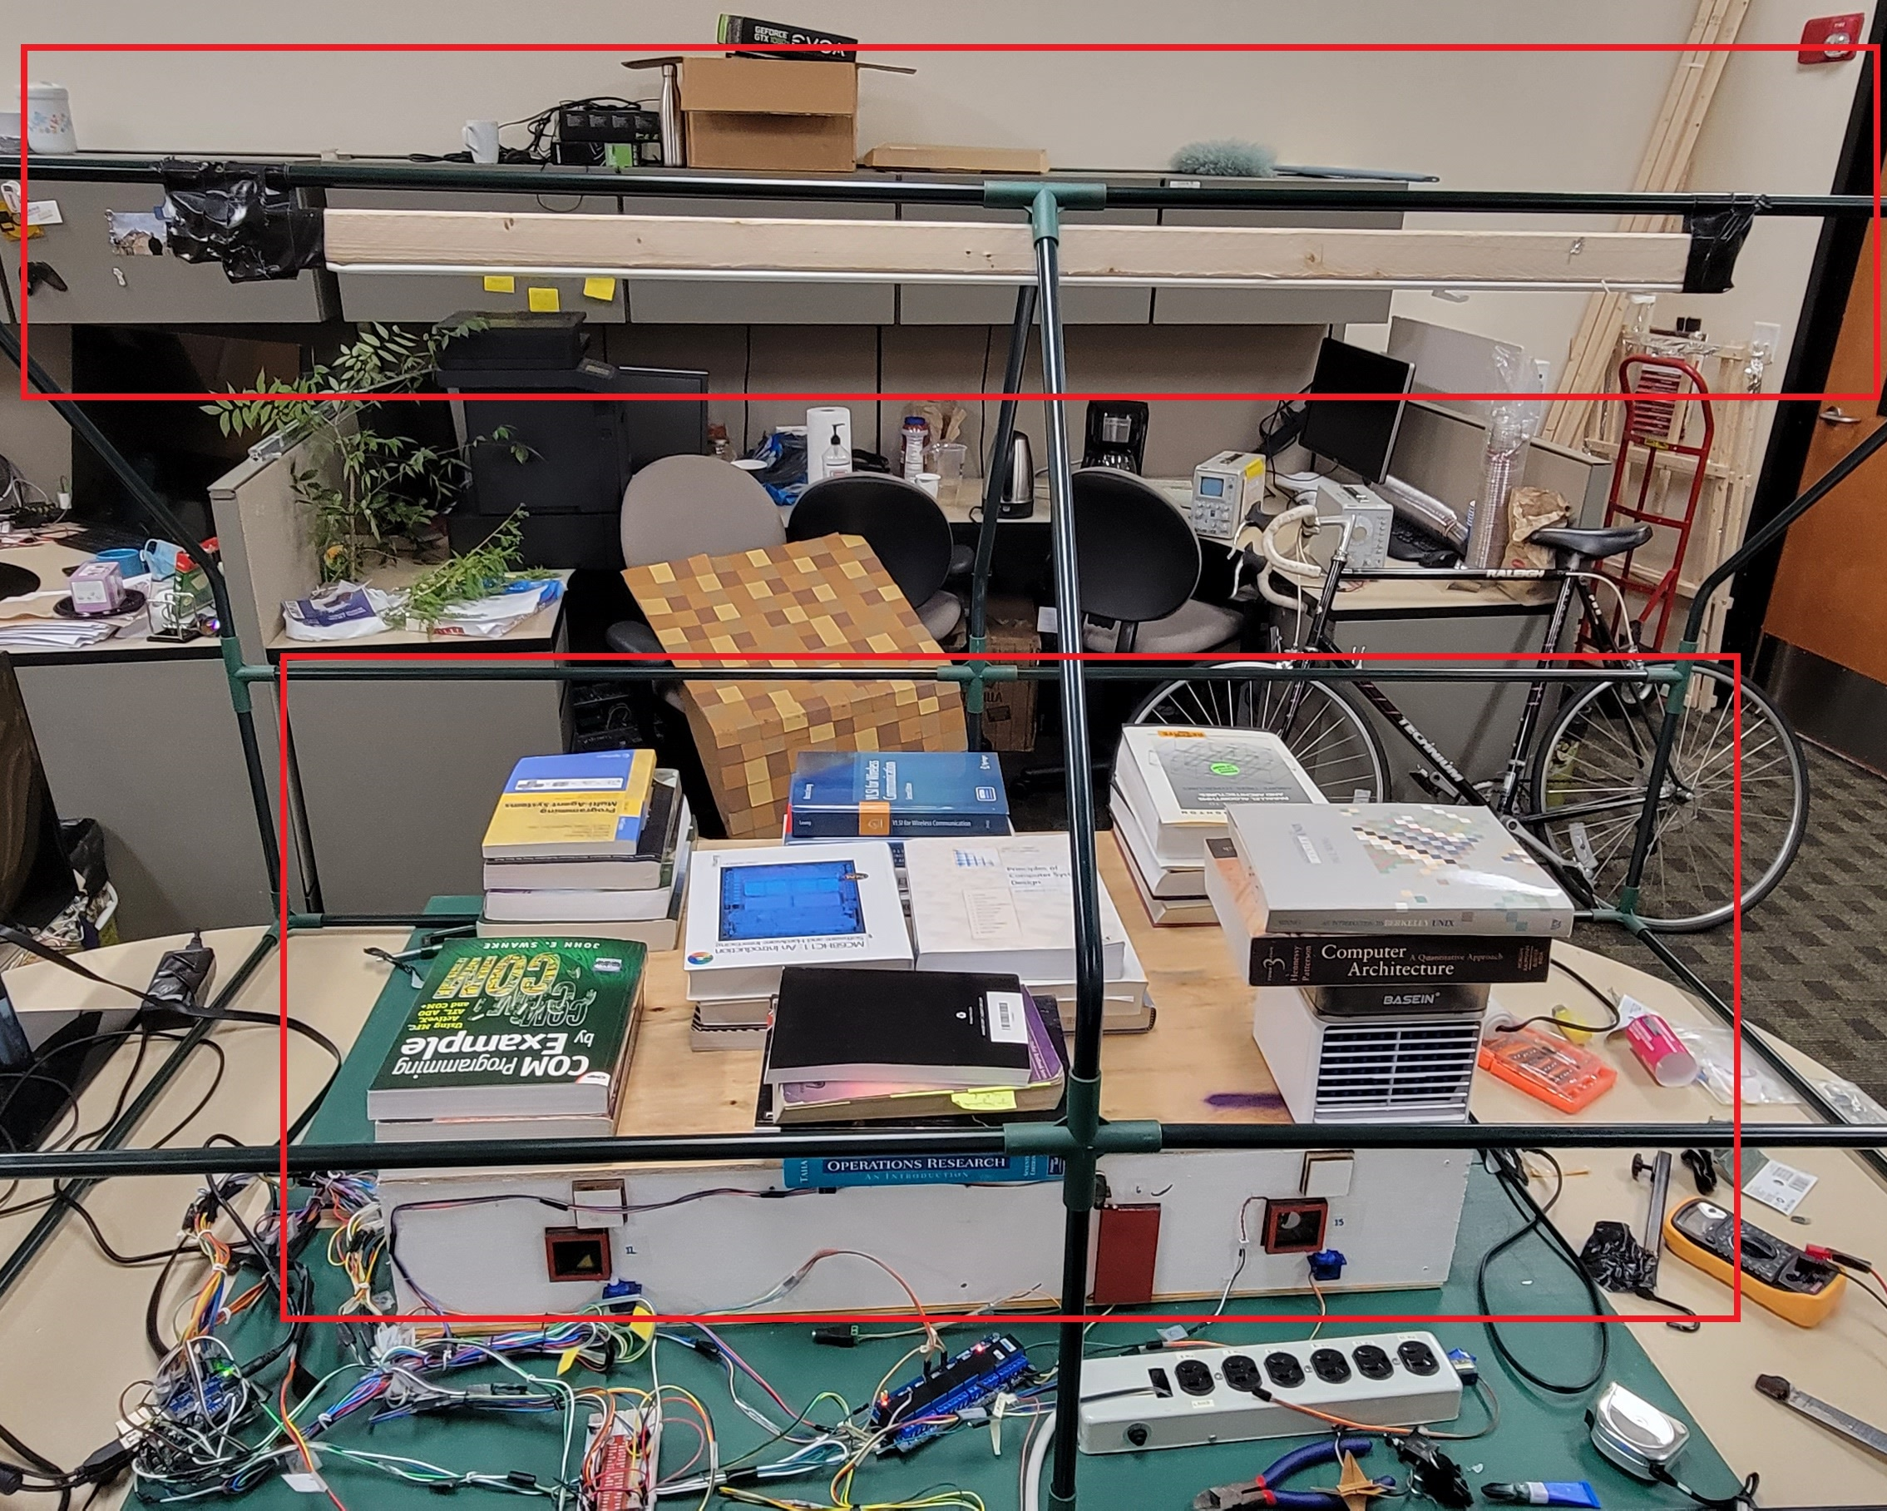
Problems
NSF REU Research Experience on Internet of Things 2022

