Slide 1
Project #5: Biopolymer Based Sensors and Actuators REU Students: Jayla Smalls & Kevin Deng
Faculty mentor(s): Hyoung Jin Cho and Ladislau Bölöni
Week #8 (Tuesday July 5, 2022– Friday July 8, 2022)
NSF REU Research Experience on Internet of Things 2022

Slide 2
Accomplishments
Finished Final Poster & Practiced
Continued to work on Research Paper
Problems & Solutions
The data collected still has stability issues.
NSF REU Research Experience on Internet of Things 2022

Slide 3
Experiment
Since the curves start on the negative plane and sometimes showing an incomplete circle, meaning that for some reason when the measurement is taking place, the device thinks the electrode impedance is negative. So if a resistor is added in series with the working electrode, maybe that’ll move the electrode impedance to the positive plane and fix the issue.
NSF REU Research Experience on Internet of Things 2022

Slide 4
Experiment
NSF REU Research Experience on Internet of Things 2022

Slide 5
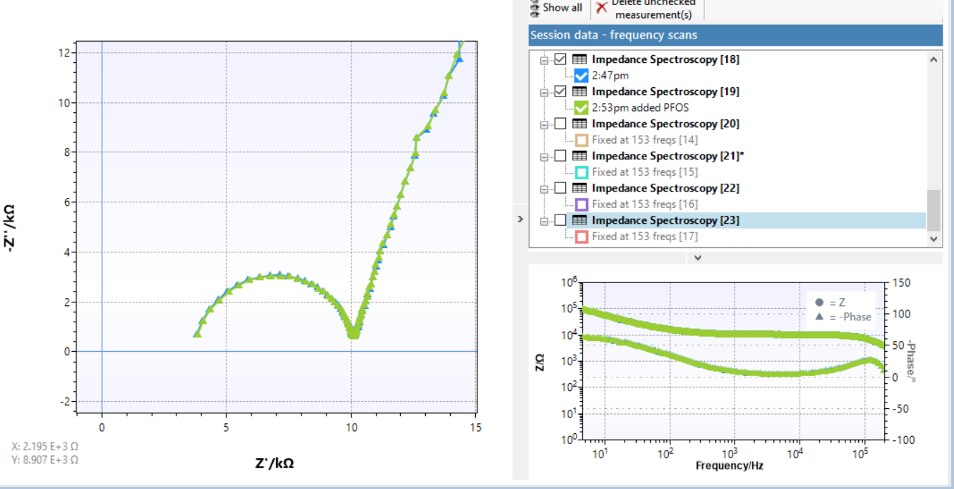
Experiment results
The curve did get shift to the right, but when if the value of the resistor is subtracted from the x component of every point, it seems that the curve still starts on the negative plane(in this case it’s a 10k ohm resistor).
NSF REU Research Experience on Internet of Things 2022

Slide 6
Possible issues
Reference electrode. There was one experiment that uses a tiny RE from Dr. Lee’s lab, and the result of that experiment shows a huge semi circle that goes from 0 to 10k ohms. But when done with reference electrode from our lab, it’s usually a small semi circle that goes from 0 to less than 1k ohms. Suggesting that reference electrode may play a huge role in how data looks. But it’s just one of the possibilities as there might be other factors that changed the experiment.
Impedance Analyzer issues. The impedance analyzer that we used, Emstat, has issues with noises when measuring in the higher frequencies. This is confirmed during one of the experiments when the device is measuring with a noise reducing hood on top of Emstat as opposed to measuring without it. The result from the one with hood shows less fluctuation in data(although not by a lot) compared to the result without.
Buffer solutions. The buffer used affect how the experimental data looks and whether the data shifts. This is also confirmed when doing an experiment with PBS compared to experiments done using other solutions. The result from the one using PBS shows a stable curve while others do not.
Wait time before measurement. In some of the papers, when the experiment was set up and the reference, counter, and working electrode are in the buffer solution, the researchers stated that they waited an hour before the experiment. Suggesting that allowing the sensor to sit in the buffer for some time may provide more stable result.
There could also be other factors that makes the result unstable, maybe the experimental set up is not correct, or the 4-minute stirring time after PFOS is added is too long, or the sensor is only one time use and further usage will not provide good data, or the parameters for the EIS experiments are not correct.
NSF REU Research Experience on Internet of Things 2022

Slide 7
Future plans
The graduate student has agreed that we can continue working on the project after the program ended, and that we can work on things that can be done remotely.
NSF REU Research Experience on Internet of Things 2022

