Slide 1
Project #5: Biopolymer Based Sensors and Actuators REU Students: Jayla Smalls & Kevin Deng
Faculty mentor(s): Hyoung Jin Cho and Ladislau Bölöni
Week #2 (Monday May 23, 2022 – Friday May 27, 2022)
Brief Description of Project
Goal: Manufacture sensors that can detect toxic substances in solution
NSF REU Research Experience on Internet of Things 2022

Slide 2
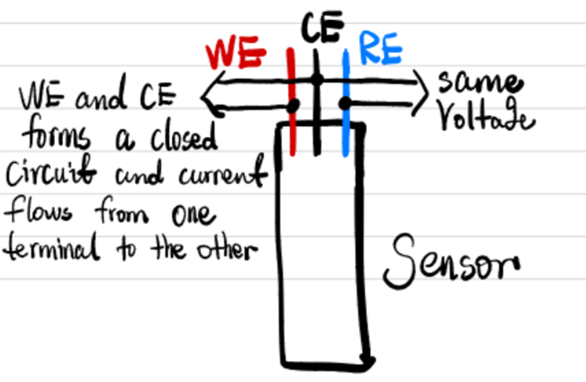
Electrode
An electrode is an electrical conductor that makes contact with the nonmetallic circuit parts of a circuit, such as an electrolyte, semiconductor or vacuum. If in an electrochemical cell, this is also known as an anode or cathode.
In electrochemistry, there is a so-called “n-electrode system”, with the goal of measuring either the potential between two electrode or the current that flows from one to another.
Two/three electrode system:
NSF REU Research Experience on Internet of Things 2022

Slide 3
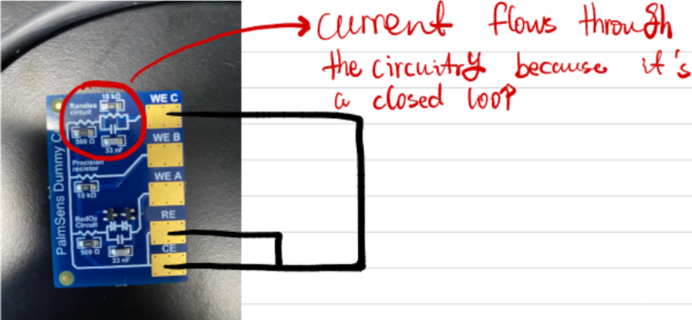
In the case of a dummy cell made of electrical components, there’s no need for a three electrode system because charge carrier is electron and potential between WE and CE is invariant.
Example 1
NSF REU Research Experience on Internet of Things 2022

Slide 4
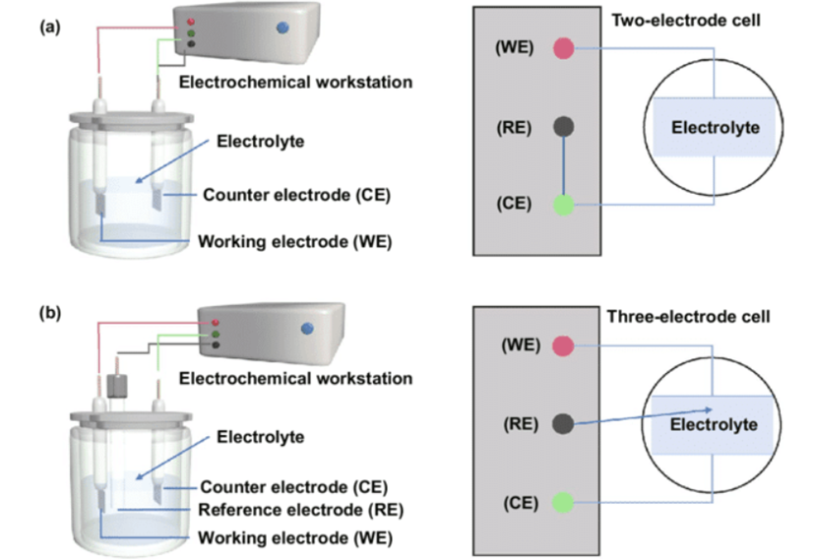
Example 2: Sensor in electrolyte
In the case of electrolyte, the charge carrier is ions and potential is unstable, which is why the Reference electrode is needed.
The surface of the sensor submerged in electrolyte forms an unknown circuit and needs to be determined from data.
NSF REU Research Experience on Internet of Things 2022

Slide 5
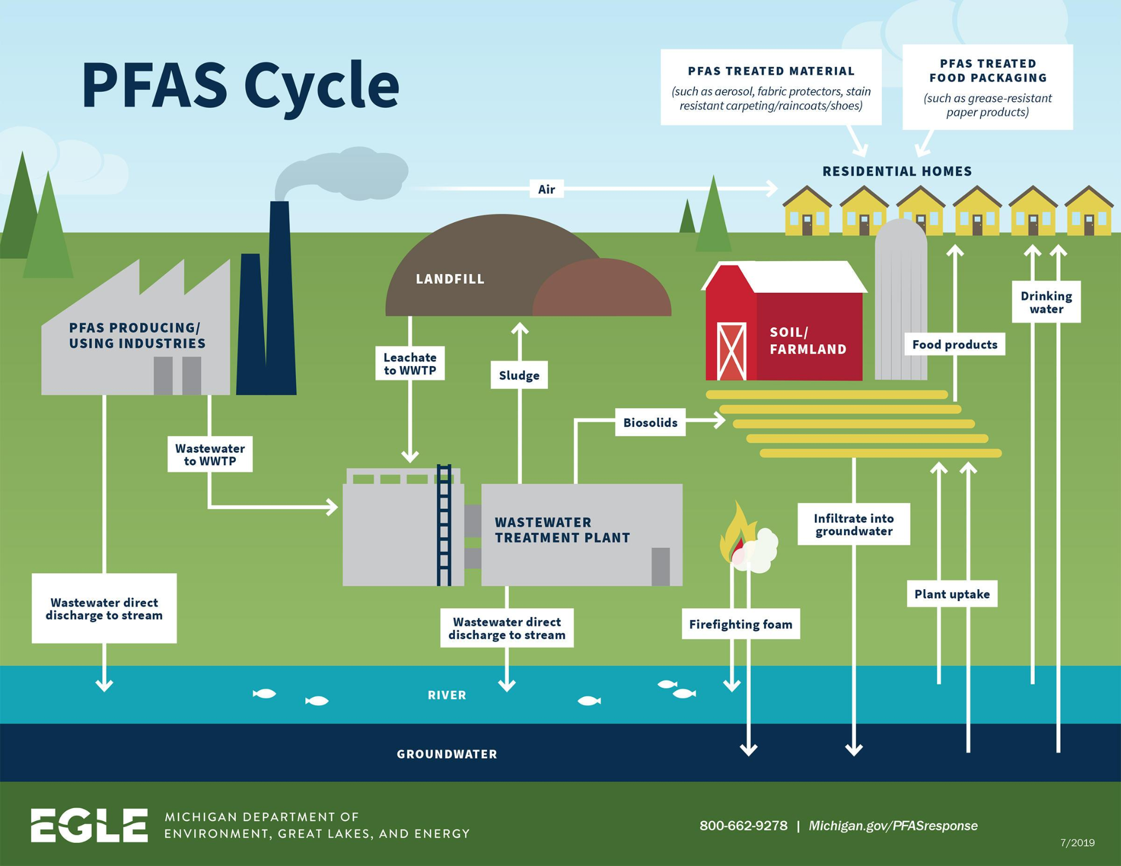
The sensors detects two kinds of toxic substance: heavy metal(e.g., lead) and microplastics(e.g., Perfluorooctane Sulfonate or PFOS).
Heavy metal are conductive and can be treated like a regular circuit element.
Microplastics are non-conductive, which is why we calculate its impedance by using Nyquist plot and Bode plot(Electrochemical Impedance Spectroscopy or EIS).
PFAS chemicals cycle through the environment
in the air, water, soil, and sediments– and eventually accumulate in fish, wildlife, and people.
NSF REU Research Experience on Internet of Things 2022

Slide 6
PFAS Health Effects
NSF REU Research Experience on Internet of Things 2022

Slide 7
How the electropolymerization of sensor works:
The substances left on the surface of the sensor will affect the current output, and based on that we can measure the
impurities in water.
NSF REU Research Experience on Internet of Things 2022

Slide 8
NSF REU Research Experience on Internet of Things 2022

Slide 9
Electrodeposition preparation
NSF REU Research Experience on Internet of Things 2022

Slide 10
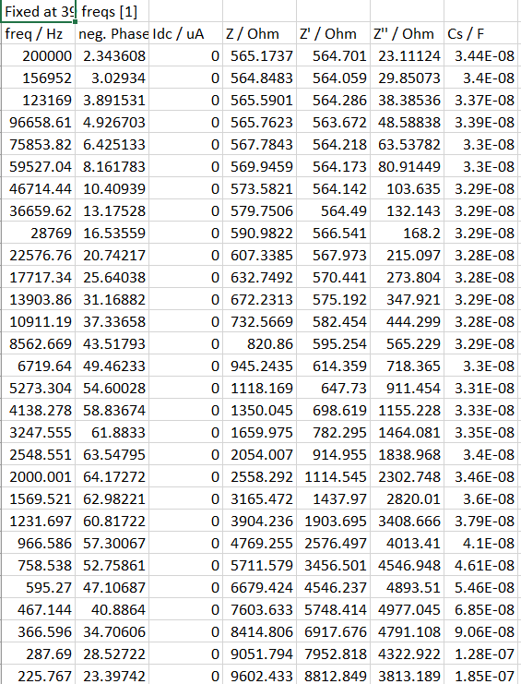
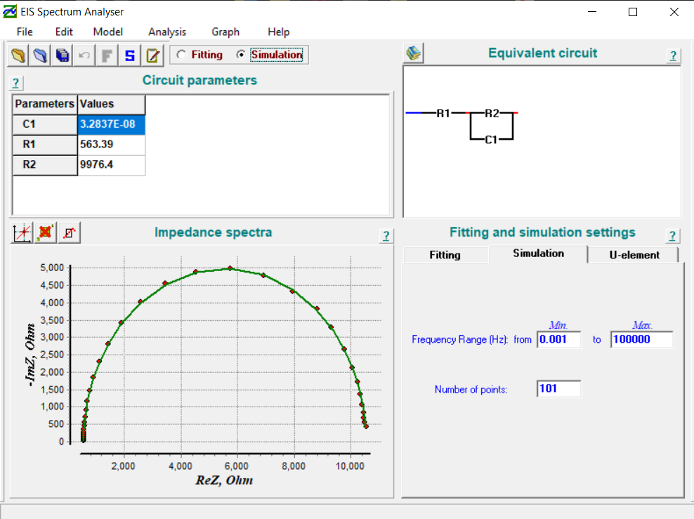
EIS analyzer
NSF REU Research Experience on Internet of Things 2022

Slide 11
Accomplishments:
Started with the beginner stage of Arduino by connecting the Arduino MKRZERO device with my computer, and using the breadboard and jumper cables to make the LED flash on and off.
Identified what each pin on the Arduino MZERO meant so I get a better understanding.
Continued to read more research papers on Sensors & Actuators
NSF REU Research Experience on Internet of Things 2022

Slide 12
PROBLEMS & SOLUTIONS
NSF REU Research Experience on Internet of Things 2022

Slide 13
Arduino MKRZERO LED ON/OFF
Problem: I was having trouble with making the LED light up on the breadboard.
Solution: I switched up some of my code and set up the jumper cables, resistor, and LED the correct way on the breadboard.
* If the pin has been configured as an OUTPUT with pinMode(), its voltage will be set to the corresponding value: 5V for HIGH, 0V (ground) for LOW.
NSF REU Research Experience on Internet of Things 2022

Slide 14
Problem: There was an issue with trying to connect the Bluetooth module with my cellular device and PC to turn on/off the LED. (Using Arduino UNO)
NSF REU Research Experience on Internet of Things 2022

Slide 15
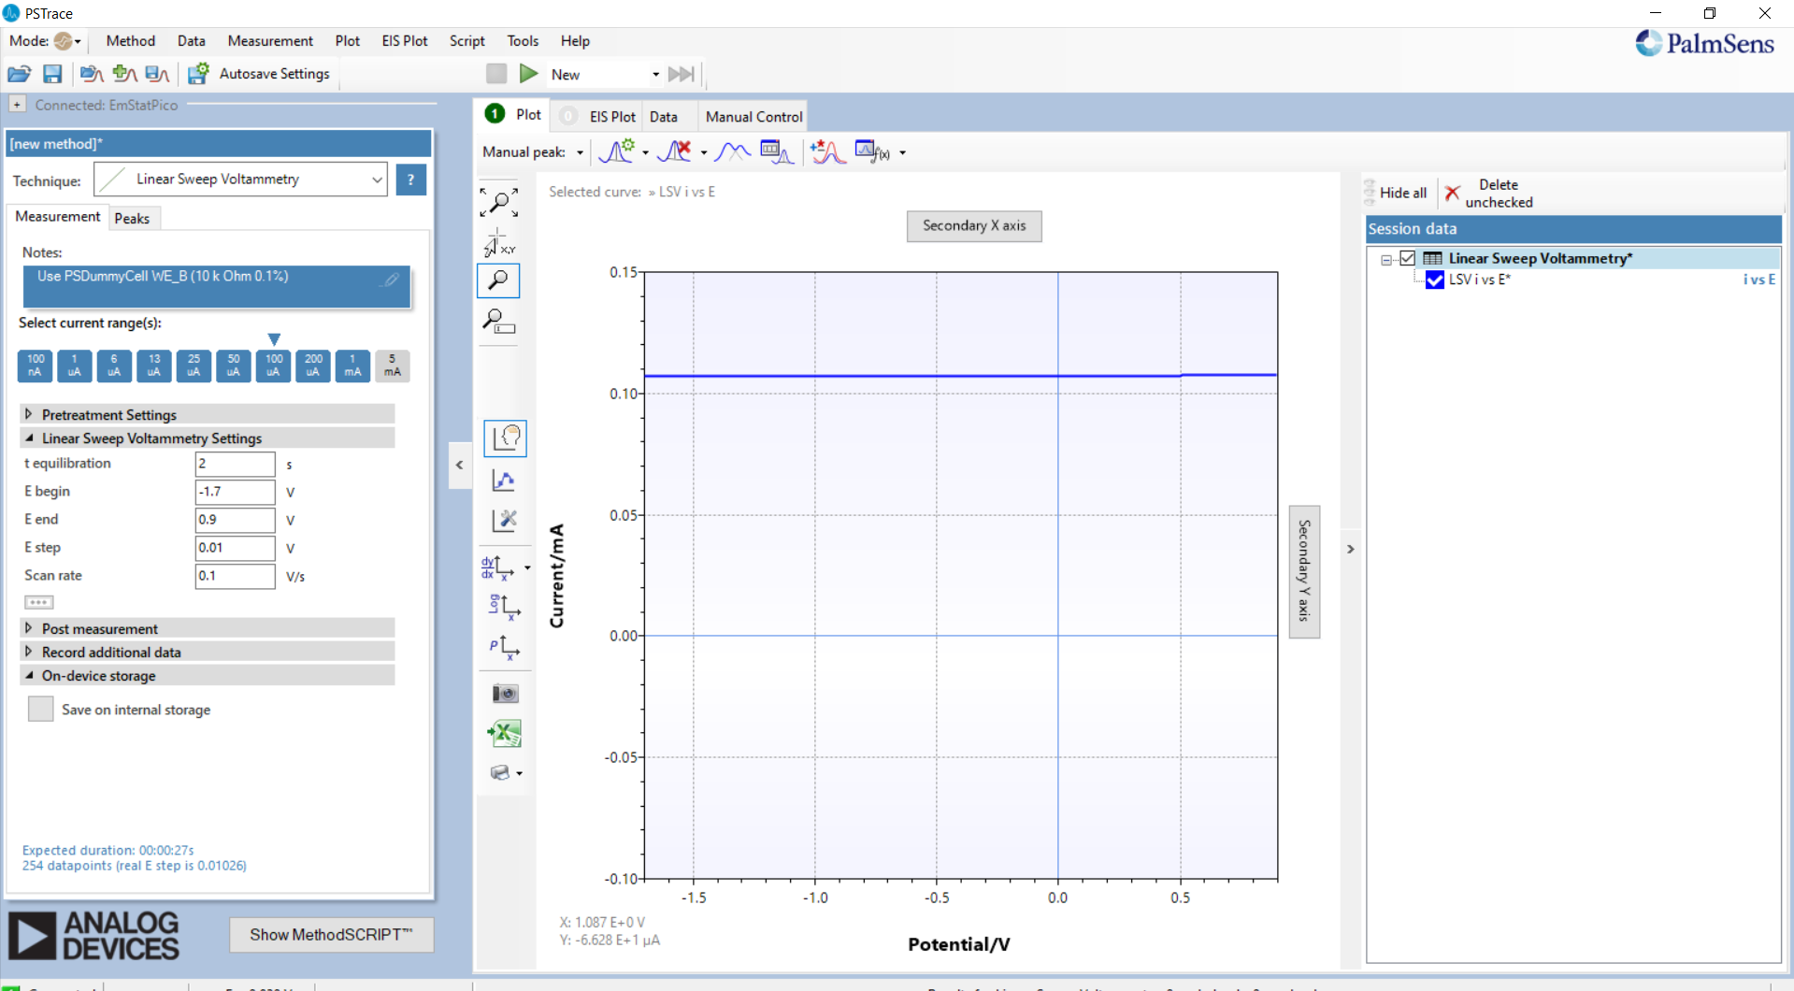
Solving connection problem
Three electrode connected: Getting a straight horizontal line when the line should be linearly proportional(V=IR).
NSF REU Research Experience on Internet of Things 2022

Slide 16
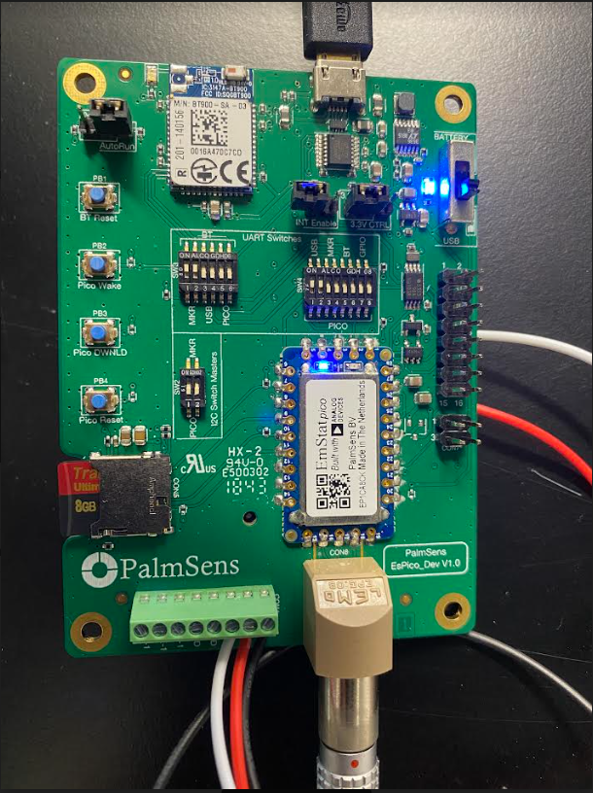
Solving cord connection problem
Original button pinout:
NSF REU Research Experience on Internet of Things 2022

Slide 17
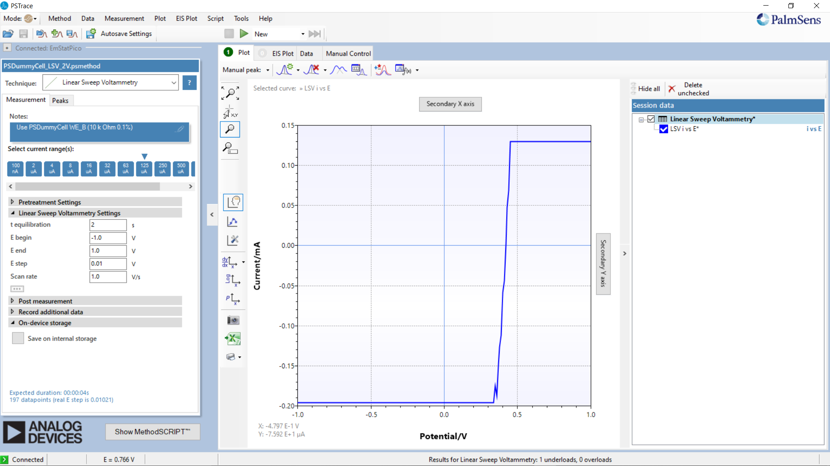
Solving cord connection problem
Only WE and CE connected:
NSF REU Research Experience on Internet of Things 2022

Slide 18
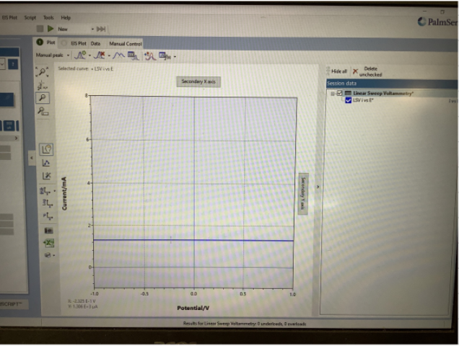
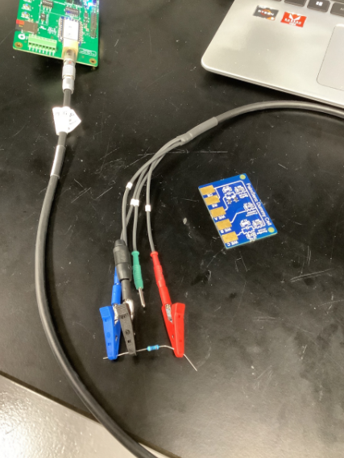
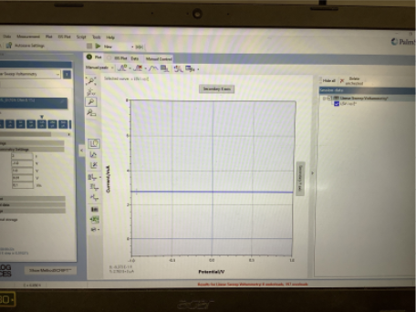
Solving cord connection problem
R=1000 ohms:
R=470 ohms:
NSF REU Research Experience on Internet of Things 2022

Slide 19
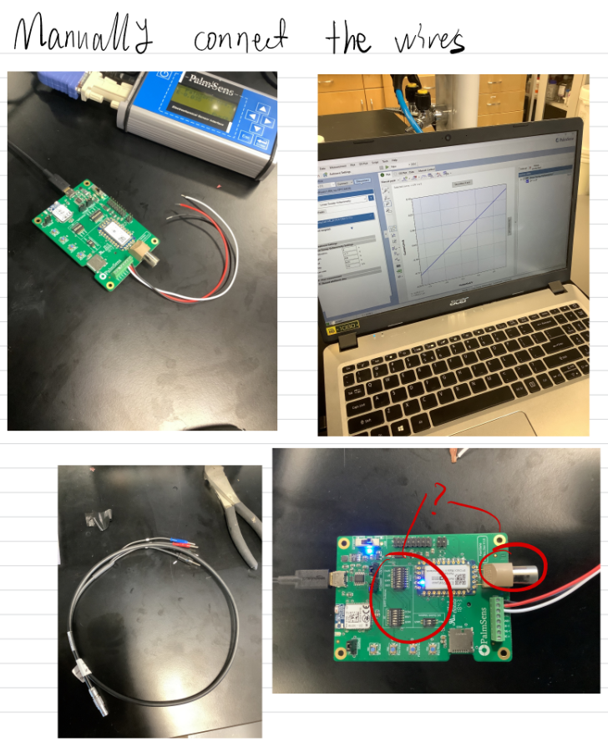
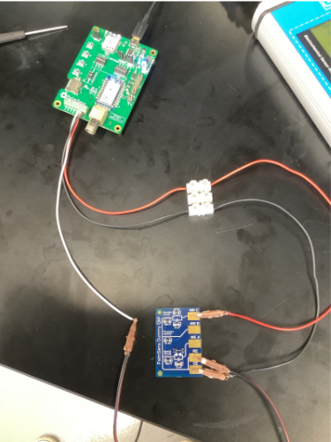
Solving cord connection problem
NSF REU Research Experience on Internet of Things 2022

Slide 20
Bluetooth connection and other problems
Problem 1: Was not able to use the Bluetooth feature of the EmPico Stat for some reason
Problem 2: getting a flat line of current when it should be linearly proportional to potential sweep. Suspected to be a hardware problem so I emailed the company .
NSF REU Research Experience on Internet of Things 2022

Slide 21
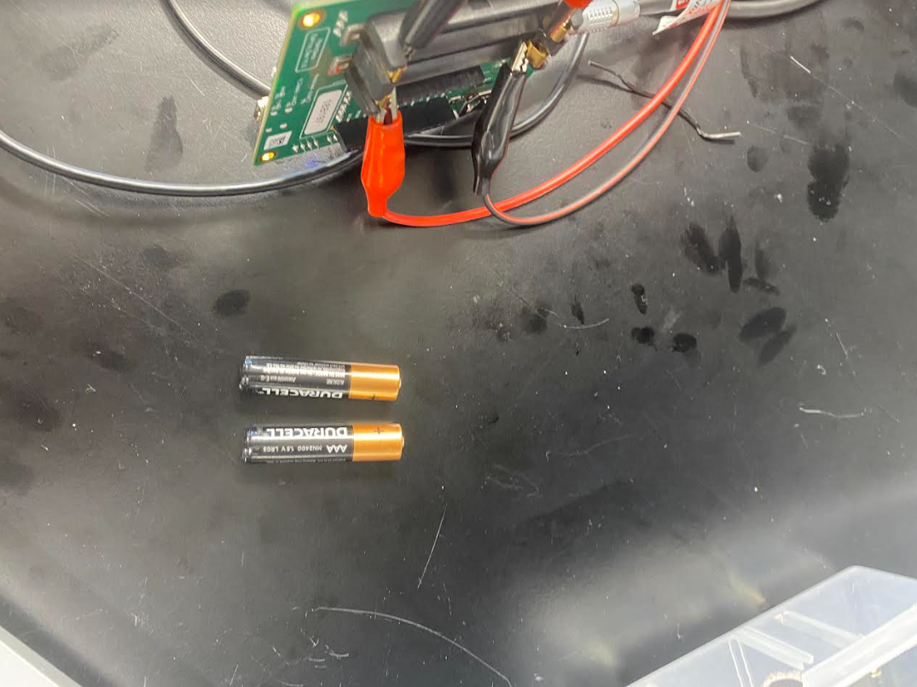
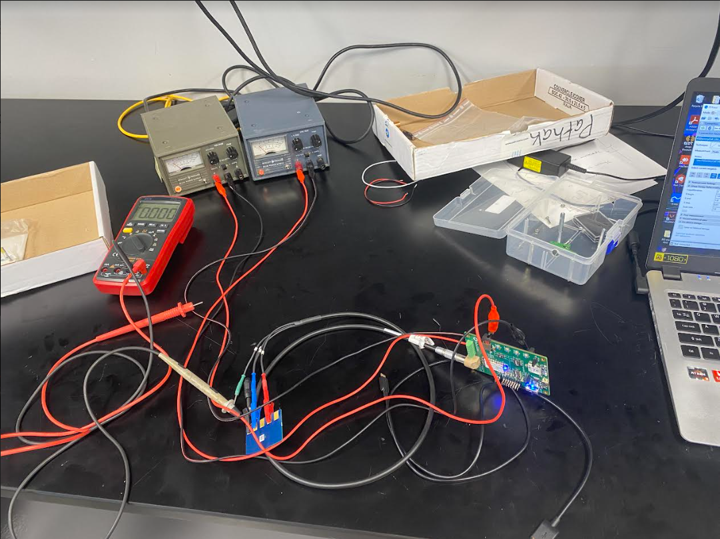
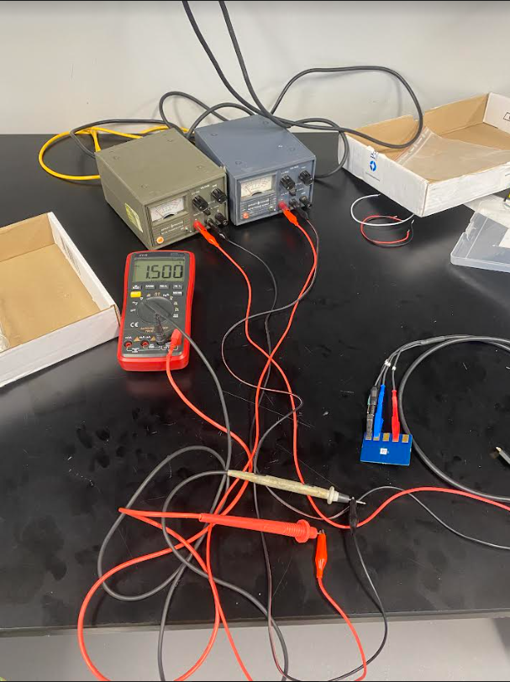
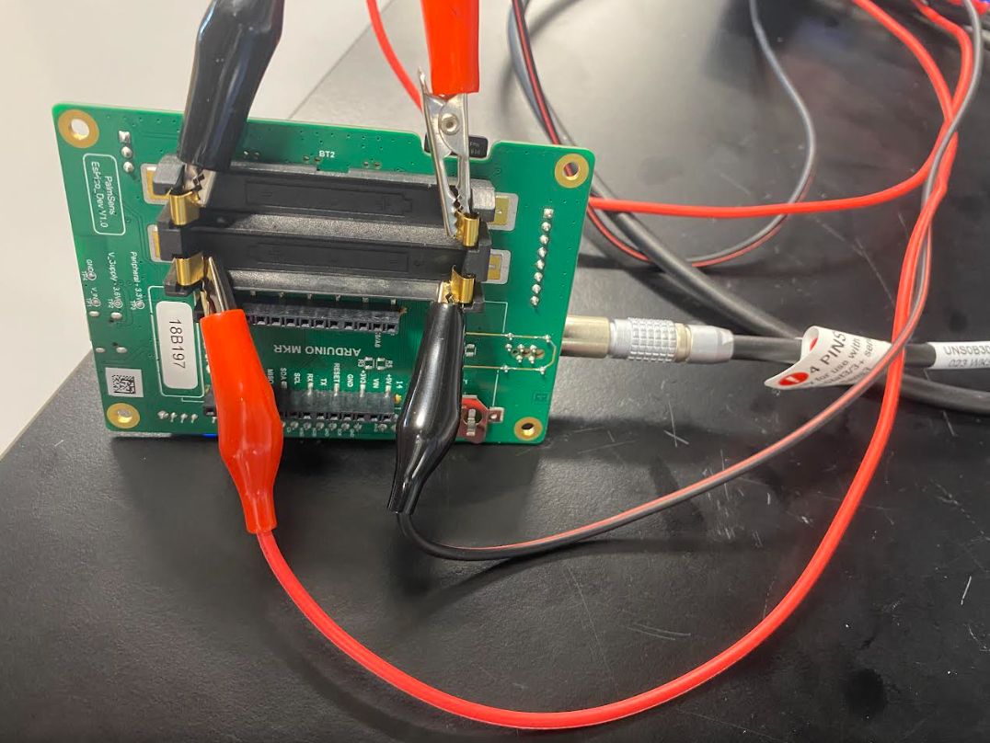
Solution to Bluetooth problem
Bluetooth connection needs to be powered by battery, but the battery was dead so we used two voltage supplies instead as power source.
NSF REU Research Experience on Internet of Things 2022

Slide 22
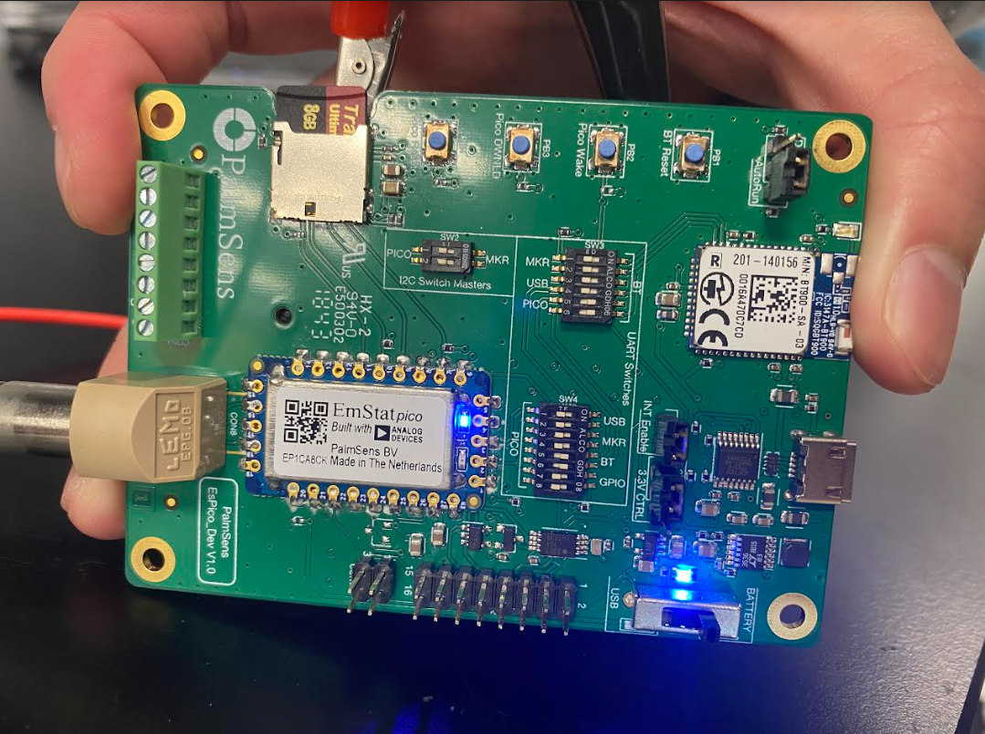
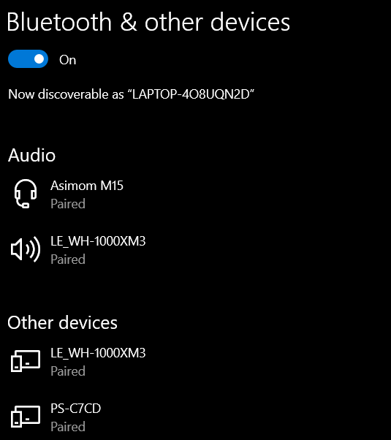
Solution to Bluetooth problem
There were still some issues with the Bluetooth(kind of fixed it by playing with the plastic cap in red circle. Now it can connect to laptop but not the software).
NSF REU Research Experience on Internet of Things 2022

Slide 23
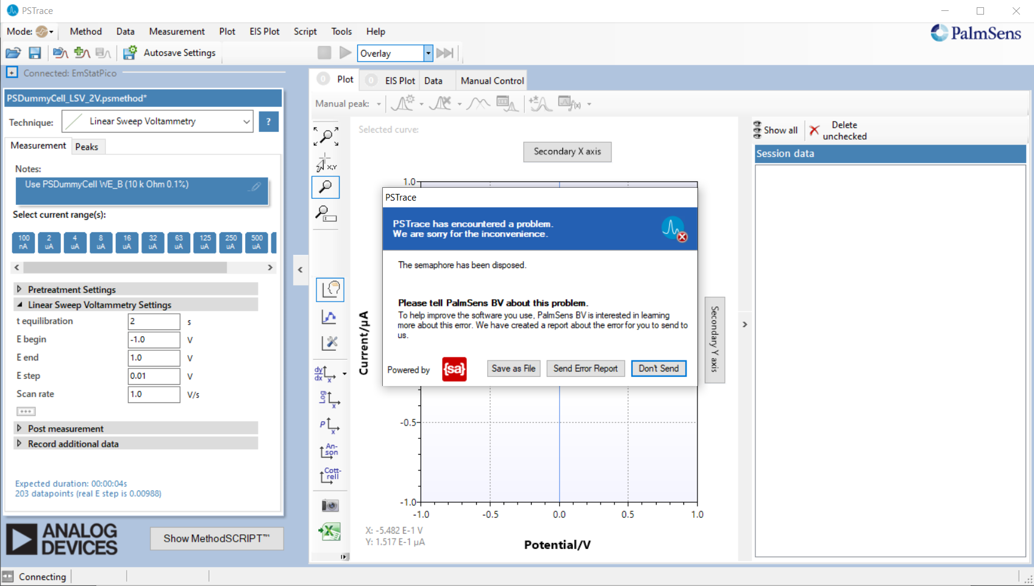
Solution to Bluetooth problem
Somehow it worked when I clicked connect one time… but can’t run
An error that
popped up
NSF REU Research Experience on Internet of Things 2022

Slide 24
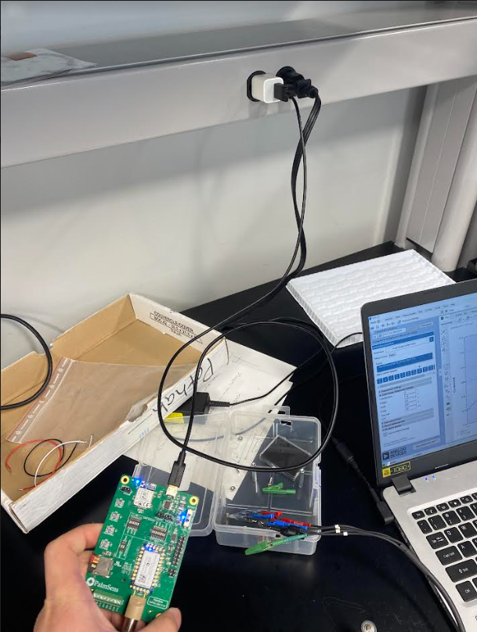
Solution to Bluetooth problem
It turns out that the power supply was not working(it’s working properly and supplying a constant 1.5V as asked, but the device just won’t connect),so we just used a power socket and it worked.
Found out later that the Bluetooth itself also needs a battery, that’s why
it wasn’t working.
NSF REU Research Experience on Internet of Things 2022

Slide 25
Solution to Bluetooth problem
NSF REU Research Experience on Internet of Things 2022

Slide 26
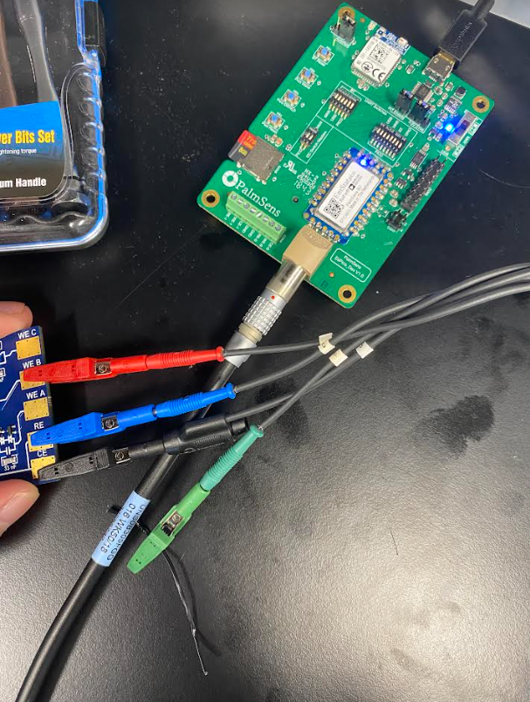
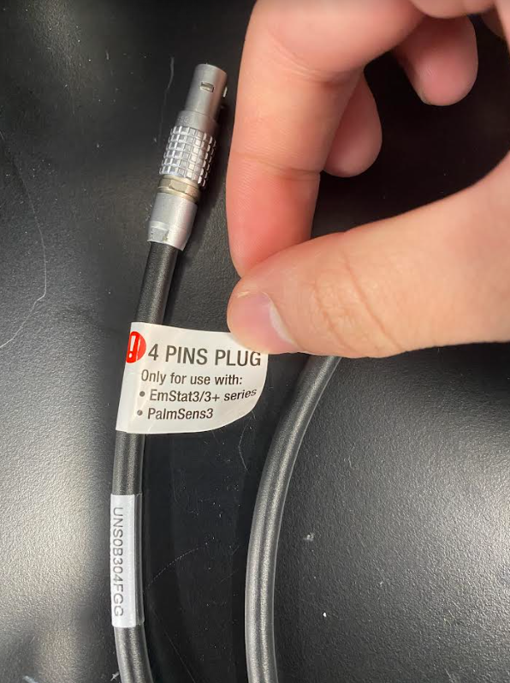
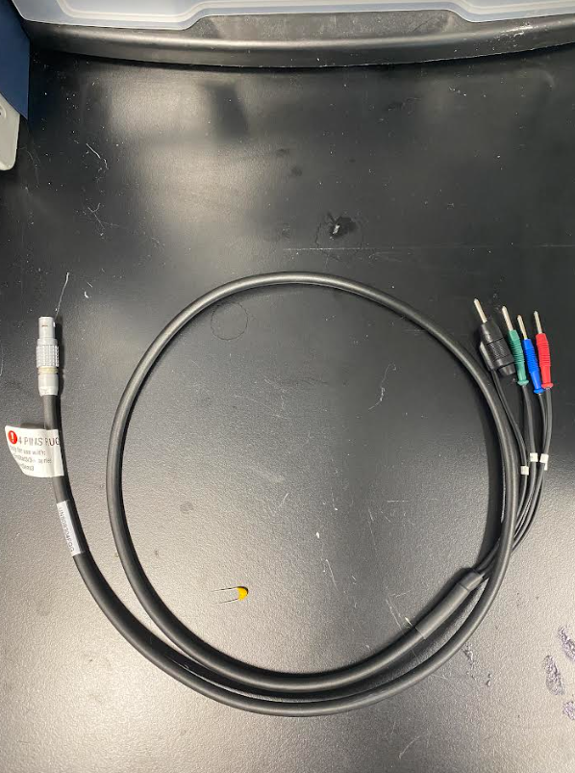
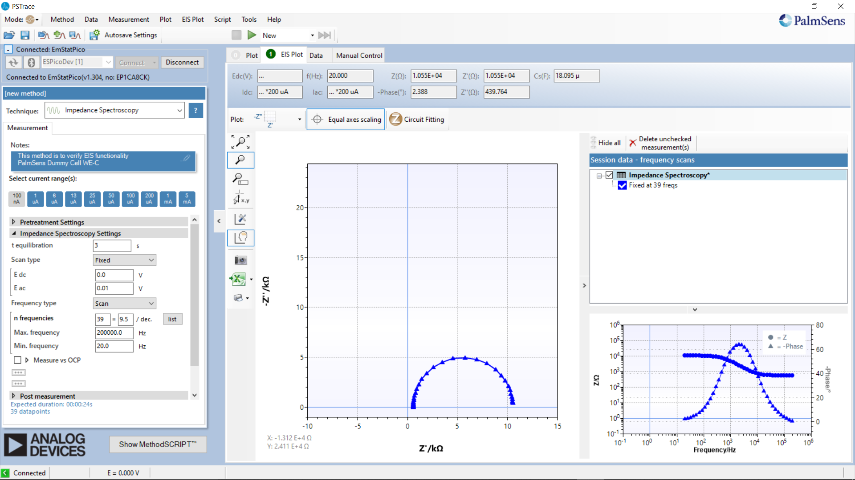
Solution to the cord connection problem
Turns out the problem is with the cord after all. Used a new cord and everything is working
Old:
New:
NSF REU Research Experience on Internet of Things 2022

Slide 27
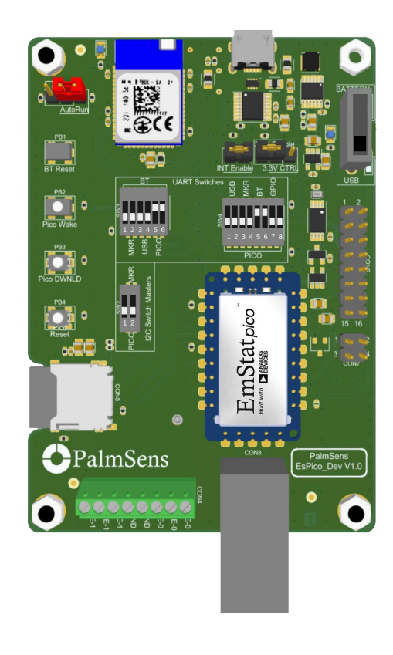
Solution to cord/Bluetooth problem
Correct pinout
for cord connection:
For Bluetooth:
NSF REU Research Experience on Internet of Things 2022

Slide 28
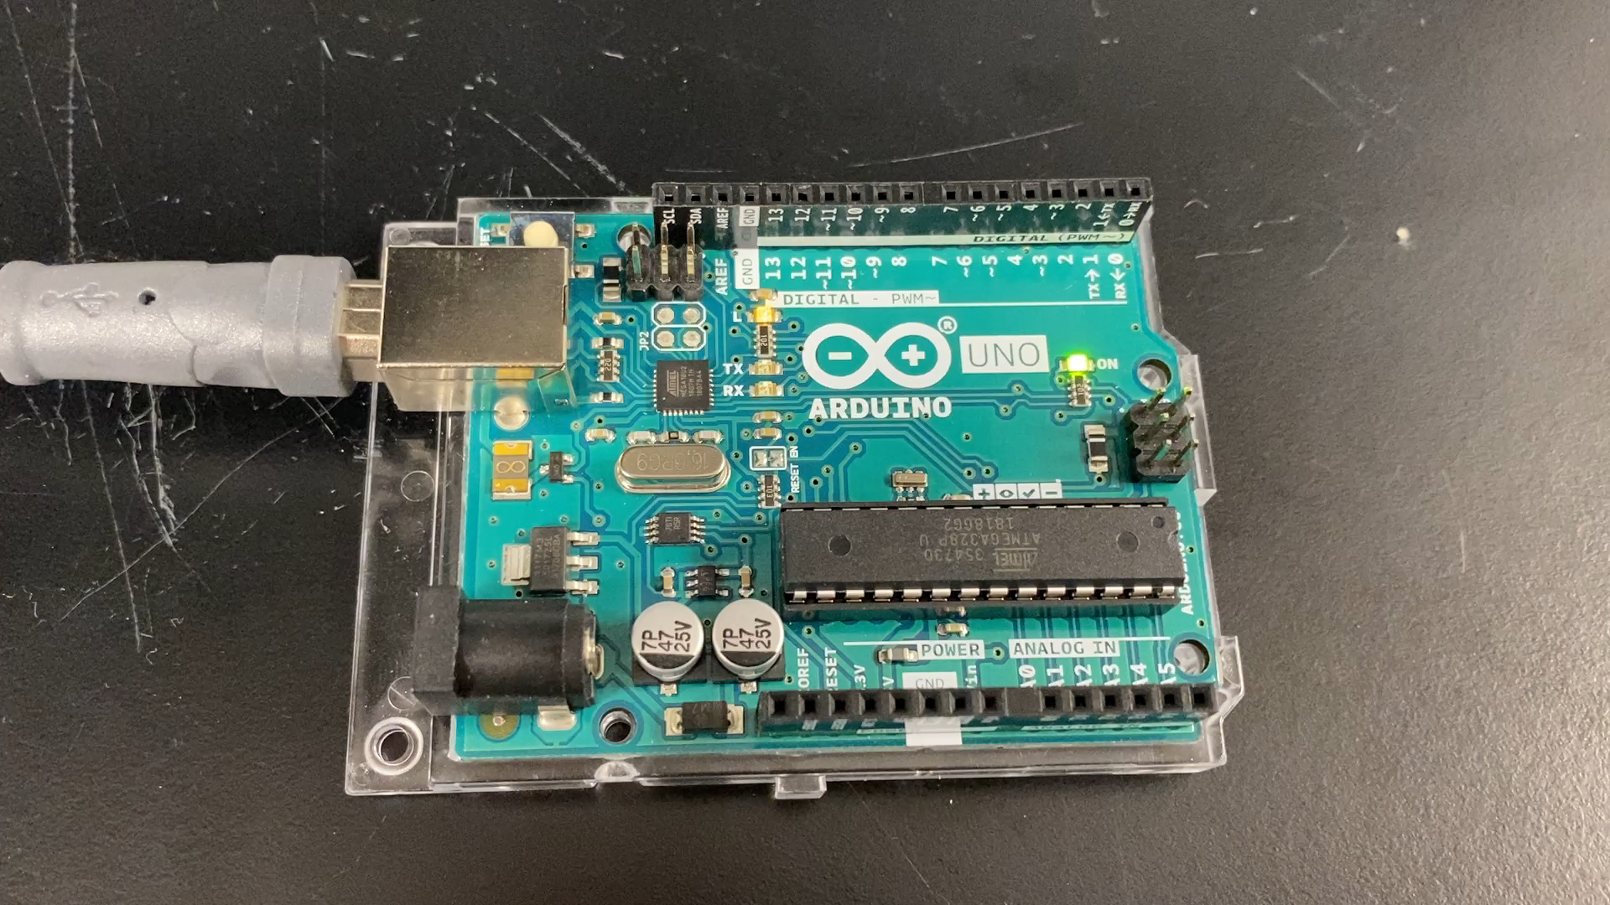
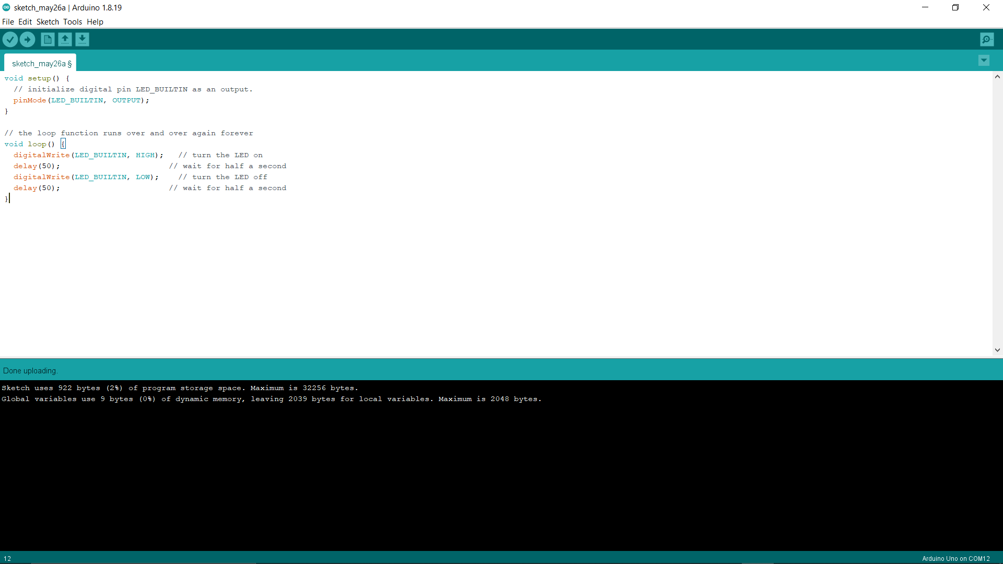
Arduino Uno
Test:
NSF REU Research Experience on Internet of Things 2022

Slide 29
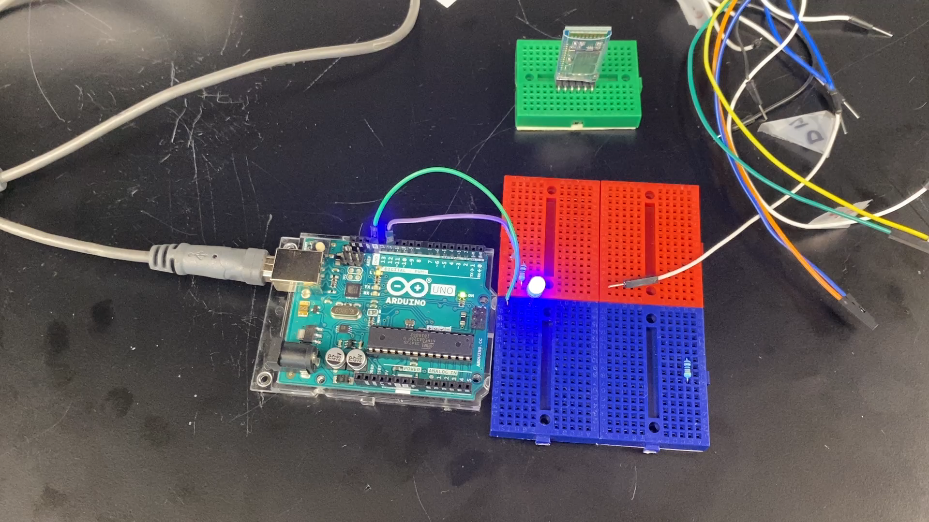
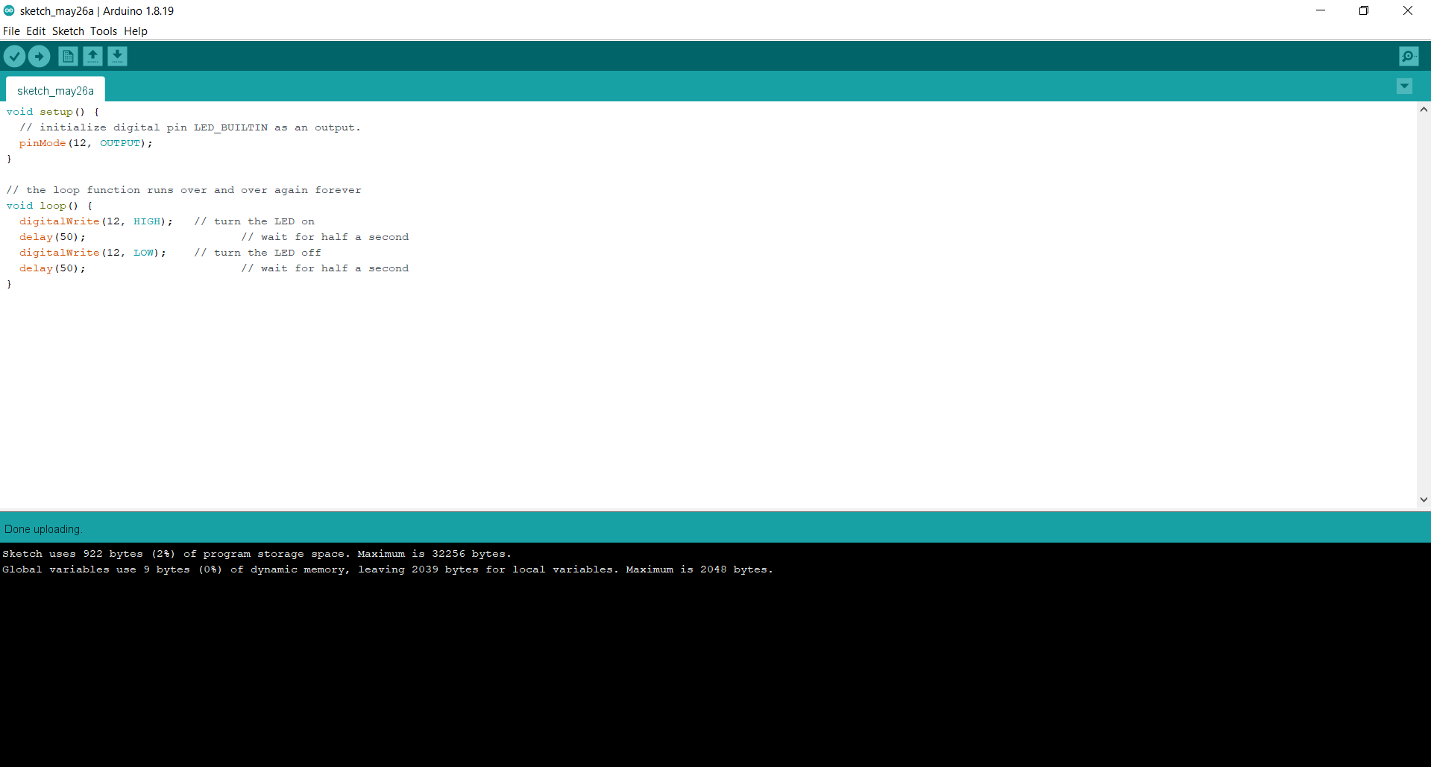
Arduino Uno
Test:
NSF REU Research Experience on Internet of Things 2022

Slide 30
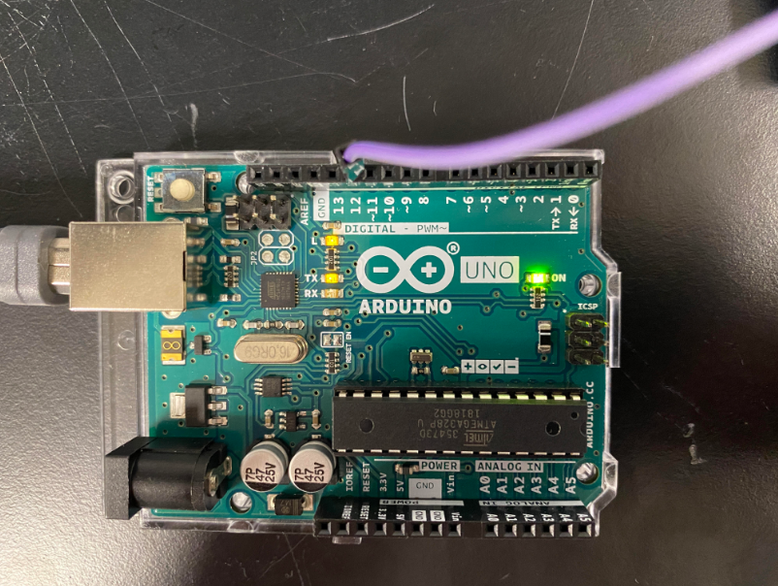
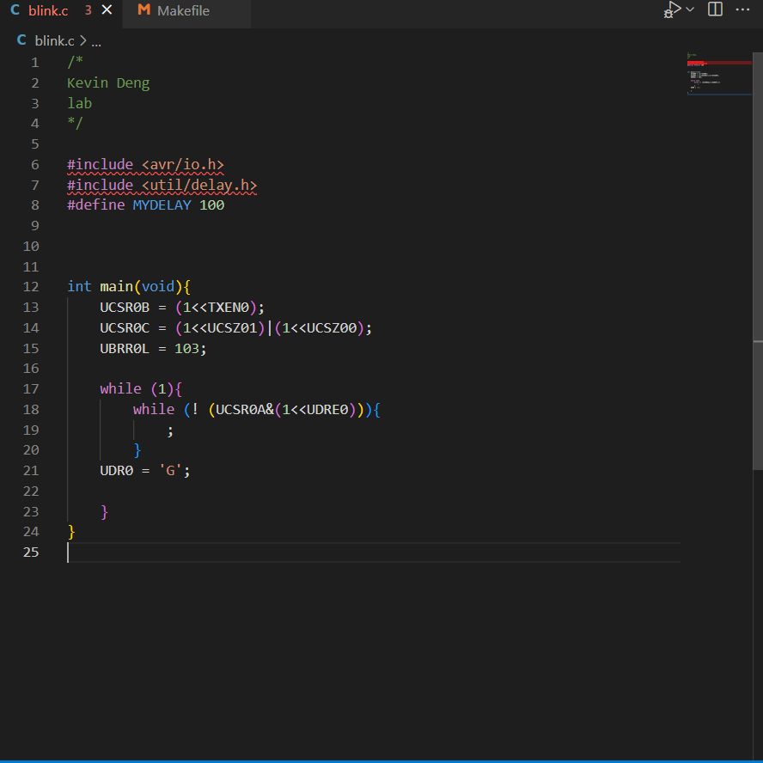
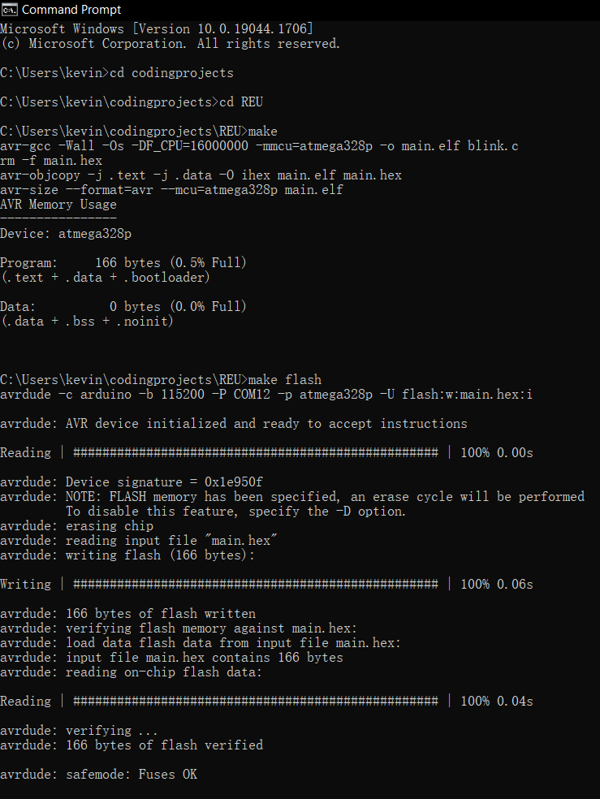
Arduino Uno
Write and Send string of character to Terminal Emulator
Using C:
NSF REU Research Experience on Internet of Things 2022

Slide 31
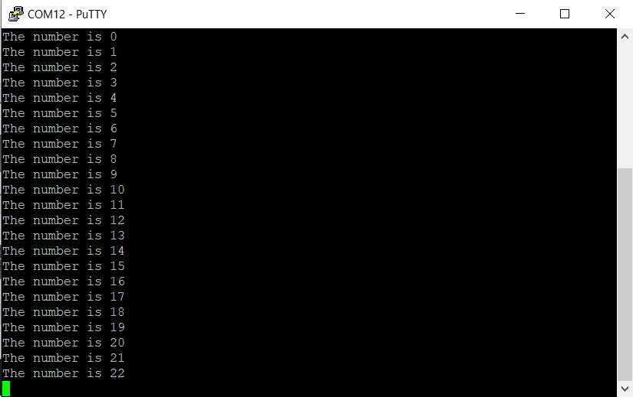
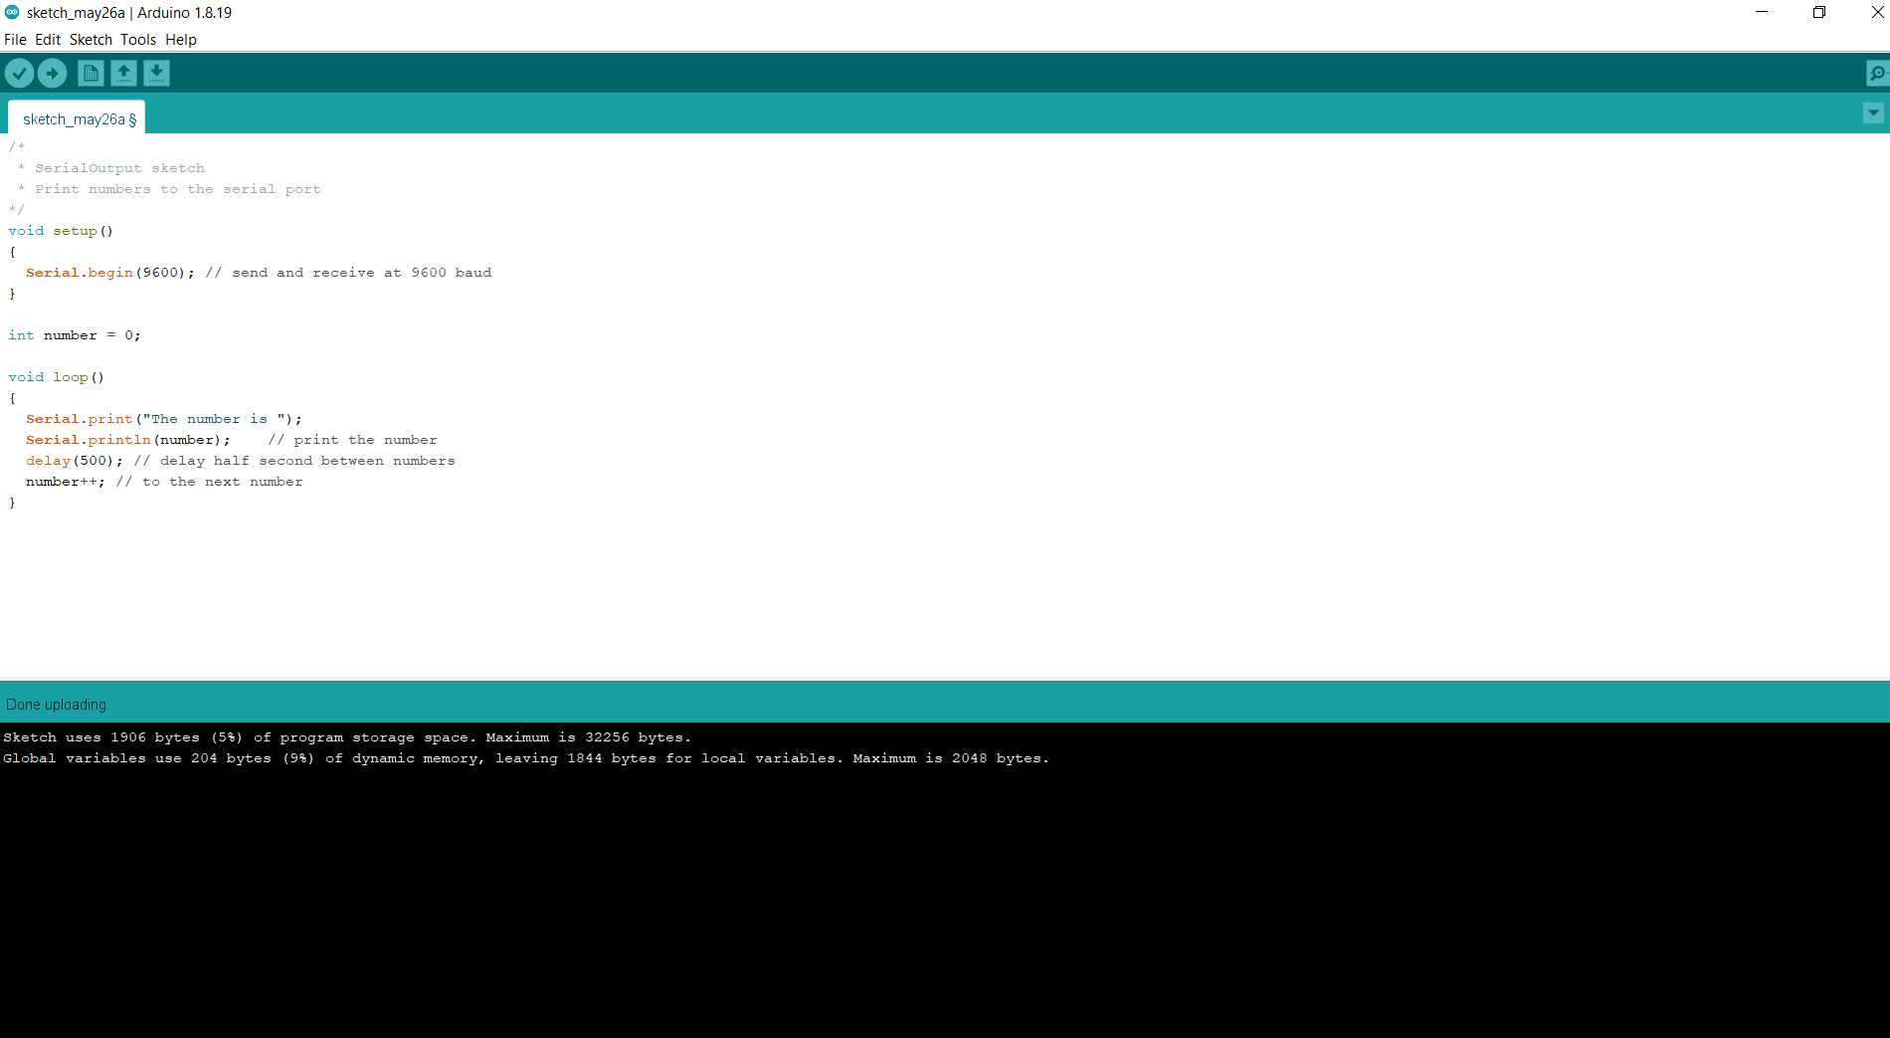
Arduino Uno
Using Arduino IDE:
NSF REU Research Experience on Internet of Things 2022

Slide 32
Next Week Plans
Start electrodeposition
Build electric robot arms and other things(that might be helpful to the project)
NSF REU Research Experience on Internet of Things 2022

Slide 33
Reference
https://www.palmsens.com/app/uploads/2020/04/PSAN0401-Use-Bluetooth-on-EmStat-Pico-dev-board.pdf
https://www.palmsens.com/product/oem-emstat-pico-development-kit/
https://www.palmsens.com/app/uploads/2021/04/PSDAT-ESP-EmStat-Pico-Datasheet.pdf
https://www.palmsens.com/app/uploads/2020/02/ESPico-dev-board-overview-card.pdf
NSF REU Research Experience on Internet of Things 2022

