Slide 1
The Interaction of Animal Furs with Water Flow to Identify Biologically-Driven Anti-Fouling Mechanisms
Week 6 (June 20 – June 24, 2022)
Alex Carter and Douglas Shu Dr. Andrew Dickerson, Milos Krsmanovic, Dr. Damla Turgut
NSF REU Research Experience on Internet of Things 2022
Notes:
Good title slide
Split up more based on accomplishments, issues, and future work! More of a flow

Slide 2
Accomplishments
NSF REU Research Experience on Internet of Things 2021
Notes:
Good title slide
Split up more based on accomplishments, issues, and future work! More of a flow

Slide 3
Physical Experiment
Continued taking videos with new experimental plan
Discovered more efficient method to video taking considering linear pressure drop over a given time period
Began Reynold’s number calculations for new flow cell
NSF REU Research Experience on Internet of Things 2022

Slide 4
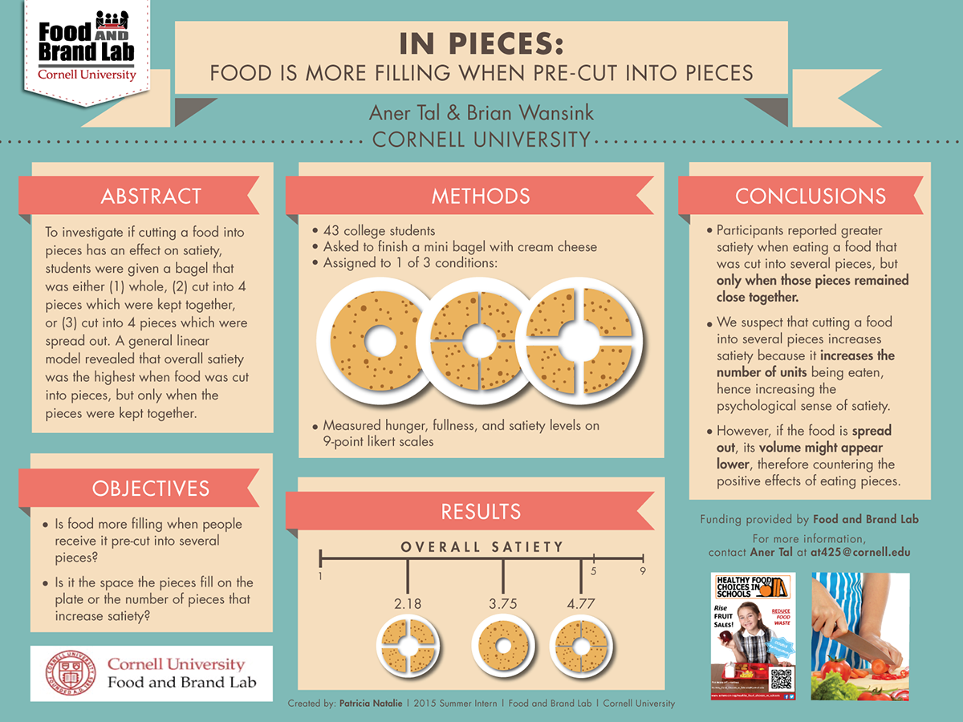
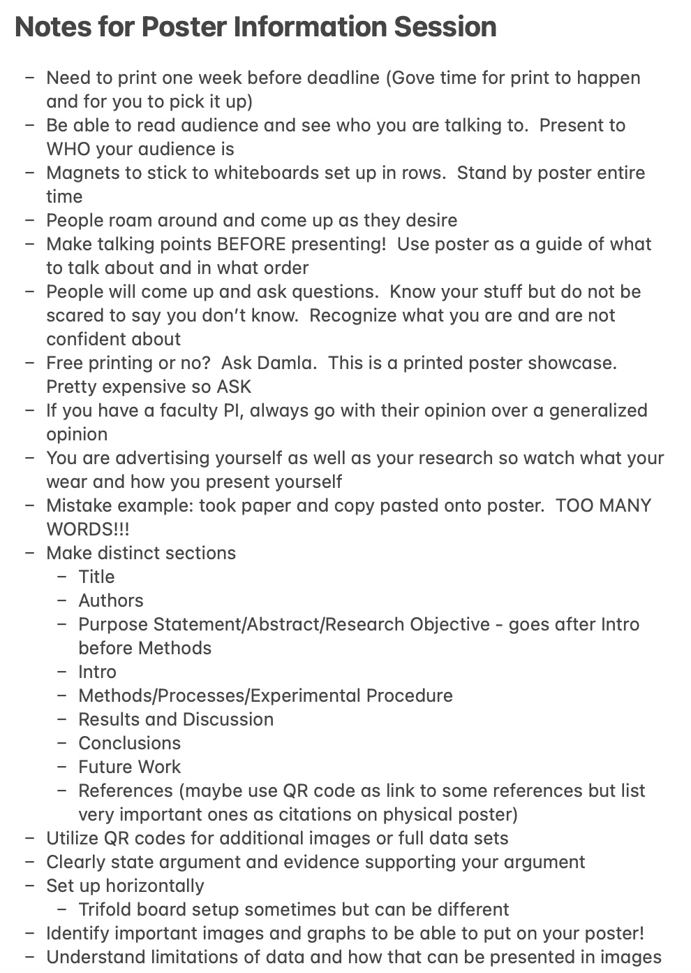
Paper and Poster
Finished abstract, introduction, and most of related works section of paper
Finished template for poster and now need to fill in the information
Would love to do peer review if possible early next week (eek)
NSF REU Research Experience on Internet of Things 2022

Slide 5
Python Code Development
Continued developing Random Forest, Gradient Boosting, and Support Vector Regressors
NSF REU Research Experience on Internet of Things 2022

Slide 6
MATLAB Code Development
Continued gathering data from MATLAB with new experimental procedure to get more variability in what we input into Machine Learning
Completely dropped frequency as a variable (officially)
Allowed proper endpoint to be tracked
More in struggles section
NSF REU Research Experience on Internet of Things 2022

Slide 7
Struggles and How They Were Handled
NSF REU Research Experience on Internet of Things 2022
Notes:
Good title slide
Split up more based on accomplishments, issues, and future work! More of a flow

Slide 8
Physical Experiment
400 through 700 ml/min fur were not showing significant movement especially below 15 mm
Changing to more data points at higher flow rate ranges to capture more significant movement
NSF REU Research Experience on Internet of Things 2022
Notes:
Figures for publications must be in pdf format (easiest)
You can write list of materials
Note if these animals are in East Tennessee: many projects start at home

Slide 9
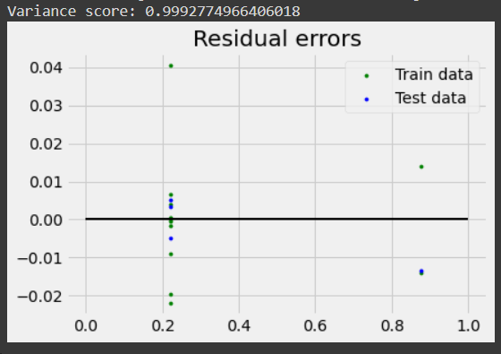
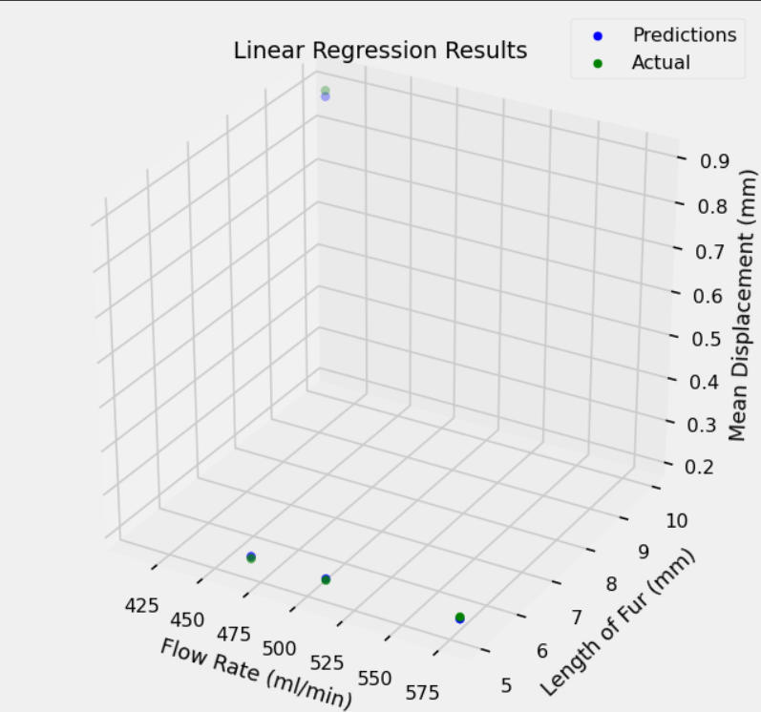
Python Code Development
Multi-variable input harder to plot
Error plot used with some difficulty
3D plot used to compare fur length and other variables
NSF REU Research Experience on Internet of Things 2022

Slide 10
MATLAB Code Development
Nylon
Tracking issue of endpoint and bottom point of fur
If extra pixel pops up (potentially resolution issue) our code tracks the wrong point
Order is right-most column, bottom-most row
Gets rid of bubble tracking issue but this is new
Fixed via code specification
NSF REU Research Experience on Internet of Things 2022

Slide 11
Plans For Next Week
NSF REU Research Experience on Internet of Things 2022
Notes:
Good title slide
Split up more based on accomplishments, issues, and future work! More of a flow

Slide 12
Future
Continue working on paper and poster
Plans to continue taking fast capture videos of furs in flow
Continue optimizing variable extraction from data in MATLAB
Continue Machine Learning code in Python
Develop Random Forest Regressor and Gradient Boosting Regressor and Support Vector Regressor further
NSF REU Research Experience on Internet of Things 2022

