Slide 1
Project: The effects of virtual representation in a new virtual environment REU Students: Priscilla Ramos and Meelad Doroodchi Faculty mentor(s): Dr. Gerd Bruder and Dr. Greg Welch
Week # (May 23 - May 27, 2022)
Accomplishments:
Read in depth articles on our project
Figured out project and essential questions
CITI training
Problem & Solutions
Sticking to one idea, we solved it by coming to terms with a realistic plan
Plans for next week:
Get familiar with softwares(Unity, Mesh, SecondLife)
Create a project plan
NSF REU Research Experience on Internet of Things 2021

Slide 2
Project: The effects of virtual representation in a new virtual environment
-Introduction to projects by mentors and prof.
Project 1: Austin (Graduate Student)
Effects of Transparency on Perceived Humanness: Implications for Rendering Skin Tones Using Optical See-Through Displays
“Perceived Bias”
Austins project used holographic lenses and consisted of different types of visual aids being presented while wearing the headset. He came to the conclusion from his study that darker objects were much harder to see and when I put my hand through a dark visual I would be able to see it through the avatar. We were able to see that it is much easier to see things with white text on a black background then vice versa.
We wanted to see if other things would produce similar issues including tattoos for instance and if someone was wearing contacts would it affect the visual that they were looking at.
Project 2: Priscilla and Meelad
Tune into the next slide!!
Project 3: Hiroshi (Graduate student)
Topography mapping(in the beginning stages of the project)
Improving people’s ability to read a map using AR
Questionnaires
He would have a minimum of 10 experts and hopefully 30-40 amateurs go through multiple stages before taking a training course to come to the conclusion whether or not the training course they took improved their ability to read a map.
Creating a world with no vegetation but would want to see the difference in the training effects in an expert and amateurs.
NSF REU Research Experience on Internet of Things 2021

Slide 3
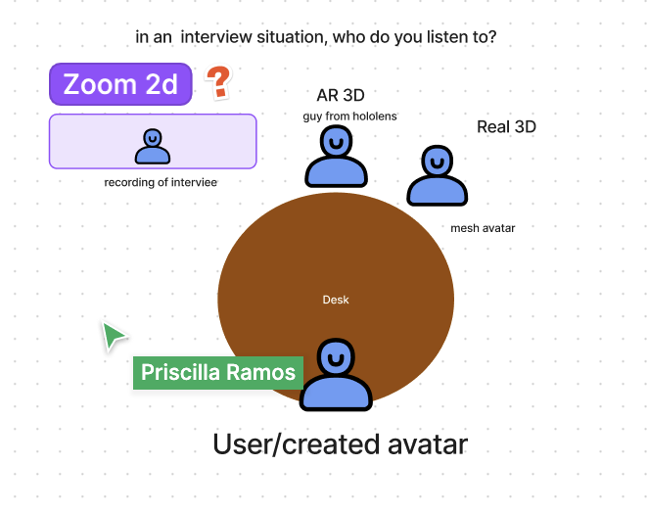
Project: The effects of virtual representation in a new virtual environment
NSF REU Research Experience on Internet of Things 2021

