Slide 1
Project 3: Designing mobility services using large-scale data from a smart city testbed
REU Students: Ashley Mojica & Molika So
Faculty mentor(s): Samiul Hasan & Damla Turgut
Week 2 (May 23 – May 27, 2022)
NSF REU Research Experience on Internet of Things 2022

Slide 2
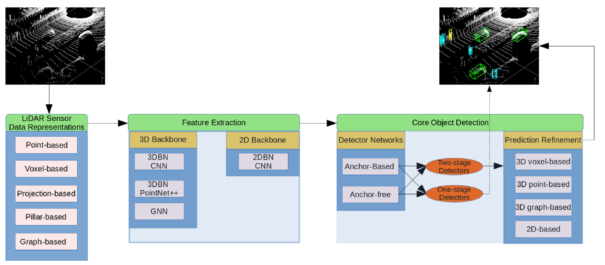
Accomplishments
Read through the paper that the team has been using to better understand the operational pipeline of LiDAR-based 3D object detectors with Deep Learning
NSF REU Research Experience on Internet of Things 2022

Slide 3
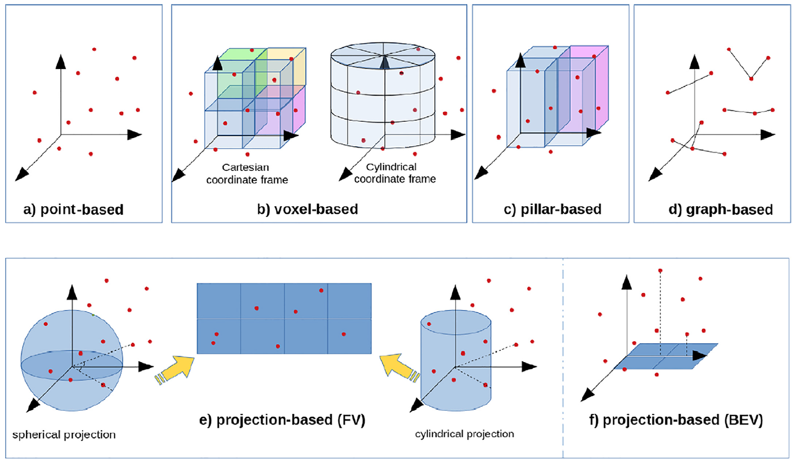
Accomplishments
NSF REU Research Experience on Internet of Things 2022

Slide 4
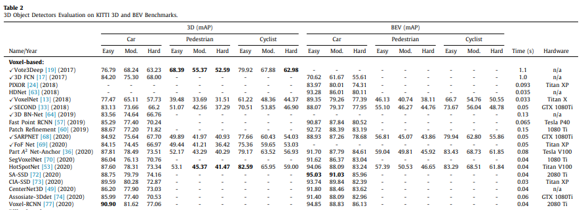
Accomplishments
Read about possible 3D object detection methods that could be used
Narrowed it down to two methods: Vote3Deep and HotSpotNet
NSF REU Research Experience on Internet of Things 2022

Slide 5
Problems & Solutions
We faced scheduling conflicts with our research team.
This issue was resolved by condensing our several weekly scheduled meetings into one meeting to better accommodate our REU scheduled events.
Plans For Next Week
Potentially confirm our project topic and start implementation.
NSF REU Research Experience on Internet of Things 2022

