Slide 1
Project 8: Privacy aware health monitoring for the elderly
REU Students: Chris Gittings
Faculty mentor(s): Ladislau Bölöni and Damla Turgut
Week #8 (July 5 – July 8, 2022)
NSF REU Research Experience on Internet of Things 2022

Slide 2
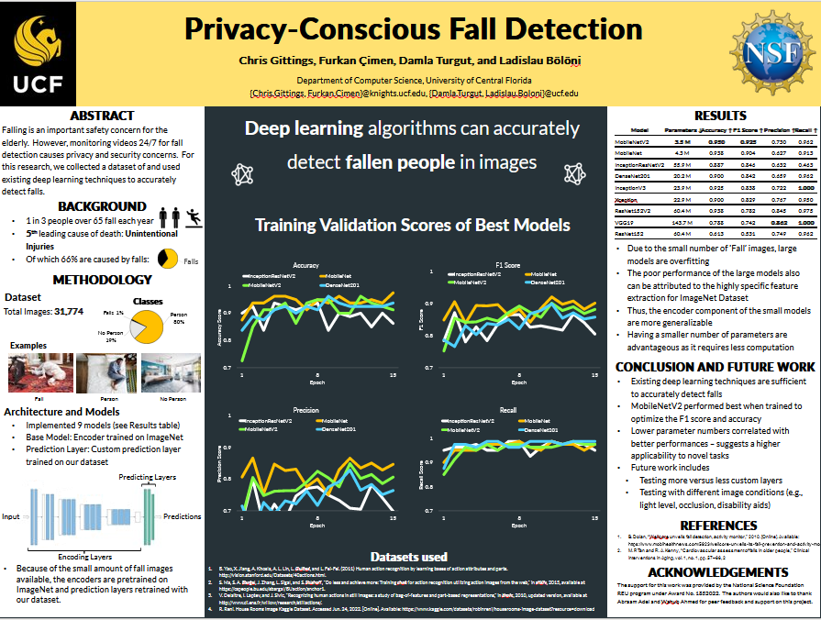
Accomplishments
Finalized Poster
Wrote Script for Poster Presentation
Practiced Presentation
Attended Program Events
NSF REU Research Experience on Internet of Things 2022

Slide 3
Challenges & Approaches
Challenge
Presentation skills insufficient and script not yet learned
Approach
Practice
NSF REU Research Experience on Internet of Things 2022

Slide 4
Plans for The Future
Present Poster
(Hopefully) Publish a Paper
Continue updating Overleaf document
Test more encoders
Test hyperparameters of prediction layer of model
Draft Research Paper
Edit, revise, get feedback
Submit Paper
NSF REU Research Experience on Internet of Things 2022

