Slide 1
Project 8: Privacy aware health monitoring for the elderly
REU Students: Chris Gittings
Faculty mentor(s): Ladislau Bölöni and Damla Turgut
Week #4 (June 6 – June 10, 2022)
NSF REU Research Experience on Internet of Things 2022

Slide 2
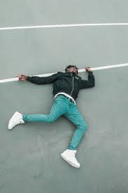
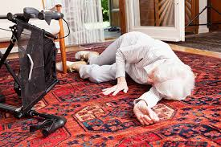
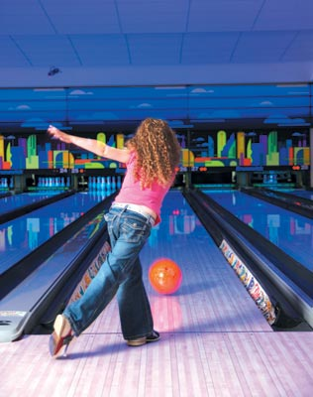
Accomplishments
Curated Image Dataset
Examples of Fallen People
Total Images: 32,706
Images with People: 26,377
Images With a Fallen/Falling Person: 361
Total Categories: 93
Images without People: 5,968
Images gathered from google image scrapes and 3 datasets used by other researchers
Examples of Non-Fallen People
NSF REU Research Experience on Internet of Things 2022

Slide 3
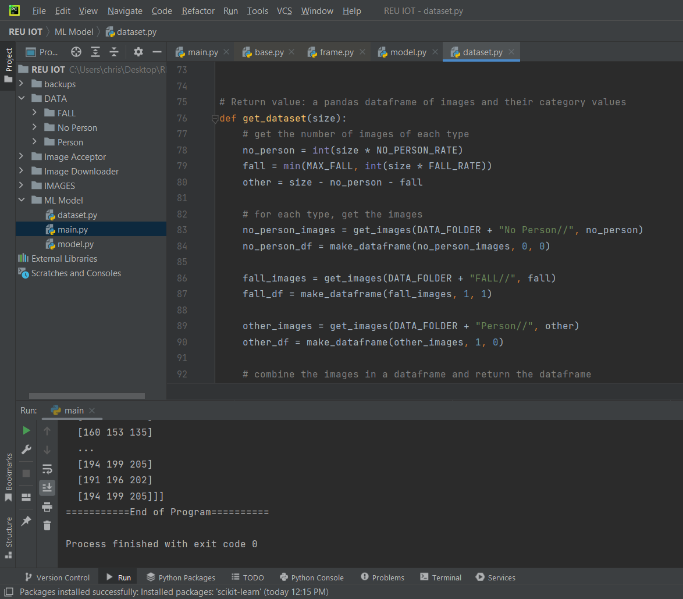
Accomplishments
2. Started Coding Person Recognition ML Model
Progress So Far:
Decided on using PyCharm
Getting all image paths
Converting image paths to RGB arrays
Choosing a number of images to use in the final dataset
Splitting the data into train, validation, and test sets
NSF REU Research Experience on Internet of Things 2022

Slide 4
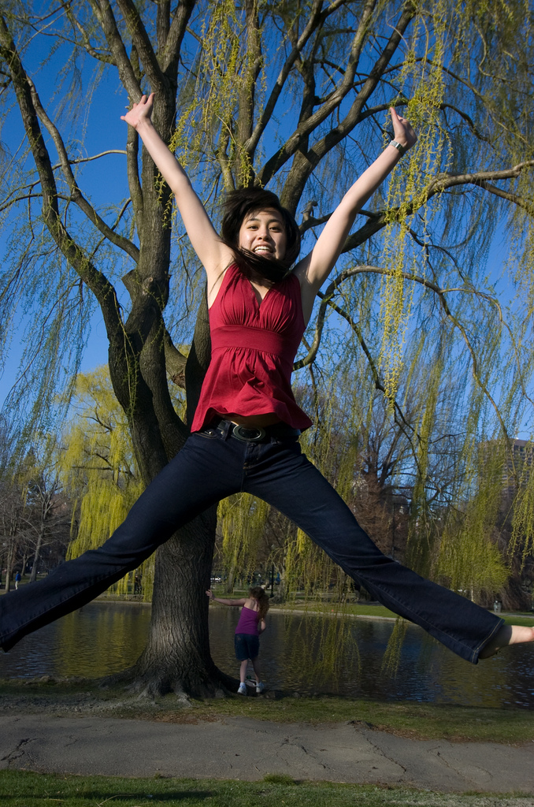
Problem & Solutions
Problem
I currently have the images sorted by 93 states, but many images can fall under multiple categories (overlapping categories)
Solution
Two Options:
Combine categories to decrease overlap
Label the states as [person or no person] and [fallen or not fallen]
Current Approach: Discussion with mentors
Example:
Jumping AND Jumping Jack
NSF REU Research Experience on Internet of Things 2022

Slide 5
Problem & Solutions
Problem
What IDE do I use to code my ML algorithm?
Solution
Internet research indicates that PyCharm works well for machine learning in Python machine learning
Already had PyCharm installed, so no need to download anything
NSF REU Research Experience on Internet of Things 2022

Slide 6
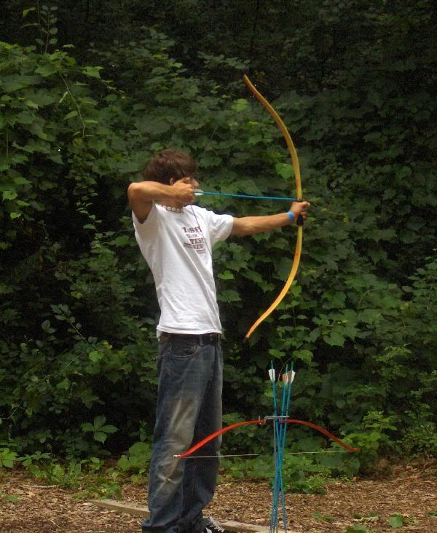
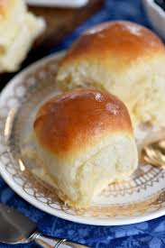
Problem & Solutions
Problem
Which model is best for recognizing the presence of people in images?
Solution
ResNet, VGG-19, and ViT have all been recommended
All are pre-trained
Approach: Next week I will test all three on my dataset and choose the one with the highest accuracy.
NSF REU Research Experience on Internet of Things 2022

Slide 7
Plans for Next Week
Finalize Image Dataset Categories
Test the ResNet, VGG-19, and ViT models
Employ Data Loading for improved program performance
Determine optimal train, validation, and test set sizes
Discuss this week’s progress and part 2 of the model with mentors
NSF REU Research Experience on Internet of Things 2022

