Slide 1
Project: The Effects of Virtual Representation in a Virtual Environment REU Students: Priscilla Ramos and Meelad Doroodchi Faculty mentor(s): Dr. Gerd Bruder and Dr. Greg Welch
Week #4 (June 6 - June 10th, 2022)
Accomplishments:
Created pre and post questionnaires
Set up HUSIS with equipment for experiment
Uploaded characters into our environment
Problem & Solutions
Problems calibrating room dimensions for different heights, will calibrate for an average height and we will be ready to calibrate if necessary
Adding a webcam script in the Hololens to be able to do the avatar transition smoother, we will add the script once we figure it out
Until Wednesday we did not know how we wanted to display our User Interface, if we wanted to use the internet browser on the Hololens or to stream it with a webcam
Plans for next week:
Carry out experiment and start practicing
Create last questionnaire
Create webcam script to allow us to stream the avatar creation process through Unity
NSF REU Research Experience on Internet of Things 2022

Slide 2
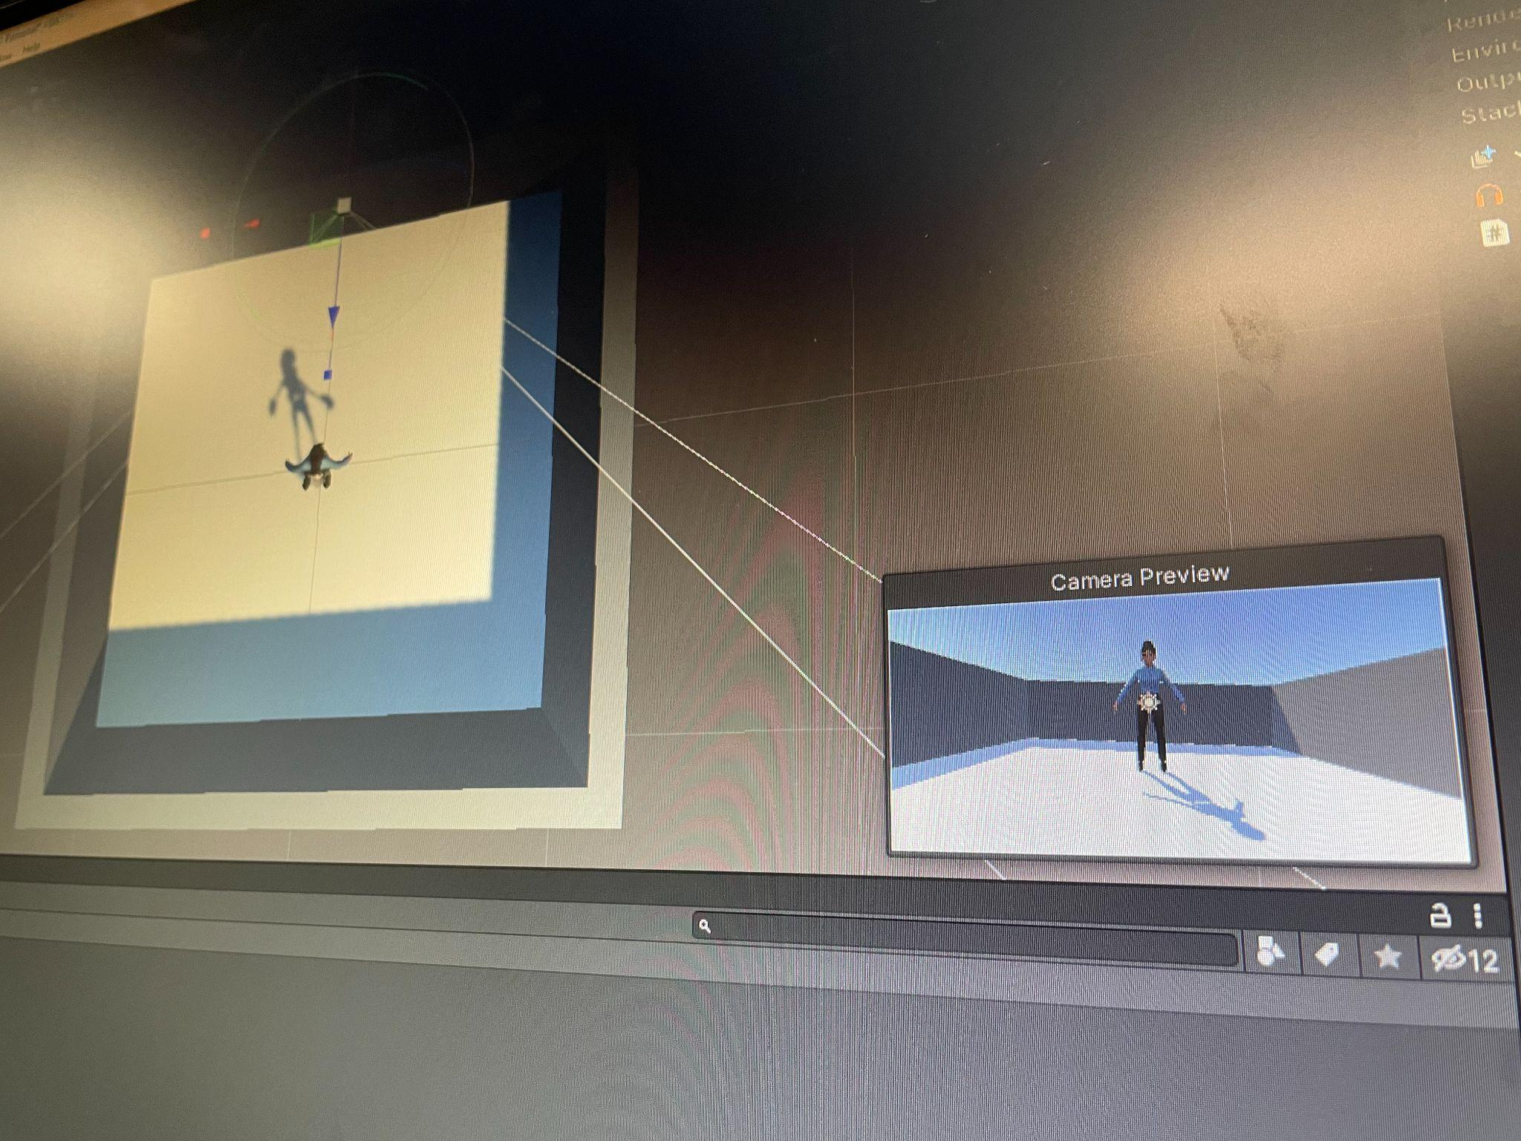
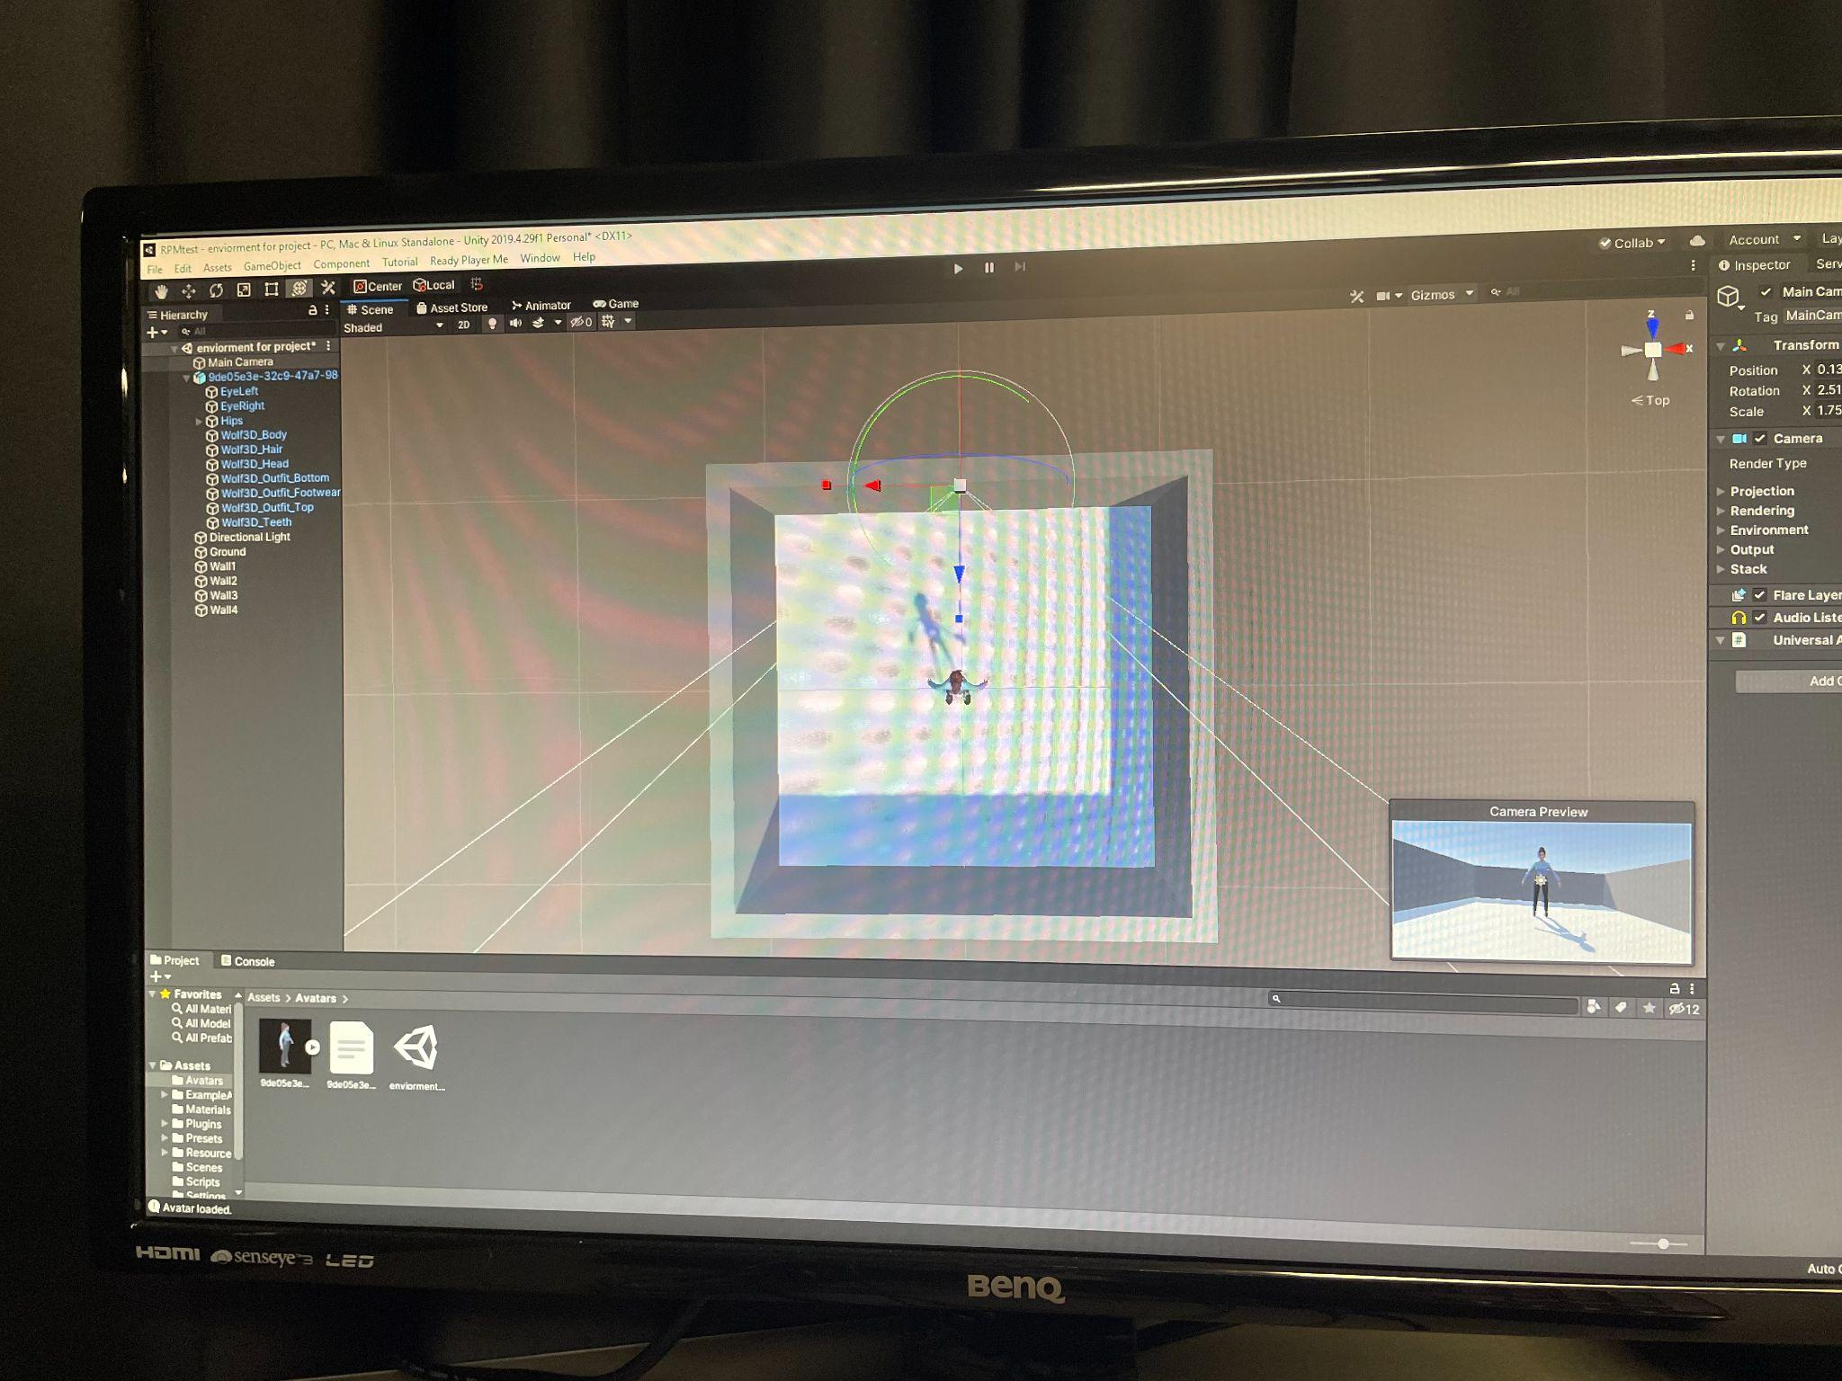
Project: The Effects of Virtual Representation in a Virtual Environment REU Students: Priscilla Ramos and Meelad Doroodchi Faculty mentor(s): Dr. Gerd Bruder and Dr. Greg Welch
Week #4 (June 6 - June 10th, 2022) Link To This Week's Notion Page
Link of Accomplishments:
Conditions
A 2 by 2 experiment with lighting conditions with one being outdoor lighting and the other being dim-office lighting along with a casual vs professional environment conditions(clothes & appearance)
NSF REU Research Experience on Internet of Things 2022

