Slide 1
Project #5: Biopolymer Based Sensors and Actuators REU Students: Jayla Smalls & Kevin Deng
Faculty mentor(s): Hyoung Jin Cho and Ladislau Bölöni
Week #4 (Monday June 6, 2022– Friday June 10, 2022)
NSF REU Research Experience on Internet of Things 2022

Slide 2
Accomplishments
Connected Electrical Robot Arm to Bluetooth Module
Completed the electric boat version 1; started on version 2
tested sensor with drop casting technique and recorded results with different concentration of PFOS
NSF REU Research Experience on Internet of Things 2022

Slide 3
Electric Boat schematics

Slide 4
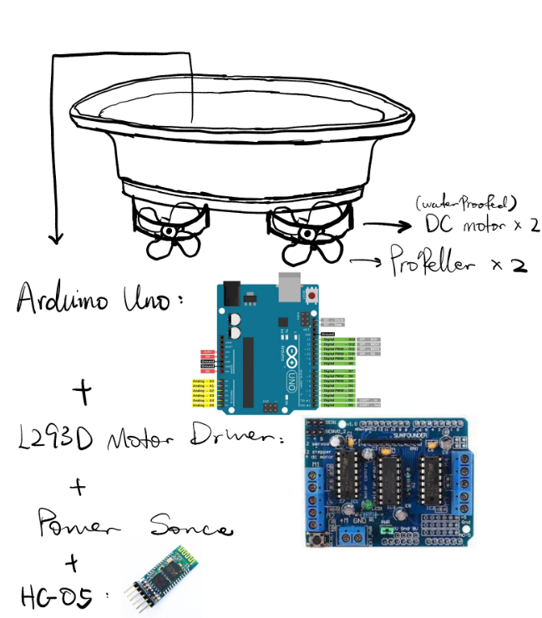
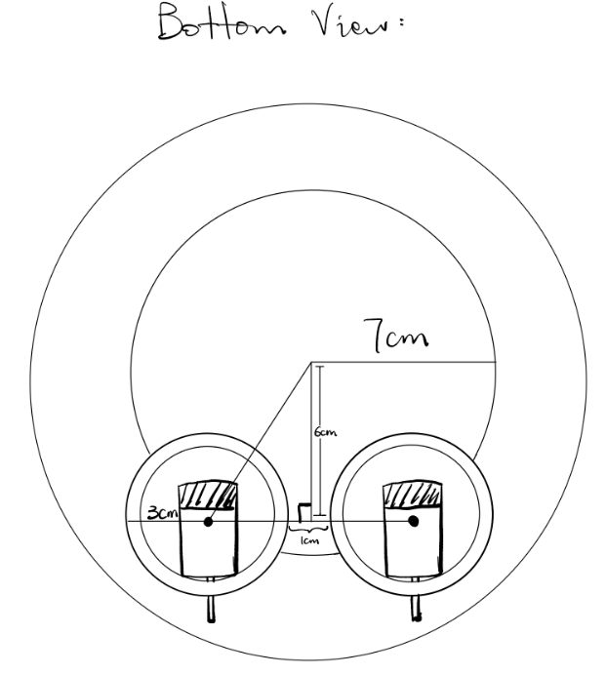
Electric Boat schematics

Slide 5
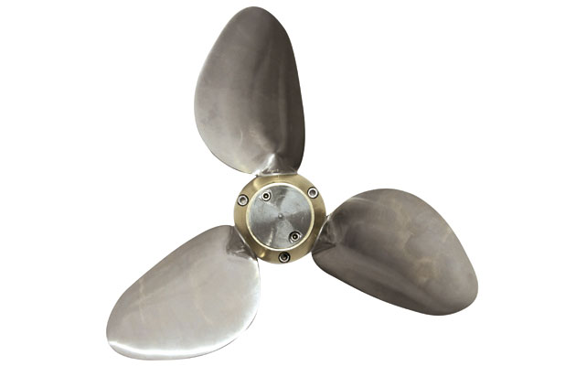
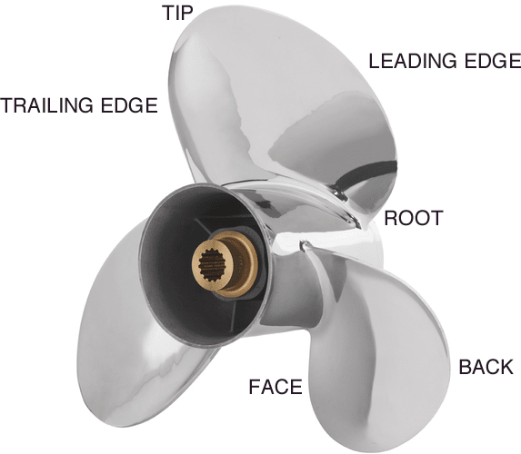
Electric Boat propeller
Forward
Backward
Rightward
Leftward

Slide 6
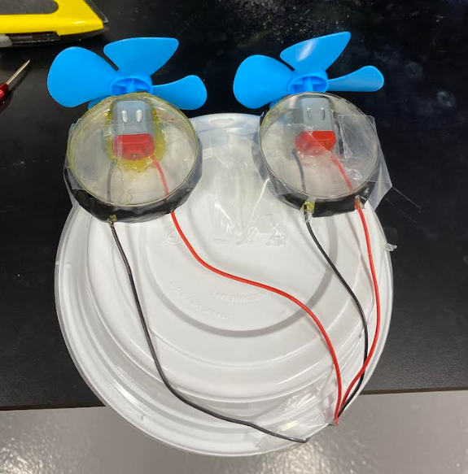
Electric Boat project

Slide 7
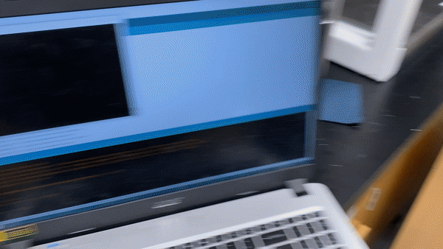
Electric Boat project

Slide 8
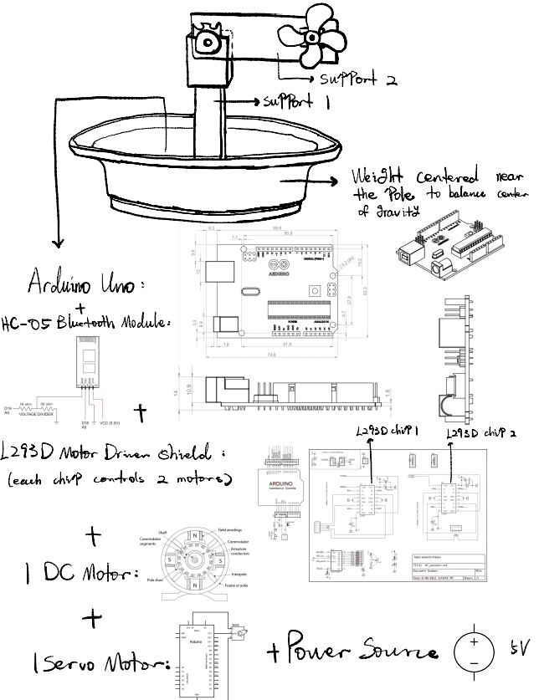
Boat Idea #2

Slide 9
Drop casting
For MIPs(Molecularly imprinted Polymers), it’s best to use chronoamperometry for electrodeposition(deposit chitosan and PFOS at the same time). But because we will be using NIPs(Non-Imprinted Polymers) we will do the deposition in a different way called drop casting(deposit chitosan solution only, add PFOS in the electrolyte).
The EIS is for measurement after sensor usage.

Slide 10
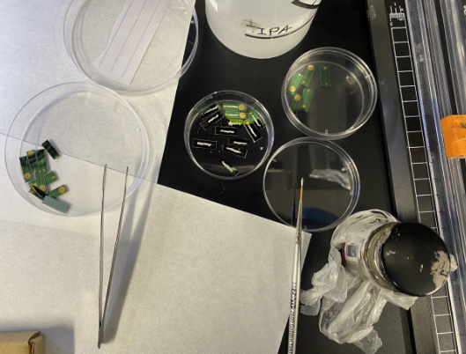
Drop casting
For the ones that have cracks on conducting line, coat the conducting thin line with silver paste
Painted sensors
Brush
Silver Paste

Slide 11
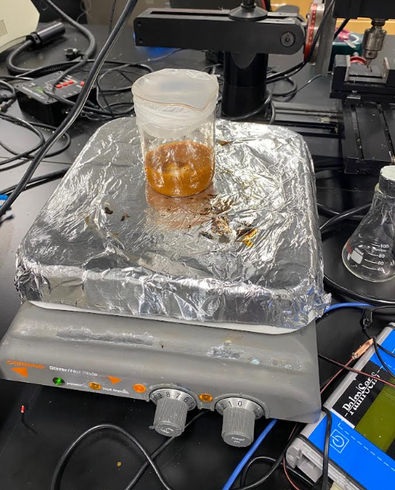
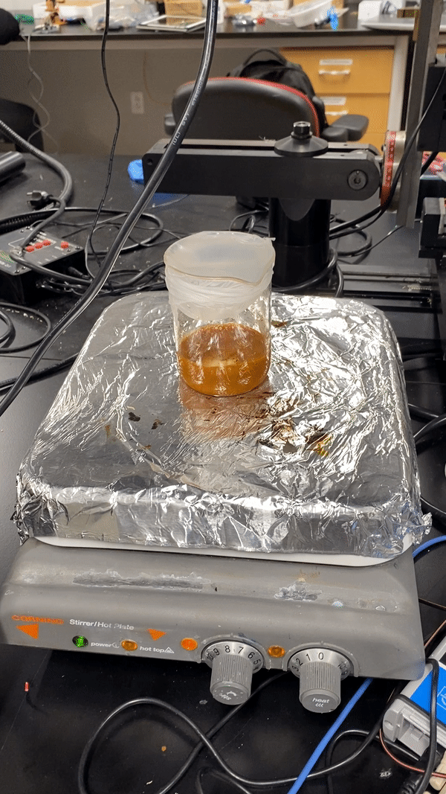
Drop casting
Preparing the chitosan solution:
0.984g magnetic nanoparticles
0.05g chitosan
40ml deionized water
0.23ml acetic acid
After mixing, stir for 12 hours:

Slide 12
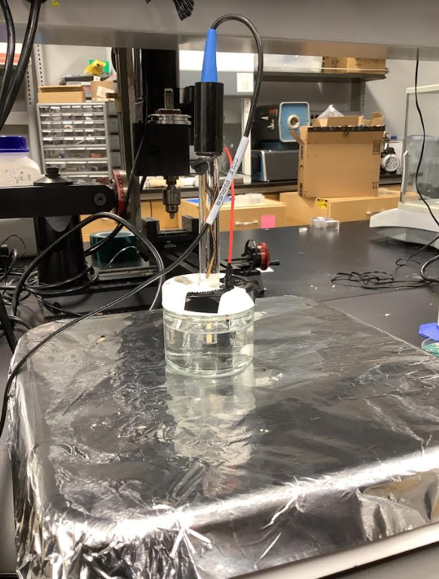
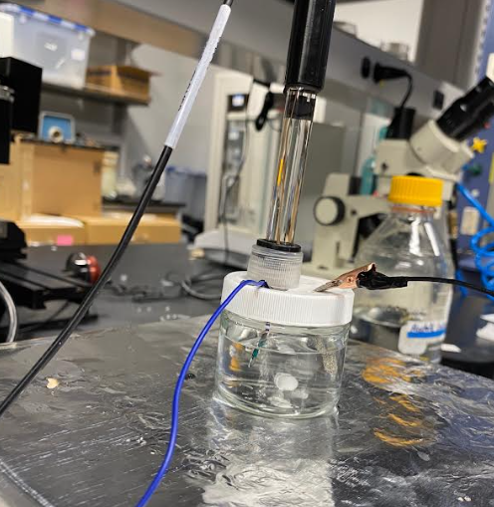
Drop casting experiment
Connection set up:
RE
CE
WE

Slide 13
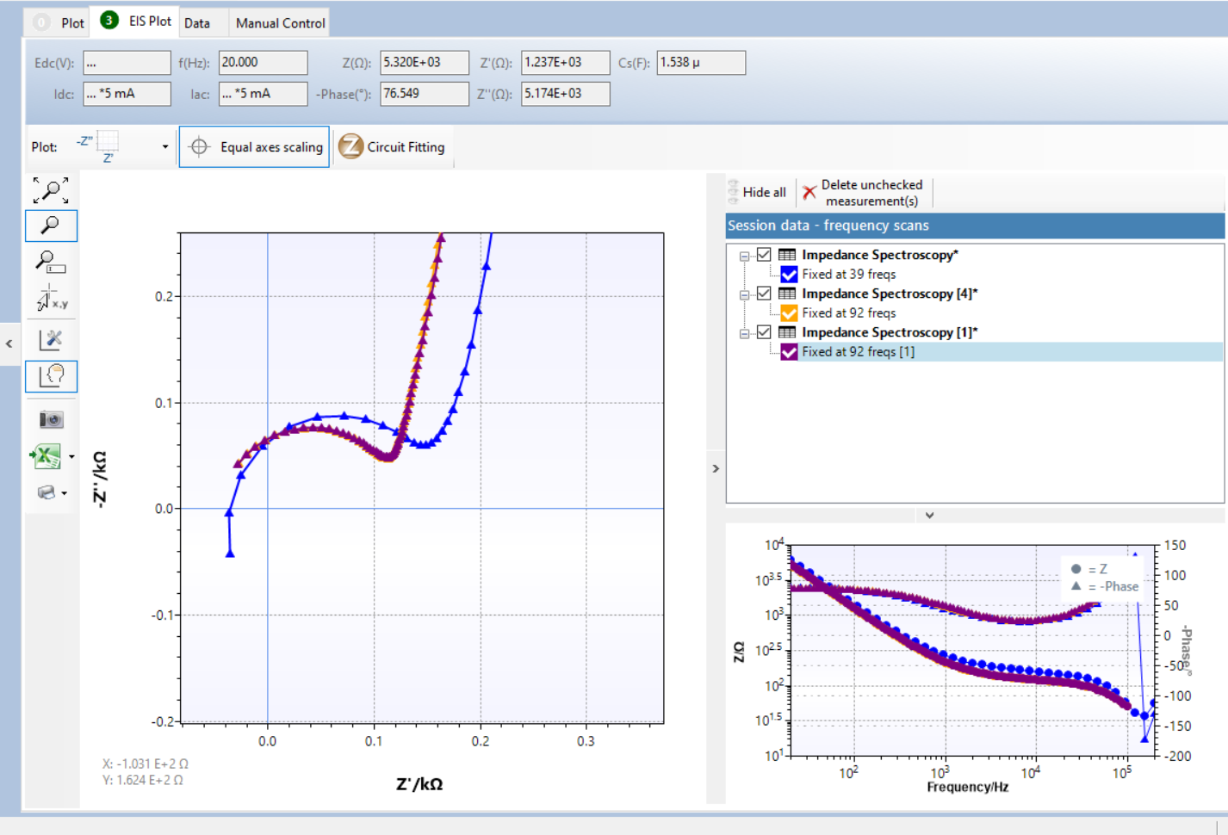
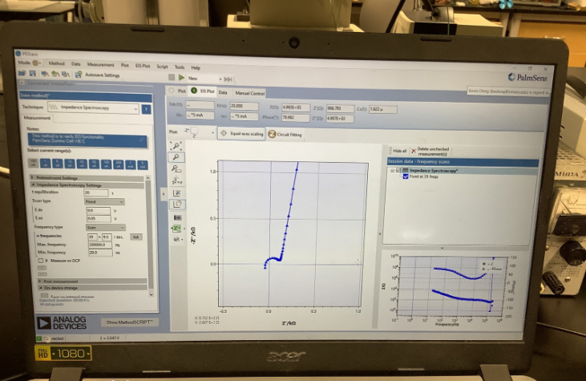
Drop casting experiment
New parameters:
Mixing time: 4mins stirring speed: 240rpm
t equilibration: 50s E DC: 0V
E AC: 0.05V Max freq: 100,000 Hz
Min freq: 20Hz n freq: 92=24.6/dec
Blue 1 ppb, orange 2 ppb, purple 3 ppb
Experiment results:
No PFOS

Slide 14
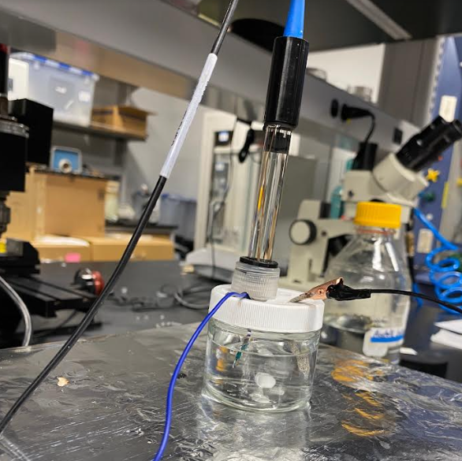
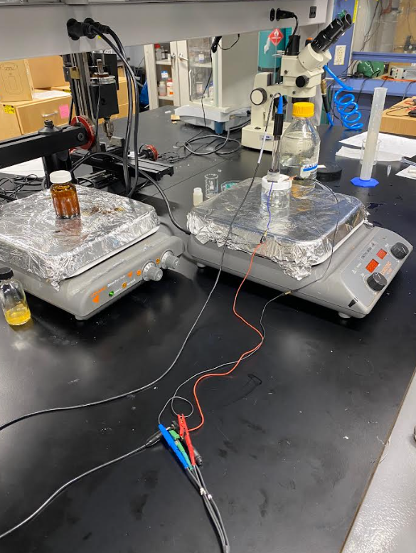
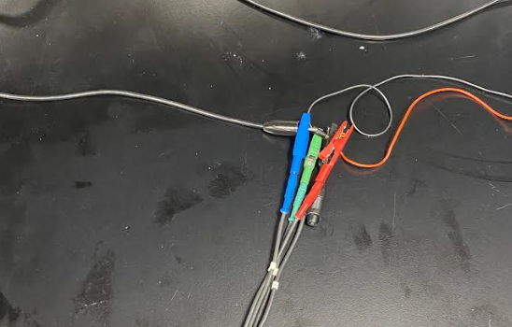
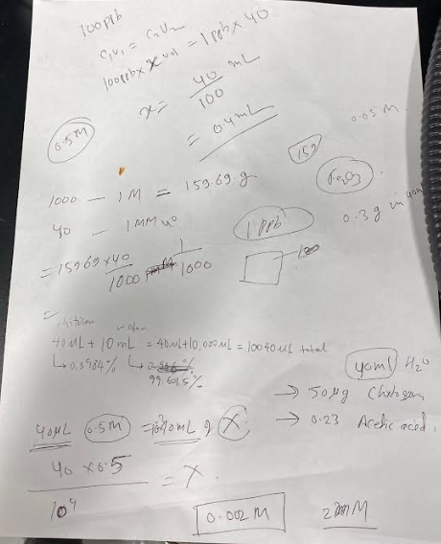
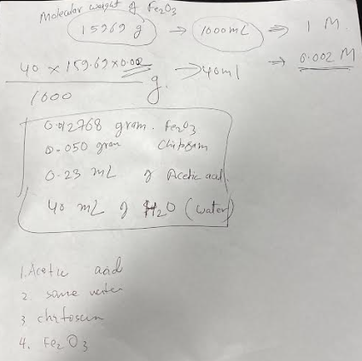
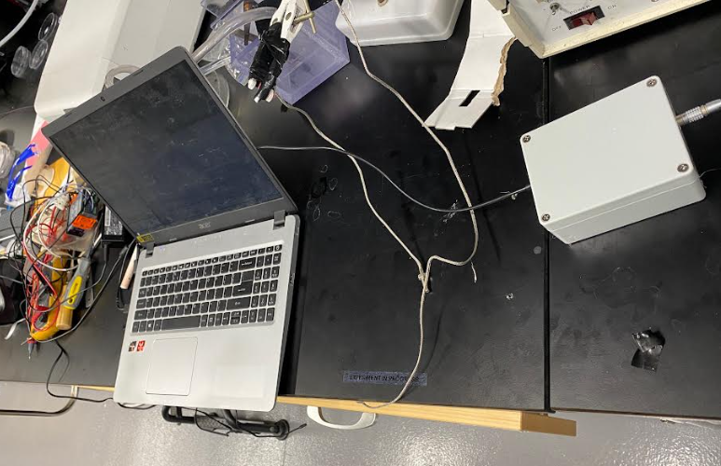
Drop casting experiment
Set up:
1 5uL drop of chitosan iron oxide with water:
Concentration:
0.012768g Fe2O3
0.05g chitosan
0.23mL acetic acid
40mL water

Slide 15
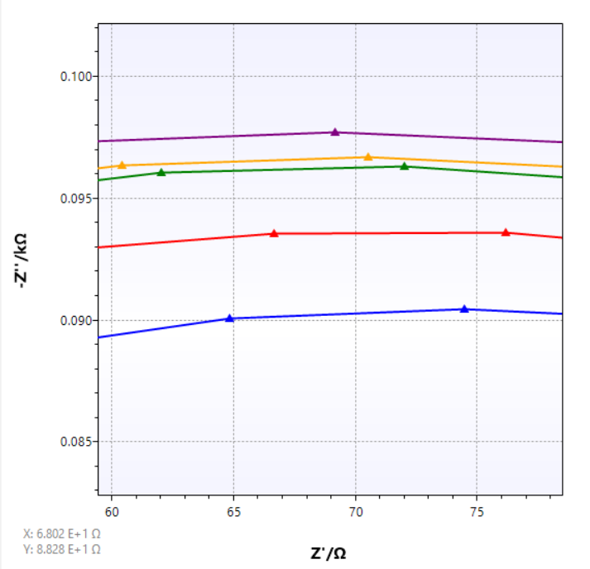
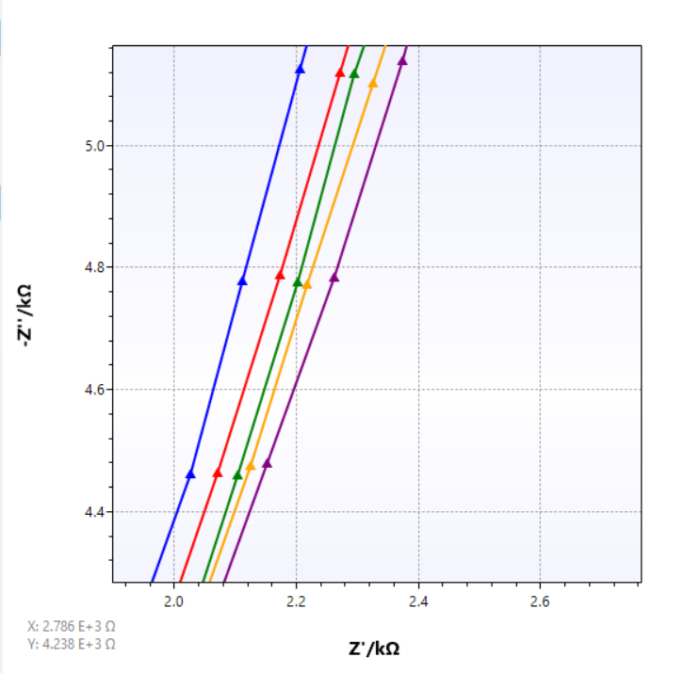
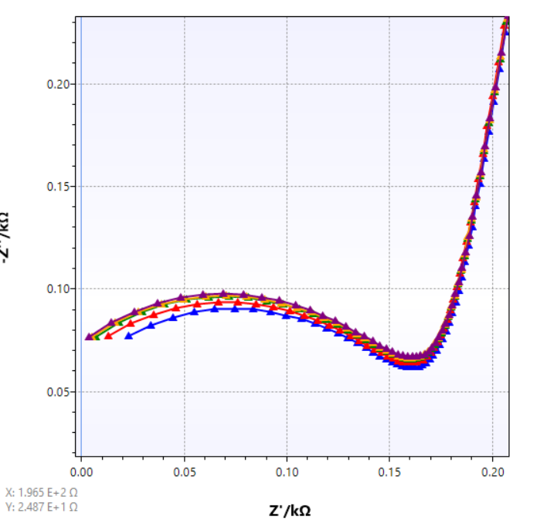
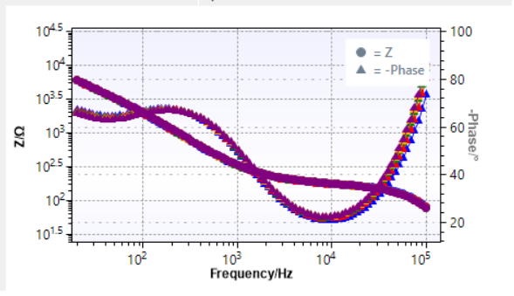
Drop casting experiment results
Blue: baseline (no PFOS)
Red: PFOS concentration 100 ppt
Green: PFOS concentration 150 ppt
Orange: PFOS concentration 200 ppt
Purple: PFOS concentration 400 ppt

Slide 16
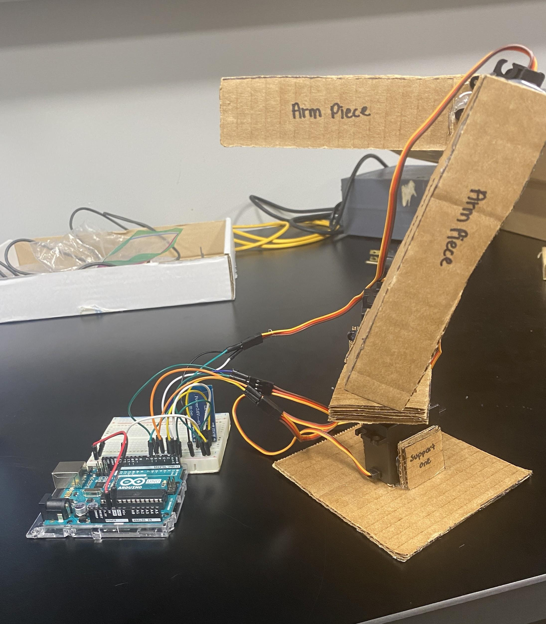
Connected Electrical Robot Arm to Bluetooth Module
Arduino Code
NSF REU Research Experience on Internet of Things 2022

Slide 17
Problems and solutions
Sensors have cracks on their conducting layer. solved by applying silver layer on top
Lots of issues with connections of arduino(it’s all about luck)
waterproofed motor is still not waterproof… will work on version 2 instead

Slide 18
Plans For Next Week
keep working on the electric boat and hopefully combine it with the robot arm, and transfer the codes so that we can control two devices with one laptop and one bluetooth module
work on the sensors experiments and get more data
NSF REU Research Experience on Internet of Things 2022

