Slide 1
Project #5: Biopolymer Based Sensors and Actuators REU Students: Jayla Smalls & Kevin Deng
Faculty mentor(s): Hyoung Jin Cho and Ladislau Bölöni
Week #3 (Monday May 30, 2022– Friday June 3, 2022)
NSF REU Research Experience on Internet of Things 2022

Slide 2
Accomplishments
NSF REU Research Experience on Internet of Things 2022

Slide 3
Successfully connected the bluetooth module to my PC
Serial Monitor
NSF REU Research Experience on Internet of Things 2022

Slide 4
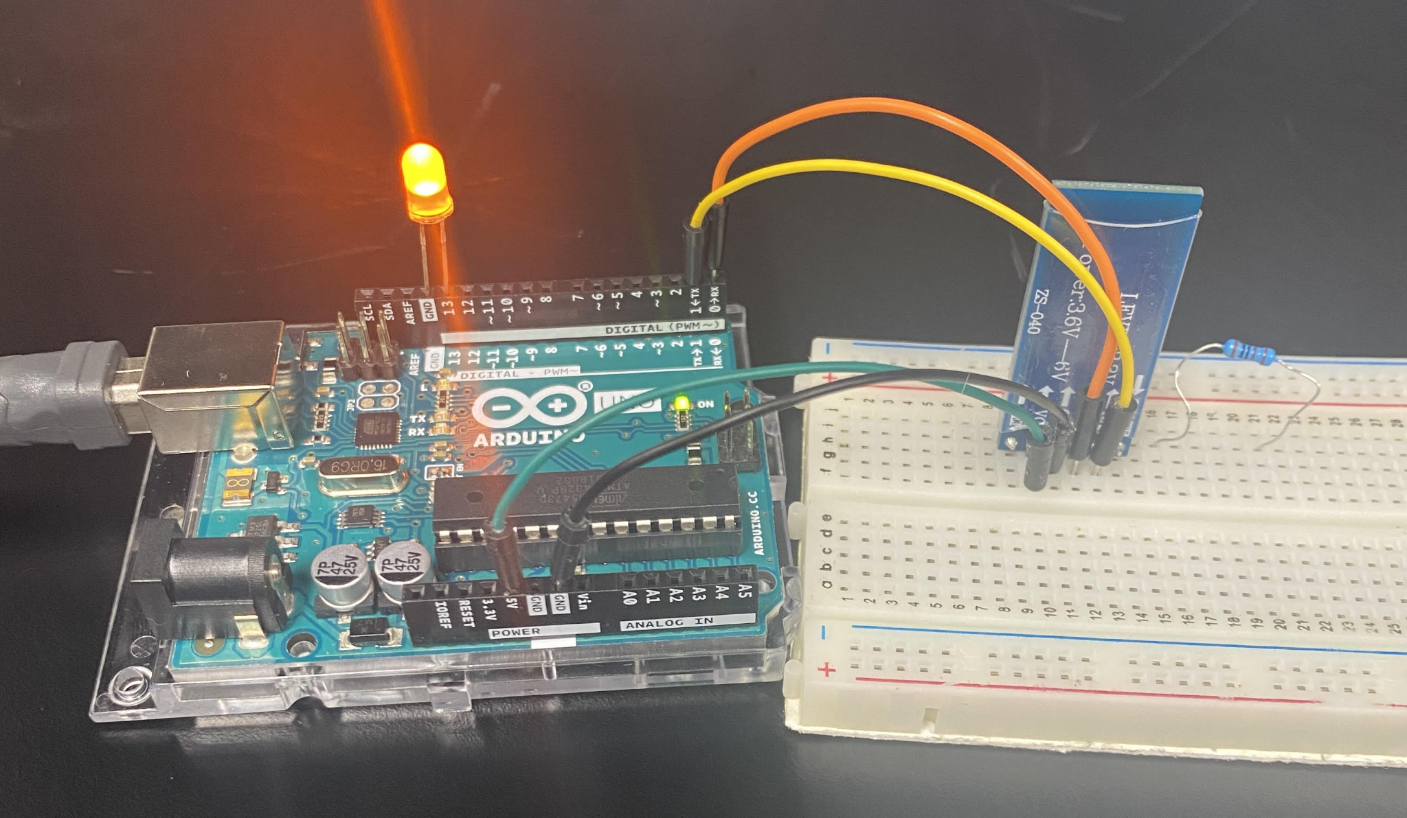
Setting Up
Connect…
Arduino UNO >> Bluetooth
5V >> VCC
GND >> GND
(1 TX) >> RX
(0 RX) >> TX
Place LED Pin in Port 13 & GND
Add resistor to breadboard
NSF REU Research Experience on Internet of Things 2022

Slide 5
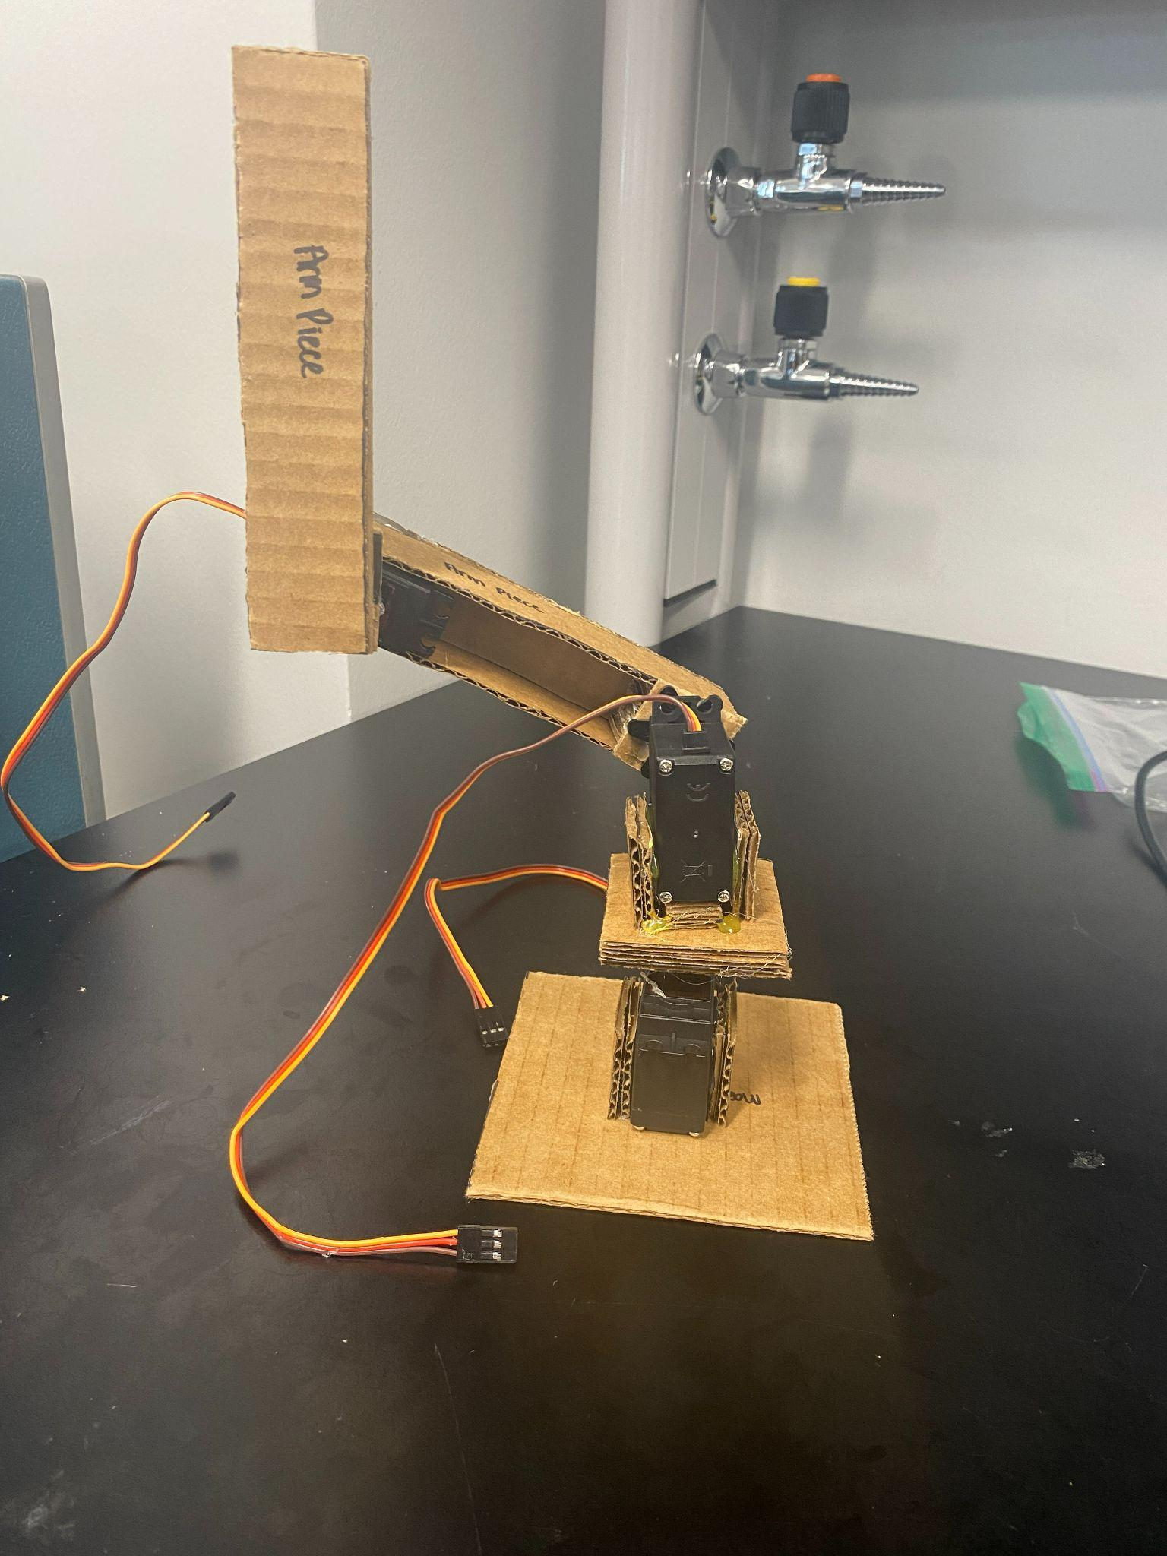
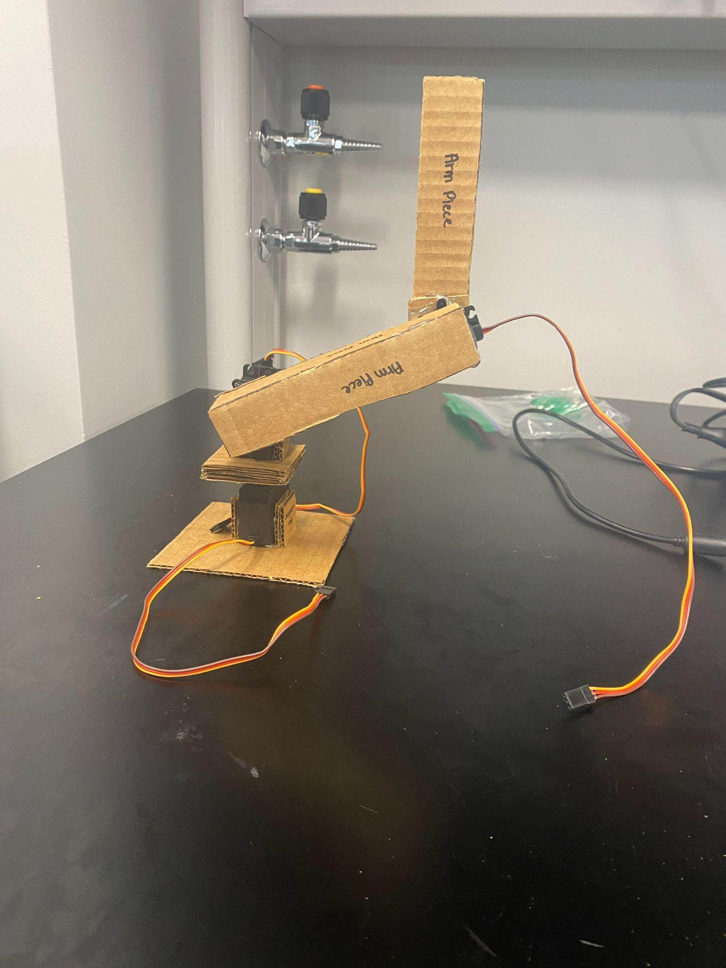
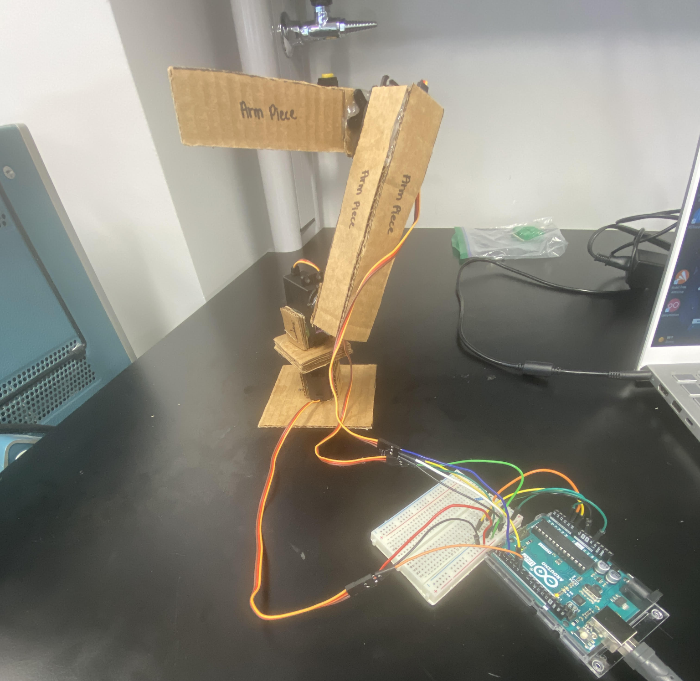
Built a Cardboard Robot Arm
Note: The electrical Robot arm will be used to dip the sensor into the water.
NSF REU Research Experience on Internet of Things 2022

Slide 6
Accomplishments:
1.Created Bluetooth connection sequence for Arduino Uno(or any sensors).
2.Added other electrical elements to the circuit that might be helpful to the project.
3.Started working on temperature sensor.
4.Managed to get DC motors running using Arduino Uno and L293D Motor Driver.
5.Waterproofing DC motors.
NSF REU Research Experience on Internet of Things 2022

Slide 7
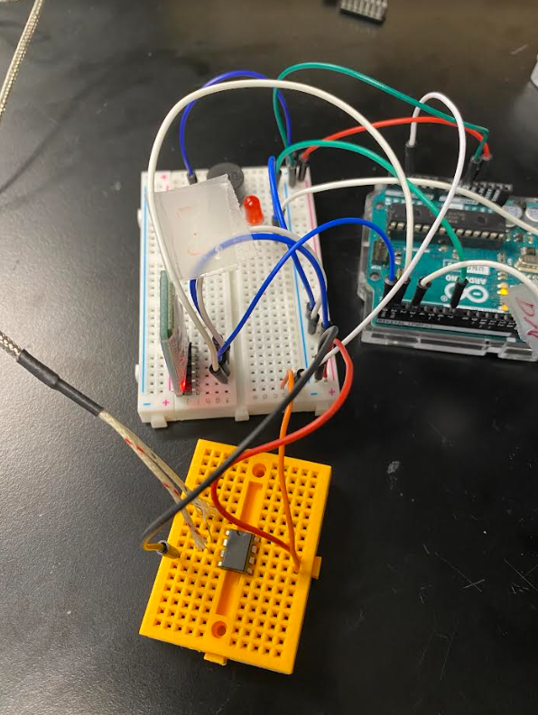
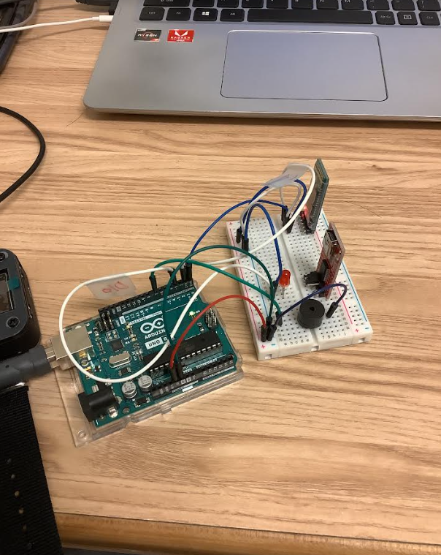
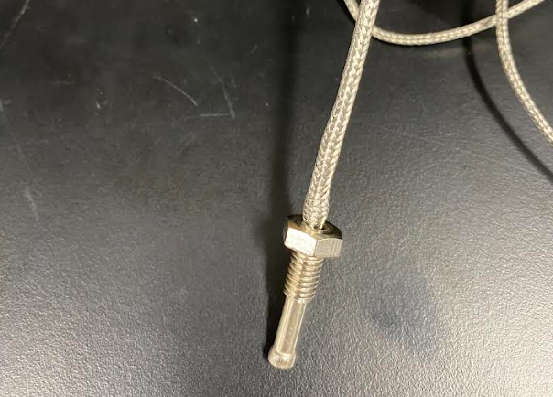
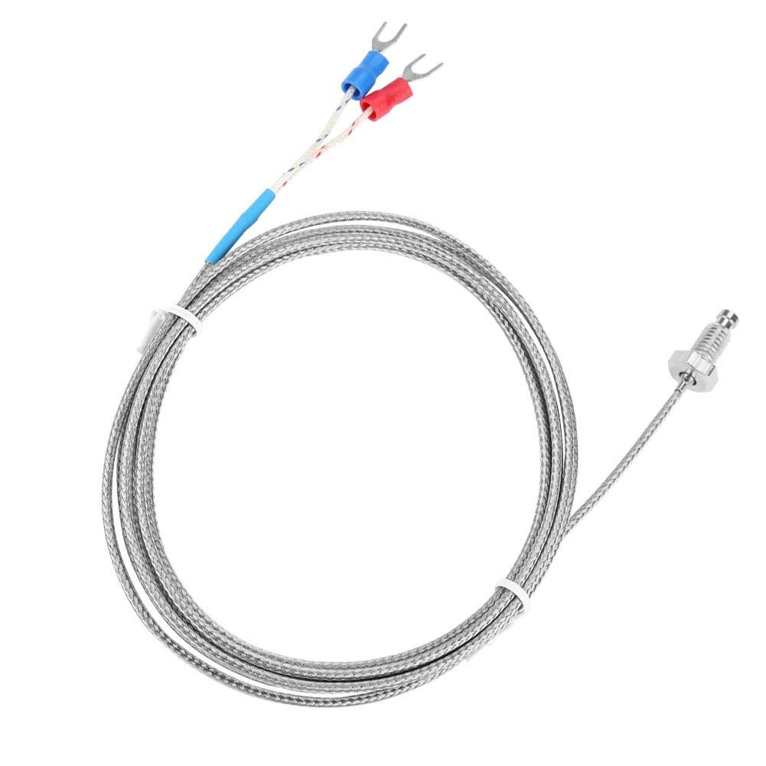
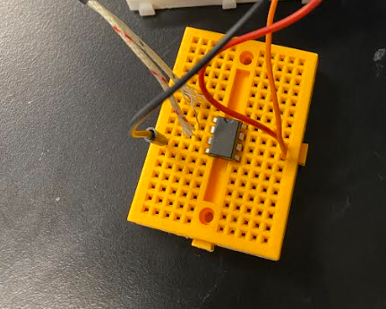
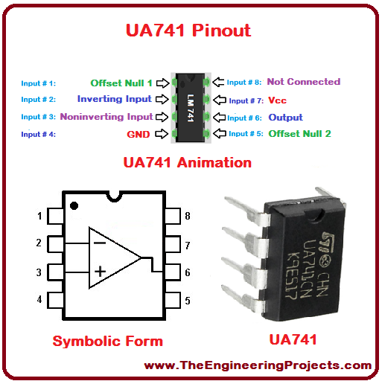
Arduino Circuit
2nd UART
Serial Adapter
LED
Type K Thermocouple Temp. Sensor
+Vcc(5V)
Vout
Vout connected to Analog to Digital
Converter(ADC) on Arduino Uno
Piezo Buzzer
-Vcc(GND)
+Vin
-Vin
Op Amp
NSF REU Research Experience on Internet of Things 2022

Slide 8
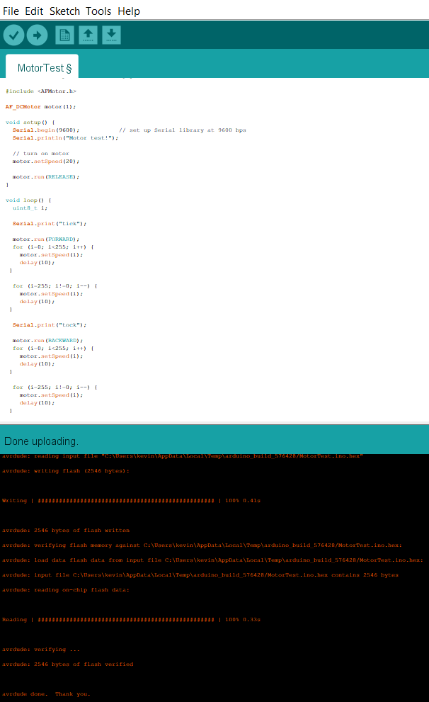
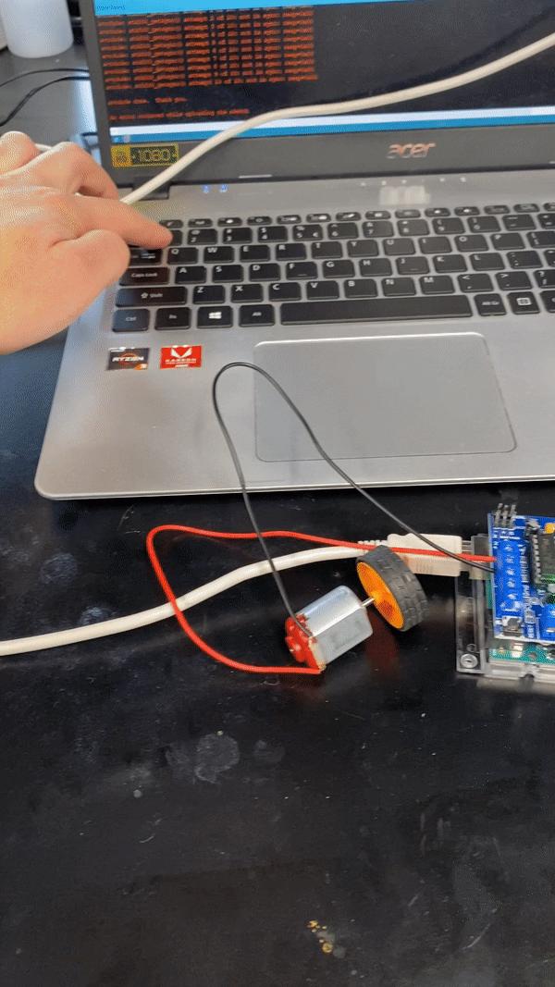
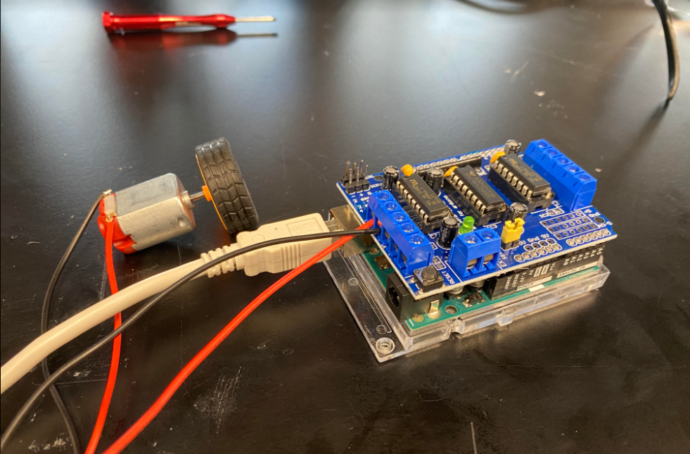
L293D Motor Driver
NSF REU Research Experience on Internet of Things 2022

Slide 9
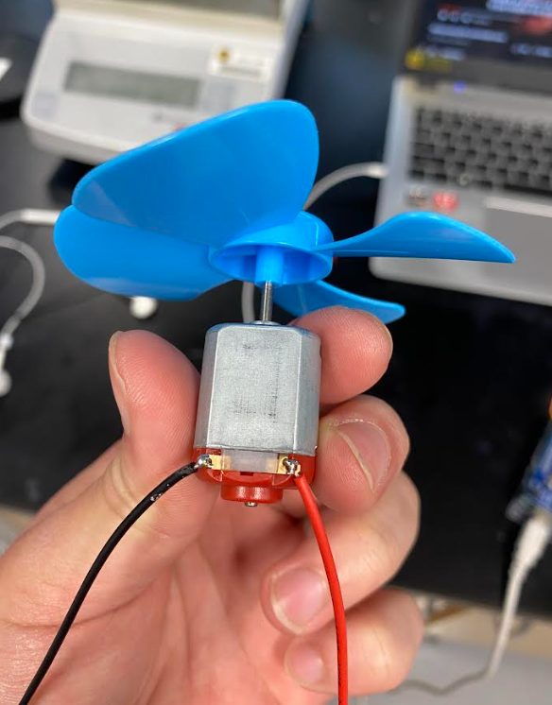
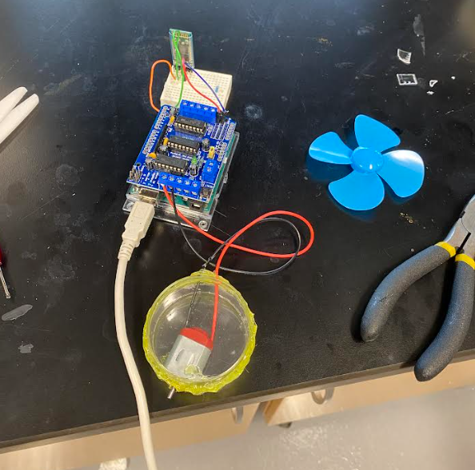
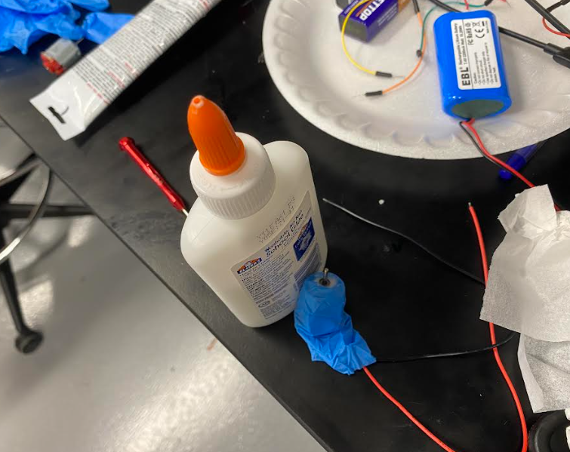
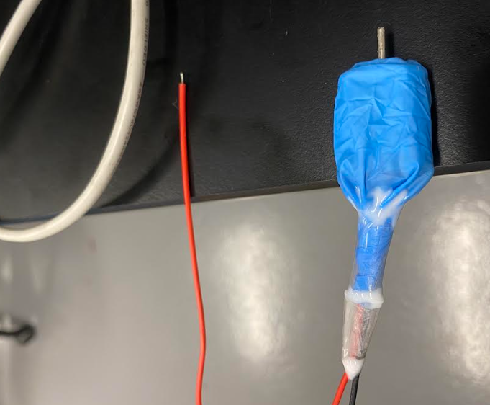
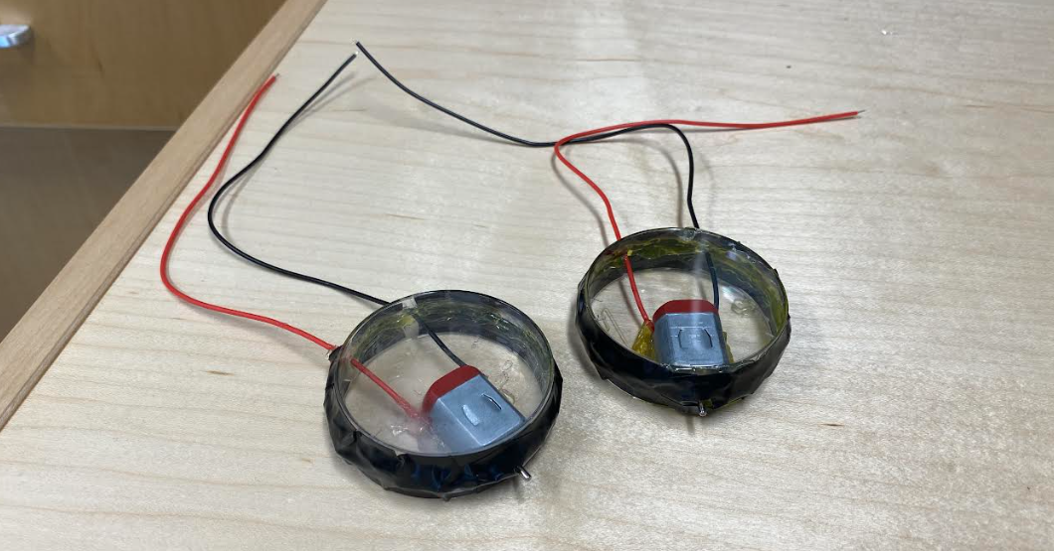
Waterproofing DC motor
Design 1: Design 2:
NSF REU Research Experience on Internet of Things 2022

Slide 10
Problems & Solutions
NSF REU Research Experience on Internet of Things 2022

Slide 11
Problems and solutions
Temperature sensor is not very sensitive to ambient changes and has a very small change in potential(in mVs). To solve that we tried to use an Op Amp and see if we can amplify the potential.
Motors would sometimes refuse to receive instructions/have delays in performance. Solution: rewiring circuit, soldering wires to pins.
The motor driver needs power supply and it’s not ideal to use a Bluetooth module when you still need a cord to power the circuit. Tried with the 9V battery and rechargeable 7.4V battery but still having issues(single 9V is not supplying enough current and 7.4V battery seems to be broken and can’t charge).
The DC motors are not waterproof, so we tried to provide it with a protective case. Water leakage will still happen but most likely it won’t be serious.

Slide 12
Plans For Next Week
Continue to work on the electric robot arm by writing code to control it
Try rewiring Op Amp again and see if it can pick up the temperature reading.
Find another power source for the motor driver(power bank maybe?)
Electrodeposition(Hopefully).
NSF REU Research Experience on Internet of Things 2022

