Slide 1
The Interaction of Animal Furs with Water Flow to Identify Biologically-Driven Anti-Fouling Mechanisms
Week 4 (June 6 – June 10, 2022)
Alex Carter and Douglas Shu Dr. Andrew Dickerson, Milos Krsmanovic, Dr. Damla Turgut
NSF REU Research Experience on Internet of Things 2021

Slide 2
Accomplishments

Slide 3
MATLAB Code Development
Added marker to identify point being tracked to calculate delta
Found inconsistent tracked point on fur
Changed tracked point from midline point to bottom point of tip of fur
Automated exporting of data
Obtained results from wavelet calculations, curve fitting function, and Fourier Transform graph
More on issues slide
NSF REU Research Experience on Internet of Things 2021

Slide 4
Physical Experiment
Took a few hundred more videos
Increased efficiency using direct hose to fill keg
Stopped making flow cells due to reuse capabilities
Determined how to compress both .AVI and .TIF files to magnitudes less in size
HandBrake
IrfanView
NSF REU Research Experience on Internet of Things 2021

Slide 5
Issues and How They Were/ Will Be Tackled

Slide 6
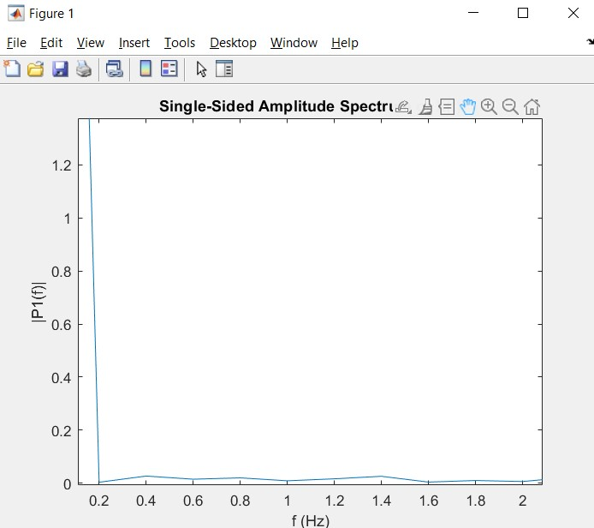
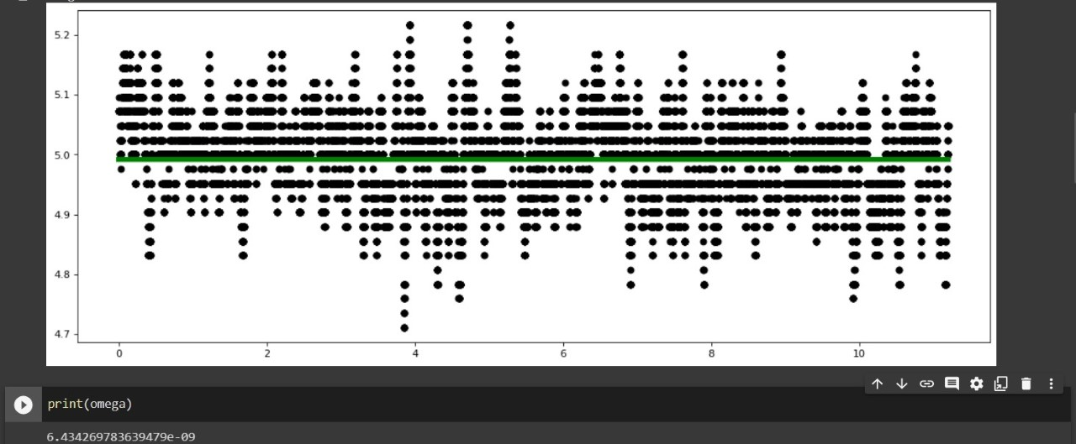
MATLAB + Python Code Development
NSF REU Research Experience on Internet of Things 2021

Slide 7
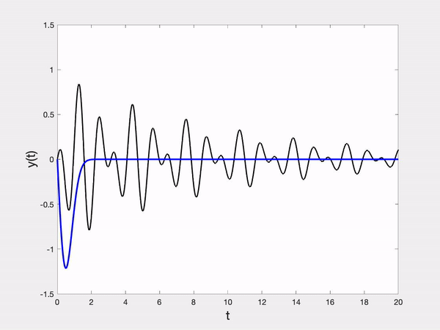
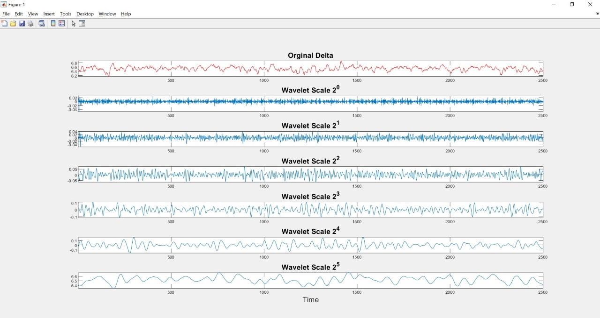
MATLAB Code Development
NSF REU Research Experience on Internet of Things 2021

Slide 8
Physical Experiment
Bubbles in videos
Solved by running high flow rate through cells to knock bubbles off fur
Debris from tap water attaches to fur
Solved by emptying flow cell then flushing system with high velocity fluid to knock off unwanted substances
25-gauge needle head keeps breaking
Solutions?
NSF REU Research Experience on Internet of Things 2021

Slide 9
Plans for Next Week

Slide 10
Final Notes
Take hundreds more videos
Use terrestrial mammal fur
Start varying fluid density and viscosity during experiments
Keep working to identify useful data from currently available data sets
Start developing Machine Learning split for training and test sets in Python
Choose model types to utilize during machine learning (i.e. Random Forest Regressor or Multi-Layer Perceptron)
NSF REU Research Experience on Internet of Things 2021

