Slide 1
The Interaction of Animal Furs with Water Flow to Identify Biologically-Driven Anti-Fouling Mechanisms
Week 2 (May 22 – May 27, 2022)
Alex Carter and Douglas Shu Dr. Andrew Dickerson, Milos Krsmanovic, Dr. Damla Turgut
NSF REU Research Experience on Internet of Things 2021
Notes:
Good title slide
Split up more based on accomplishments, issues, and future work! More of a flow

Slide 2
Accomplishments
NSF REU Research Experience on Internet of Things 2021
Notes:
Good title slide
Split up more based on accomplishments, issues, and future work! More of a flow

Slide 3
Time Log
Variable amount
How many of each variable
How long videos would take for each group of variables
Variable inputs are:
Fiber length
Fur type
Flow rate
Density of fluid
Viscosity of fluid
NSF REU Research Experience on Internet of Things 2021
Notes:
Figures for publications must be in pdf format (easiest)
You can write list of materials
Note if these animals are in East Tennessee: many projects start at home

Slide 4
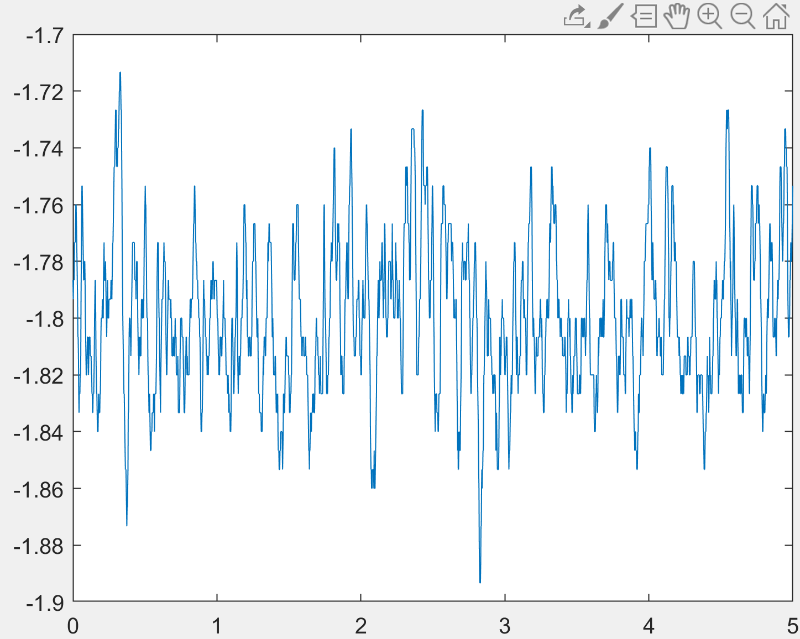
MATLAB Code Development
$$δ$$
NSF REU Research Experience on Internet of Things 2021

Slide 5
Physical Experiment
Ran Initial Experiments
Zipties, pliers, nail polish, epoxy, UV glue
Setting up a new flow cell
Tested more variable sets
Set camera to desired exposure to make binarization easier
NSF REU Research Experience on Internet of Things 2021
Notes:
Figures for publications must be in pdf format (easiest)
You can write list of materials
Note if these animals are in East Tennessee: many projects start at home

Slide 6
Struggles and How They Were Handled
NSF REU Research Experience on Internet of Things 2021
Notes:
Good title slide
Split up more based on accomplishments, issues, and future work! More of a flow

Slide 7
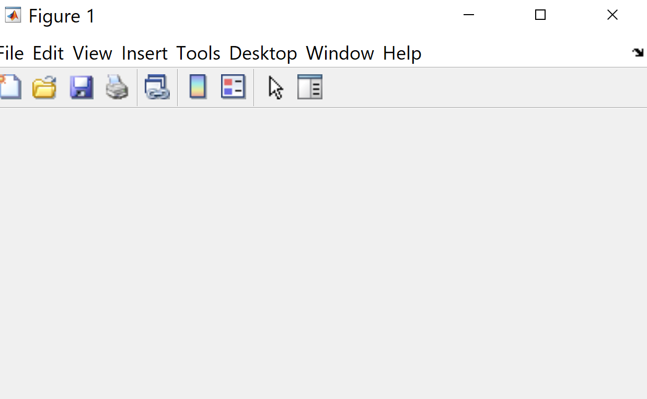
MATLAB Code Development
$$δ$$
Cropping Issue
Subtraction of Initial Image
NSF REU Research Experience on Internet of Things 2021

Slide 8
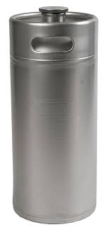
Physical Experiment
Ran Initial Experiments
Leak through porous laminizers
Nail Polish Porous Surfaces
Leak in keg
Epoxy to fix
Leak through flow cell
Fixed with gorilla glue
NSF REU Research Experience on Internet of Things 2021
Notes:
Figures for publications must be in pdf format (easiest)
You can write list of materials
Note if these animals are in East Tennessee: many projects start at home

Slide 9
Plans For Next Week
NSF REU Research Experience on Internet of Things 2021
Notes:
Good title slide
Split up more based on accomplishments, issues, and future work! More of a flow

Slide 10
Future
Print remaining flow cells for experiments
Plans to continue taking fast capture videos of furs in flow
Continue
Continue Machine Learning code in Python
Variable initialization complete and packages loaded
NSF REU Research Experience on Internet of Things 2021

