Slide 1
Project #:4 Machine learning-based disaster resilient microgrid design and management
REU Students: Paco-Jaleel Balthazar, Anthony Bishop-Gylys
Graduate Students: Fazlullah Hakimi Faculty mentor(s): Qun Zhou Sun, Damla Turgut.
Week #7 (June 27 - July 1)
Accomplishments:
Great progress on the poster
Finished bug testing Storage.py
MVP for Storage class finished
Problem & Solutions
Problem: Basic Q-Learning deemed inadequate for power management system
Solution: Deep Q-Learning will be implemented to avoid training bottlenecks
Plans for next week:
Finish poster
Fix power management system
Continue work on paper
NSF REU Research Experience on Internet of Things 2022

Slide 2
Project #:4 Machine learning-based disaster resilient microgrid design and management
REU Students: Paco-Jaleel Balthazar, Anthony Bishop-Gylys
Graduate Students: Fazlullah Hakimi Faculty mentor(s): Qun Zhou Sun, Damla Turgut
Week #7 (June 27 – July 1)
Themes:
Poster work and more power management training bottlenecks
NSF REU Research Experience on Internet of Things 2022

Slide 3
Notes:
To-do:
Change font to be more readable (maybe to Calibri? See if you can copy paste from PDF example to see what they used)
Compare font size with example posters by printing to PDF
Implement as many figures as example posters (Background would be a good one, maybe tables in open-source modeling)
Thinking graph comparison with previous self-discharge function and new self-discharge function

Slide 4
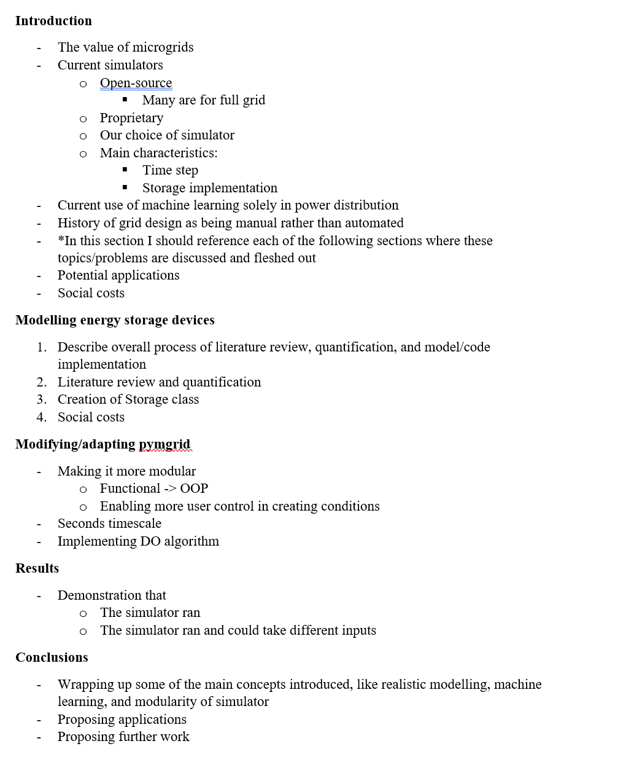
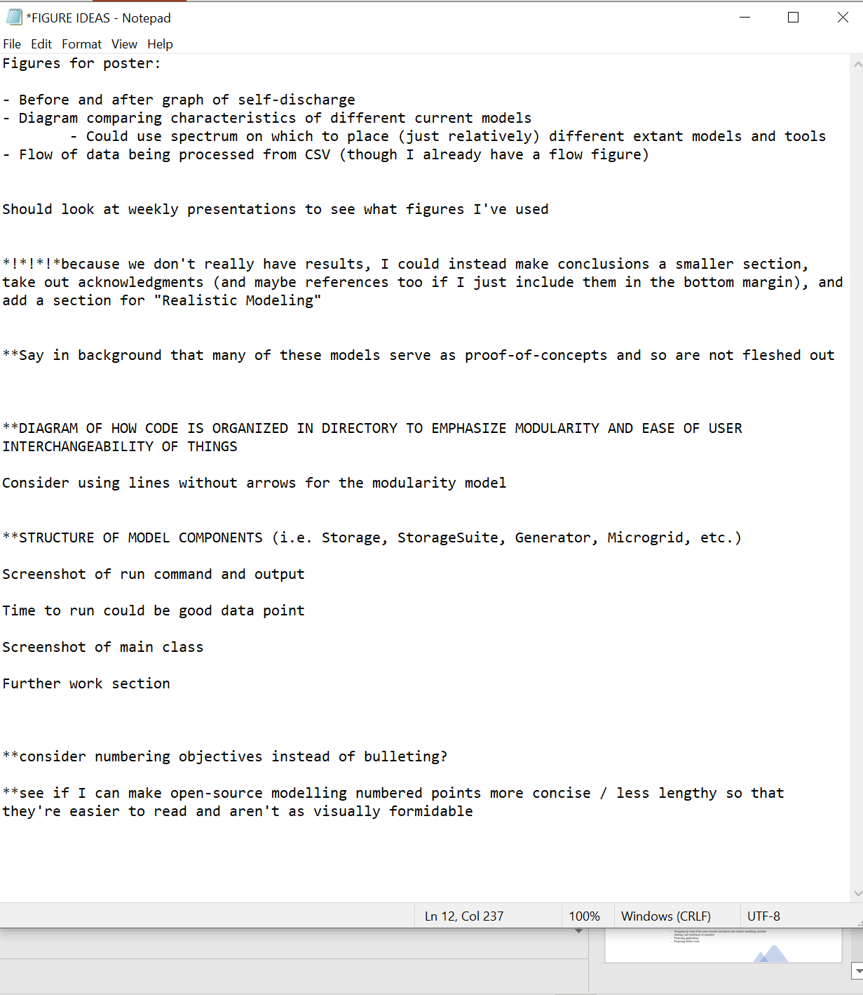
Outlines and Notes

Slide 5
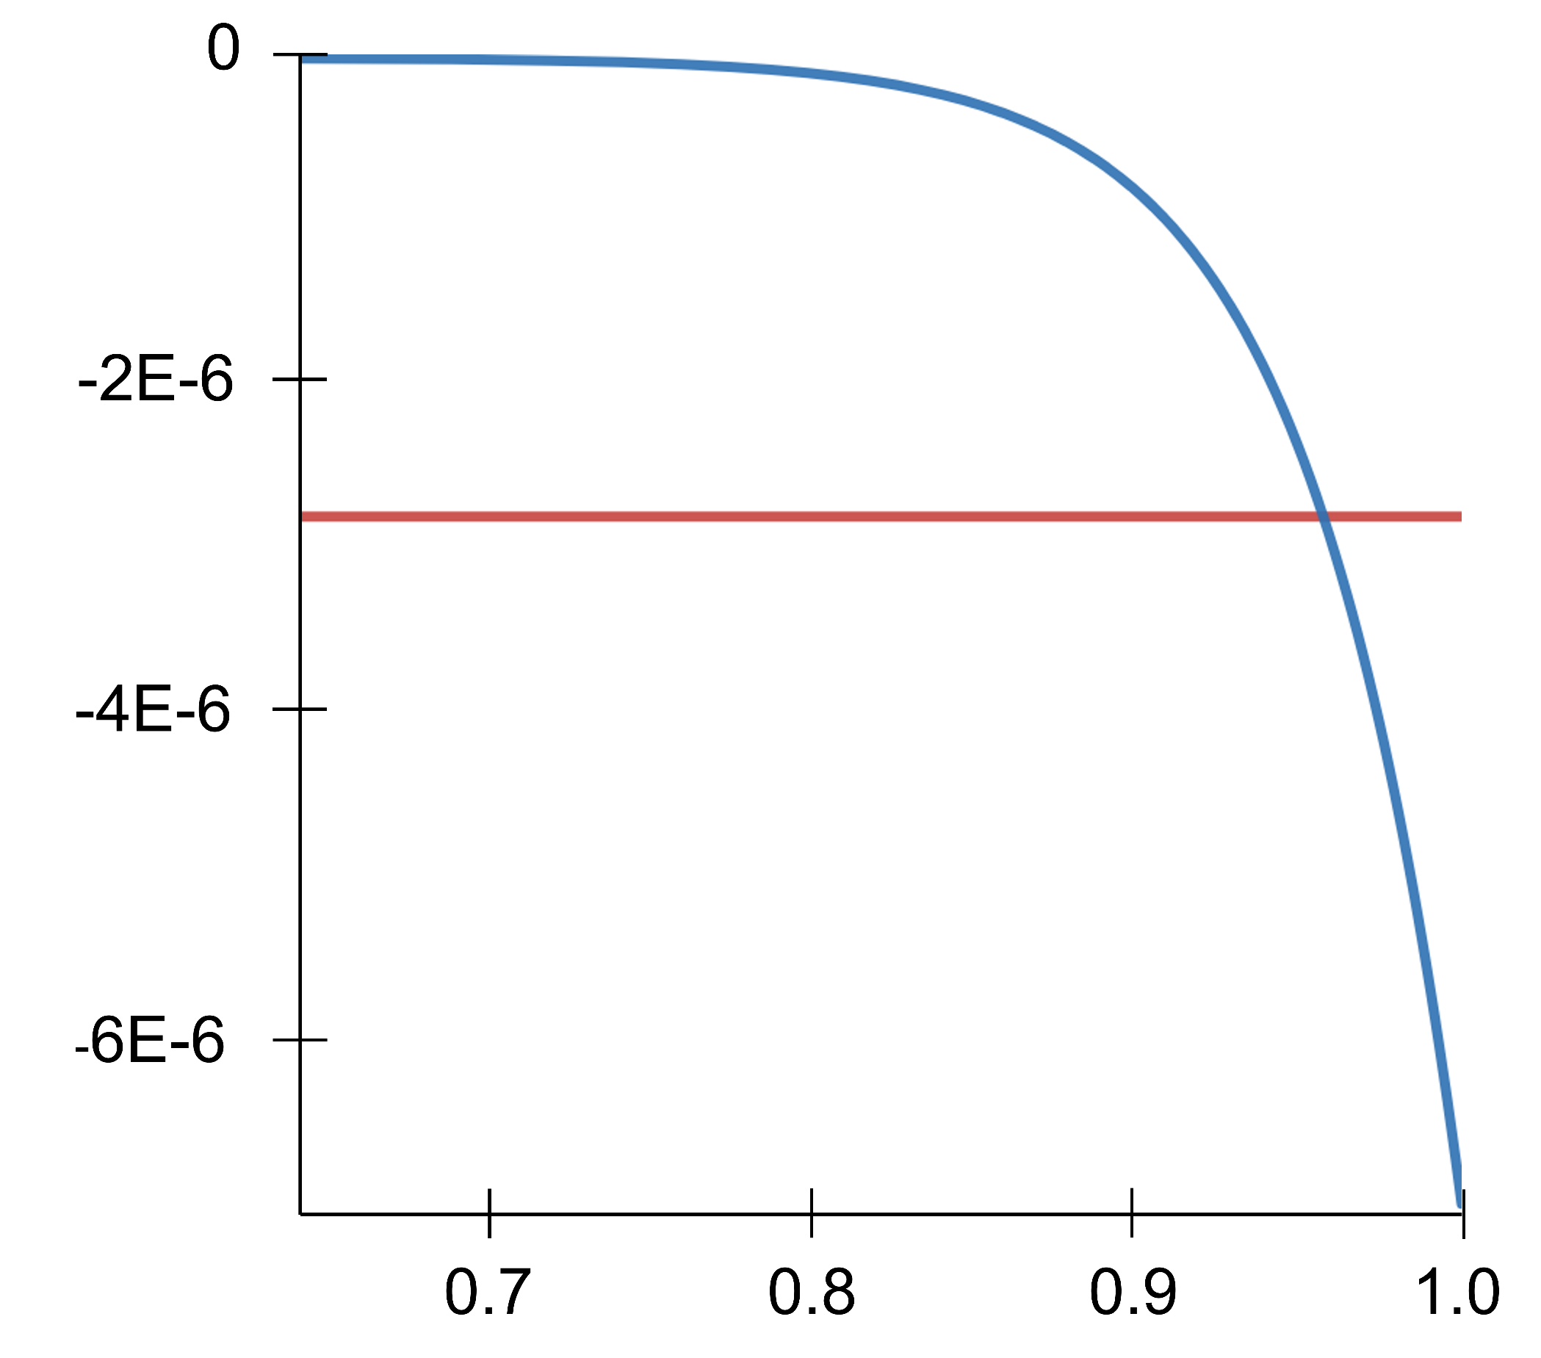
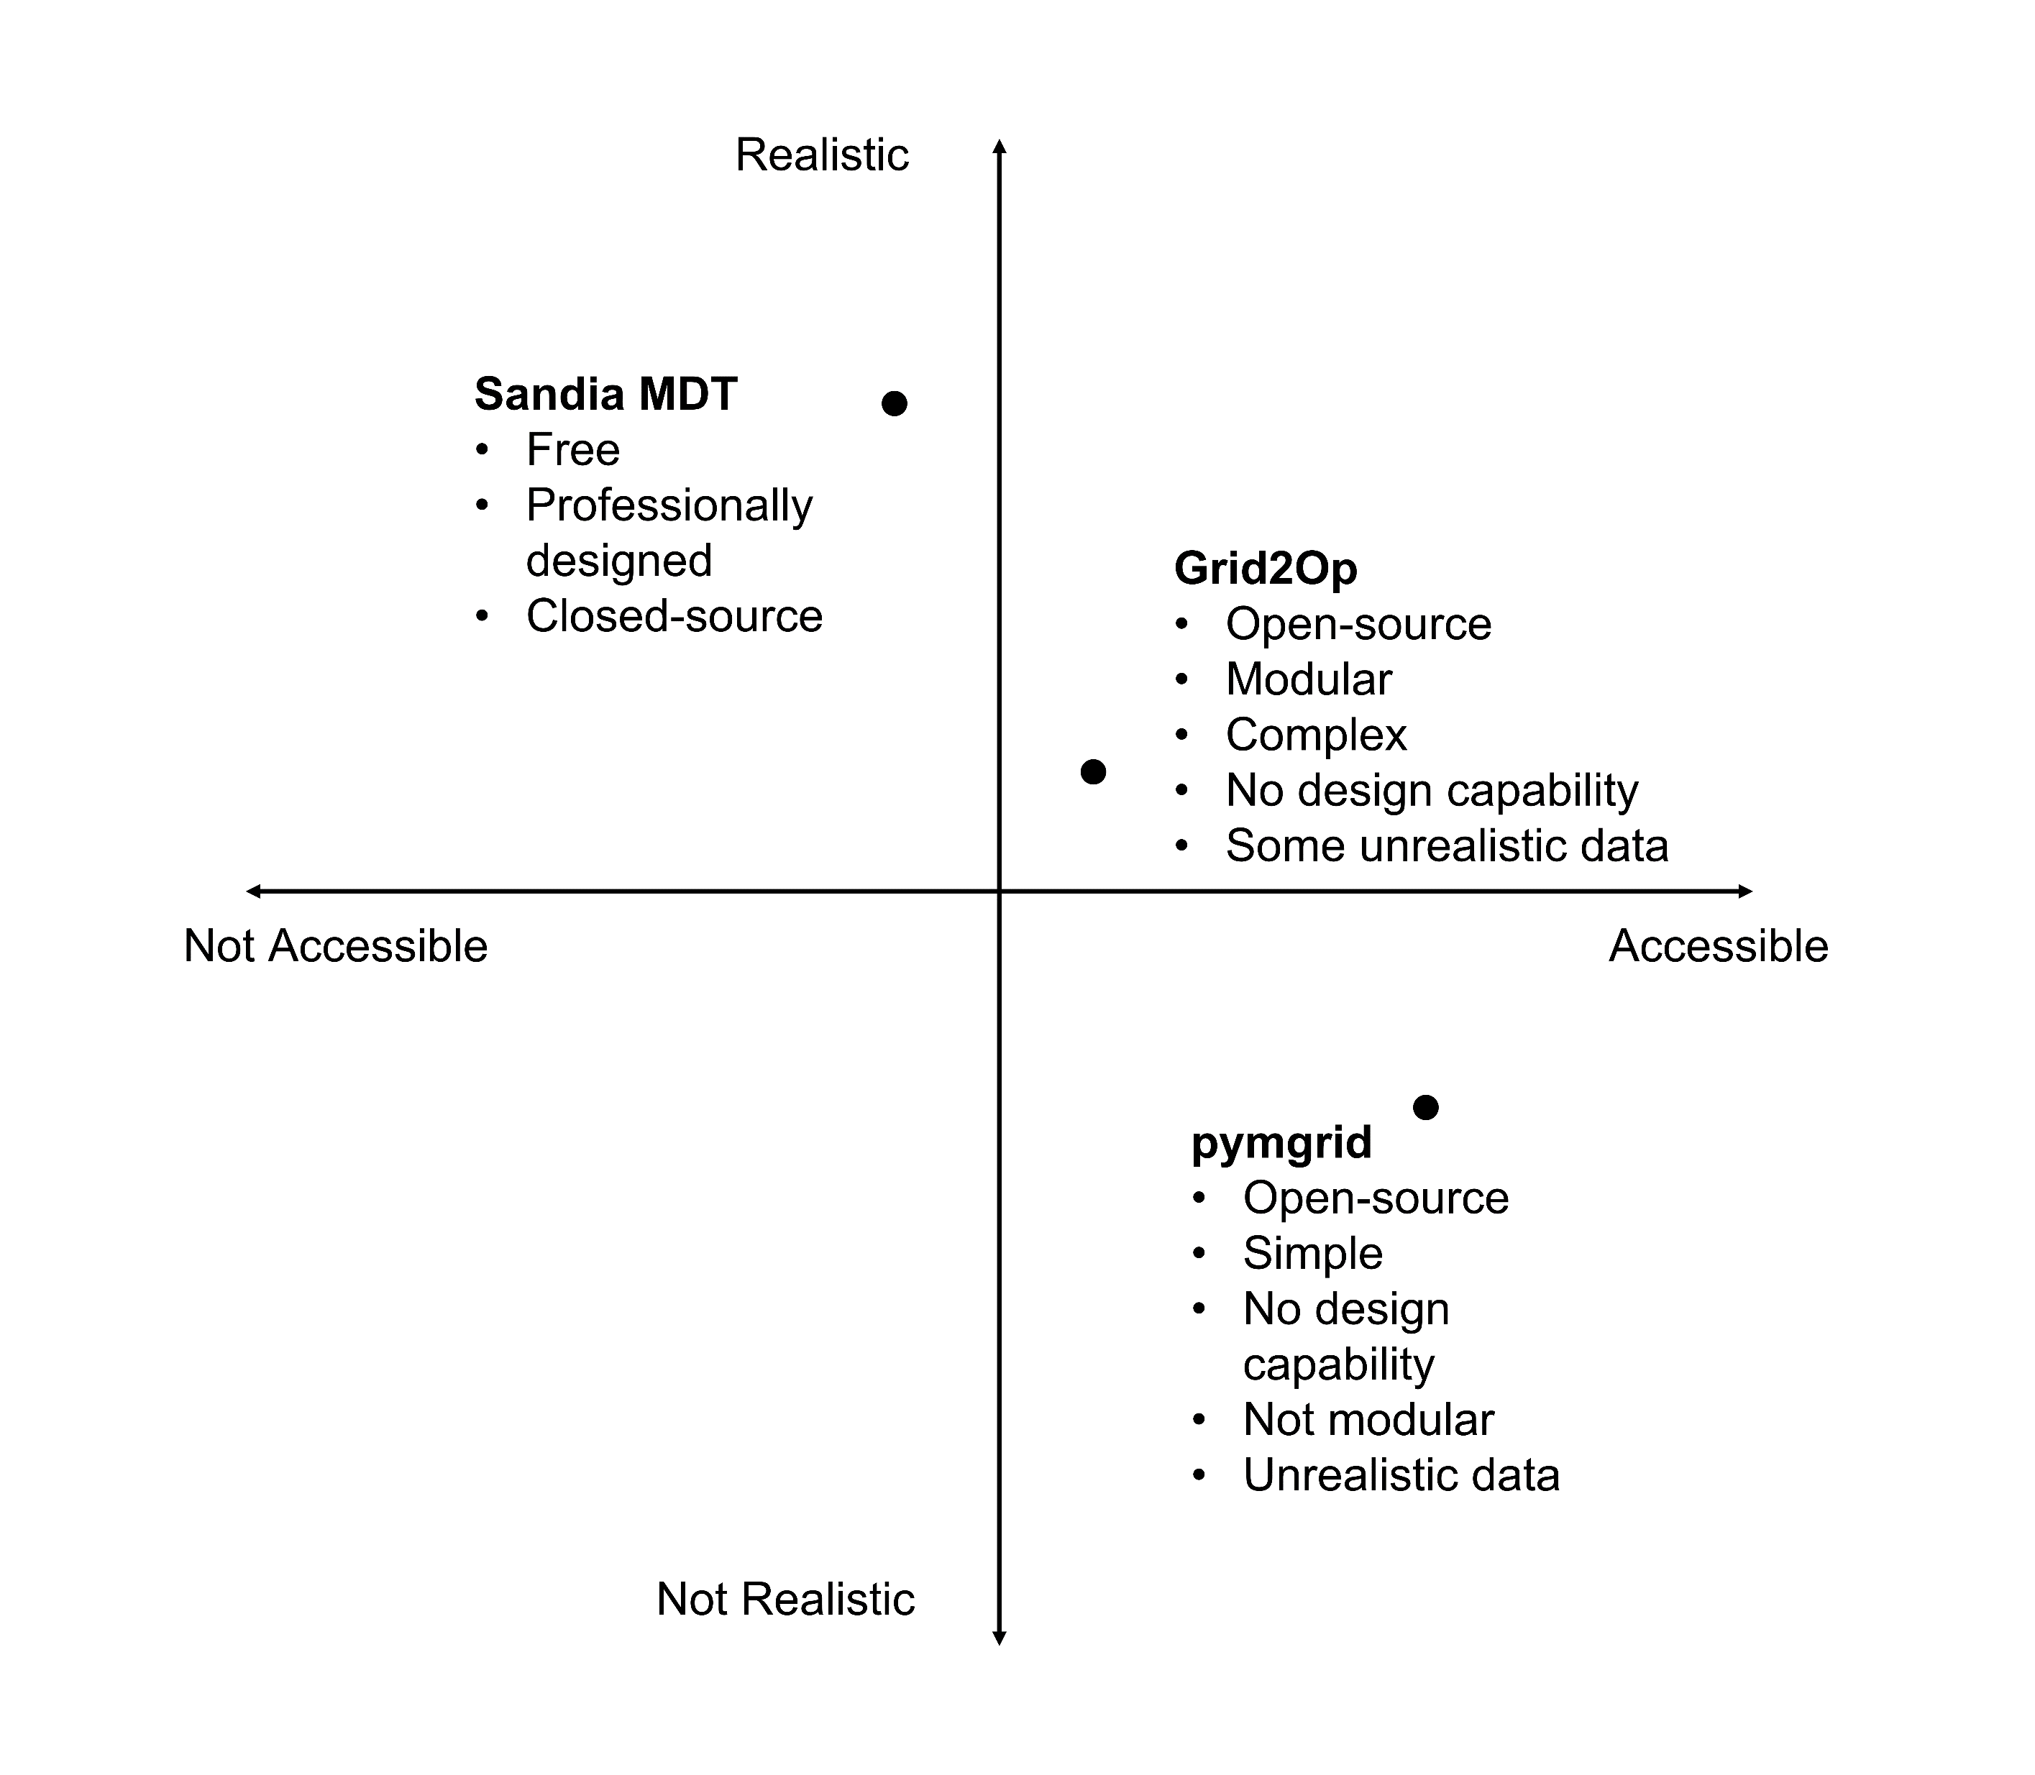
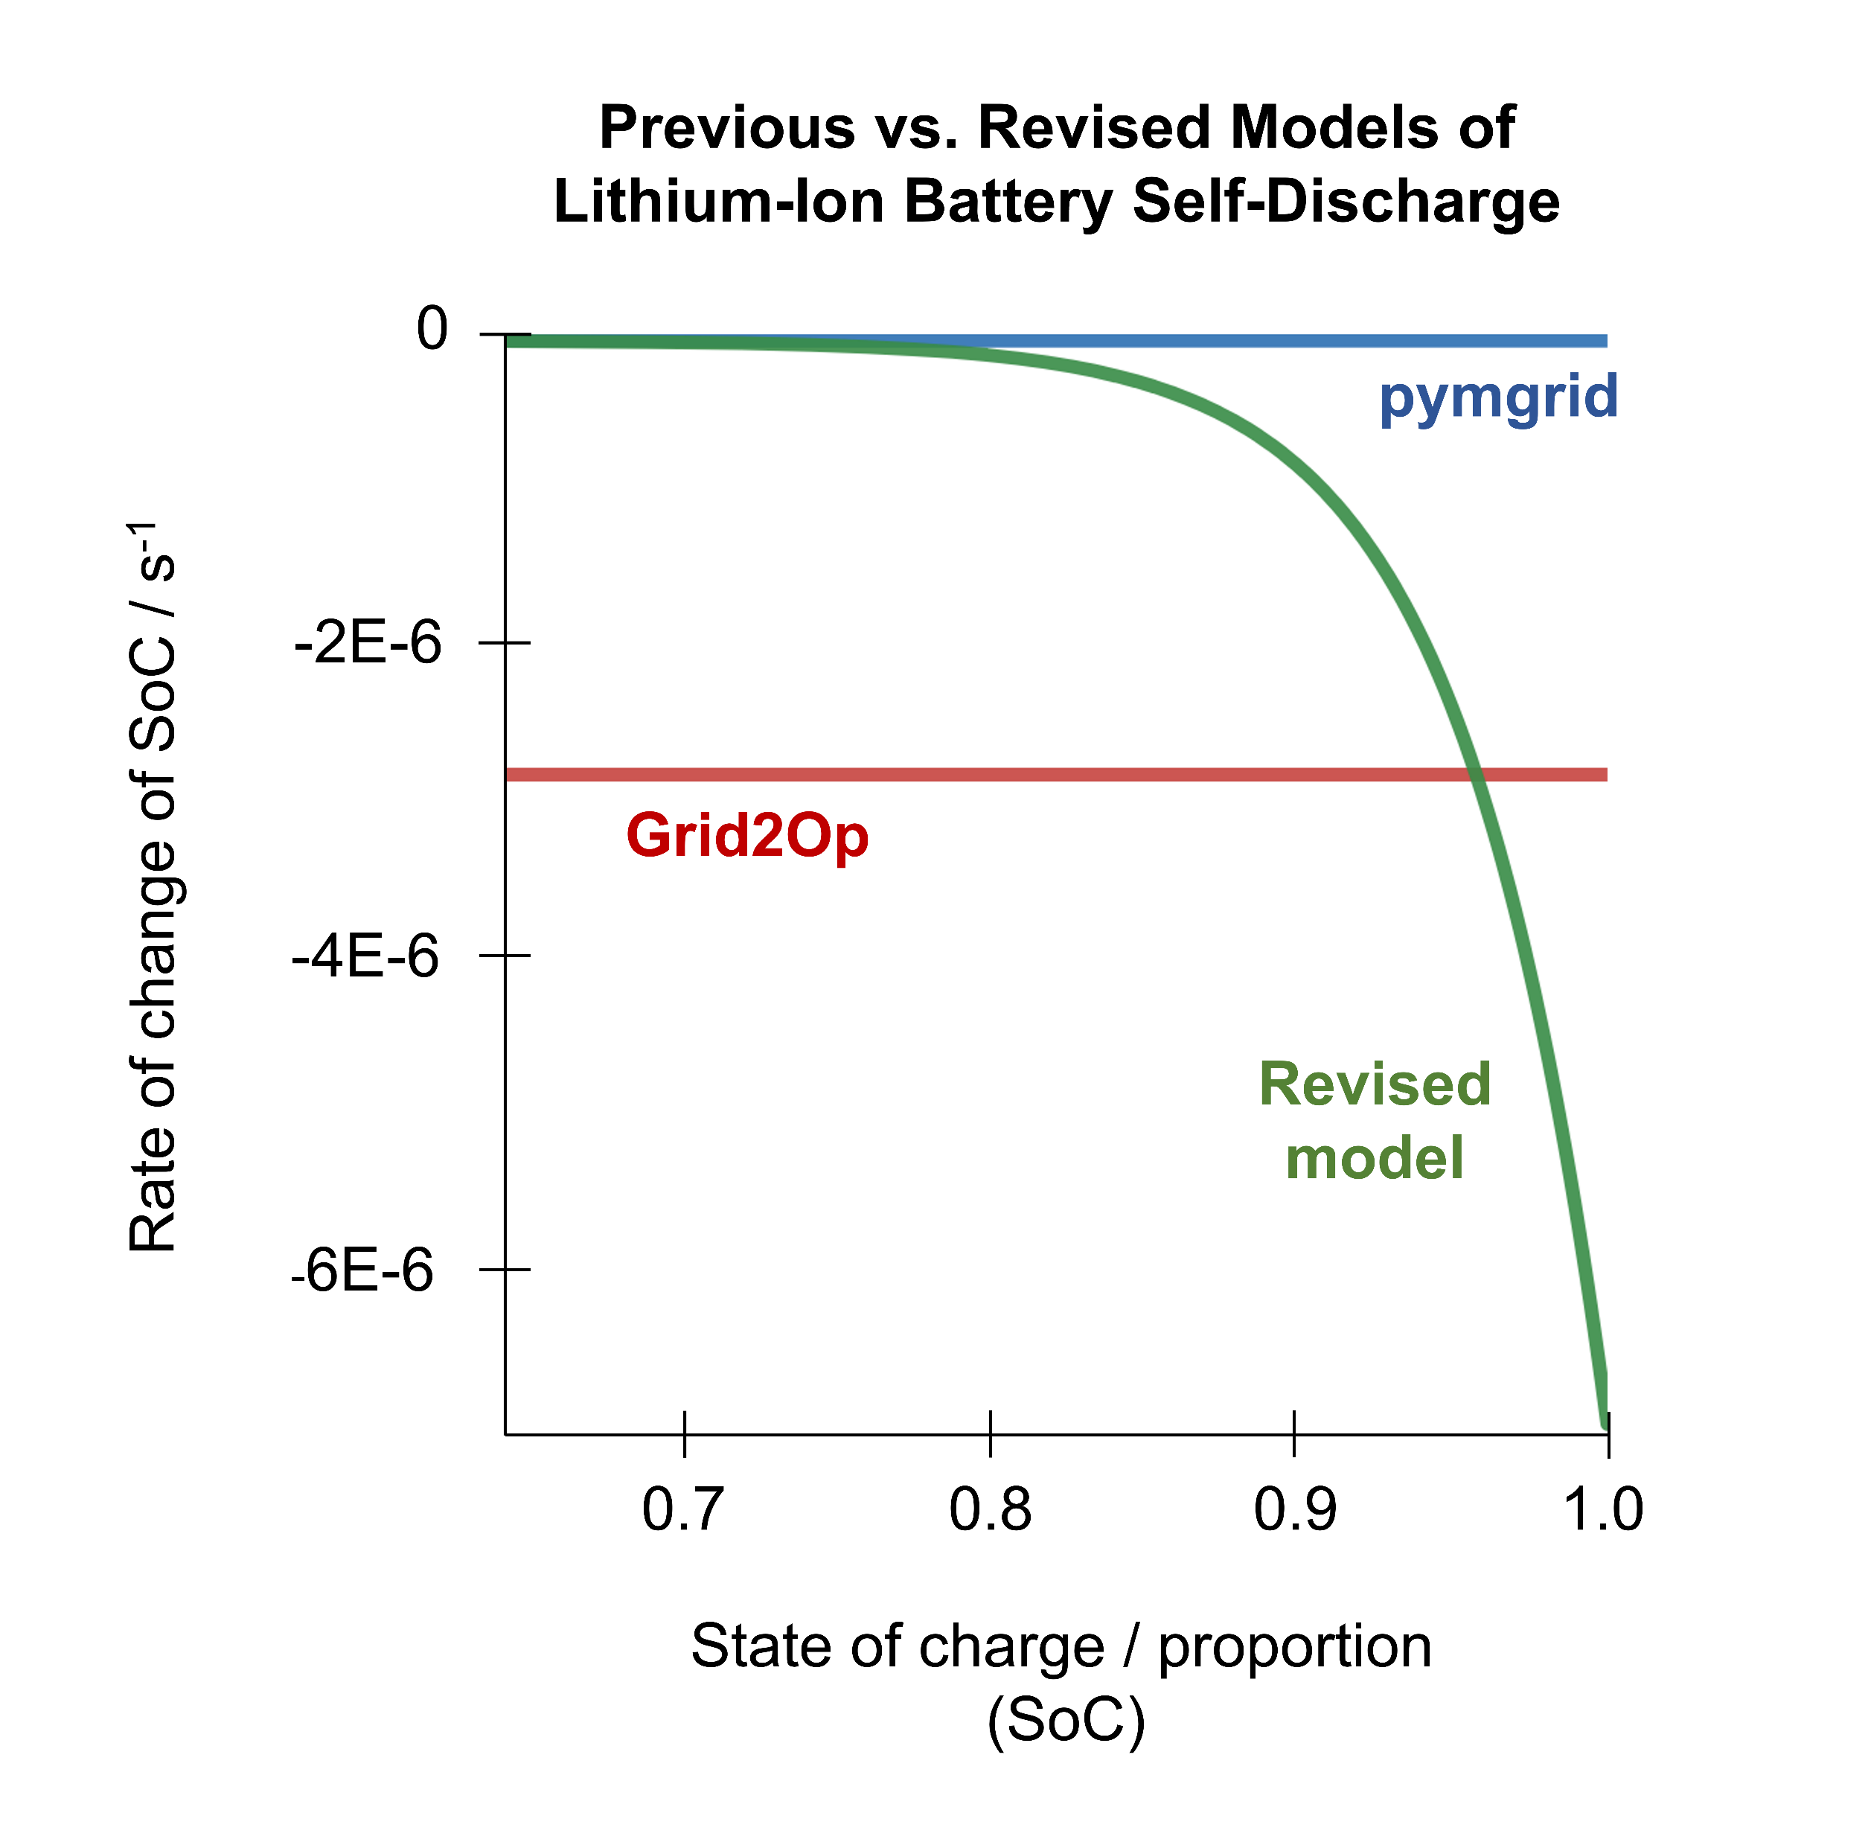
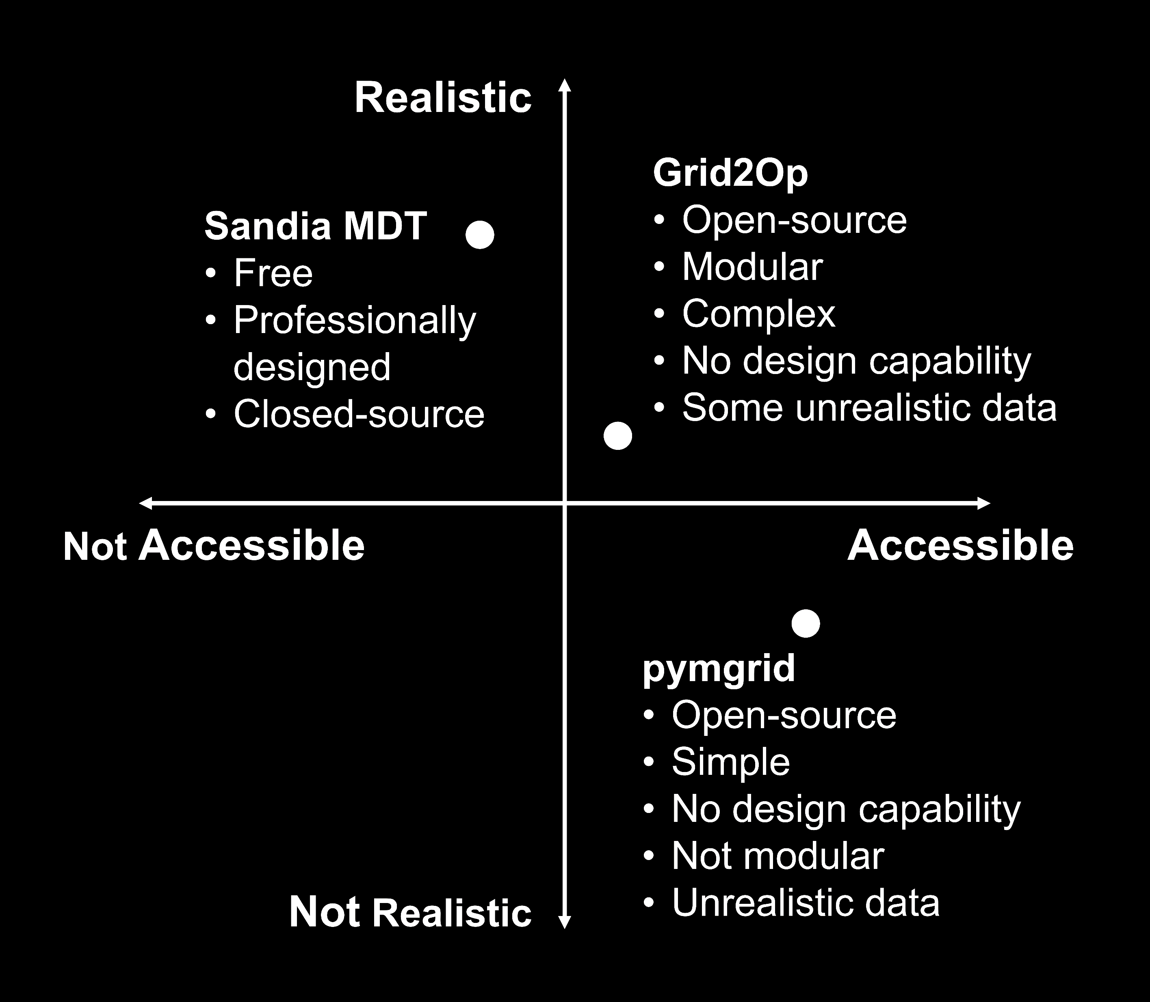
Figure Development

Slide 6
Q-Learning Vs Deep Q-Learning
Q-Learning |  | Deep Q-Learning
Q-Learning iterates through a table of state-action pairs and assigns each a given score. A fully trained table has score values for every state-action pair |  | Deep Q-learning uses a deep neural network to predict the score of a given state-action pair by fitting its output to a function.
Pros | Cons | Pros | Cons
Fast for small state spaces | Training time increases exponentially with every additional parameter | Can handle larger state spaces without exponential increase in training time | More complex
Simple |  |  | Slow
Score output is precise |  |  | Score output is approximate
NSF REU Research Experience on Internet of Things 2022

Slide 7
What’s Next?
Write Deep Q-Learning Algo
Implement design algo into simulator
Begin testing prebuilt and random grid designs in normal and disaster scenarios
Continue designing poster
Continue writing paper
NSF REU Research Experience on Internet of Things 2022

