Slide 1
Project #:4 Machine learning-based disaster resilient microgrid design and management
REU Students: Paco-Jaleel Balthazar, Anthony Bishop-Gylys
Graduate Students: Fazlullah Hakimi Faculty mentor(s): Qun Zhou Sun, Damla Turgut.
Week #4 (June 6- June 10)
Accomplishments:
Documented the structure of the Pymgrid simulator
Finished compiling data on remaining energy storage devices
Implemented second timescale processing to parts of the Pymgrid simulator
Problem & Solutions
Problem: All data was not on a 1 second timescale
Solution: Automatic interpolation function implemented to convert all Pymgrid data to 1 second timescale using linear interpolation
Plans for next week:
Finish implementing second timescale data processing to Pymgrid
Start the mid-term report
Finalize literature report and source sorting
Compile more data to feed simulator
NSF REU Research Experience on Internet of Things 2022

Slide 2
Project #:4 Machine learning-based disaster resilient microgrid design and management
REU Students: Paco-Jaleel Balthazar, Anthony Bishop-Gylys
Graduate Students: Fazlullah Hakimi Faculty mentor(s): Qun Zhou Sun, Damla Turgut
Week #4 (June 6 - June 10)
Themes:
Simulator modifications, data formatting, and custom class creation
NSF REU Research Experience on Internet of Things 2022

Slide 3
Committing Pymgrid’s structure to memory
We developed a 71-slide presentation on how each function in the Pymgrid simulator is implemented, including its outputs and inputs.
Pymgrid has a total of 67 individual function (__init__ functions included)
NSF REU Research Experience on Internet of Things 2022

Slide 4
Data interpolated
Data interpolation involves estimating a value based on its surrounding values.
Most data we found was in the wrong timescale, an interpolation loop was needed
NSF REU Research Experience on Internet of Things 2022

Slide 5
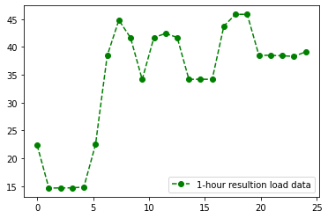
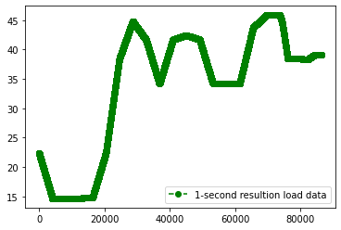
Load data after interpolation
Load data before interpolation
NSF REU Research Experience on Internet of Things 2022

Slide 6
Interpolation Function
def inter(df,original_size):
i=1
while True:
if df.shape[0] == DAY:
df = df.interpolate()
return df
elif i % 2 != 0:
if i > (original_size*2)-1:
df = df.interpolate(method='linear')
return df
else:
np_arr = df.to_numpy(dtype=float)
np_arr = np.insert(np_arr,i, np.nan)
df = pd.DataFrame(np_arr, columns=['Value'],)
i = i+1
For aspiring data scientists: Converting a dataframe into a numpy array and working on it directly sometimes works faster than doing operations on it directly.
NSF REU Research Experience on Internet of Things 2022

Slide 7
Energy Storage Modeling
Refined input data for easier human and machine readability
Documented Storage class in code
Debugged and prepared Storage class for integration
NSF REU Research Experience on Internet of Things 2022

Slide 8
Previous self-discharge function
y = 0.1
NSF REU Research Experience on Internet of Things 2022

Slide 9
Complicated self-discharge function
y =
-(233189*e^(-(493*((-(10^12*ln(-e^-((100x-2855)/473)+1)+275221.68)/0.3944)-3275300))/(1.25*10^15)-1567/10^9))/((1.25*10^17)*(1-e^(-(493*((-(10^12*ln(-e^-((100x-2855)/473)+1)+275221.68)/0.3944)-3275300))/(1.25*10^15)-1567/10^9)))
NSF REU Research Experience on Internet of Things 2022

Slide 10
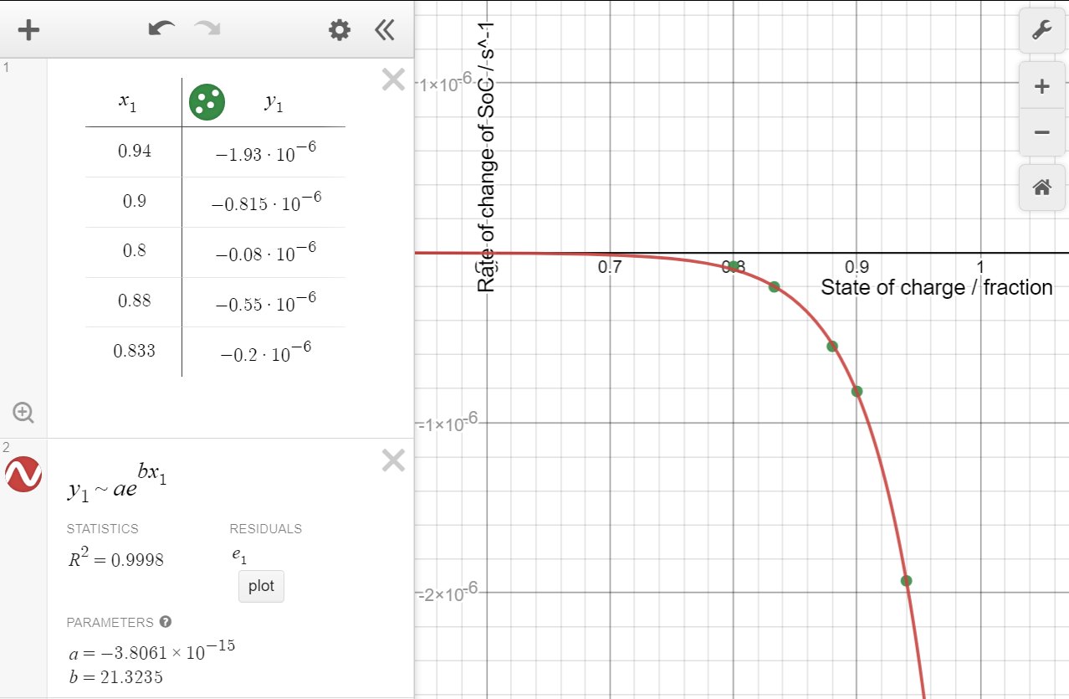
Simplified self-discharge function
[3] T. Deutschen, S. Gasser, M. Schaller, and J. Siehr, “Modeling the self-discharge by voltage decay of a NMC/graphite lithium-ion cell,” J. Ener. Stor., vol. 19. Elsevier BV, pp. 113–119, Oct. 2018. doi: 10.1016/j.est.2018.07.003.

Slide 11
Old and New Energy Storage Data Tables
Complicated Energy Storage Model
Refined Energy Storage Model
NSF REU Research Experience on Internet of Things 2022

Slide 12
Next Steps
How do we take the simulator from only using
to using
in a way that produces a realistic model while remaining simple and straightforward enough for open-source interaction?
Notes:
We’re going to document well
We’re going to take a step back every so often and take a look at our code to make sure we’re not doing anything in a roundabout way
We’re going to look at previously written code to see if we still understand it

