Slide 1
Project #7: IoT Augmented Physical Scale Model of a Suburban Home
Week 7 (June 27 – July 1, 2022)
REU Students: Wahub Ahmed, Abraam Youssef
Faculty mentors: Damla Turgut, Lotzi Bölöni
Graduate mentor: Furkan Cimen
NSF REU Research Experience on Internet of Things 2022

Slide 2
Accomplishments
The model of the Sun runs with some confidence
Personal laptop is working
The house code is reformatted, and LSTM is functional
Data is currently being collected
Made emulation of the simulation with Tkinter
NSF REU Research Experience on Internet of Things 2022

Slide 3
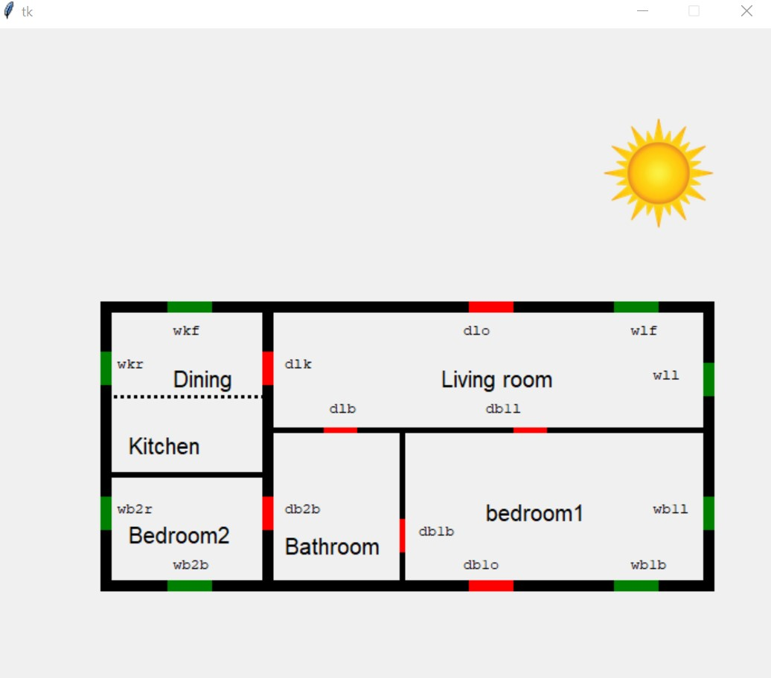
Accomplishments
NSF REU Research Experience on Internet of Things 2022

Slide 4
Problems & Solutions
The tilting broke
Data is unreliable
Lamp is not strong enough to heat up home
Sensor 25 is broken
NSF REU Research Experience on Internet of Things 2022

Slide 5
Future Actions
Get running sensor in living room
Collect sensible data
Train LSTM and Transformers
Write report and poster on emulation
NSF REU Research Experience on Internet of Things 2022

