Slide 1
Project #7: IoT Augmented Physical Scale Model of a Suburban Home
Week 5 (June 13 – June 17, 2022)
REU Students: Wahub Ahmed, Abraam Youssef
Faculty mentors: Damla Turgut, Lotzi Bölöni
Graduate mentor: Furkan Cimen
NSF REU Research Experience on Internet of Things 2022

Slide 2
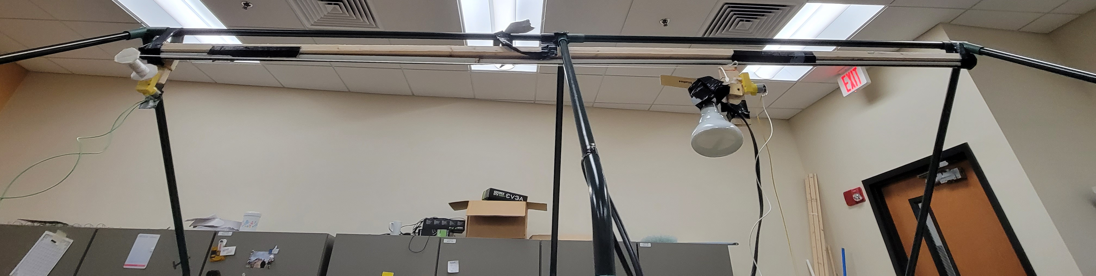
Accomplishments
The model of the Sun consistently works
NSF REU Research Experience on Internet of Things 2022

Slide 3
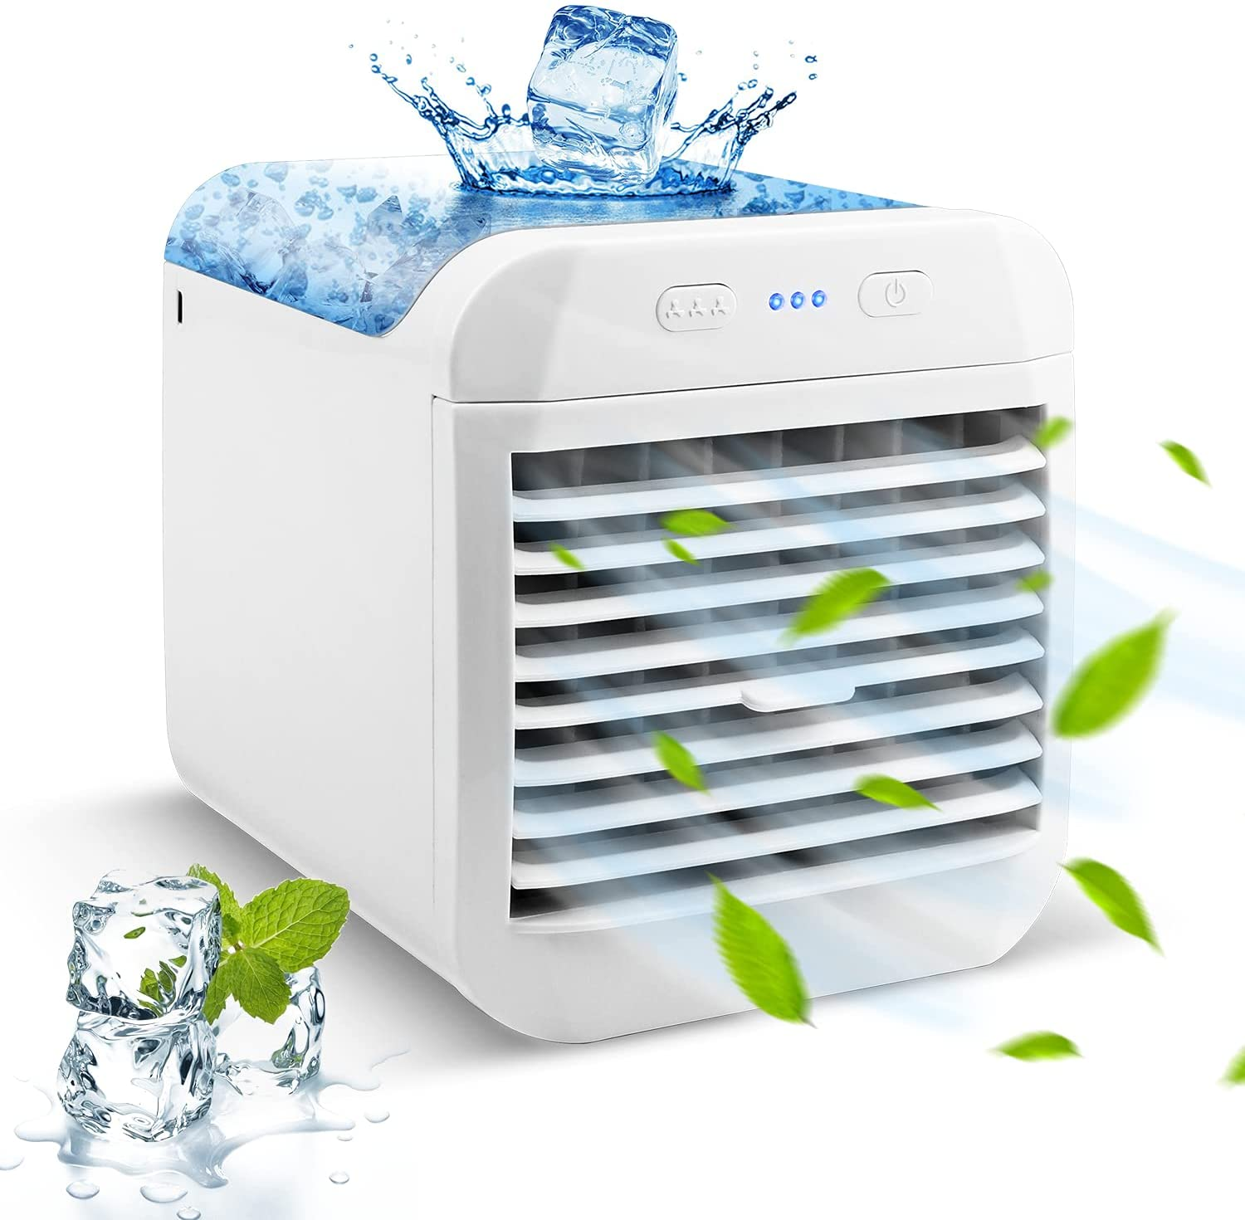
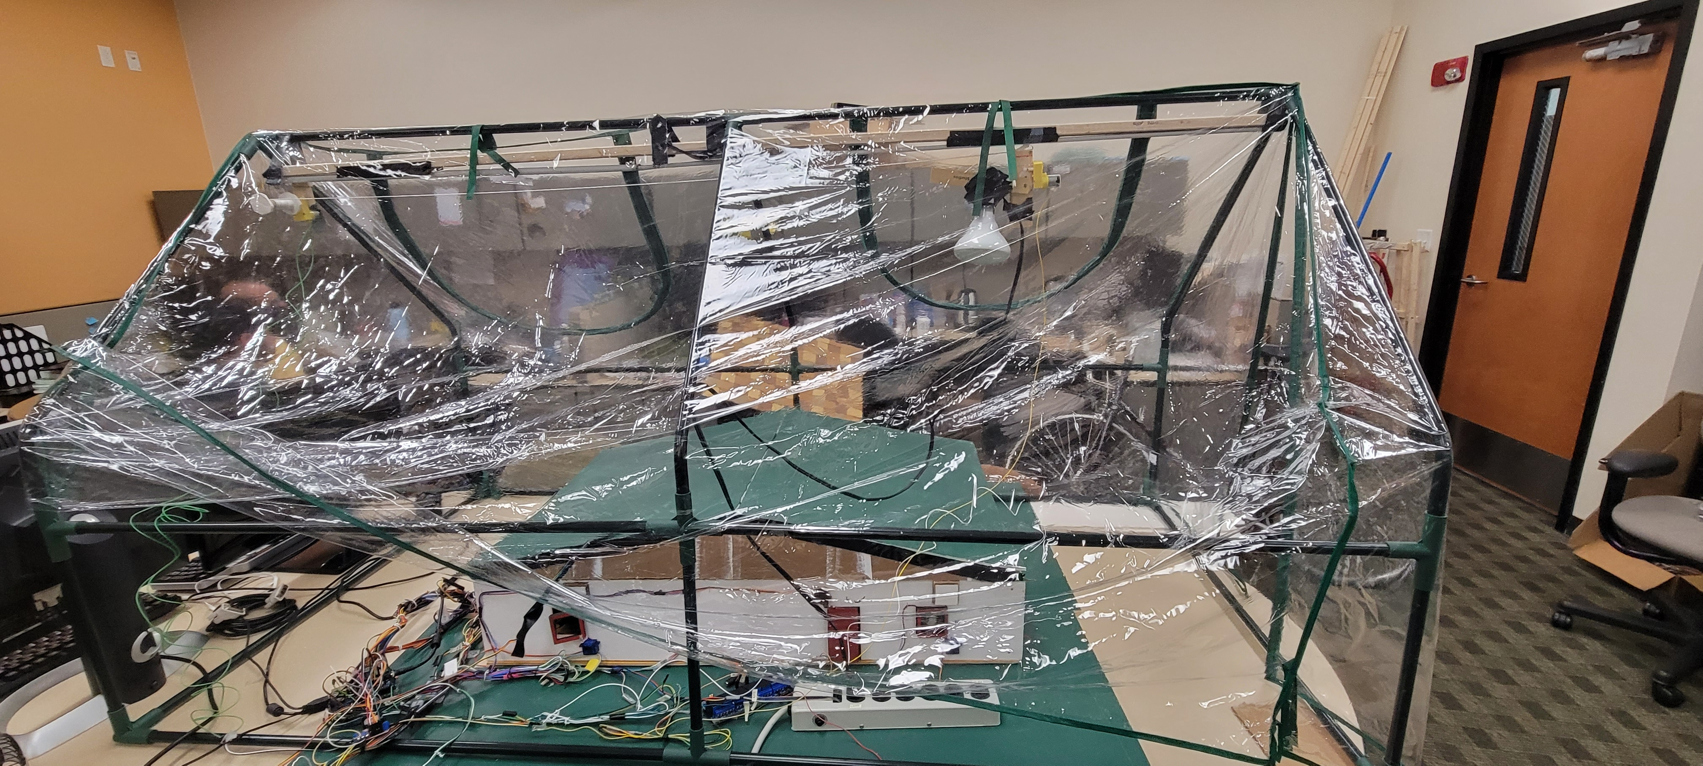
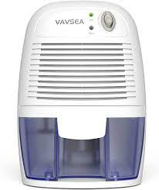
Accomplishments
Wrote extra simulations and prepared different environments
Link to simulation text file
NSF REU Research Experience on Internet of Things 2022

Slide 4
Accomplishments
Rewrote code for parsing data simulation to be more efficient
NSF REU Research Experience on Internet of Things 2022

Slide 5
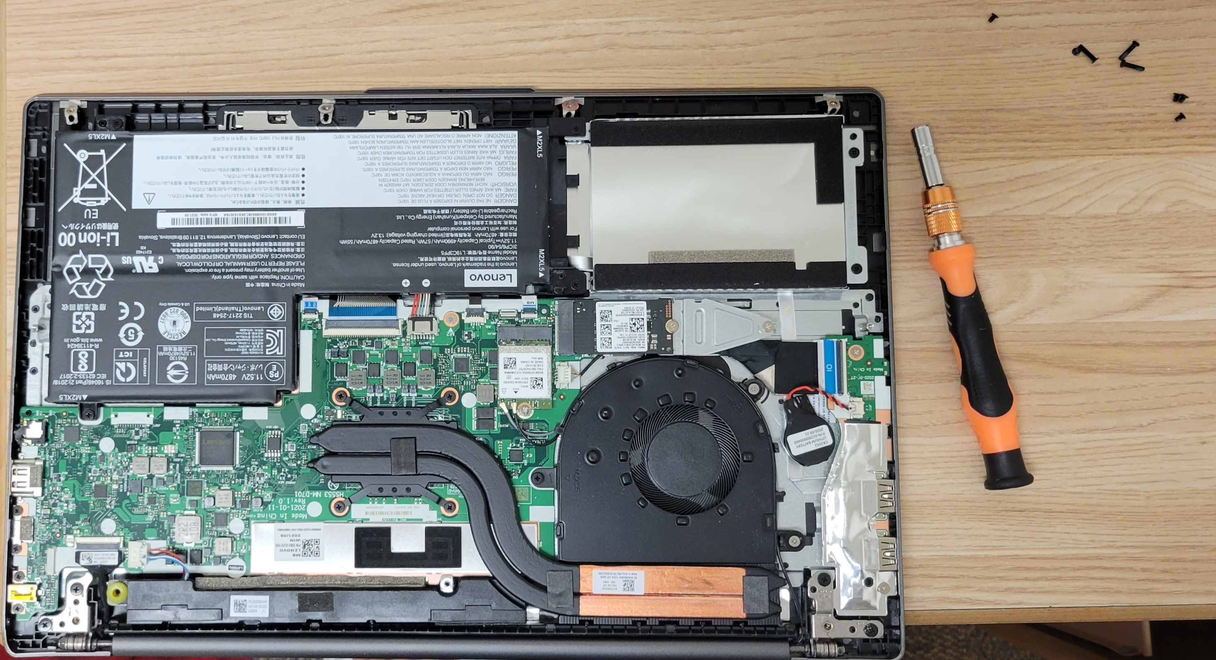
Problems & Solutions
Technology is unreliable
NSF REU Research Experience on Internet of Things 2022

Slide 6
Problems & Solutions
Previous code is convoluted and inefficient
NSF REU Research Experience on Internet of Things 2022

Slide 7
Problems & Solutions
Simulation can vary in stops and time
NSF REU Research Experience on Internet of Things 2022

Slide 8
Future Actions
Run as many simulations as possible
NSF REU Research Experience on Internet of Things 2022

Slide 9
Future Actions
Refine research direction
NSF REU Research Experience on Internet of Things 2022

Slide 10
Future Actions
Create and compare more robust LSTM to Transformers ML model
NSF REU Research Experience on Internet of Things 2022

