Slide 1
Project 2: IoT and augmented reality: agents with pervasive awareness, appearance, and abilities
REU Students: Courtney Harris, Nikolas Yonkers & Connor Flick Faculty mentor(s): Gregory Welch & Gerd Bruder
Week 7 (Monday, June 28 – Friday, July 2 2021)
Accomplishments:
Finished User Study
Drafted research poster
Began data analysis
Continued writing research paper
NSF REU Research Experience on Internet of Things 2021

Slide 2
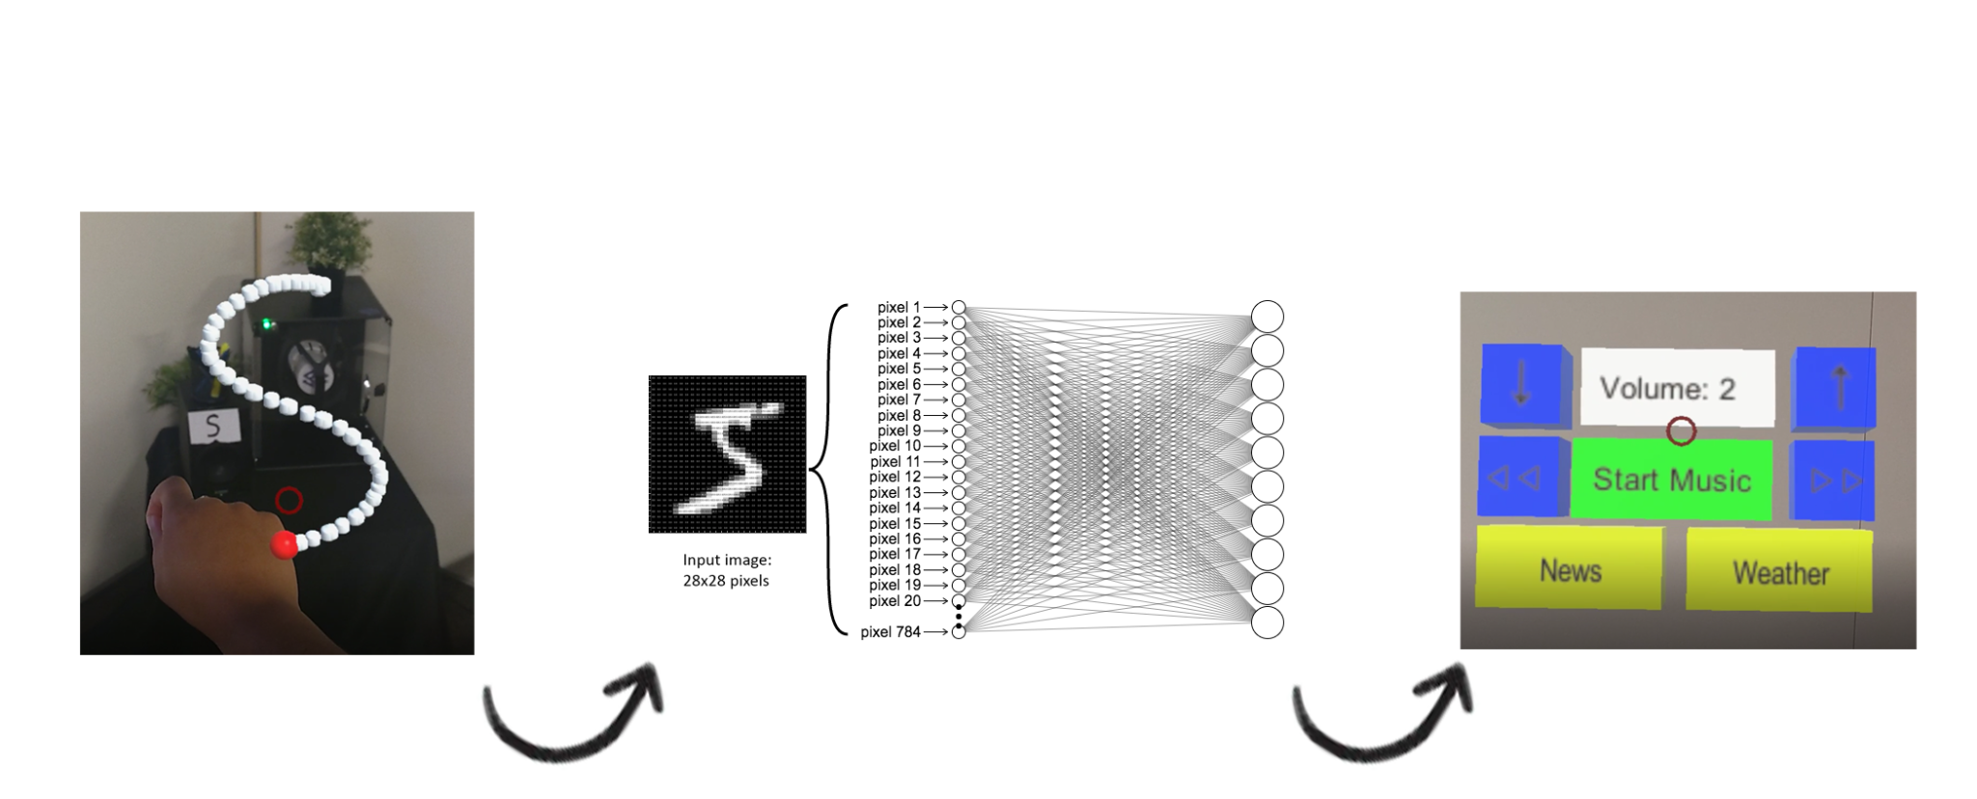
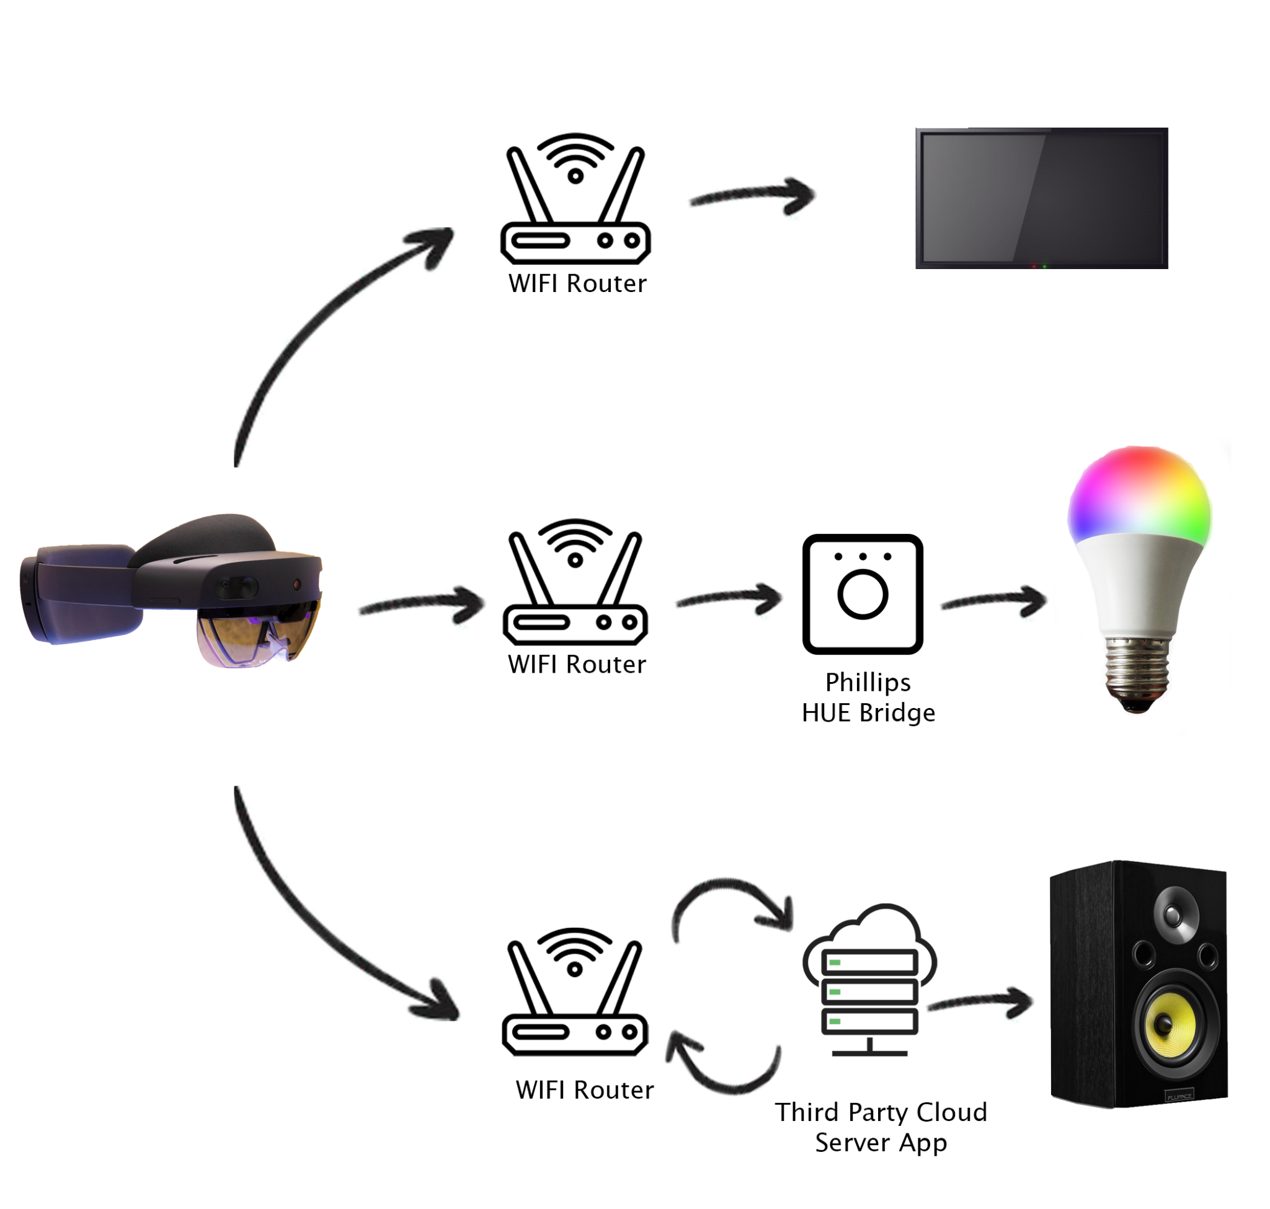
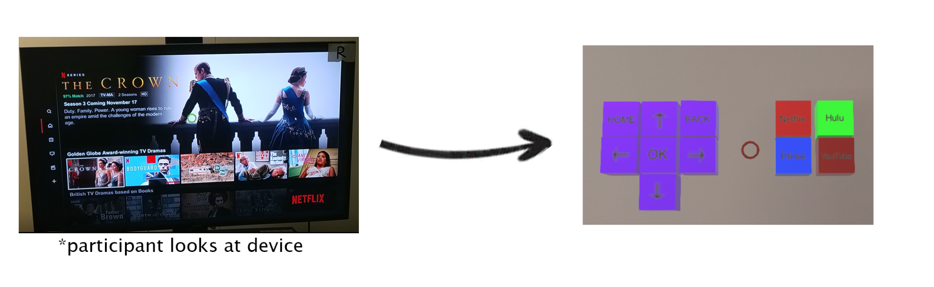
POSTER GRAPHICS

Slide 3
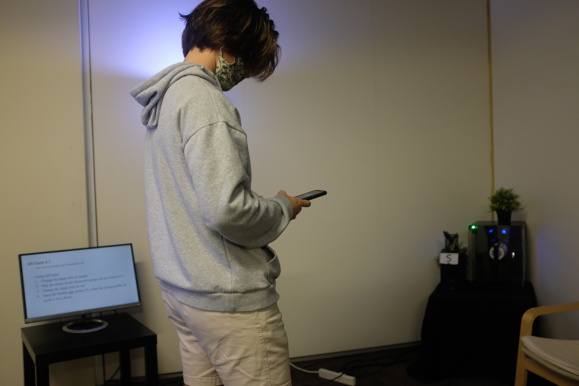
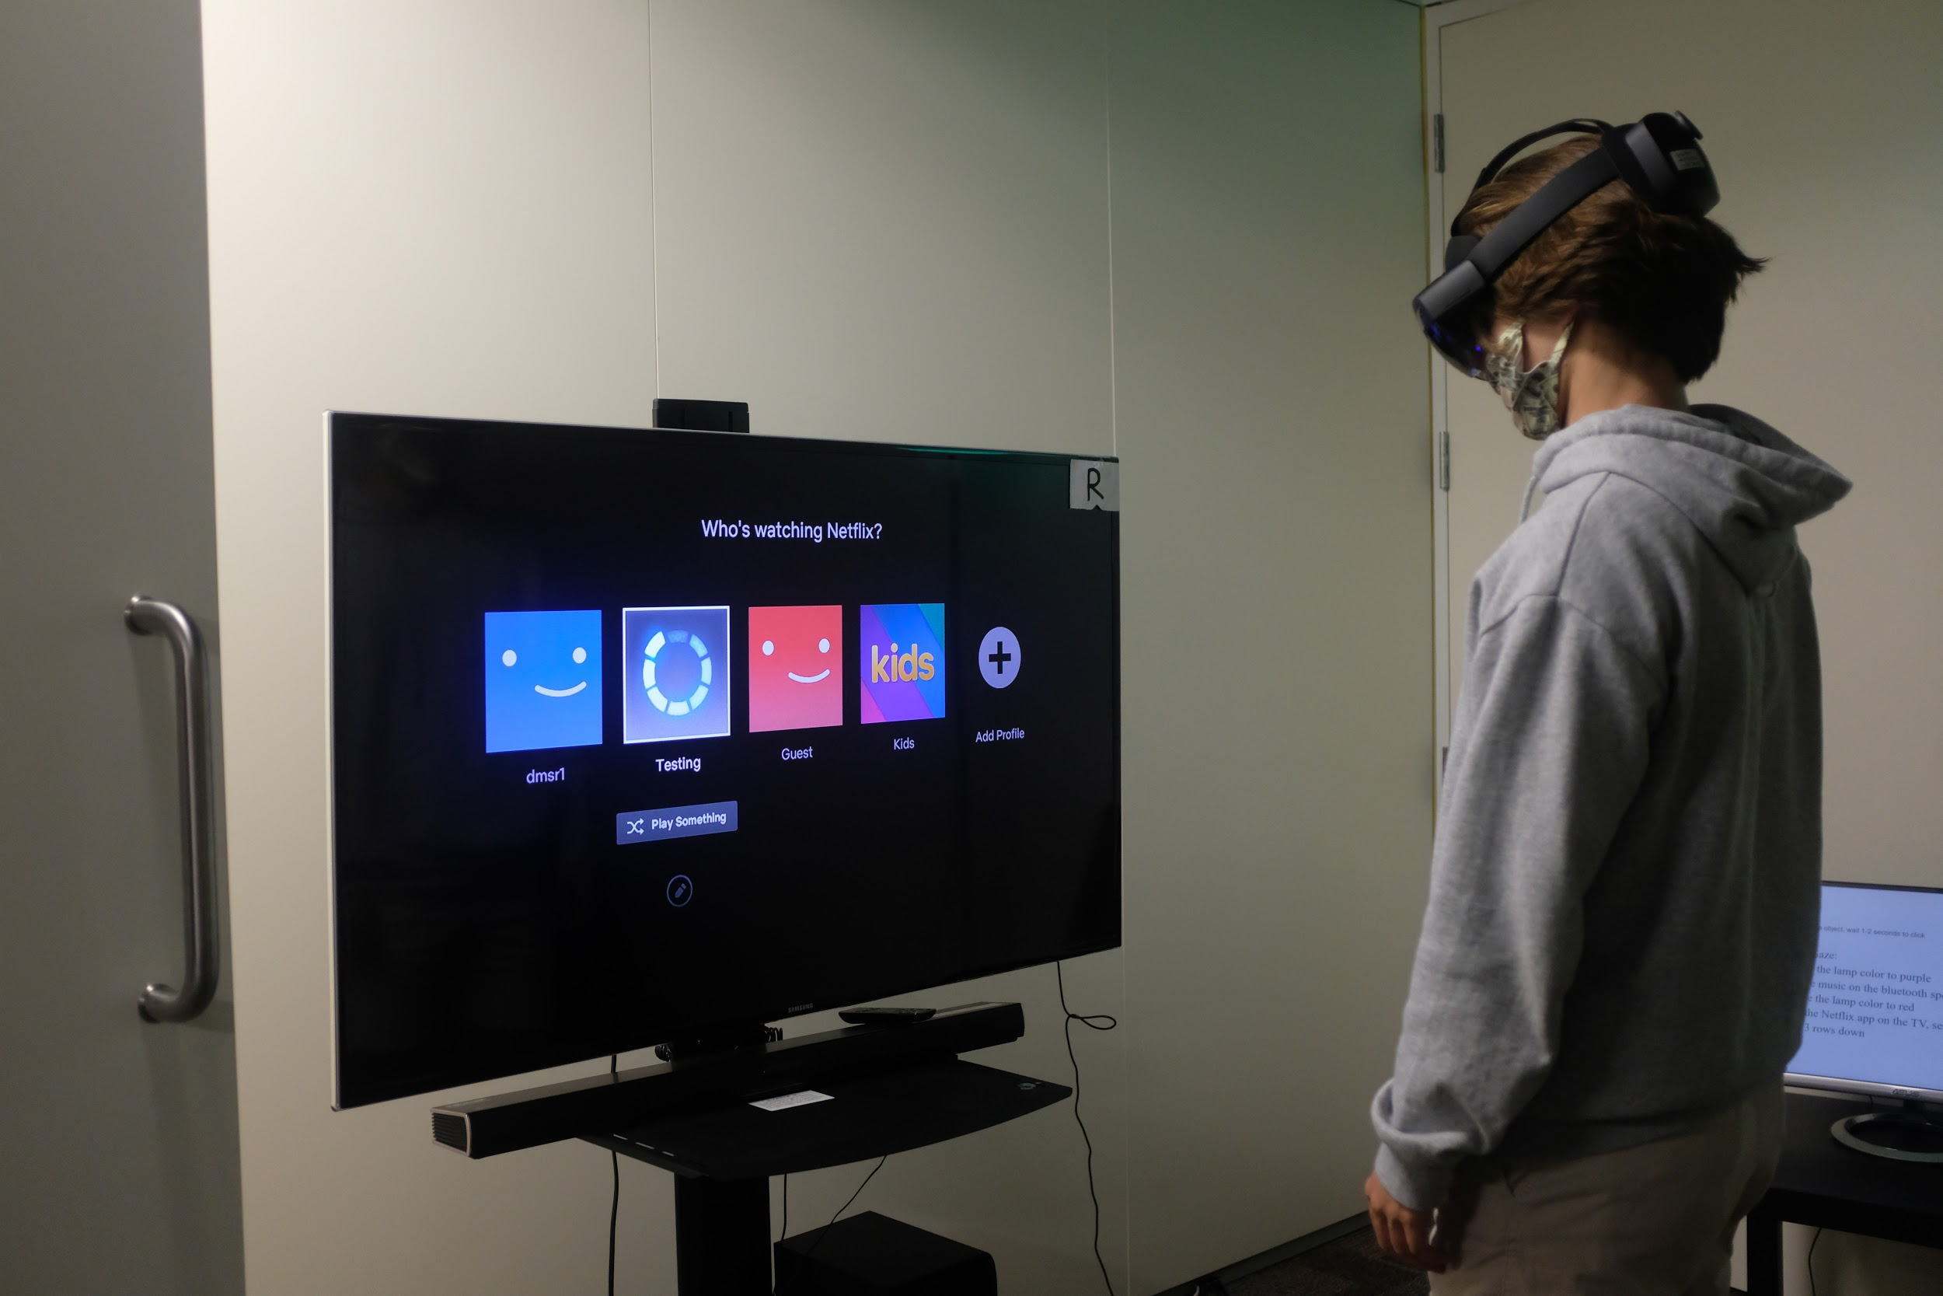
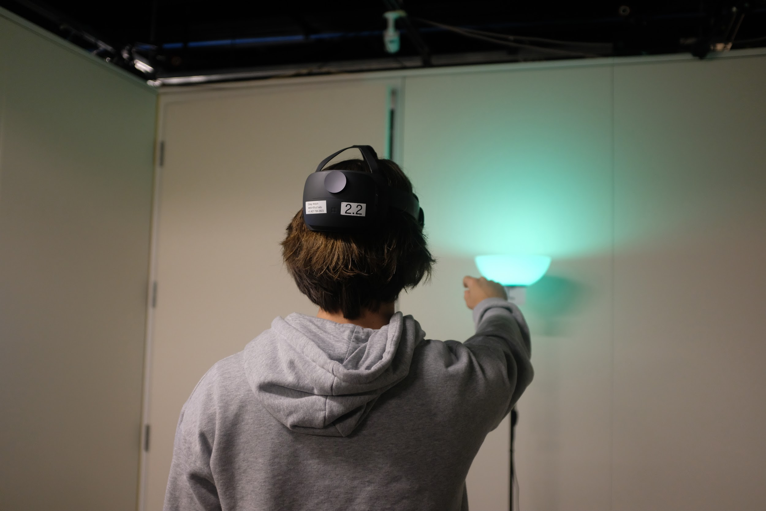
USER STUDY

Slide 4
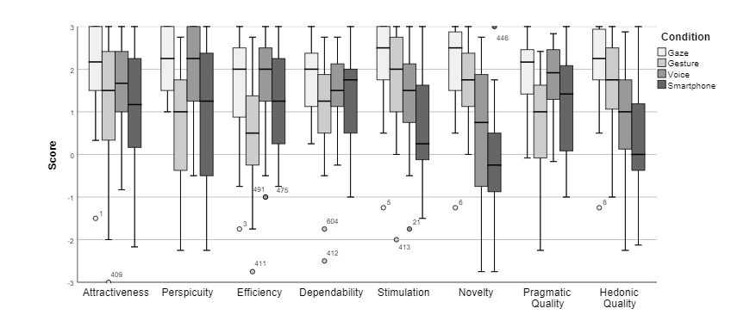
UEQ DATA
Notes:
Pragmatic: dealing with things sensibly and realistically in a way that is based on practical rather than theoretical considerations.
Hedonic: relating to or considered in terms of pleasant (or unpleasant) sensations.

Slide 5
Project 2: IoT and augmented reality: agents with pervasive awareness, appearance, and abilities
REU Students: Courtney Harris, Nikolas Yonkers & Connor Flick Faculty mentor(s): Gregory Welch & Gerd Bruder
Week 7 (Monday, June 28 – Friday, July 2 2021)
Problem & Solutions
Lights had connectivity issues during study
Solution: WiFi interference issues causing it, reset the app and Hue Bridge to change local Zigbee channels
The Alexa app cannot play media outside of music (with VERY limited exception)
Solution: Updated the task slides to reflect limitations
Participants cancelled or showed up late causing us to have less data.
Solution: We still have enough data to have a thorough analysis
NSF REU Research Experience on Internet of Things 2021

Slide 6
Project 2: IoT and augmented reality: agents with pervasive awareness, appearance, and abilities
REU Students: Courtney Harris, Nikolas Yonkers & Connor Flick Faculty mentor(s): Gregory Welch & Gerd Bruder
Week 7(Monday, June 28 – Friday, July 2 2021)
Plans for next week:
Finalize and print poster
Continue writing research paper
Present work at symposium
NSF REU Research Experience on Internet of Things 2021

