Slide 1
Project 1: IoT-enabled smart mobility devices for aging and rehabilitation REU Students: Laura Figueroa, Myat Win Faculty mentor(s): Dr. Turgut & Dr. Bӧlӧni
Week 5 (June 14 – June 18, 2021)
Accomplishments:
Additional data collected (dataset 3)
Linear Regression, Polynomial Regression, Random Forest Regression, and K-Nearest Neighbor Regression Model
Exported test files into one csv file
Problem & Solutions
We had a problem choosing a model to focus on, so we tested all relevant ones to compare their error side by side
Plans for next week:
Choose the best model by comparing RSME, R2, and MAE for different datasets
NSF REU Research Experience on Internet of Things 2021

Slide 2
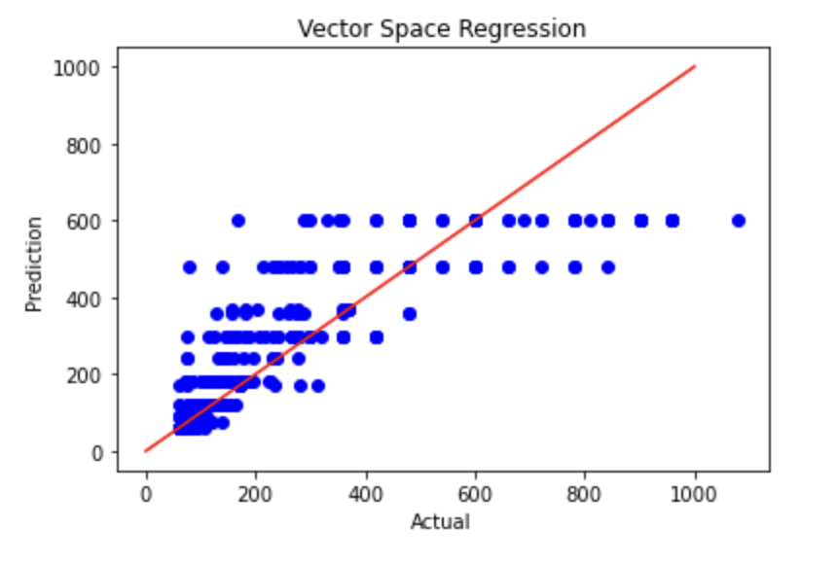
NSF REU Research Experience on Internet of Things 2021

Slide 3
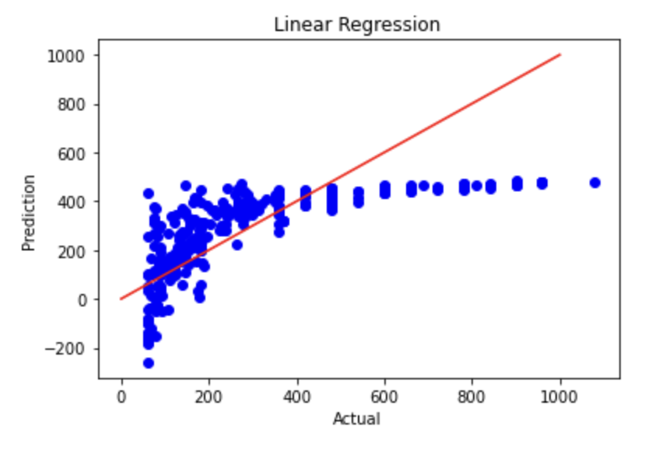
NSF REU Research Experience on Internet of Things 2021

Slide 4
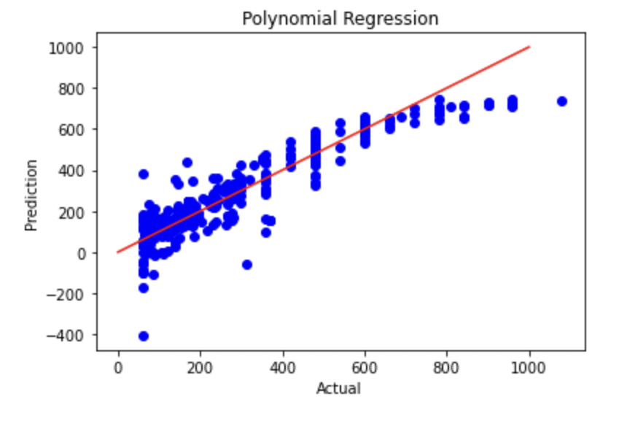
NSF REU Research Experience on Internet of Things 2021

Slide 5
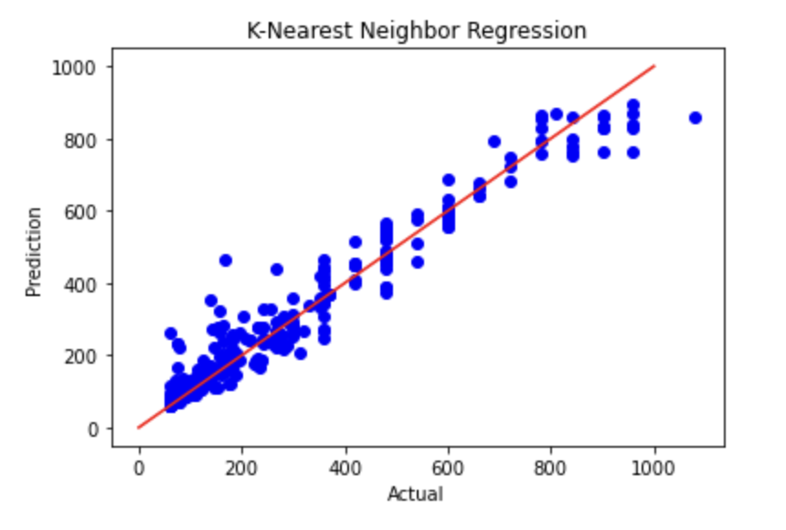
NSF REU Research Experience on Internet of Things 2021

Slide 6
NSF REU Research Experience on Internet of Things 2021

Slide 7
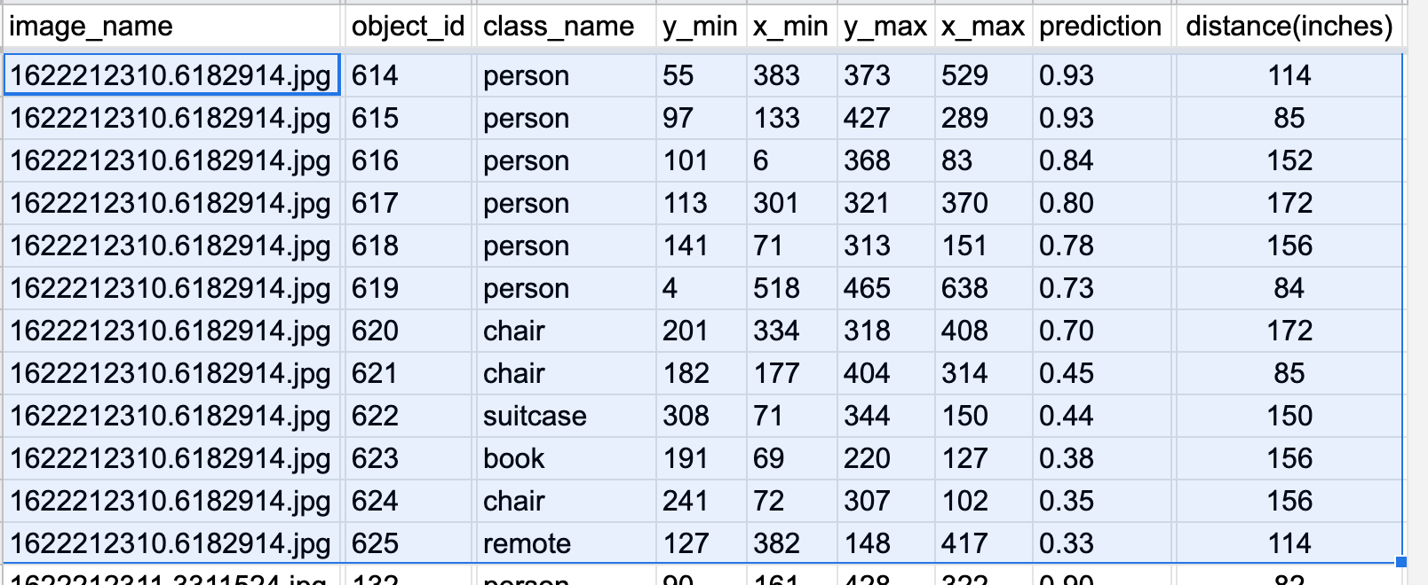
NSF REU Research Experience on Internet of Things 2021

Slide 8
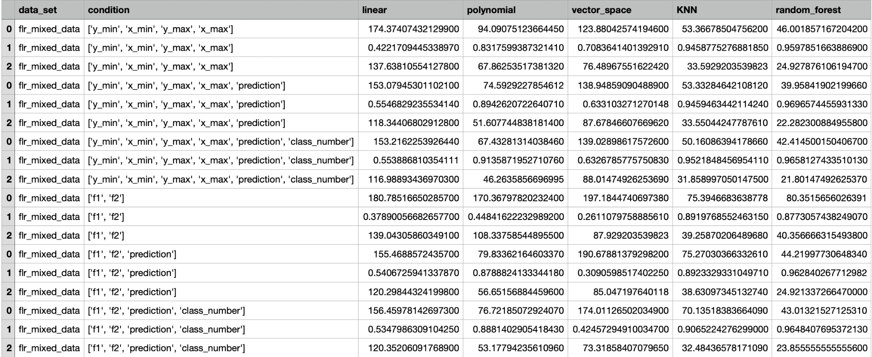
https://drive.google.com/file/d/1aqFGwBP8j5YIyAtN_UUTAAGXgdPHUOfk/view?usp=sharing
NSF REU Research Experience on Internet of Things 2021

