Slide 1
Project 5: Manufacturing IoT sensors: a flexible and wearable UV radiation sensor based on metal oxide semiconductors REU Students: Celine Ramirez & Tolga Koc
Graduate Students: Pawan Pathak & Arshya Bamshad Faculty mentor(s): Dr. Lotzi Böloni & Dr. Hyoung Cho
Week 8 (July 5 – July 9, 2021)
Accomplishments:
Connected the watch components and placed them into the case.
Finalized the design
Completed the REU symposium poster
Worked on the research paper
Problem & Solutions
Components kept disconnecting due to weak wires- caused difficulty placing the components within the case and disrupted device functionality.
NSF REU Research Experience on Internet of Things 2021

Slide 2
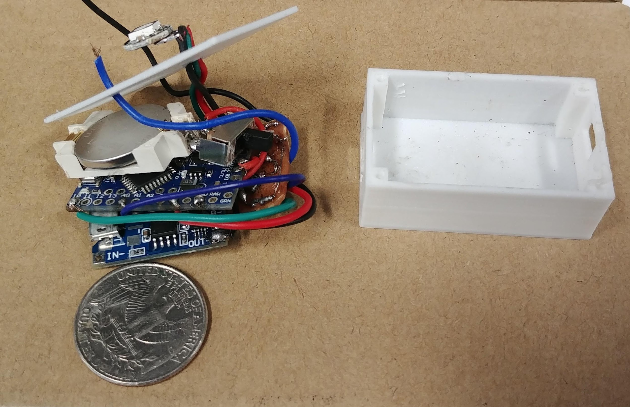
NSF REU Research Experience on Internet of Things 2021

