Slide 1
Project 5: Manufacturing IoT sensors: a flexible and wearable UV radiation sensor based on metal oxide semiconductors REU Students: Celine Ramirez & Tolga Koc
Graduate Students: Pawan Pathak & Arshya Bamshad Faculty mentor(s): Dr. Hyoung Cho & Dr. Lotzi Böloni
Week 5 (June 14 – June 18, 2021)
Accomplishments:
Started designing alternative ideas for wearable device.
Received components for the alternative design #1 (Arduino pro mini, chip resistors, and a WS2812B RGB LED).
Learned about the sensor fabrication process.
NSF REU Research Experience on Internet of Things 2021

Slide 2
Sensor Fabrication Process
NSF REU Research Experience on Internet of Things 2021

Slide 3
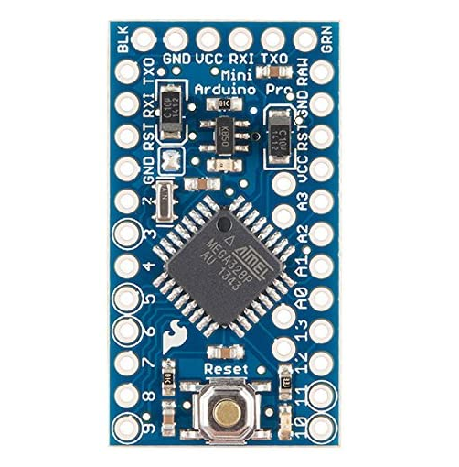
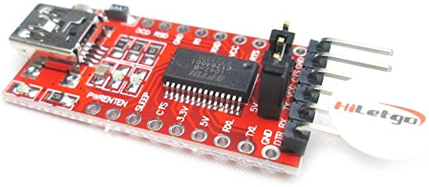
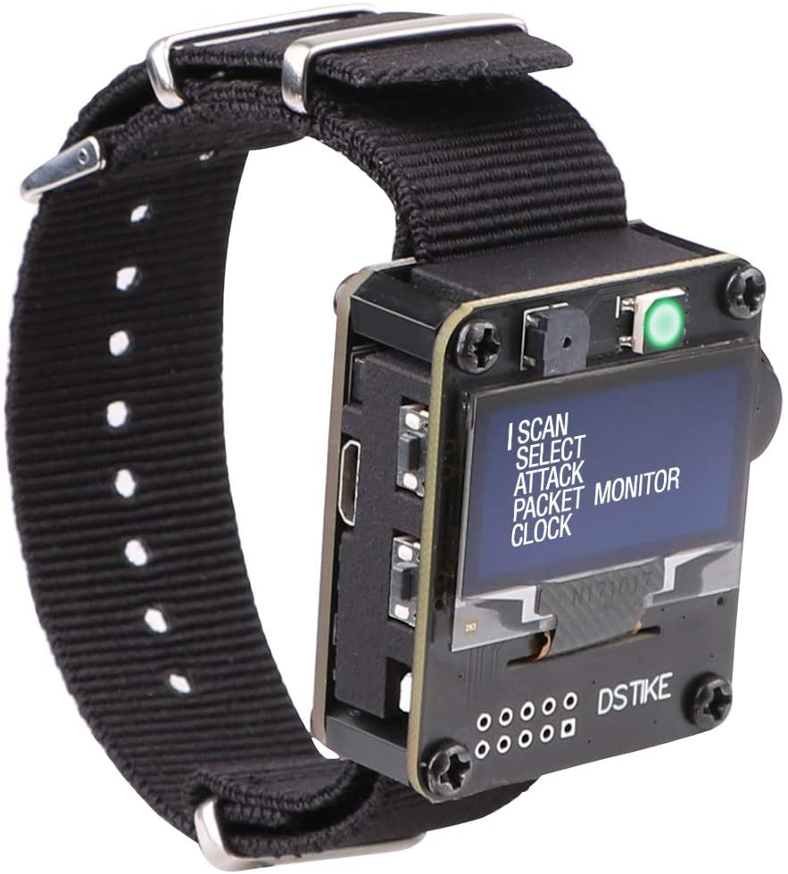
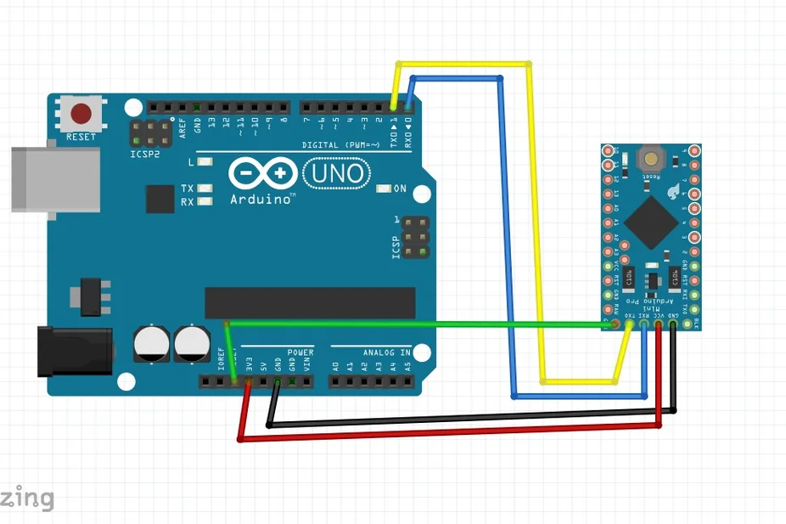
Problem & Solutions
The Arduino pro mini does not have a port to upload code to the board directly - either an Arduino Uno or serial adapter must be connected to the pro mini.
Neither of the watch development boards can be used for this project as they do not have analog pins for the sensor - confirmed by manufacturer.
NSF REU Research Experience on Internet of Things 2021

Slide 4
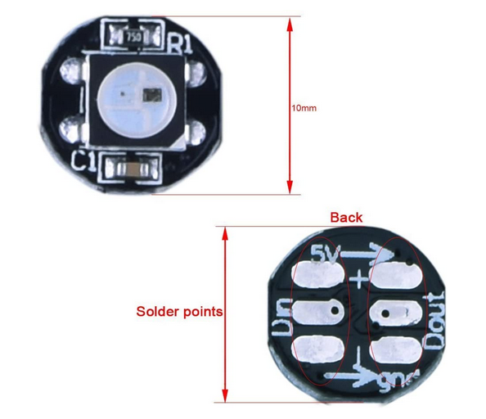
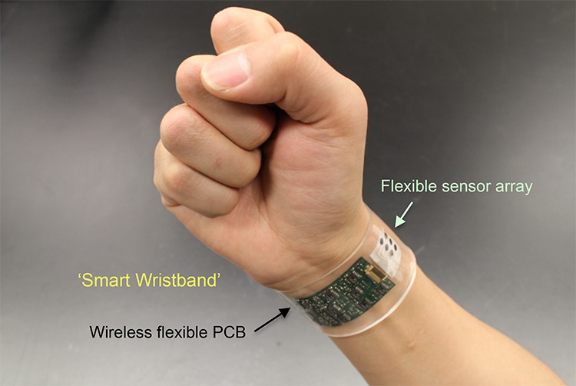
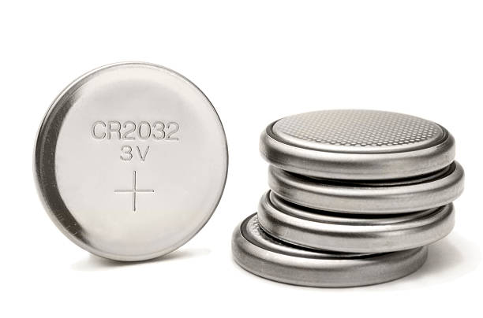
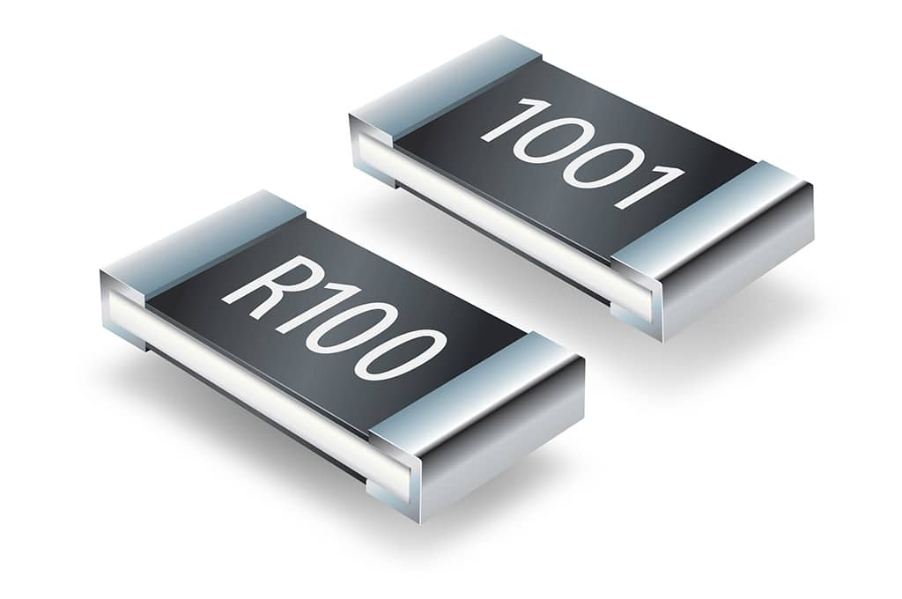
Design #1 - Wristband
Plans for next week:
Model and 3D print the casing for the arduino pro mini and battery.
Construct the wristband after getting the extra parts - battery casing and batteries
RGB LED
Arduino pro mini
Non-rechargeable battery
Chip resistors 1 ohm - 10 M ohms
Gao, Wei. Wrist Monitor. 2016
NSF REU Research Experience on Internet of Things 2021

