Slide 1
Project 5: Manufacturing of IoT Sensors: Electrochemical Sensors REU Students: Tolga Koc & Celine Ramirez
Graduate Mentor(s): Arshya Bamshad & Pawan Pathak Faculty Mentor(s): Dr. Hyoung Jin Cho & Dr. Ladislau Bölöni
Week 4 (June 7 – June 11, 2021)
Accomplishments:
Soldering the Circuit to Certified Breadboard
Tested this Circuit
Met with Mentors
Problem & Solutions
Voltage Output Value is not same as Arduino Read Value
Circuit and/or Code does not recognize user inputted value
Solutions: Unknown
Plans for next week:
Modify code to see user inputted values registered in Circuit
Once modifications made, calibrate for other Electrochemical Techniques
NSF REU Research Experience on Internet of Things 2021

Slide 2
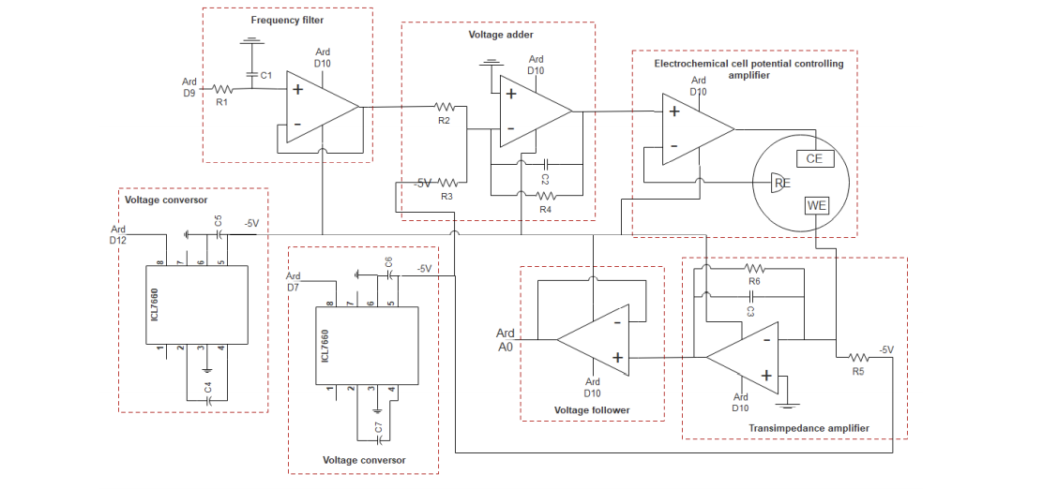
Circuit Diagram
NSF REU Research Experience on Internet of Things 2021

Slide 3
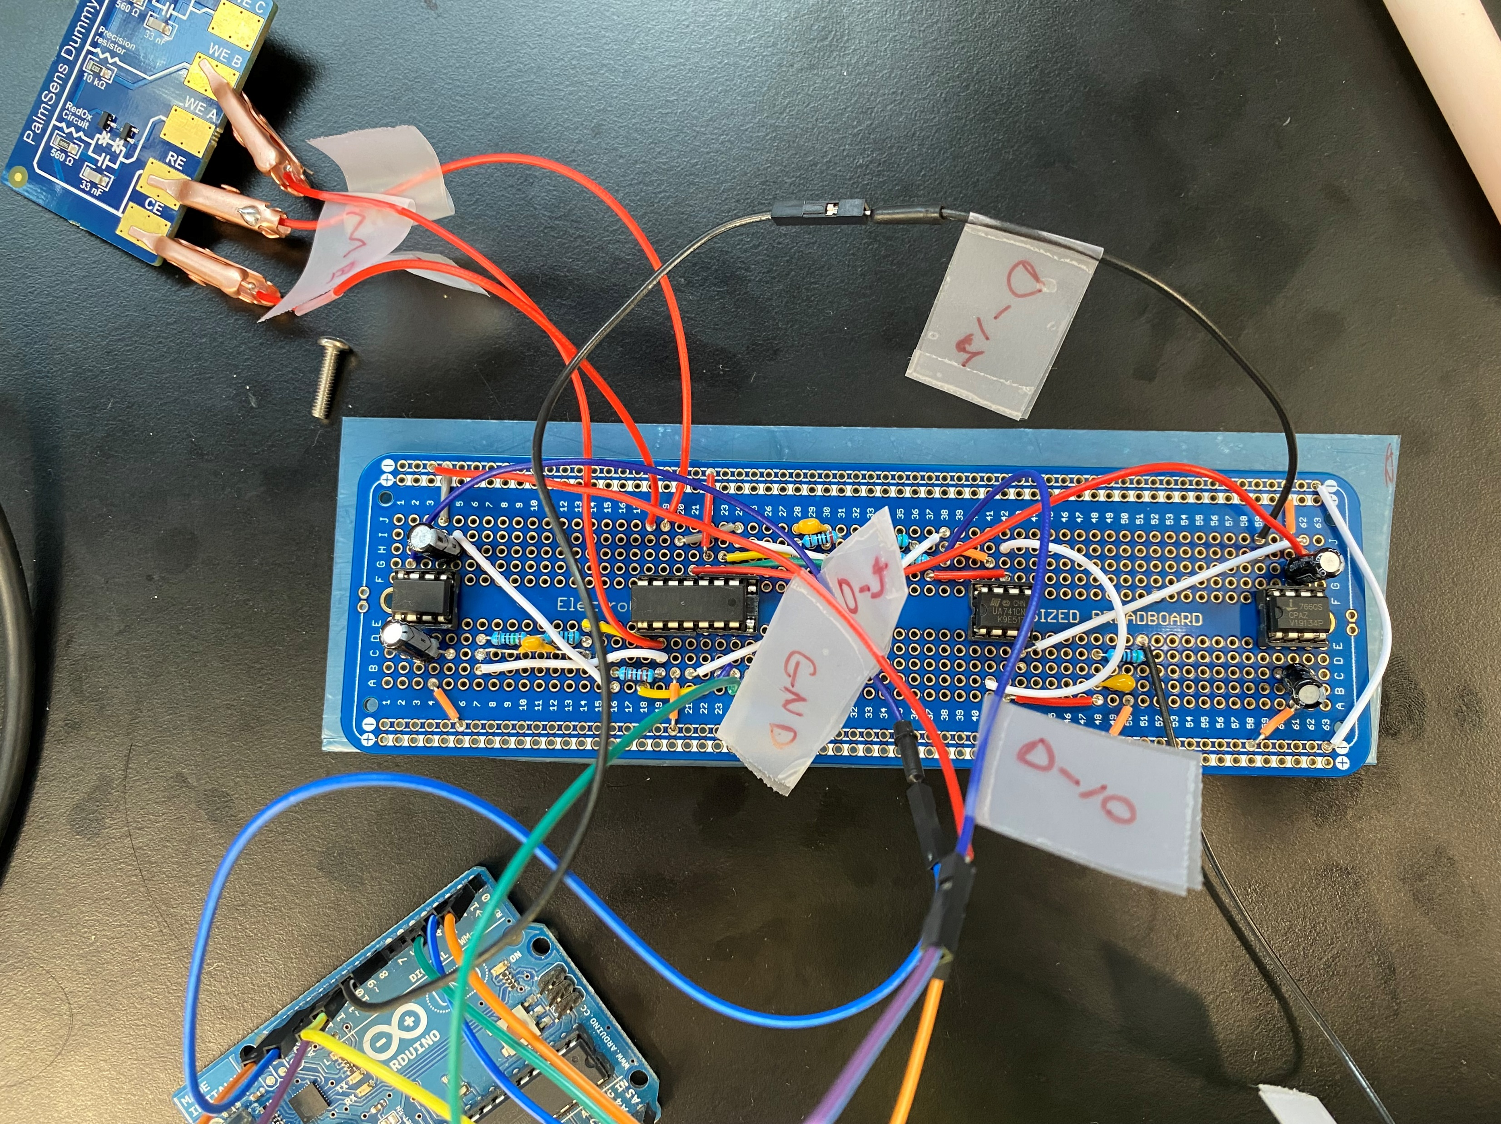
Circuit Breadboard
NSF REU Research Experience on Internet of Things 2021

