Slide 1
Project 3: Designing a mobility model using large-scale data REU Students: Leah Kazenmayer & Gabriela Ford Faculty mentor(s): Samiul Hasan & Damla Turgut
Week 6 (June 21 – June 25, 2021)
NSF REU Research Experience on Internet of Things 2021

Slide 2
Accomplishments:
Worked on all machine learning and deep learning models
Made the machine models into time series analysis
Randomized six hour chunks throughout 2016 and 2019 data for both machine and deep learning
Decided which factors to keep
Found the best way to optimize the machine learning models and compared them
NSF REU Research Experience on Internet of Things 2021

Slide 3
Problems and Solutions:
Machine learning models specifically didn’t account for time
Transforming the dataset to account for the previous 6 hours
The training data for machine and deep learning models was from around Jan-Aug; test data was from Aug-Dec
Randoming 6 hour chunks involved shuffling the rows; improved the results drastically
Decided which factors to keep
Ran code that used LSTM and tried the different combinations of factors to see which one produced low MAE/RMSE/R2 Score
Finding the best way to optimize the models
Utilized Grid Search CV (exhaustive search to fine tune parameters in machine learning models)
Compared the optimized machine learning models
NSF REU Research Experience on Internet of Things 2021

Slide 4
Formatted the data for machine learning algorithms like so:
Weekday | Peak Hour | Holiday | Hurricane | Precip | Volume (Hour - 6) | ... | Weekday | Peak Hour | Holiday | Hurricane | Precip | Volume (Current Hour)
Then randomized the rows
NSF REU Research Experience on Internet of Things 2021

Slide 5
Columns Used
0 = Datetime
1 = Weekday
2 = Peak Hour
3 = Holiday
4 = Hurricane
5 = Precipitation
6 = Volume
NSF REU Research Experience on Internet of Things 2021

Slide 6
Machine Learning (taking into account time and factors)
Multiple Linear Regression: normalize = True
Decision Tree: criterion = ‘mae’, max_depth = 7
Random Forest: max_depth = None, min_samples_split = 8, n_estimators = 99
SVR: kernel = ‘rbf’, gamma = ‘scale’
KNN: algorithm = ‘auto’, weights = ‘distance’, n_neighbors = 17
XGBRegressor: booster = ‘gbtree’, n_thread = 1
NSF REU Research Experience on Internet of Things 2021

Slide 7
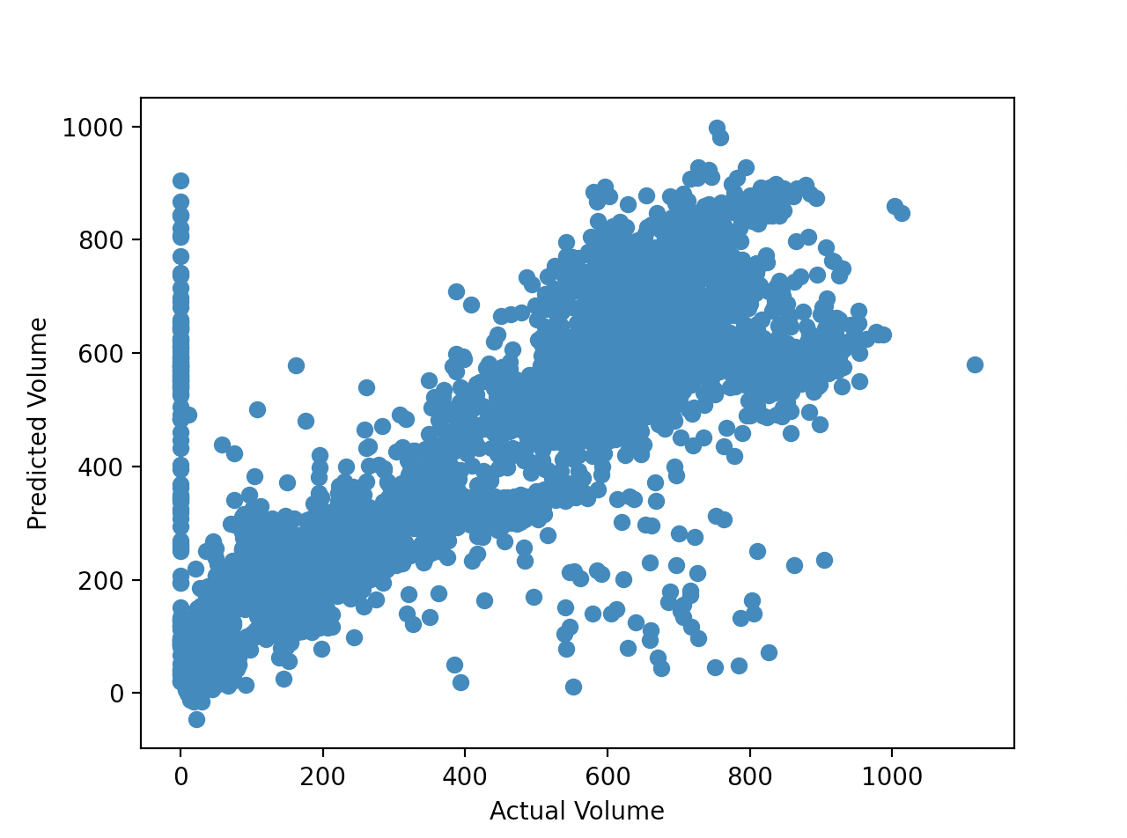
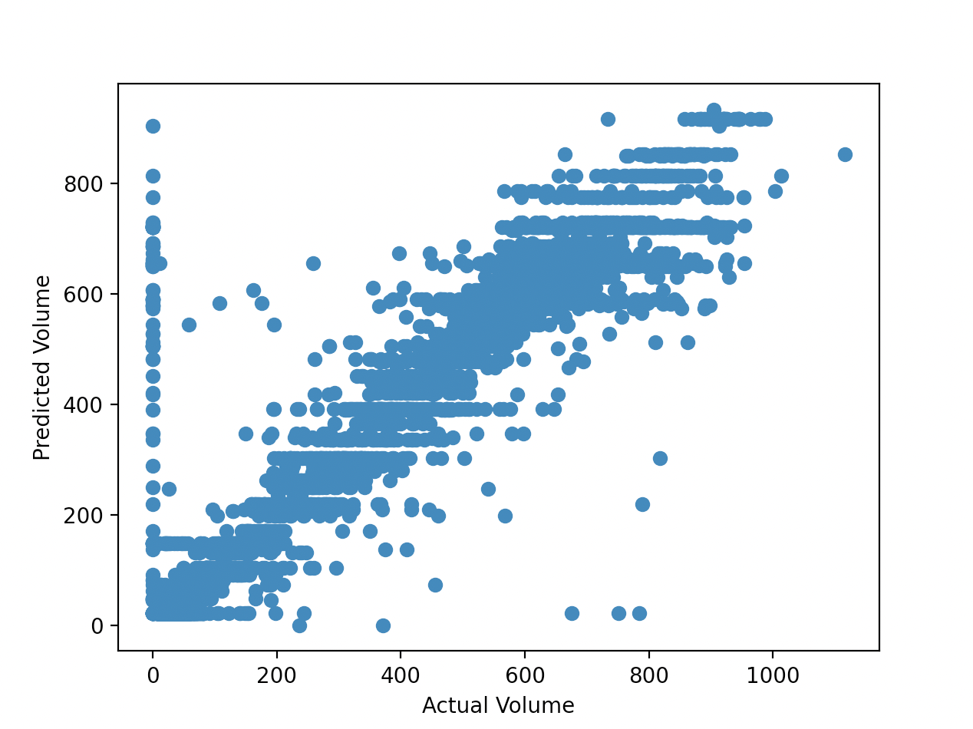
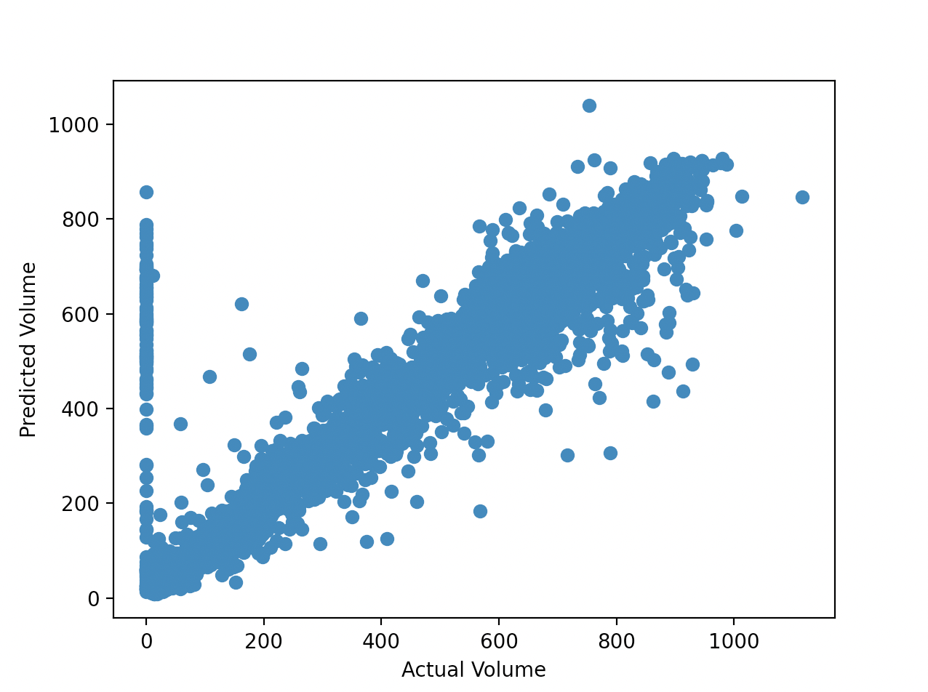
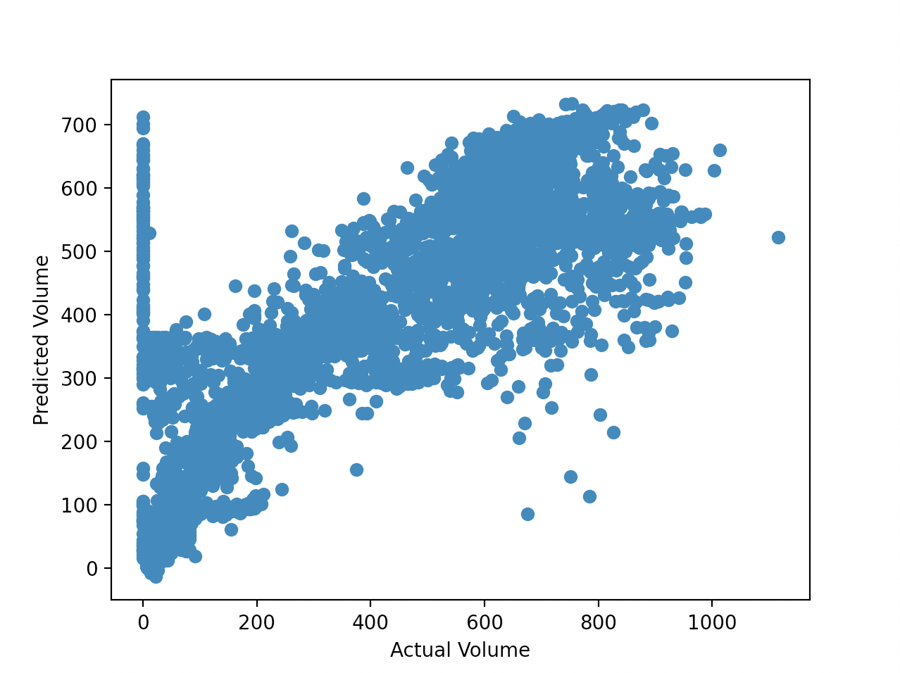
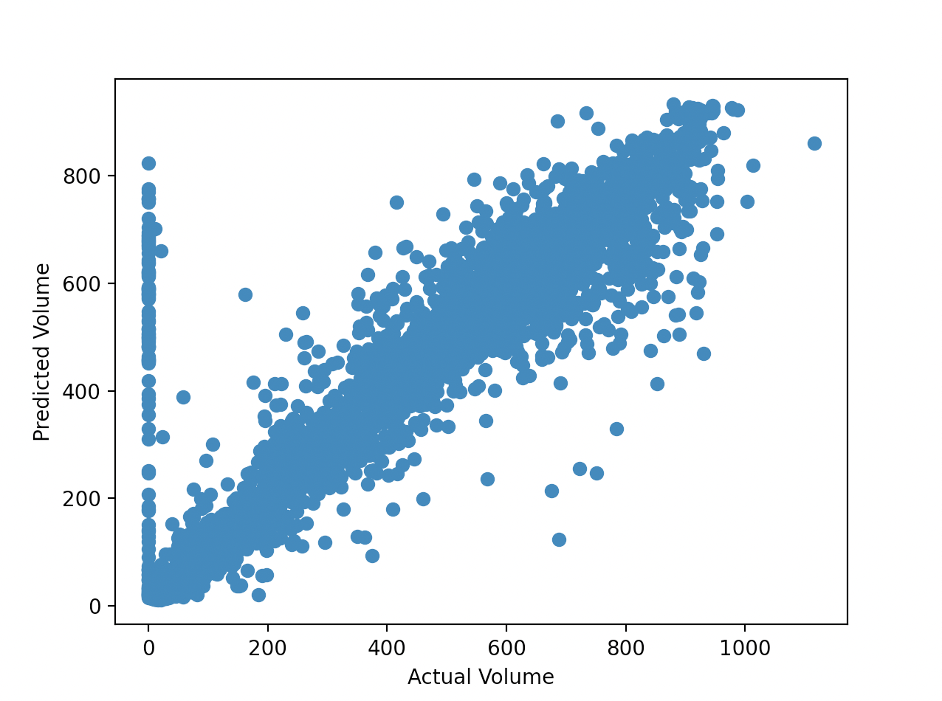
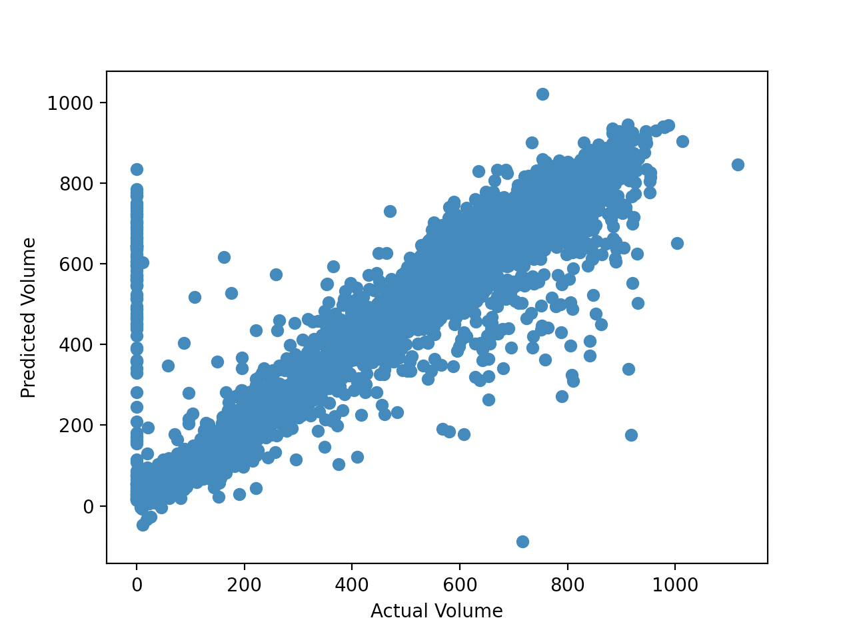
Multiple Linear Regression
Decision Tree
Random Forest
SVR
KNN
XGBoost
NSF REU Research Experience on Internet of Things 2021

Slide 8
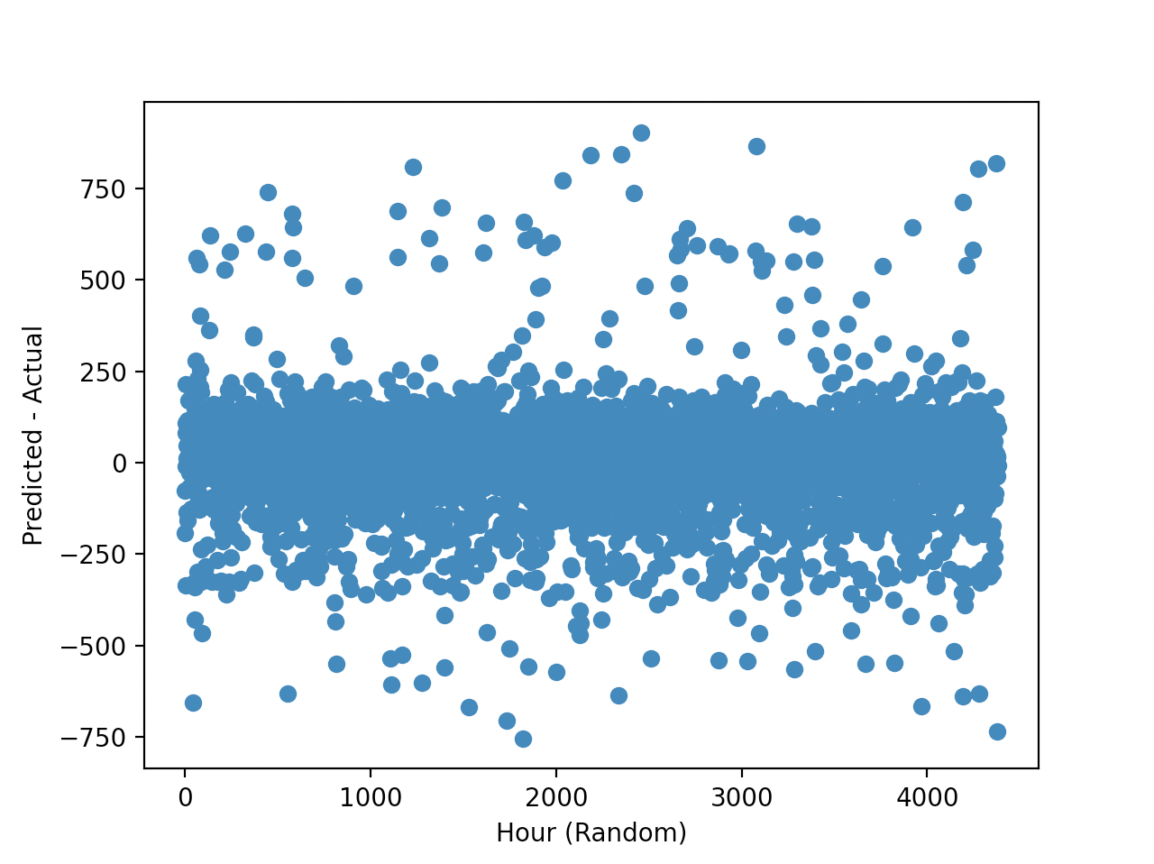
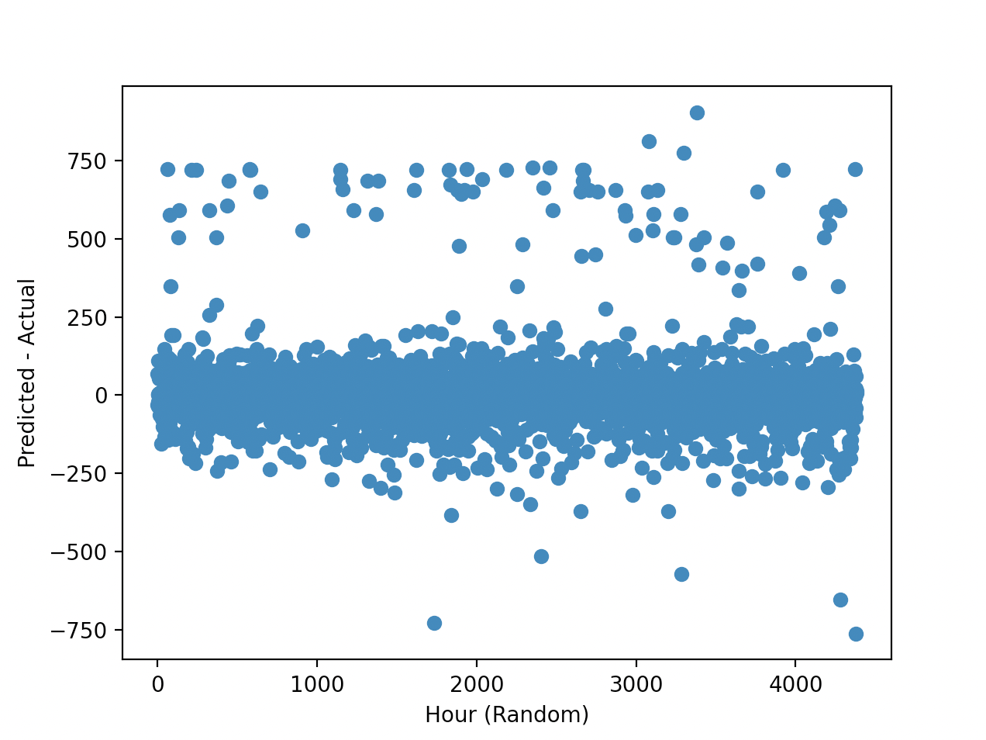
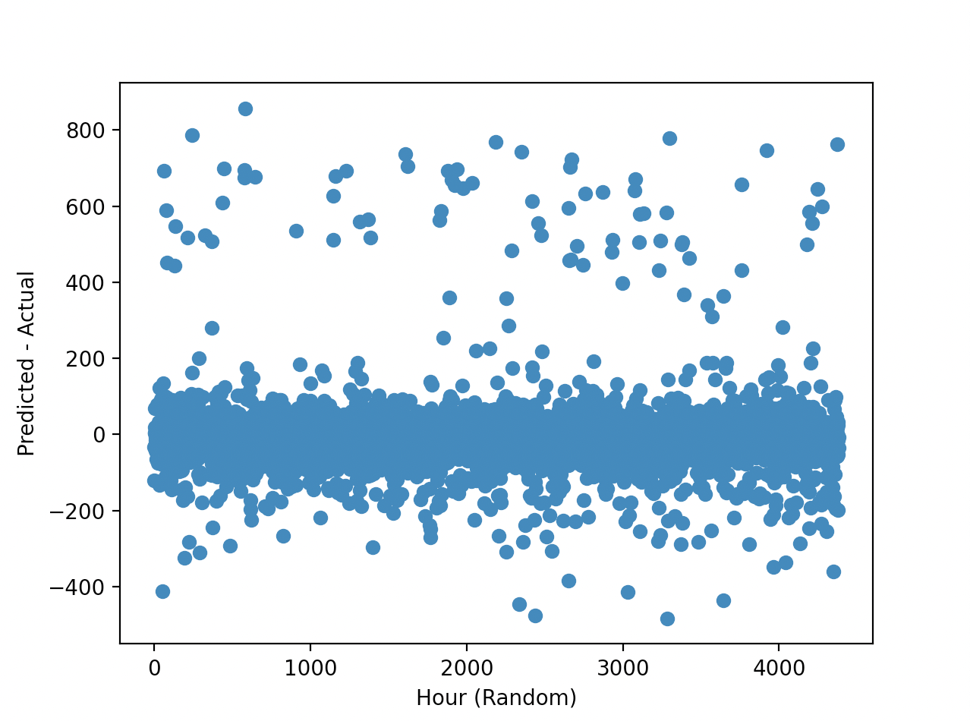
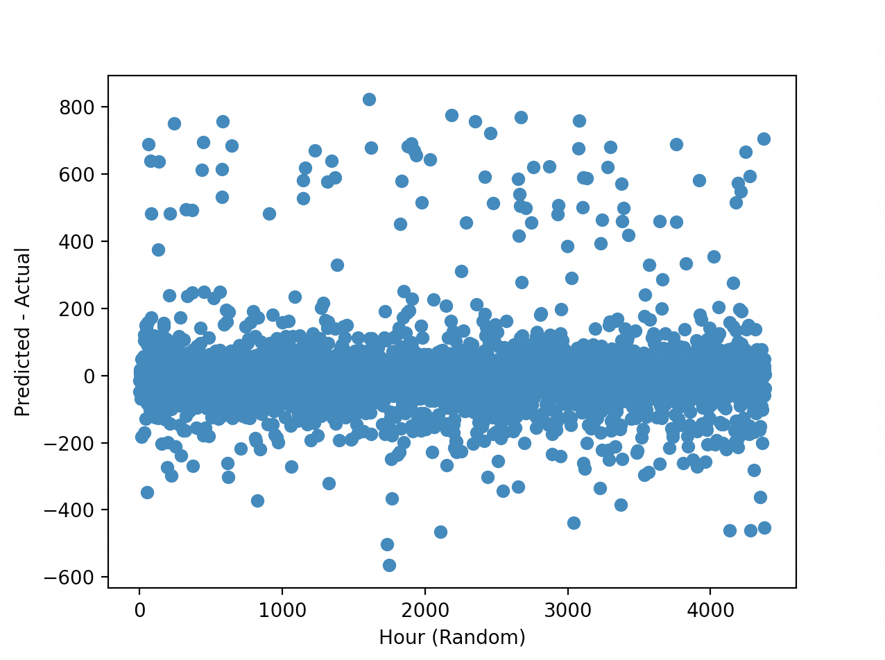
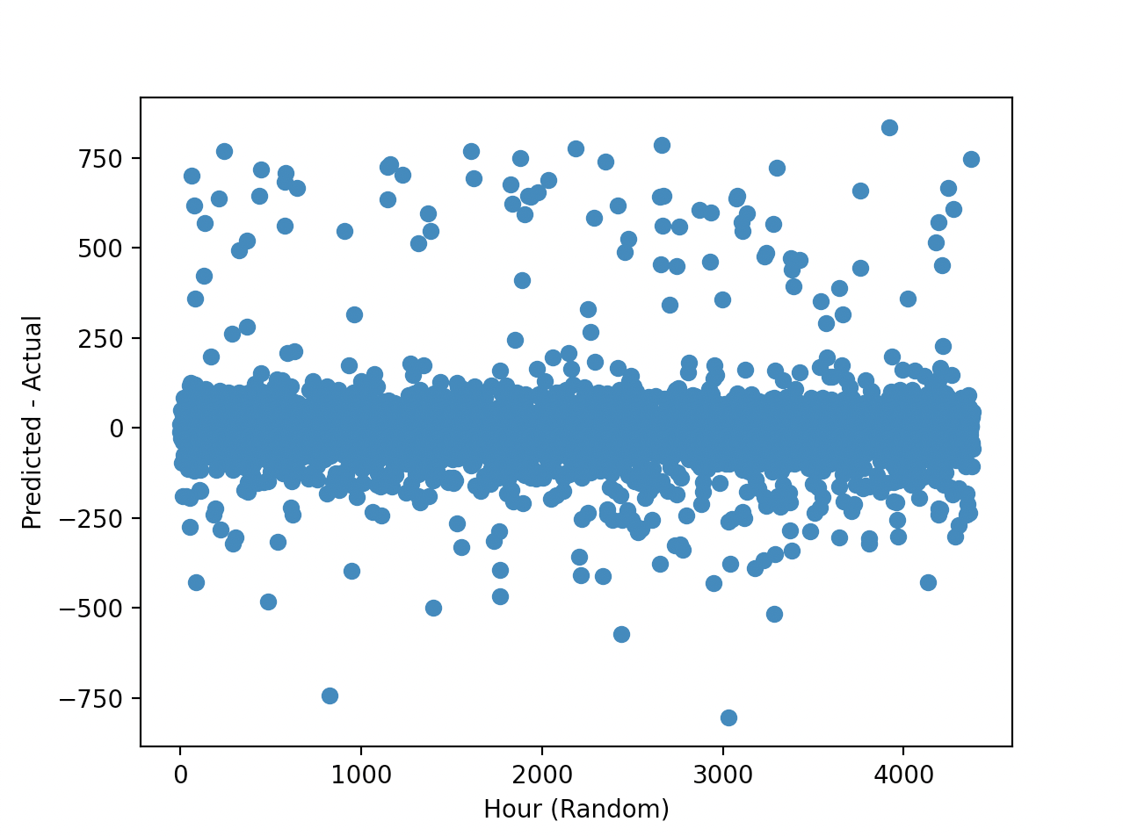
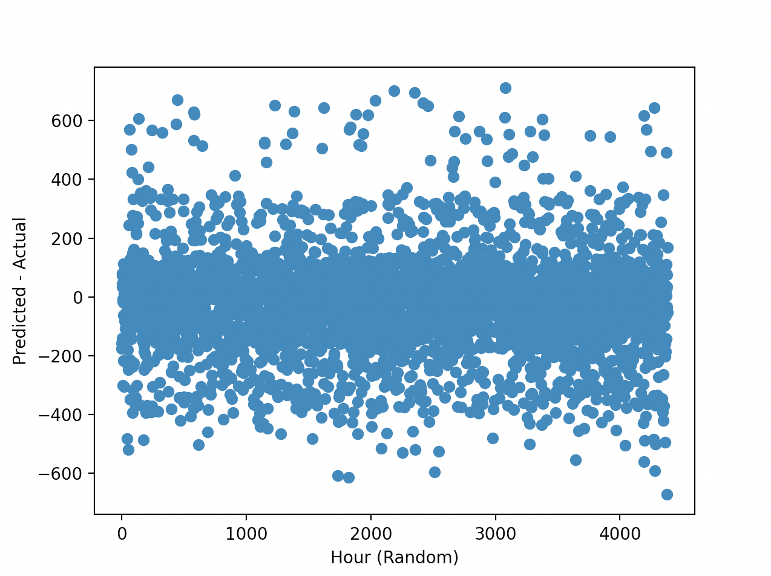
Multiple Linear Regression
Decision Tree
Random Forest
SVR
KNN
XGBoost
NSF REU Research Experience on Internet of Things 2021

Slide 9
Statistics Summary
Machine Learning Algorithm | Mean Absolute Error (MAE) | Root Mean Squared Error (RMSE) | R2 Score
MLR | 92.90 | 142.49 | 0.69
Decision Tree | 51.57 | 106.53 | 0.86
Random Forest | 46.70 | 99.04 | 0.87
SVR | 104.83 | 156.85 | 0.5
KNN | 51.39 | 102.52 | 0.86
XGBoost | 51.00 | 105.30 | 0.86
NSF REU Research Experience on Internet of Things 2021

Slide 10
Plans for Next Week:
Optimize the LSTM model (with a different amount of batches, epochs, num of layers, optimizers, loss, etc) and compare with other optimized machine learning models
Start analyzing the predicted data of the machine learning models to determine which one predicts volume the best
Potentially apply said machine learning model to the whole corridor
Take two signals into consideration, predict the third
NSF REU Research Experience on Internet of Things 2021

