Slide 1
Project 3: Designing a mobility model using large-scale data REU Students: Leah Kazenmayer & Gabriela Ford Faculty mentor(s): Samiul Hasan & Damla Turgut
Week 3 (May 31 – June 4, 2021)
NSF REU Research Experience on Internet of Things 2021

Slide 2
Accomplishments:
We defined the scope our project and selected the corridor of analysis.
We successfully found an efficient method to find hourly volumes for one intersection signal for one year.
We started collecting data sets that will potentially affect volume: holidays in the year, weather, hurricanes, accidents etc…
We successfully figured out our purpose of the project
Road construction or land use
NSF REU Research Experience on Internet of Things 2021

Slide 3
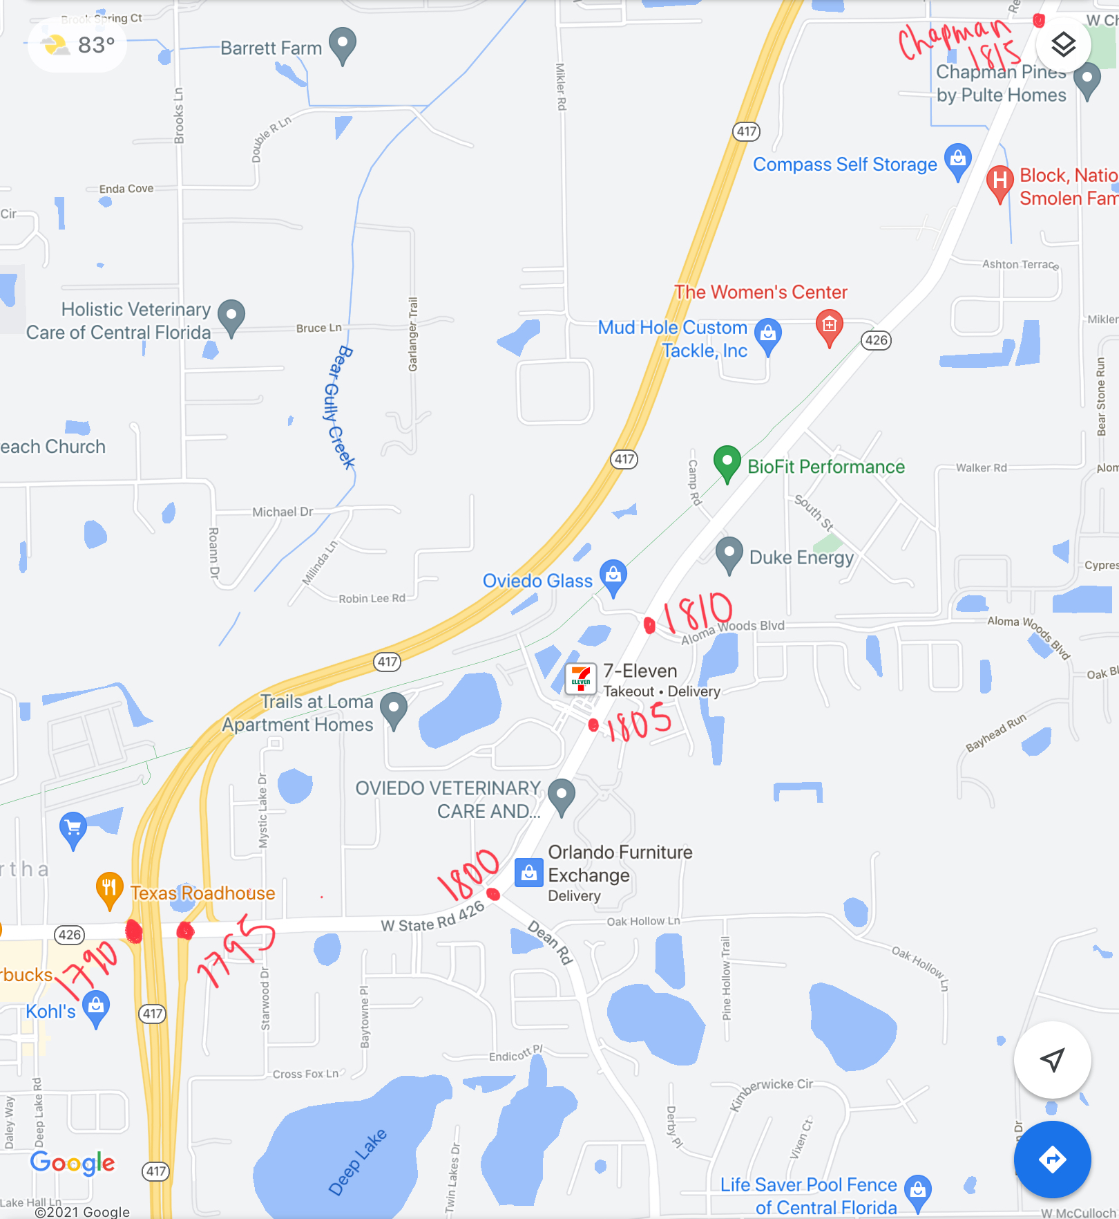
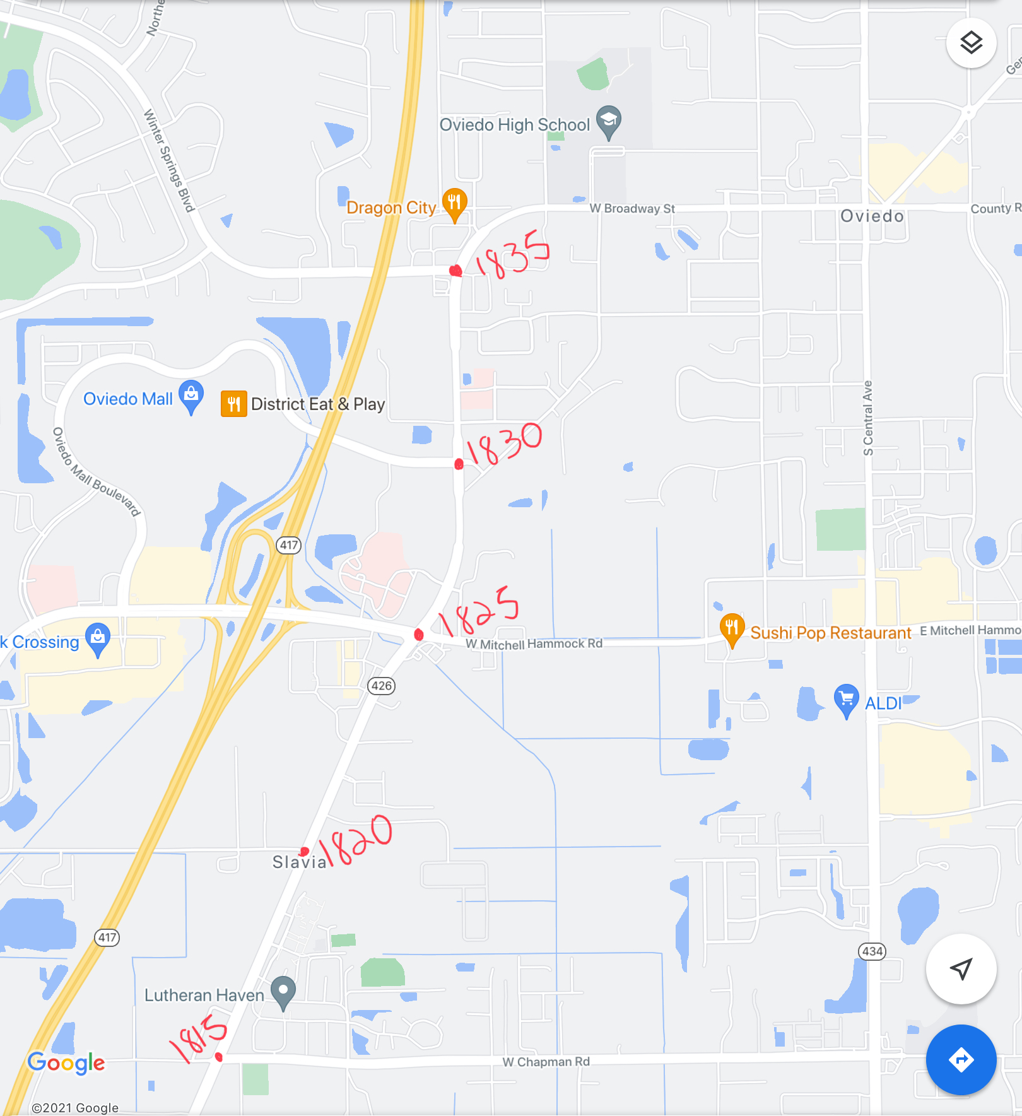

Slide 4
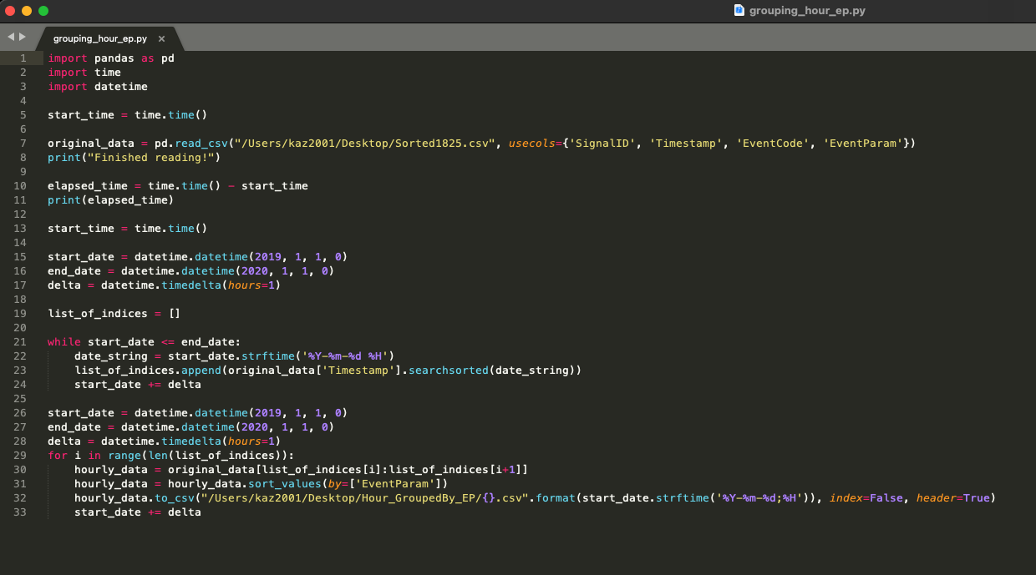
NSF REU Research Experience on Internet of Things 2021

Slide 5
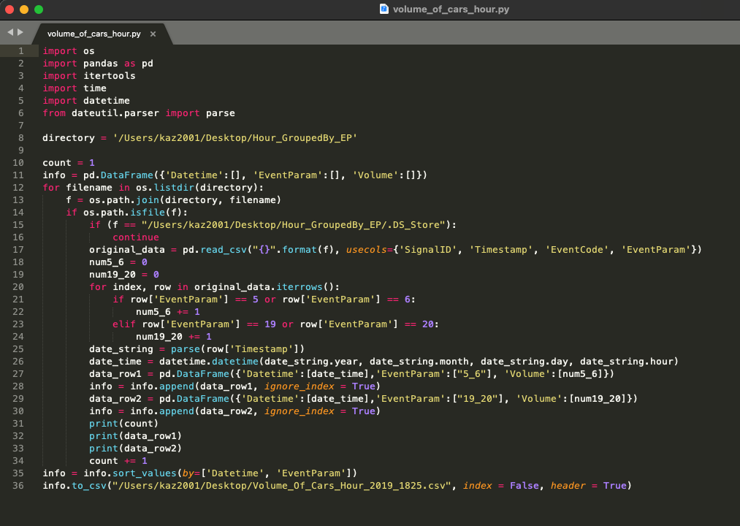
NSF REU Research Experience on Internet of Things 2021

Slide 6
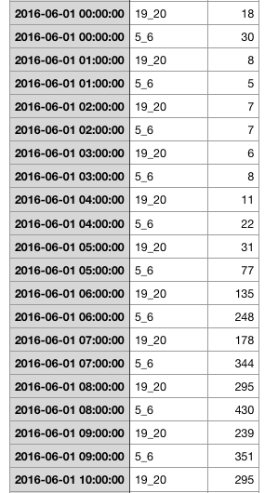
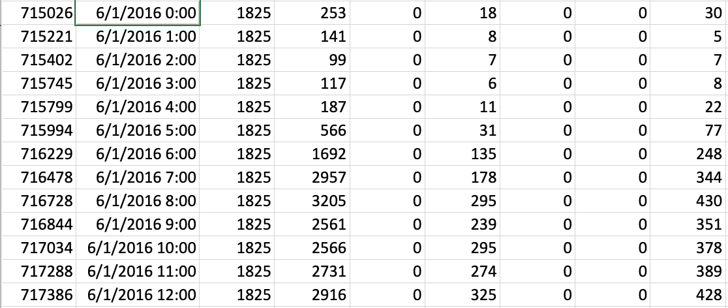
NSF REU Research Experience on Internet of Things 2021

Slide 8
Factors affecting volume
Weather | Rain
 | No rain
Hurricanes | Pre hurricane
 | Hurricane
 | NO Hurricane

Slide 9
Problem & Solutions
Trying to weigh the importance of the analysis of this data and look for a purpose that would solve a problem.
As there are 350 signals, it was difficult to choose one corridor that would benefit our research. We chose 426 because it is a big street that is comprised of different land uses, and we were already processing data from that street anyway
How to use weather? No permanent solution.
NSF REU Research Experience on Internet of Things 2021

Slide 10
Plans for next week:
Running statistical analyses to see which factors play a significant role in affecting traffic volume
Continue collecting data related to our factors that affect volume
Potentially starting the machine learning model
NSF REU Research Experience on Internet of Things 2021

