Slide 1
Project 3: Designing a mobility model using large-scale data REU Students: Leah Kazenmayer & Gabriela Ford Faculty mentor(s): Samiul Hasan & Damla Turgut
Week 5 (June 14 – June 18, 2021)
NSF REU Research Experience on Internet of Things 2021

Slide 2
Accomplishments:
Modified our variables (either dropped or simplified)
Created Multiple Linear Regression, SVR, Decision Tree, Random Forest and LSTM models (with and without factors)
Wrote our mid REU report
NSF REU Research Experience on Internet of Things 2021

Slide 3
NSF REU Research Experience on Internet of Things 2021

Slide 4
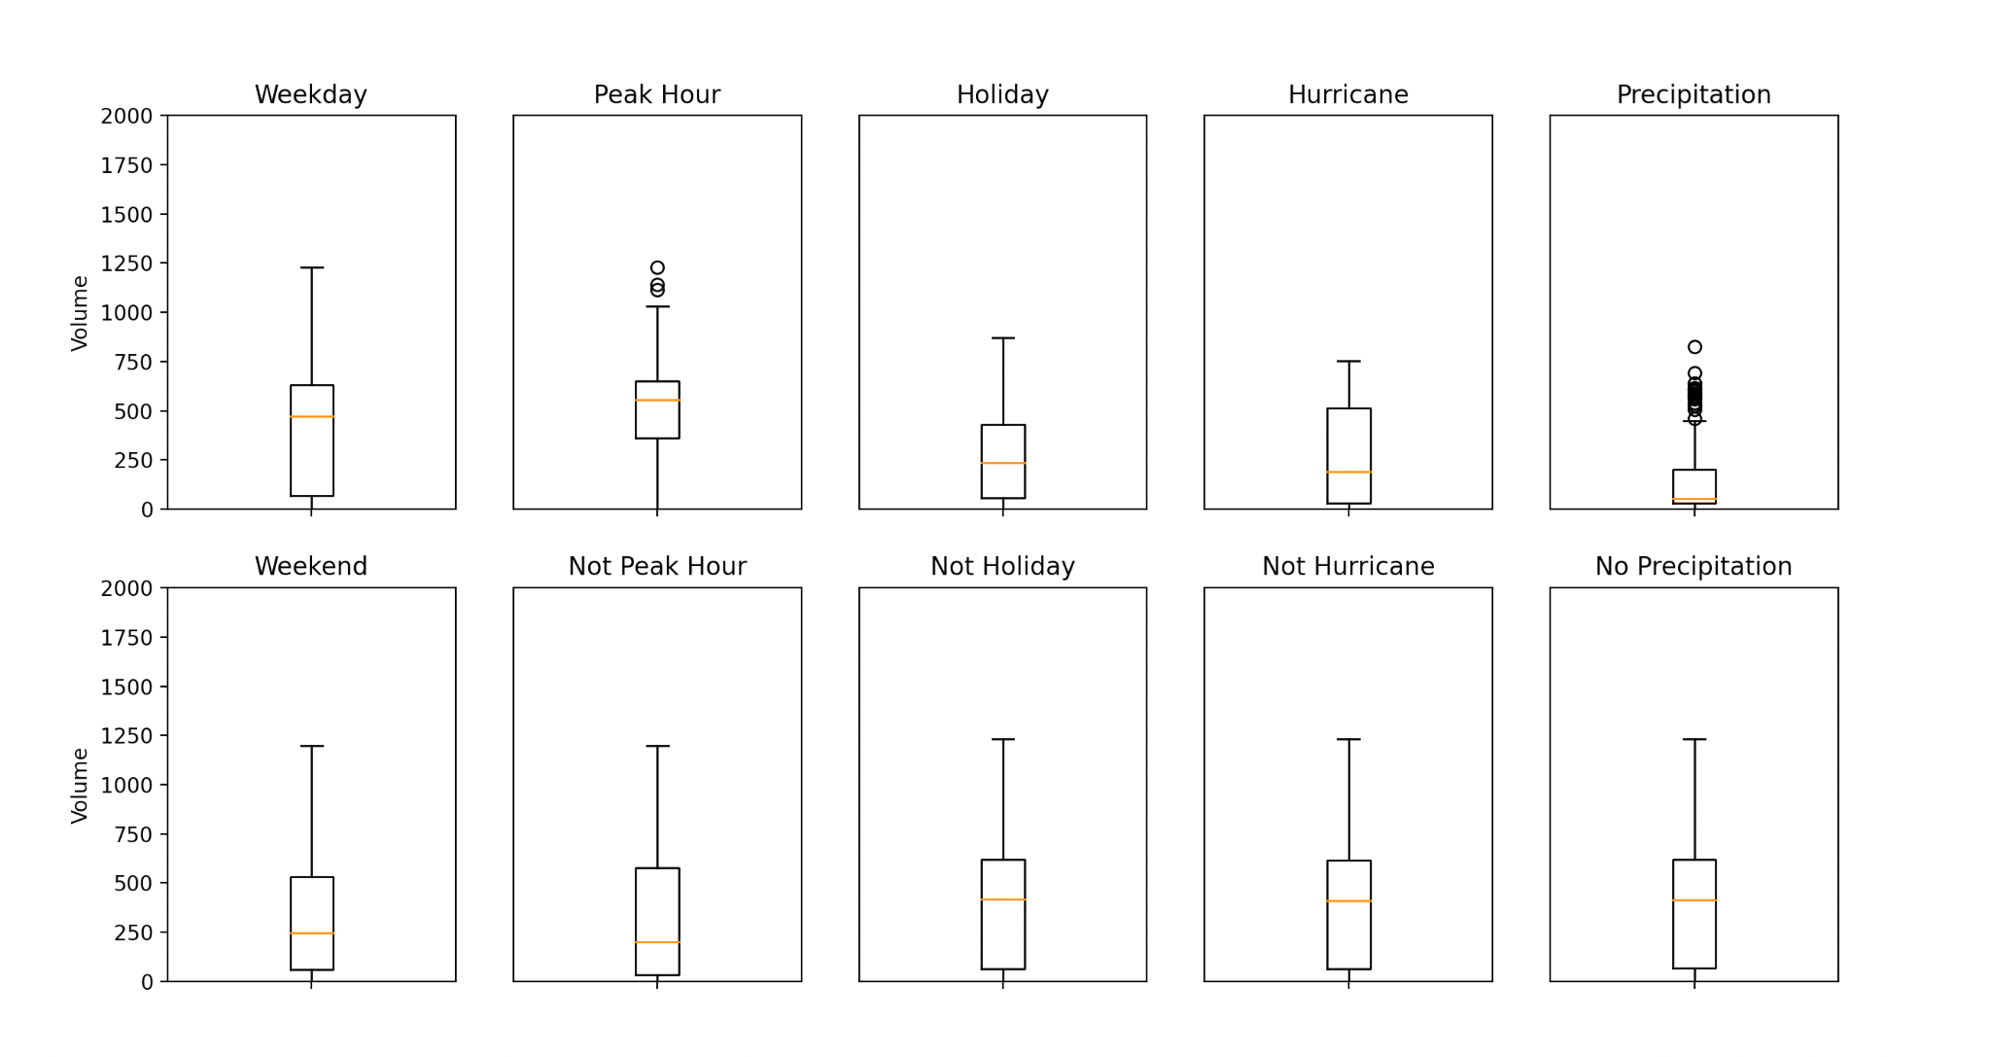
NSF REU Research Experience on Internet of Things 2021

Slide 5
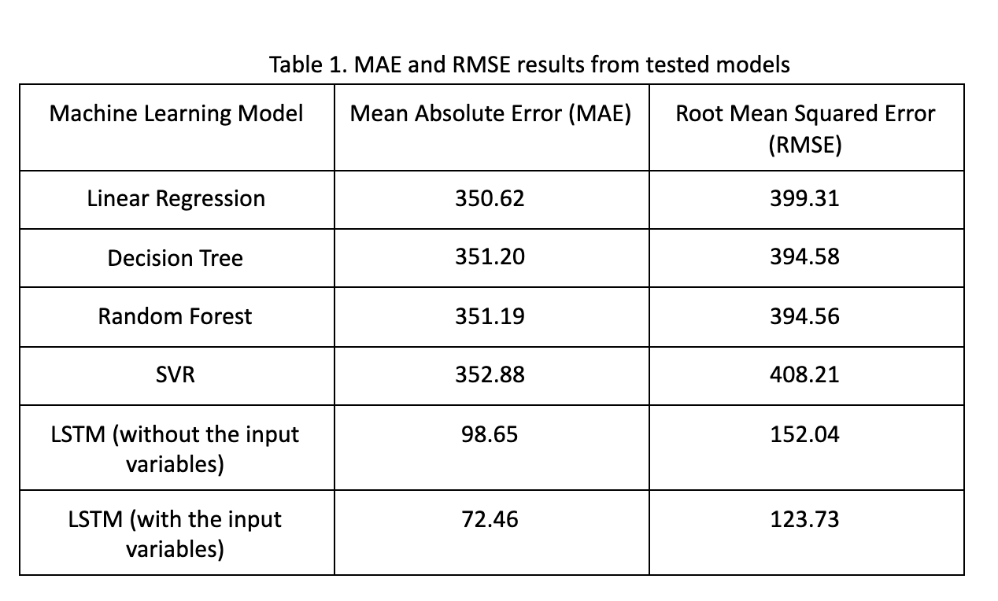
NSF REU Research Experience on Internet of Things 2021

Slide 6
Problems and Solutions:
Creating all of the machine learning models
Researched all the models online to find example codes to imitate for our specific dataset
LSTM machine learning model (with factors) did not output the MAE and RMSE correctly
Received tip from grad student; fixed the code accordingly
Did not fully understand the LSTM model
Grad student taught us all the details behind LSTM
NSF REU Research Experience on Internet of Things 2021

Slide 7
Plans for Next Week:
Perfect LSTM model and implement KNN and XGboost
Try different iterations of number of neurons, activation functions and optimizers to a make better model (lower RMSE).
Start adapting the models to more than one signal and figure out how to adapt the model for the entire corridor (if treated all together or each signal individually).
NSF REU Research Experience on Internet of Things 2021

