Slide 1
Project 3: Designing a mobility model using large-scale data REU Students: Leah Kazenmayer & Gabriela Ford Faculty mentor(s): Samiul Hasan and Damla Turgut
NSF REU Research Experience on Internet of Things 2021

Slide 2
Week 4 June 7th - June 11th, 2021
Accomplishments:
Plotted different graphs with the data
Got the final data set ready to fit into deep learning model
Problem & Solutions
Ran linear, polynomial, and other popular regression models; didn't work. Our data is not described by an equation. Decided to go for deep learning to predict the future volume of cars (hours at this point, not minutes)
Researched a lot about deep learning (watched and read tutorials online
Organized the code and files, commented the code
Cleaned and organized final data set to run in deep learning
Plans for next week:
Start deep learning with polished data set
NSF REU Research Experience on Internet of Things 2021

Slide 3
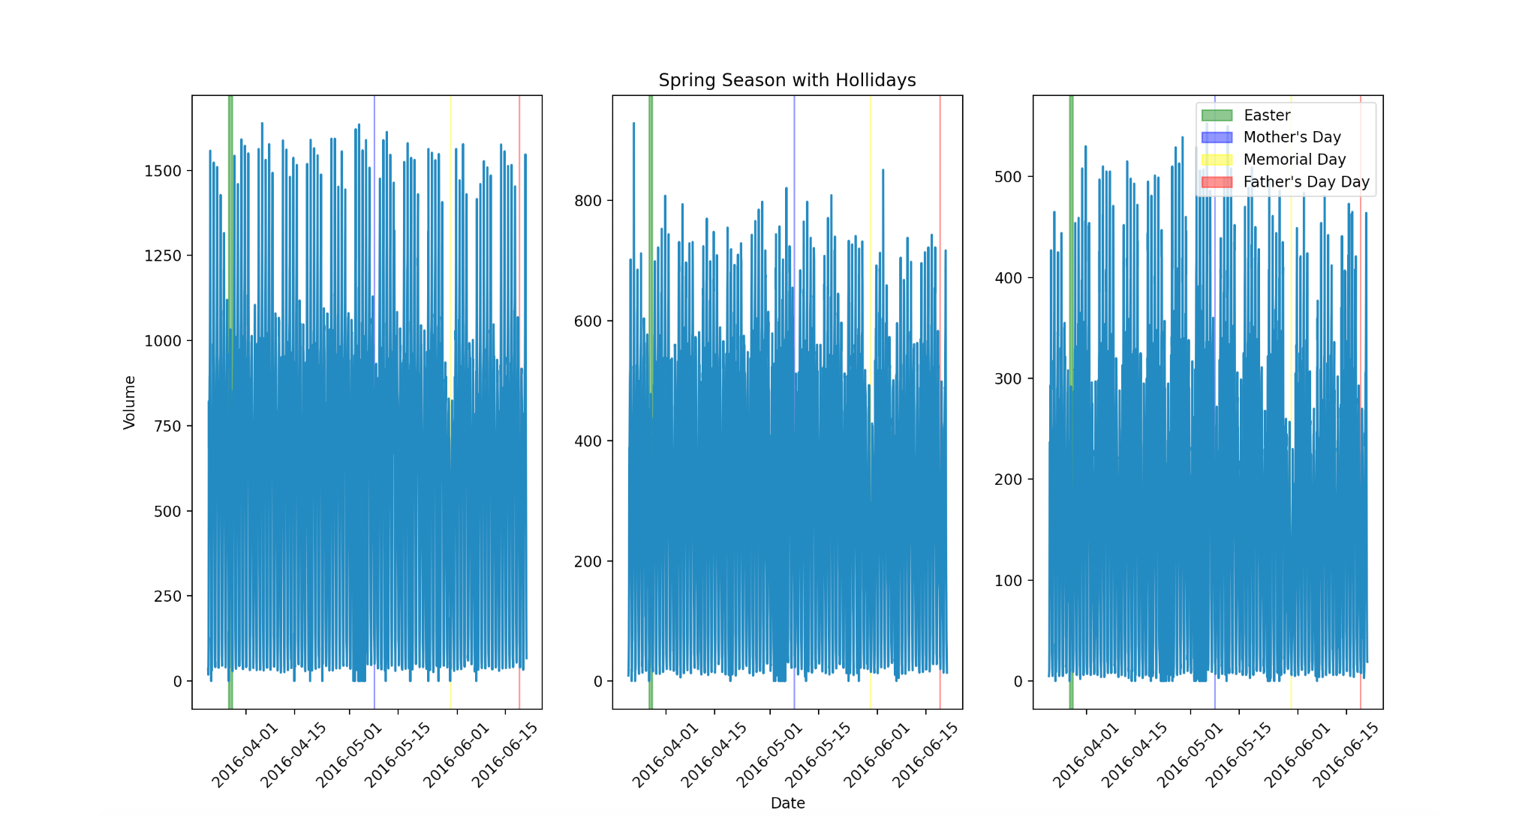

Slide 4
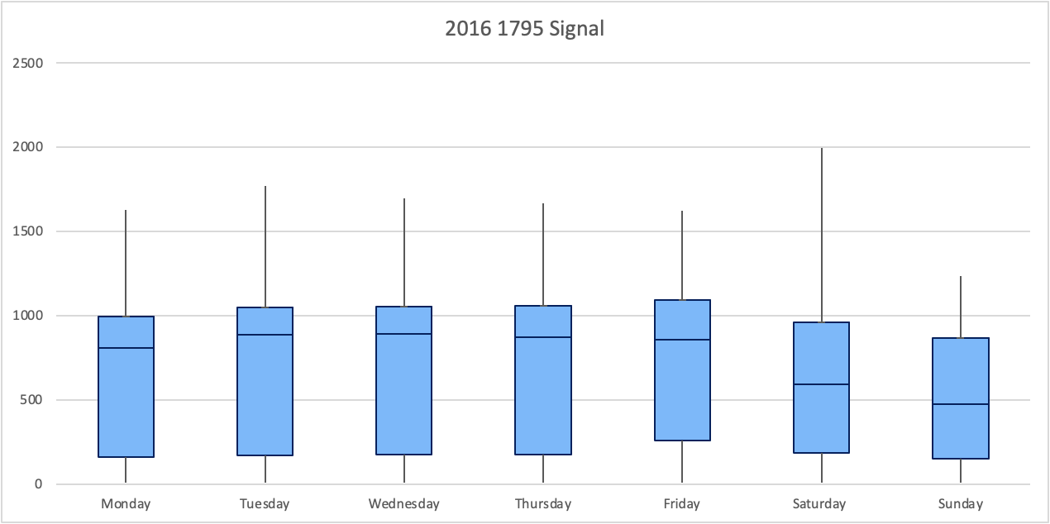
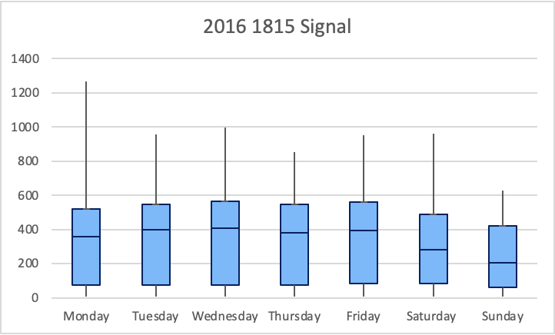
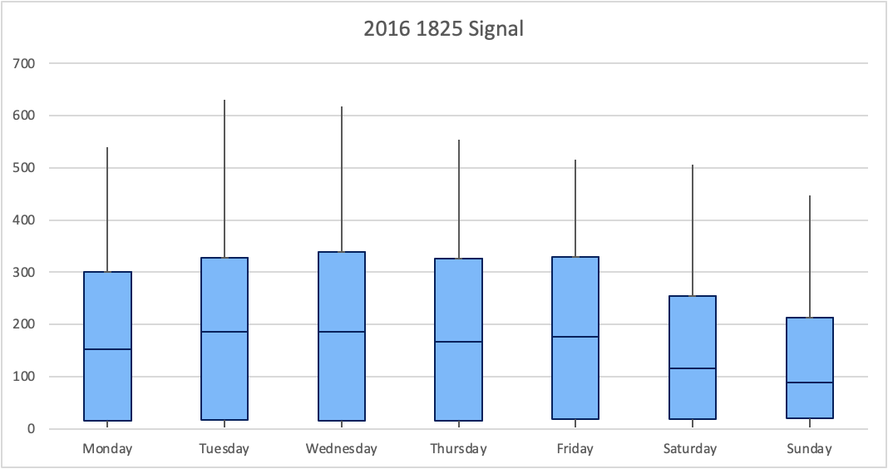
1
2
3

Slide 5
https://atspmdatavisulizaiton.herokuapp.com/

