Slide 1
Project 2: IoT and augmented reality: agents with pervasive awareness, appearance, and abilities
REU Students: Courtney Harris, Nikolas Yonkers & Connor Flick Faculty mentor(s): Gregory Welch & Gerd Bruder
Week 6(Monday, June 21 – Friday, June 24 2021)
Accomplishments:
Finished AR Gaze method
Finished development
Started our study
NSF REU Research Experience on Internet of Things 2021

Slide 2
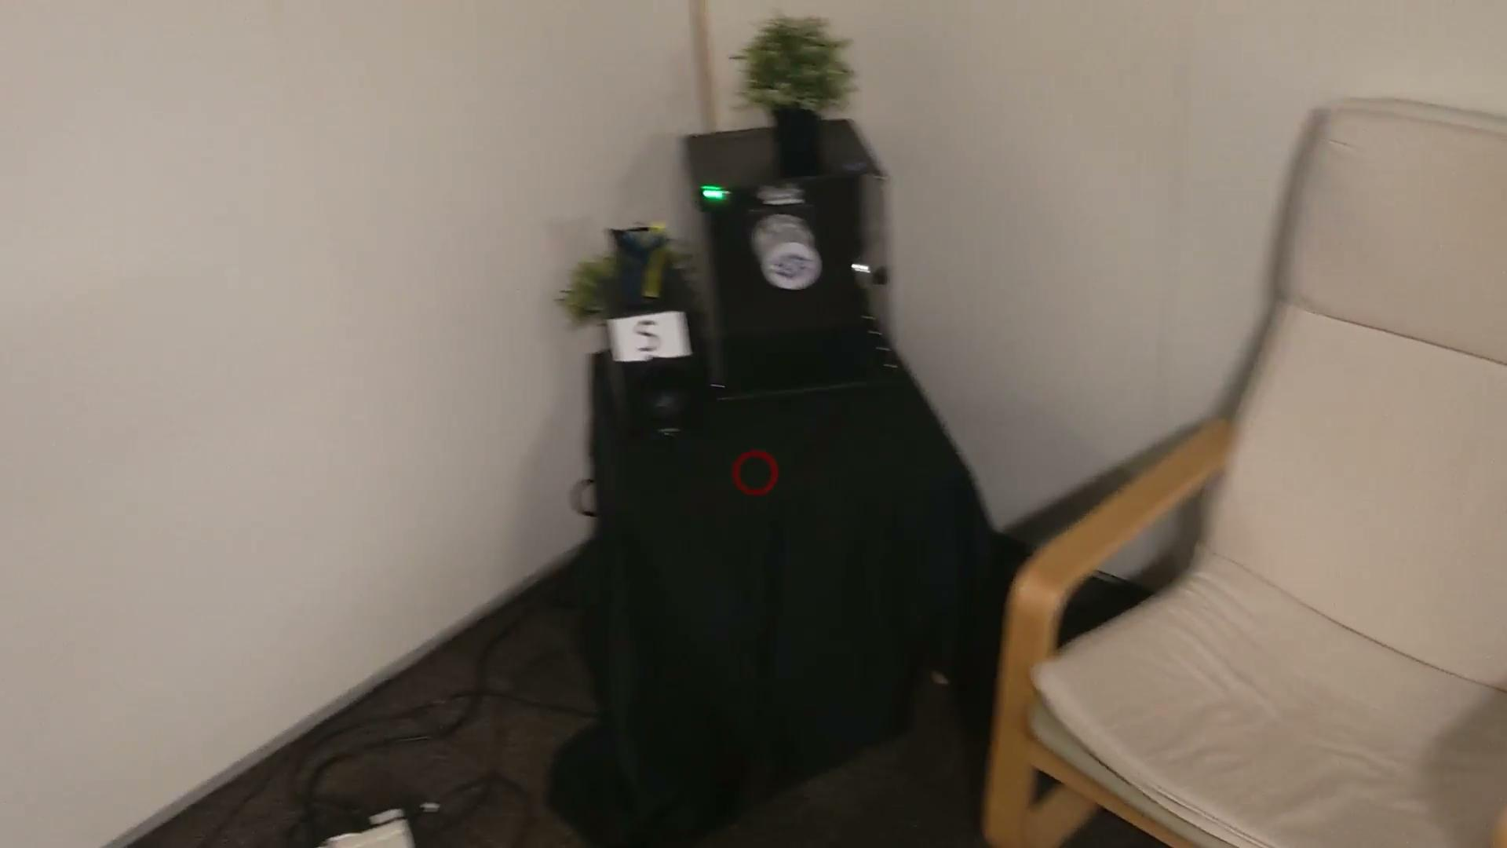

Slide 3
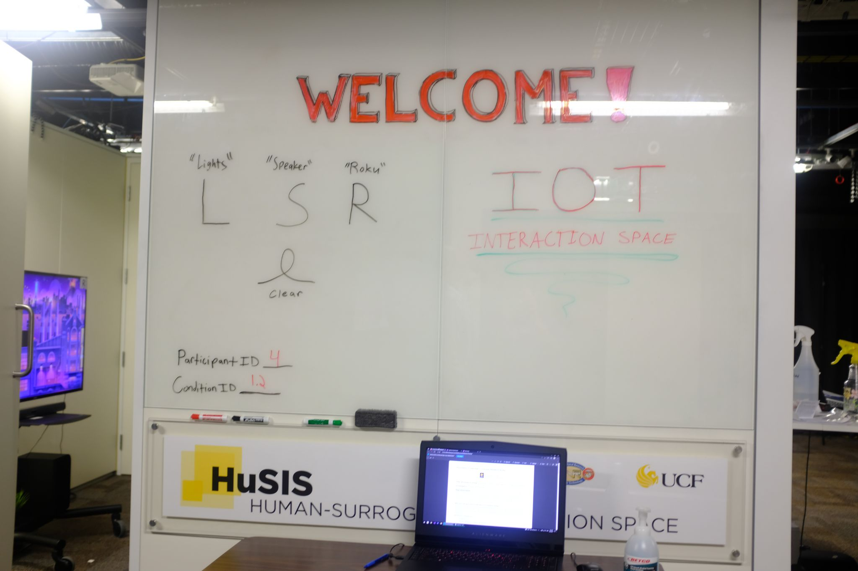

Slide 4
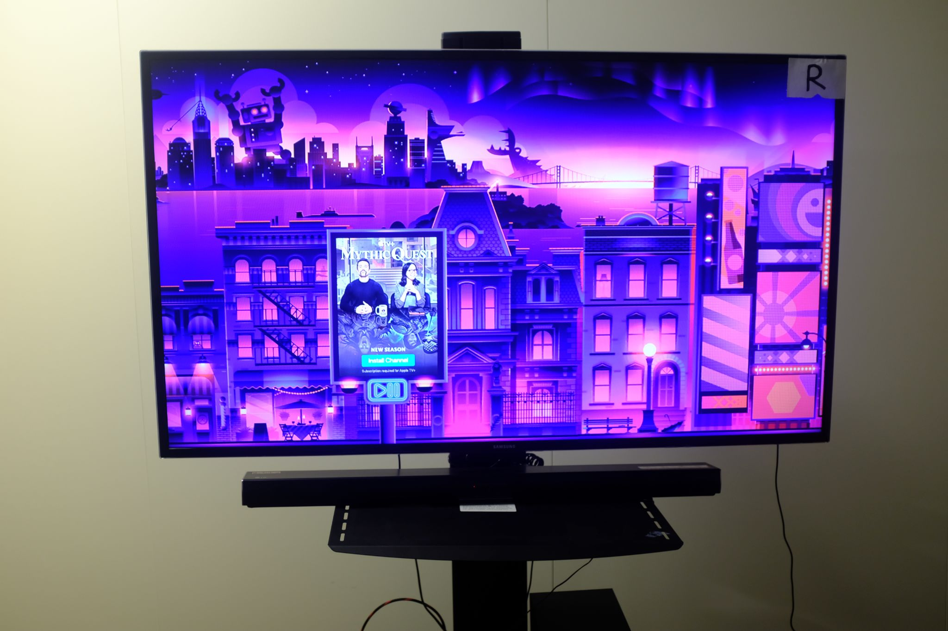
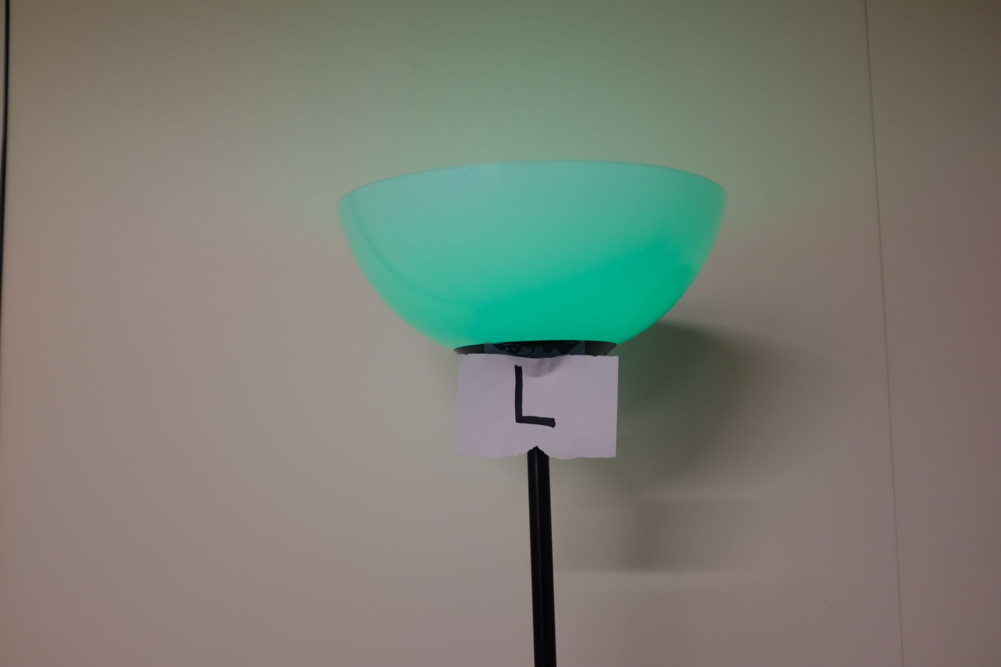
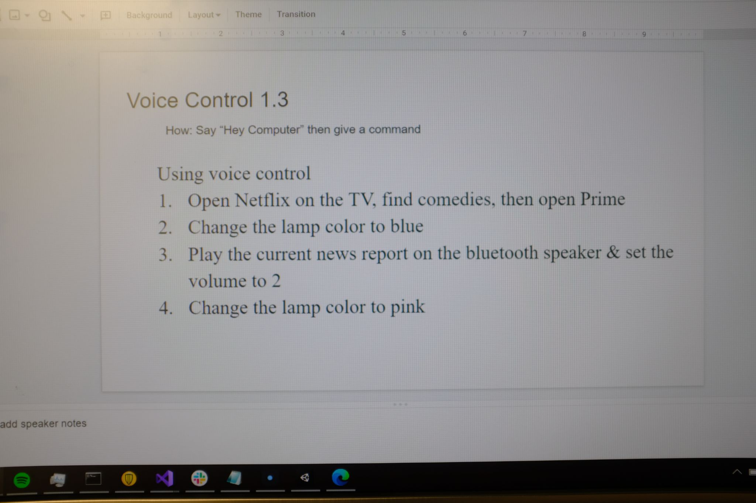

Slide 5
Project 2: IoT and augmented reality: agents with pervasive awareness, appearance, and abilities
REU Students: Courtney Harris, Nikolas Yonkers & Connor Flick Faculty mentor(s): Gregory Welch & Gerd Bruder
Week 6 (Monday, June 21 – Friday, June 24 2021)
Problem & Solutions
Debugging and finalizing code
Solution: took a while but debugged everything
Voice control tasks during the study were not functioning
Solution: Changed the tasks to something that could work, throw out data that used old tasks
Lights were inconsistently changing color, frequently ignoring inputs
Solution: Avoid sending multiple commands at once, instead focusing on the most relevant ones, in order, at any given time
NSF REU Research Experience on Internet of Things 2021

Slide 6
Project 2: IoT and augmented reality: agents with pervasive awareness, appearance, and abilities
REU Students: Courtney Harris, Nikolas Yonkers & Connor Flick Faculty mentor(s): Gregory Welch & Gerd Bruder
Week 6 (Monday, June 21 – Friday, June 24 2021)
Plans for next week:
Continue study
Analyze data
Write paper
NSF REU Research Experience on Internet of Things 2021

