Slide 1
Project 2: IoT and augmented reality: agents with pervasive awareness, appearance, and abilities
REU Students: Courtney Harris, Nikolas Yonkers & Connor Flick Faculty mentor(s): Gregory Welch & Gerd Bruder
Week 5 (Monday, June 14 – Friday, June 18 2021)
Accomplishments:
Completed AR drawing method:
user draws a gesture to connect to a specific device
gesture is recognized and appropriate menu is opened
menu allows for specific control over said device
Improved GUI of RGB lights menu
Made more progress with the gaze implementation.
Planned/prepared for study
Began research paper
Connected Unity and Hololens to Amazon Alexa
Created AR GUI for Alexa
Confirmed framework for interfacing with a Roku stick
NSF REU Research Experience on Internet of Things 2021

Slide 2
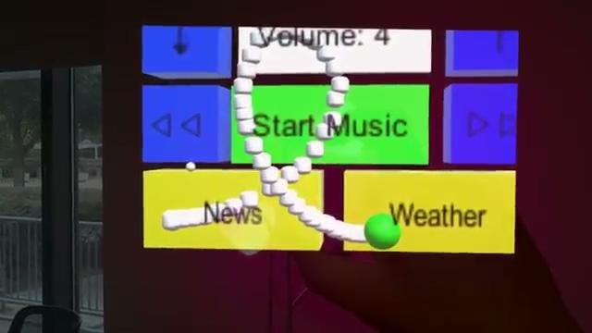

Slide 3
Project 2: IoT and augmented reality: agents with pervasive awareness, appearance, and abilities
REU Students: Courtney Harris, Nikolas Yonkers & Connor Flick Faculty mentor(s): Gregory Welch & Gerd Bruder
Week 5 (Monday, June 14 – Friday, June 18 2021)
Problem & Solutions
Hololens exporting issues
Solution: use holographic remoting instead for right now (even though it lags)
The Alexa does not have any way to execute commands remotely
Solution: Use an external app to create digital switches for the alexa to watch for changes in, which can then be associated with different “routines” and commands
The third party app isn’t designed to hold virtual switches, particularly in very large amounts, since each switch can only do one thing
Solution: Ignore useful design and press forward for now, maintaining the current system carefully
NSF REU Research Experience on Internet of Things 2021

Slide 4
Project 2: IoT and augmented reality: agents with pervasive awareness, appearance, and abilities
REU Students: Courtney Harris, Nikolas Yonkers & Connor Flick Faculty mentor(s): Gregory Welch & Gerd Bruder
Week 5 (Monday, June 14 – Friday, June 18 2021)
Plans for next week:
Final touches on development (finalized UI, wishlist items, etc.)
Connect Roku stick to Hololens
Begin study
Finalize the Gaze implementation
NSF REU Research Experience on Internet of Things 2021

