Slide 1
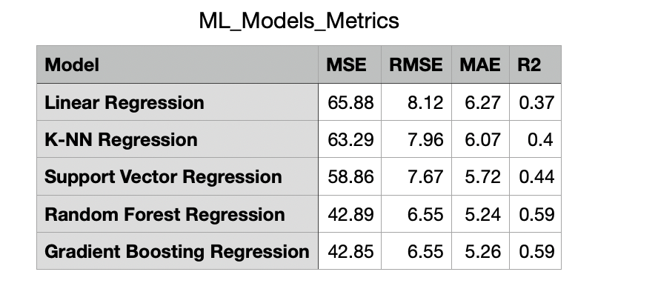
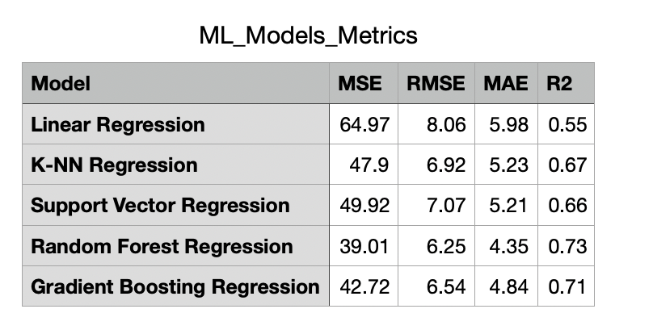


Project #:6 Processing data from a visual IoT sensor of fluid/structure interactions with machine learning
REU Students: Nicholas Boyum, and Jacob Buckelew
Faculty mentor(s): Andrew Dickerson and Damla Turgut
  Week # 6 (June 28 - July 2)
  Accomplishments:
  Applied Neverwet coating and determined that it would need to be reapplied daily
  Needed to buy more but we were able to make what we had last. Completed over 200 trials
  Began training and testing our models using the most up-to-date dataset
Results after conducting 276 Trials
Results after conducting 480 Trials
NSF REU Research Experience on Internet of Things 2021

Slide 2
  Problem & Solutions
  Due to the rain all week we had trouble reapplying the neverwet coating.
  We almost ran out of neverwet spray and had to ration it.
  Collecting Data:
    Since we are manually collecting our data, it will be best to continue focusing on data collection until the end of the program. Increasing the amount of data has increased the accuracy of our models much more than simply tuning hyperparameters.
NSF REU Research Experience on Internet of Things 2021

Slide 3
  Plans for Next Week:
  We would like to finish data collection with at least 500 trials completed.
  We will finalize our machine learning models using the complete dataset.
  Decide on a final ensemble of probably 3 machine learning algorithms
NSF REU Research Experience on Internet of Things 2021

