Slide 1
Project #:6 Processing data from a visual IoT sensor of fluid/structure interactions with machine learning REU Students: Nicholas Boyum, and Jacob Buckelew Faculty mentor(s): Andrew Dickerson and Damla Turgut
Week # 5 (June 14 - June 18)
Accomplishments:
Successfully cleaned up our spreadsheet and created a csv file that can be loaded into our python scripts
Developed a baseline linear regression model to begin our exploration into machine learning techniques.
Developed SVR and KNeighborsRegressor models and now we can begin to draw comparisons between different algorithms.
Learned how to better optimize hyperparameters of our models by using Scikit-learn’s GridSearchCV
Learned the basics of LaTeX
Began writing final journal paper in LaTeX
Began collecting images, figures and Diagrams for the final paper
NSF REU Research Experience on Internet of Things 2021

Slide 2
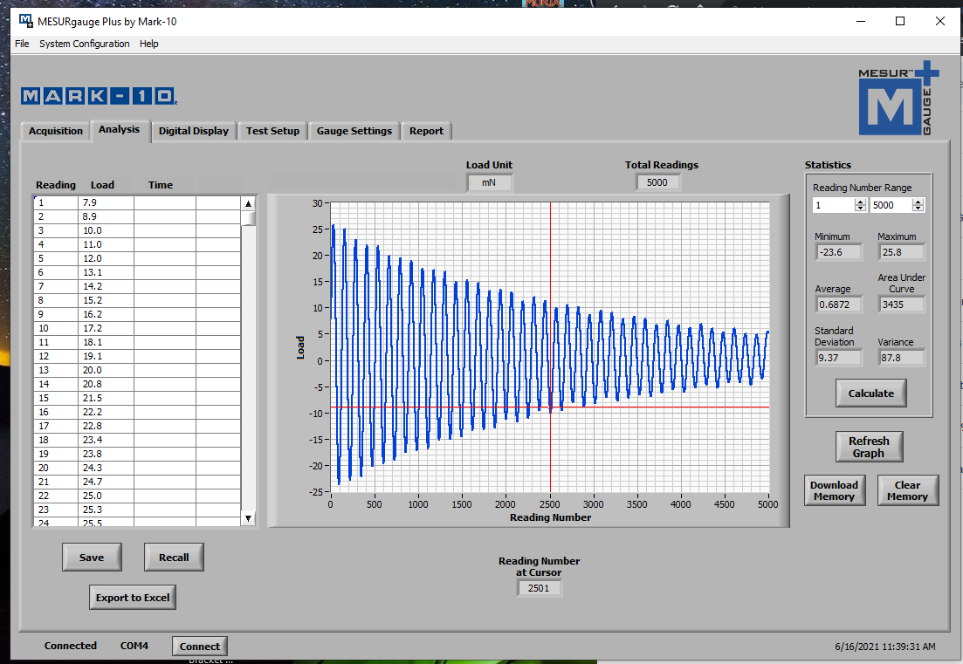
NSF REU Research Experience on Internet of Things 2021

Slide 3
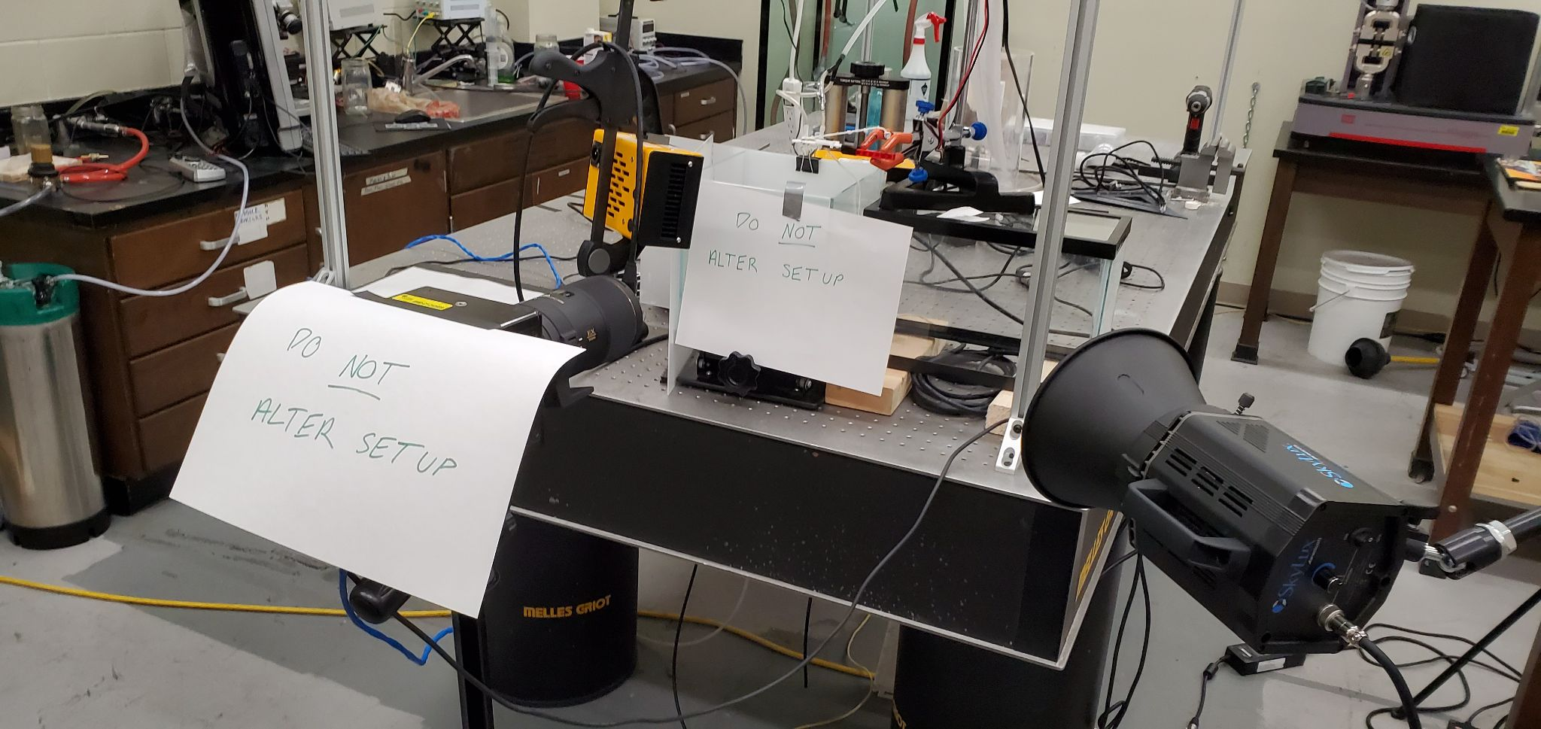
Problem & Solutions
Had problems with equipment being available in the lab
Problems with linear regression code working on Jacob’s computer but not on Nicholas’s
Had some minor problems with writing the paper in LaTex
NSF REU Research Experience on Internet of Things 2021

Slide 4
Plans for Next Week:
Gather some data in which we use NeverWet™ spray on the surfaces to make them hydrophobic. We will then have 8 features to account for rather than 7 in our machine learning models.
Explore other machine learning algorithms such as Random Forests and Gradient Boosting Algorithms
Decide on which models will be used to form an ensemble machine learning model
Continue to add more content to our publication paper. Specifically, we would like to describe in more detail what kind of computational methods we are using.
NSF REU Research Experience on Internet of Things 2021

Slide 5
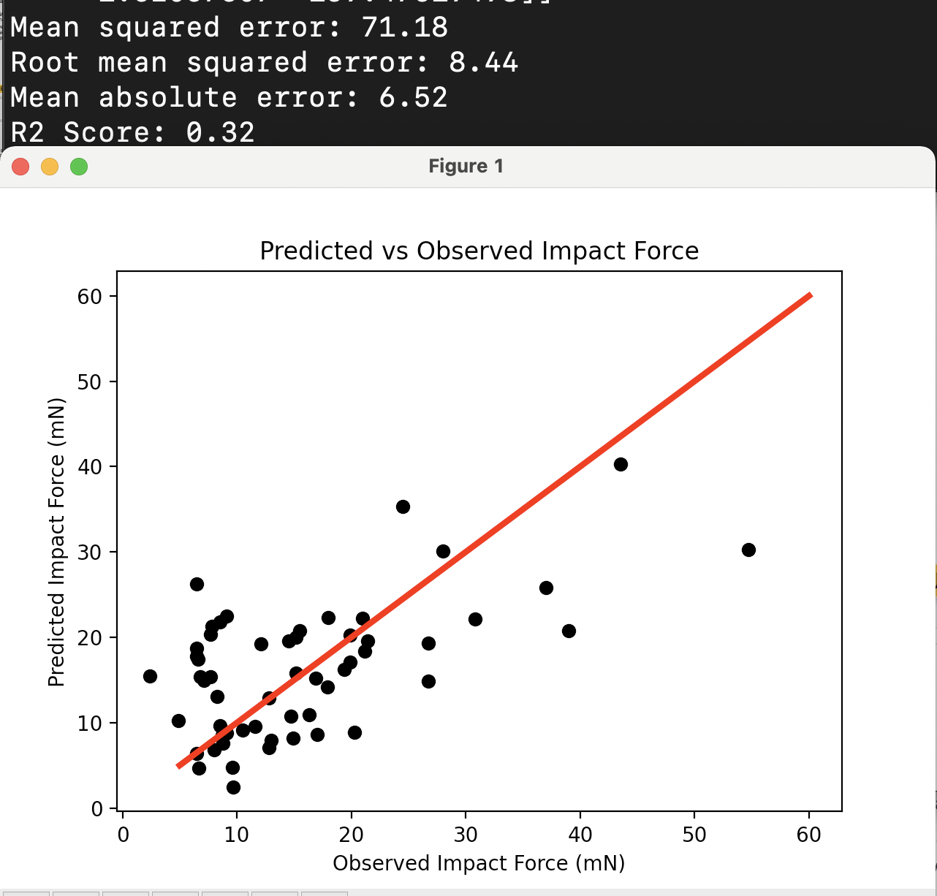
Baseline Machine Learning Algorithm using Scikit-Learn
Linear Regression
We created a baseline linear regression model using scikit-learn’s LinearRegressor
While this model is likely to be ineffective in the final paper it will still be a useful appendix item.
NSF REU Research Experience on Internet of Things 2021

