Slide 1
Project 1: IoT-enabled smart mobility devices for aging and rehabilitation REU Students: Laura Figueroa, Myat Win Faculty mentor(s): Dr. Turgut & Dr. Bӧlӧni
Week 3 (June 1 – June 4, 2021)
Accomplishments:
Processed both datasets from last week (243 pictures)
Successfully extracted variables (dictionary with the rectangle size, coordinates, labels, and certainty) to .csv
Problem & Solutions
Most of this week’s problems revolved around technical issues and digesting the program
Consulted with PhD students
Processing all data takes long
Extracting data from each processed image was challenging
Plans for next week:
Manually measure distance and eventually train the model
Make adjustments to better detection algorithms by processing the dataset
Add more weights (wall, door, stair, elevator, trash can)
NSF REU Research Experience on Internet of Things 2021

Slide 2
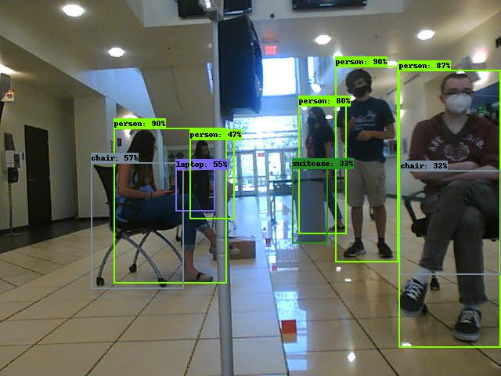
Objection detection Testing
NSF REU Research Experience on Internet of Things 2021

Slide 3
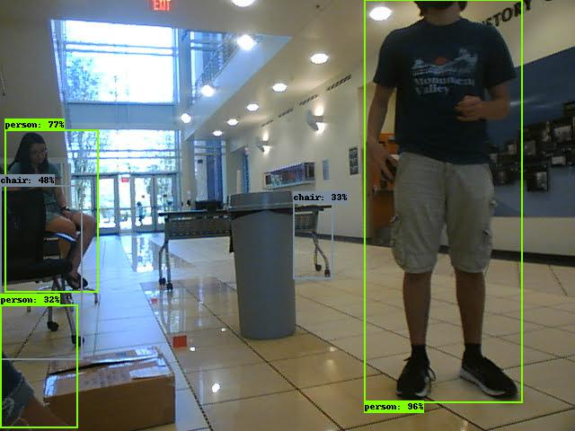
Objection detection Testing
NSF REU Research Experience on Internet of Things 2021

