Slide 1
Project 1: IoT-enabled smart mobility devices for aging and rehabilitation REU Students: Laura Figueroa, Myat Win Faculty mentor(s): Dr. Turgut & Dr. Bӧlӧni
Week 2 (May 24 – May 28, 2021)
Accomplishments:
Testing on efficentdet network
Exporting/Live casting web-cam output
Variable/Information extraction (dictionary with the rectangle size, coordinates, labels, and certainty)
Problem & Solutions
Web camera issues with connectivity, motion, and automation X fps
Reading through efficentdet code to find variables we needed
Plans for next week:
Next week will mostly consist of data collection, analysis, and hopefully starting the training process of our predictive model.
NSF REU Research Experience on Internet of Things 2021

Slide 2
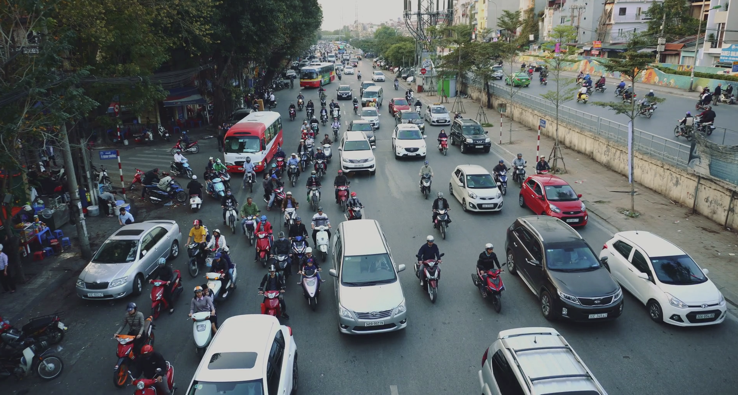
Objection detection Testing
NSF REU Research Experience on Internet of Things 2021

Slide 3
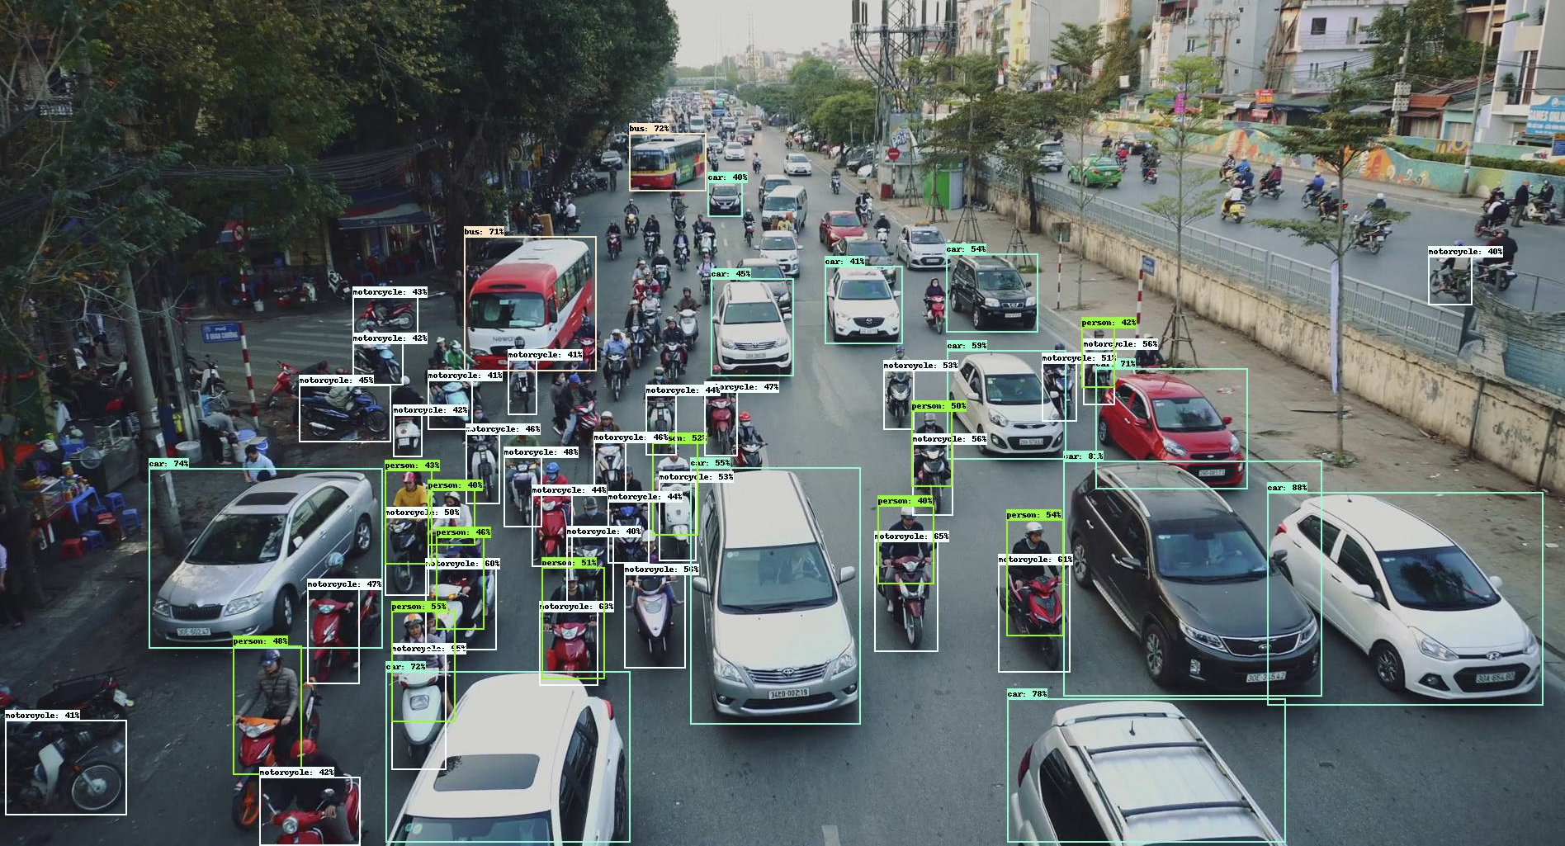
Objection detection Testing
NSF REU Research Experience on Internet of Things 2021

Slide 4
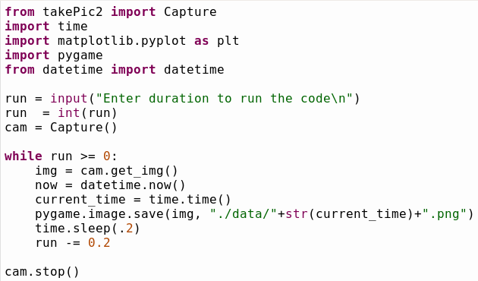
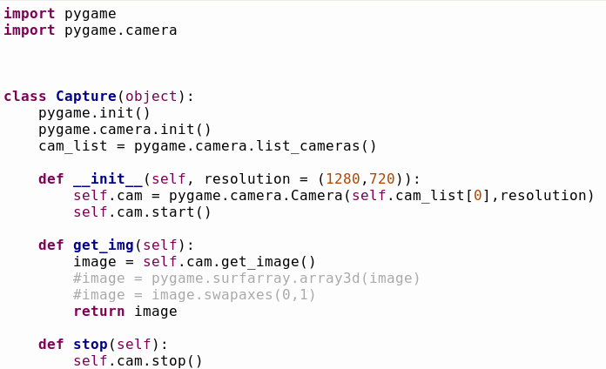
Raspberry Pi Code
NSF REU Research Experience on Internet of Things 2021

Slide 5
Volunteers Needed
In order to build towards an obstacle aversion program, we must first work towards a predictive model that will predict obstacles’ distance
Overview:
Participants will stand in assigned spots and move as directed down a straight hallway about 30 ft taking 5 fps
NSF REU Research Experience on Internet of Things 2021

