Slide 1
Project 7: IoT Augmented Physical Scale Model of a Suburban Home REU Students: Estefanía Sánchez and Caitlin Petro Faculty mentor(s): Damla Turgut and Ladislau Bölöni
Graduate mentor(s): Safa Bacanli and Furkan Cimen
Week 3 (Tuesday June 1 – Friday June 4, 2021)
Accomplishments:
Completed server-client network.
Began implementation of new weather simulation devices.
Finished writing simulation files.
Made a Github repository to hold all of our information, as well as information collected by previous REU’s.
Began discussing which machine learning algorithm(s) would work best for our project.
NSF REU Research Experience on Internet of Things 2021

Slide 2
Cont.
Problem & Solutions:
Setbacks with data collection.
We got ahead on other parts of the project in the meantime.
Plans for next week:
Begin sensor data collection.
Begin writing the machine learning algorithm to use the data on.
Set up enclosure.
NSF REU Research Experience on Internet of Things 2021

Slide 3
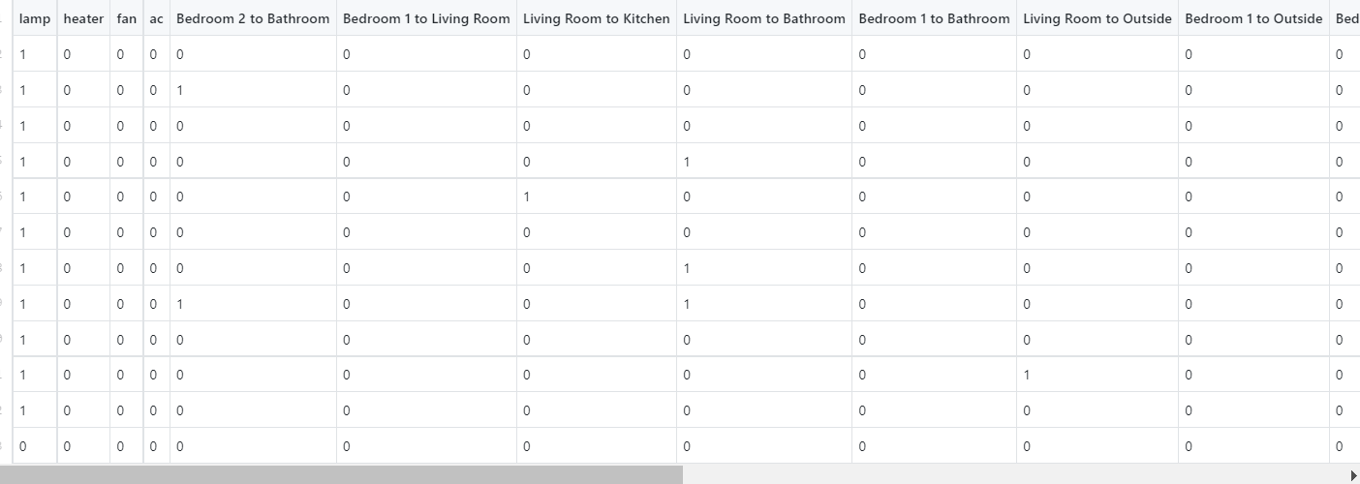
Partial Data Collected
NSF REU Research Experience on Internet of Things 2021

Slide 4
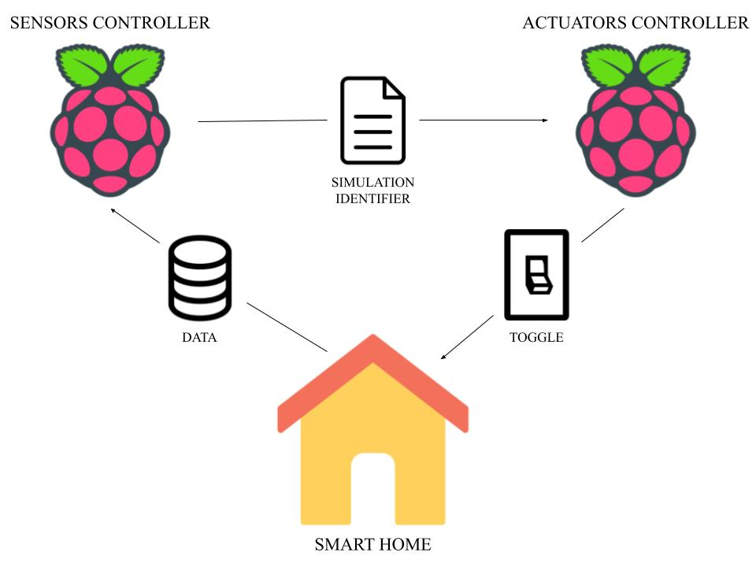
Current Architecture
NSF REU Research Experience on Internet of Things 2021

