Slide 1
Project 7: IoT Augmented Physical Scale Model of a Suburban Home REU Students: Estefanía Sánchez and Caitlin Petro Faculty mentor(s): Damla Turgut and Ladislau Bölöni
Graduate mentor(s): Safa Bacanli and Furkan Cimen
Week 2 (Monday, May 24 – Friday, May 28, 2021)
Accomplishments:
Set up a server-client network to connect the sensor and actuator controllers
Reworked the code for the actuator controllers to make it more flexible and expandable.
Tested 8 Channel Relay
Wrote preliminary simulations
NSF REU Research Experience on Internet of Things 2021

Slide 2
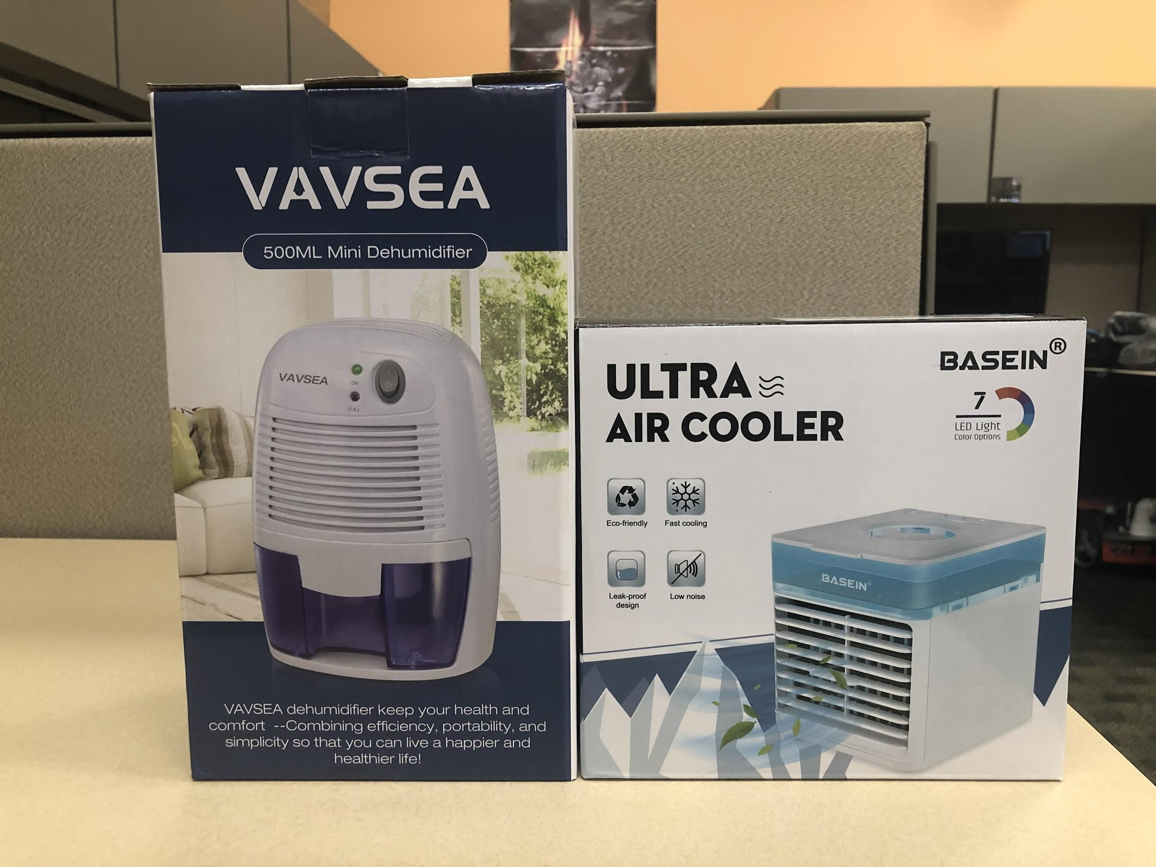
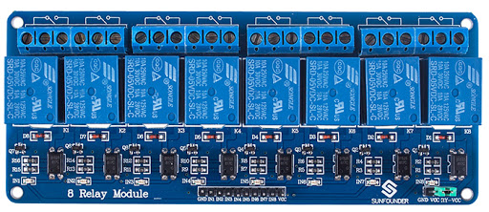
Planning For Next Week
Hook up 8 Channel Relay Module to Raspberry Pi so that we are able to have control over our new air cooler and dehumidifier
Begin planning scenarios for data collection
Optimize and further expand the code for the actuator controllers
Finalize server-client communication
Roof aesthetics
NSF REU Research Experience on Internet of Things 2021

Slide 3
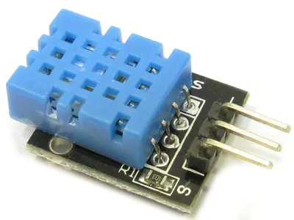
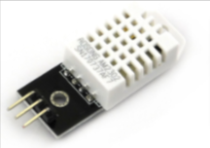
Problems and Solutions
Did not get the most consistent temperature and humidity readings from sensors
Upgraded from DHT11 to DHT22 sensors
Lack of available relays for our new weather simulation devices
Tested 8 Channel Relay
Collected data was not formatted correctly
Rewrote code that writes sensor data to csv files
General technical issues throughout the house
Checking connections and following wires to see what’s been disconnected
 | DHT11 | DHT22
Humidity Accuracy | ±5%RH | ±2%RH (max ±5%RH)
Temperature Accuracy | ±2°C | ±0.5°C
NSF REU Research Experience on Internet of Things 2021

Slide 4
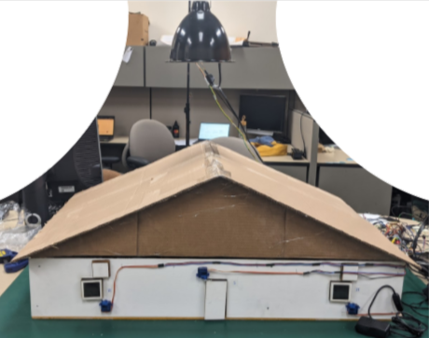
Current State of House (internal next slide)
Notable Changes
Finished roof construction
Aesthetics in progress
Raised lamp
Increases realism of experiment
Decreases fire hazard
NSF REU Research Experience on Internet of Things 2021

Slide 5
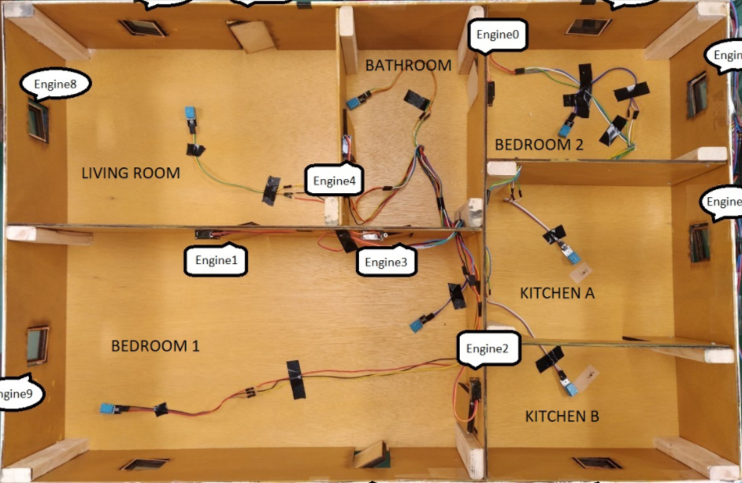
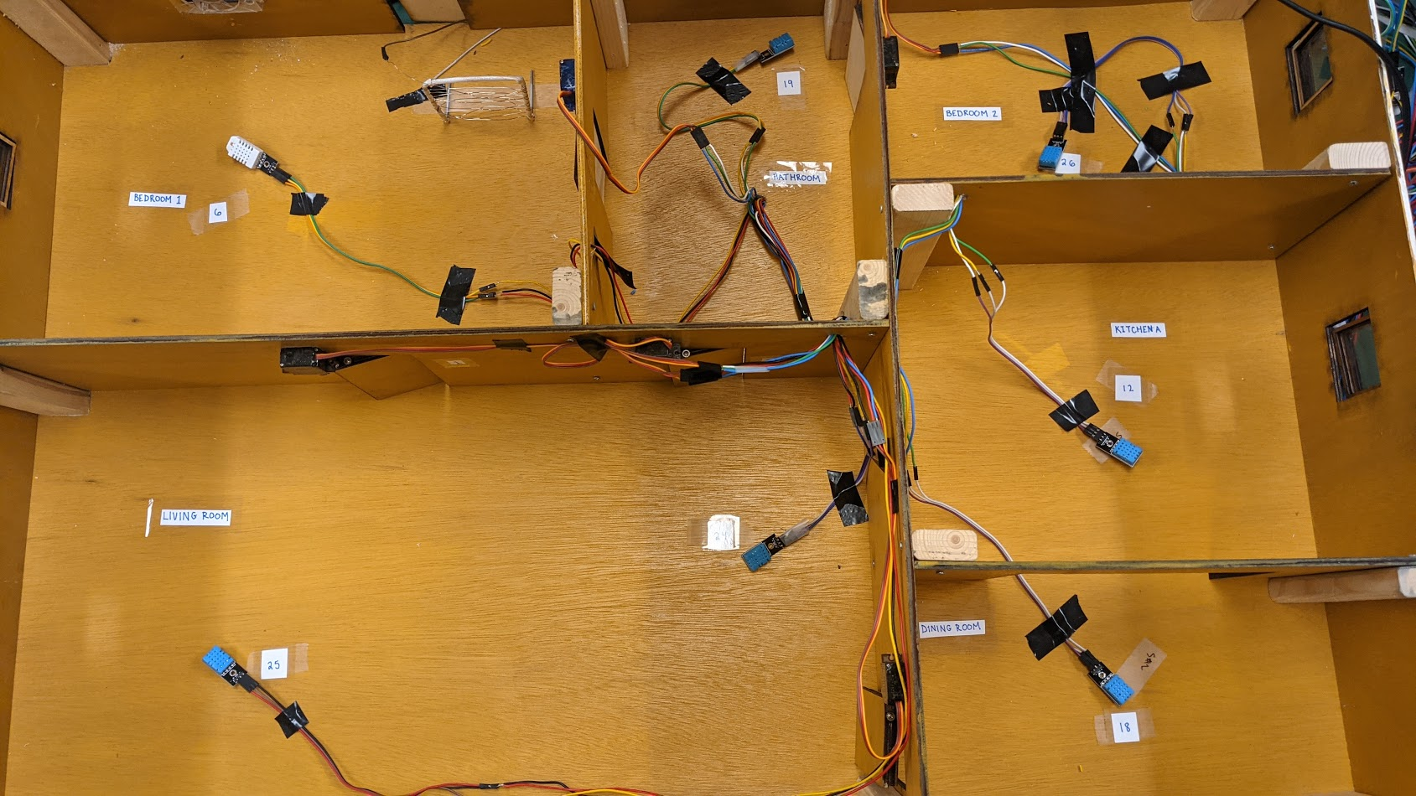
Interior Labeling
Increases realism of experiment
BEDROOM 2
BEDROOM 1
BATH
KITCHEN
LIVING ROOM
DINING
before
after
NSF REU Research Experience on Internet of Things 2021

Slide 6
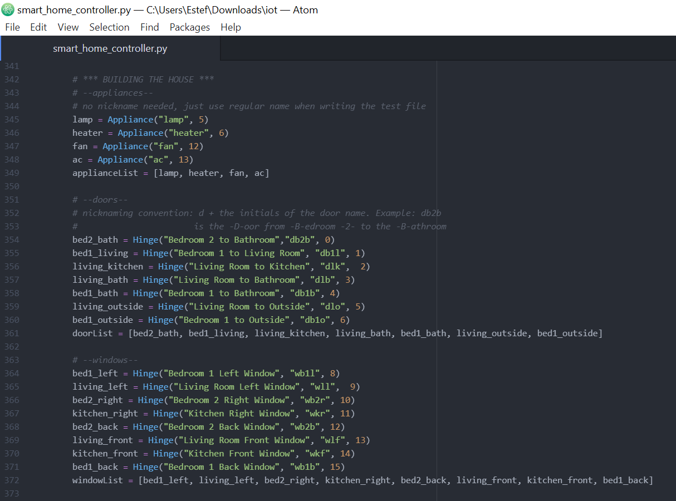
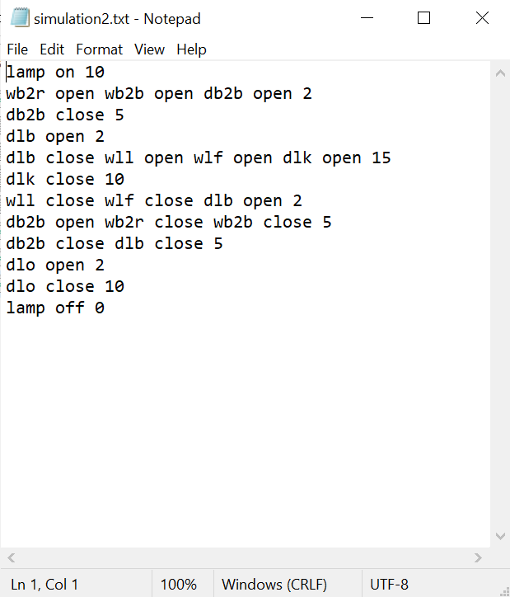
New House Controls
NSF REU Research Experience on Internet of Things 2021

Slide 7
Simulation Demo
https://youtu.be/10g9KbT5XdE
NSF REU Research Experience on Internet of Things 2021

