Slide 1
Project 5: Manufacturing IoT sensors: a flexible and wearable UV radiation sensor based on metal oxide semiconductors REU Students: Celine Ramirez & Tolga Koc
Graduate Students: Pawan Pathak & Arshya Bamshad Faculty mentor(s): Dr. Hyoung Cho & Dr. Lotzi Böloni
Week 2 (May 24 – May 26, 2021)
Accomplishments:
Attached the HC-05 bluetooth module and 7.4V rechargeable battery to the circuit.
Wireless data transmission between the UV sensor and Arduino.
Problem & Solutions
Compacting the circuit to work efficiently as a wearable device - PCB, Smaller electronic components (microcontroller, leds, resistors, etc.), and solar powered battery.
Plans for next week:
Design and print the PCB.
Compact the circuit.
NSF REU Research Experience on Internet of Things 2021

Slide 2
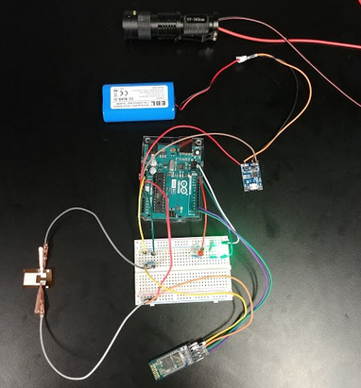
UV Flashlight (365 nmn)
7.4V Rechargeable Battery
Arduino Uno
Battery charging port/protector board
UV Sensor
HC05 Bluetooth module
NSF REU Research Experience on Internet of Things 2021

