Slide 1
Project 5: Manufacturing IoT sensors: a flexible and wearable UV radiation sensor based on metal oxide semiconductors REU Students: Celine Ramirez & Tolga Koc
Graduate Students: Pawan Pathak & Arshya Bamshad Faculty mentor(s): Dr. Lotzi Böloni & Dr. Hyoung Cho
Week 1 (May 17 – May 21, 2021)
Accomplishments:
Became familiar with the Arduino Uno and UV sensor circuitry.
Collected data from the sensor. Colour-coded LEDs respond to varying intensities of UV light.
Problem & Solutions
Uncalibrated sensor: We will have to fabricate a sensor that is more precise in its readings.
Unitless data received from sensor following analog-digital conversion. A UV meter will be used to measure the intensity to make previous data useful.
Plans for next week:
Affix bluetooth module to Arduino Uno for wireless data collection.
Sensor calibration
NSF REU Research Experience on Internet of Things 2021

Slide 2
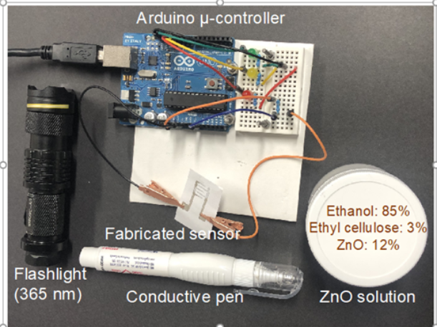
NSF REU Research Experience on Internet of Things 2021

Slide 3
LED response to varying UV radiation intensity:
NSF REU Research Experience on Internet of Things 2021

