Slide 1
Project 5: Manufacturing of IoT Sensors: UV & Electrochemical REU Students: Tolga Koc & Celine Ramirez
Graduate Mentor(s): Arshya Bamshad & Pawan Pathak Faculty Mentor(s): Dr. Hyoung Jin Cho & Dr. Ladislau Bölöni
Week 3 (June 1st - June 4th, 2021)
Accomplishments:
Learning Configuration of Various Cells
Learning more about Electrochemistry
Finished Circuit for Electrochemical Sensor
Able to Output Data directly to Arduino
Problem & Solutions
Need to calculate all voltage drops, capacitance, etc. (Kirchhoff's Law & Ohm’s Law) to get correct output of data
Circuit gave different voltage outputs
A lot of noise in data.
Solution: Use Resolution Bits to calibrate sensor for meaningful data
Solution: Test each individual cell to make sure there was no damage in cell (There was)
Solution: Replace Damaged Cells
Solution: Solder Circuit onto a Certified Breadboard
Plans for next week:
Run Circuit using certified Breadboard
Transfer Circuit over to PCB Board for Device
NSF REU Research Experience on Internet of Things 2021

Slide 2
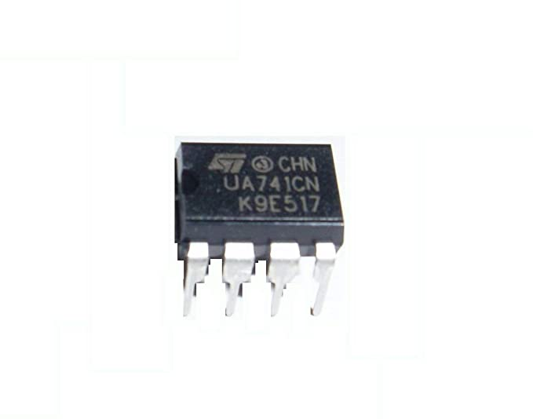
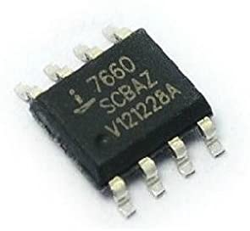
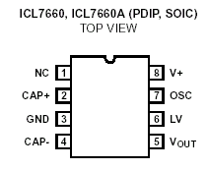
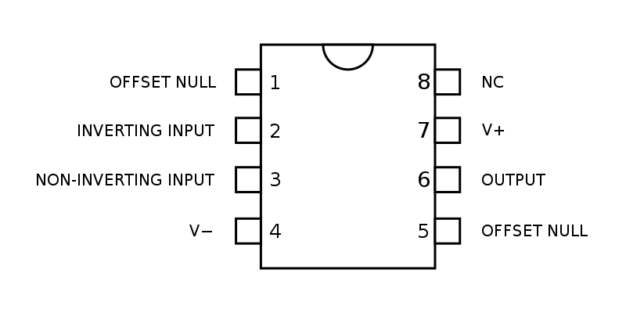
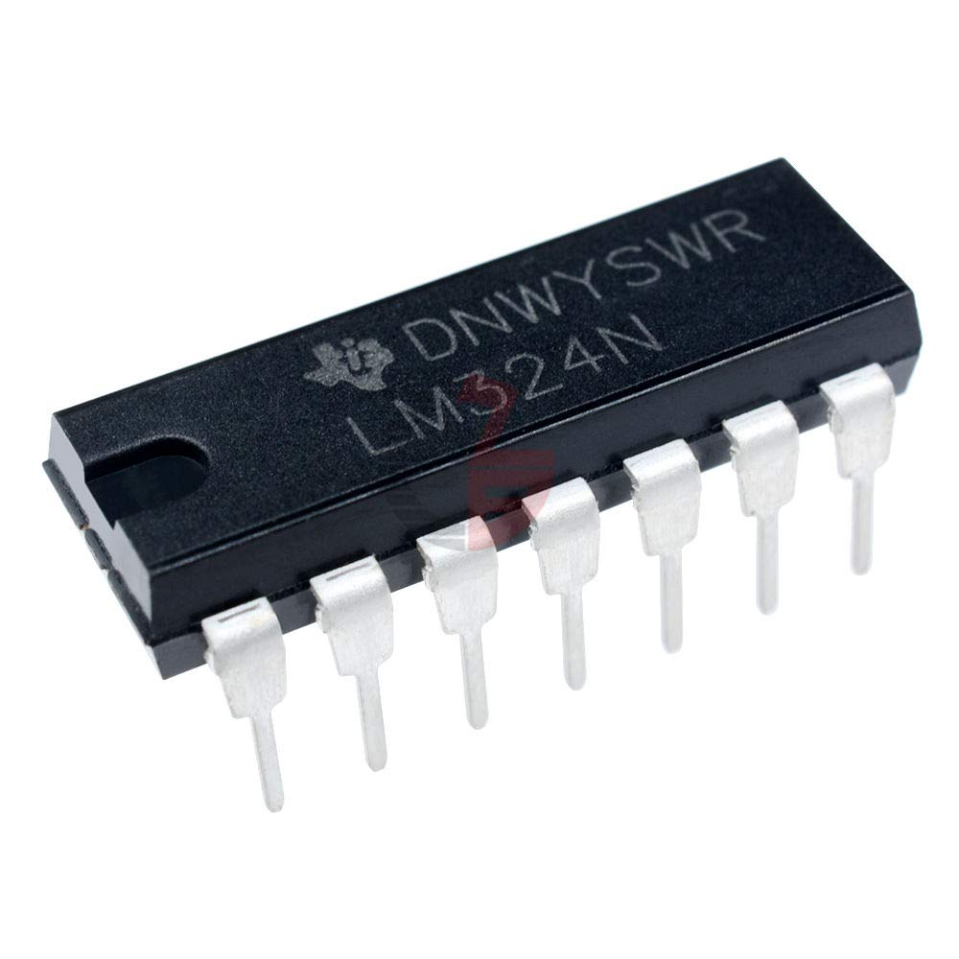
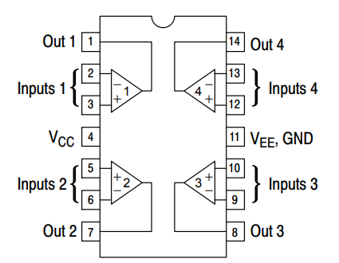
Cells & Pin Layouts
UA741- Single Operational Amplifier
ICL7660-Voltage Converter
LM324- Quad Operational Amplifier
NSF REU Research Experience on Internet of Things 2021

Slide 3
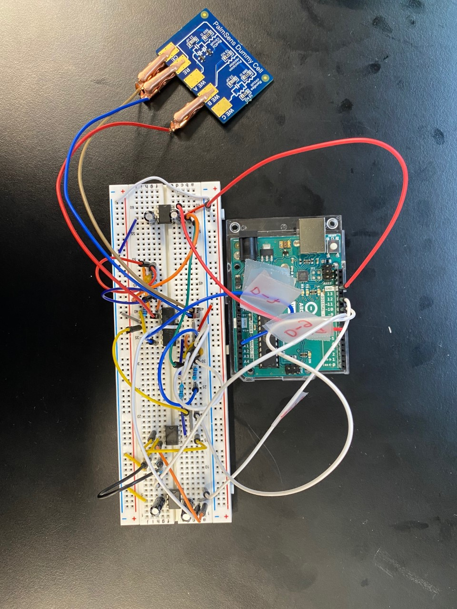
Circuit Layout
Legend:
ICL7660:
LM324:
UA741:
NSF REU Research Experience on Internet of Things 2021

Slide 4
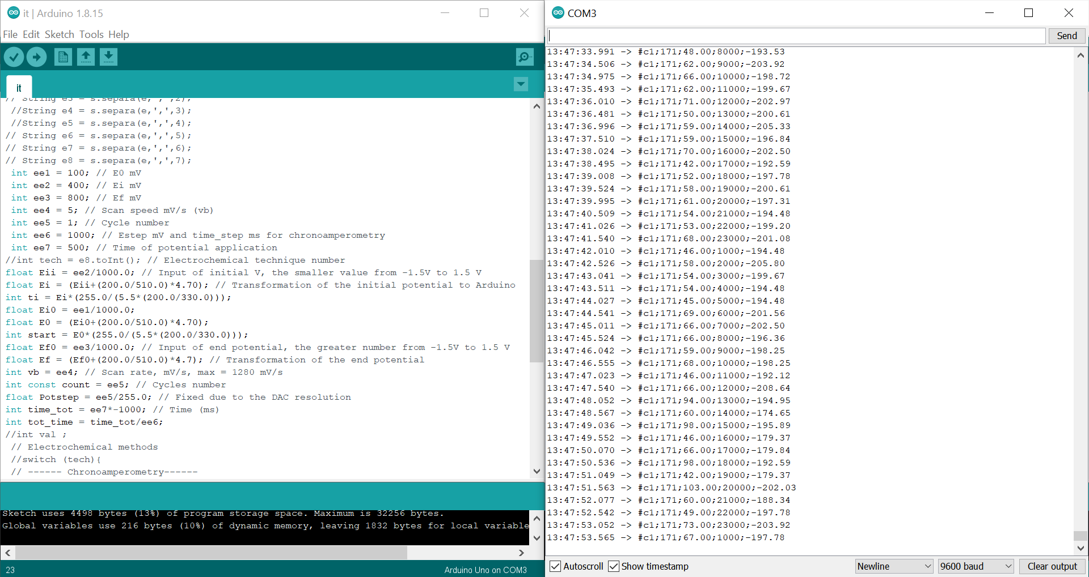
Chronoamperometry Code and Data Collection
Time(s)
Case
Data(Resolution Bits)
Current (μA)
NSF REU Research Experience on Internet of Things 2021

