Slide 1
Project 5: Manufacturing of IoT Sensors: UV & Electrochemical REU Students: Tolga Koc & Celine Ramirez
Graduate Mentor(s): Arshya Bamshad & Pawan Pathak Faculty Mentor(s): Dr. Hyoung Jin Cho & Dr. Ladislau Bölöni
Week 1 (May 17 – May 21, 2021)
Accomplishments:
Gaining knowledge of Machine Learning using Python
Familiarizing Ourselves with Lab and Equipment
Use previous research to further understand background in electrochemical & UV Sensors
Learn Arduino
Testing Initial UV Sensor for Calibration
Designing Circuits for Further Testing Methods
Problem & Solutions
Need to find Correct Power Supply for Circuit
Setting up the Circuit for Electrochemical Sensor
Solution: Research various methods for supplying Arduino board
Solution: Order Parts & Build Circuit for Sensor (Arduino)
Plans for next week:
Work on Arduino for Sensor to Read Certain Data
Build Circuit for Electrochemical Testing
NSF REU Research Experience on Internet of Things 2021

Slide 2
Summary
The following research will be to design and apply sensors to real-world applications. Using various materials, a UV sensor will be designed and fabricated to be wearable in detecting health risks. Electrochemical sensors will be designed and manufactured to be able to detect measurements of electrochemicals across various applications. Machine learning will be implemented to make these sensors “smarter” or being able to give a more accurate reading.
NSF REU Research Experience on Internet of Things 2021

Slide 3
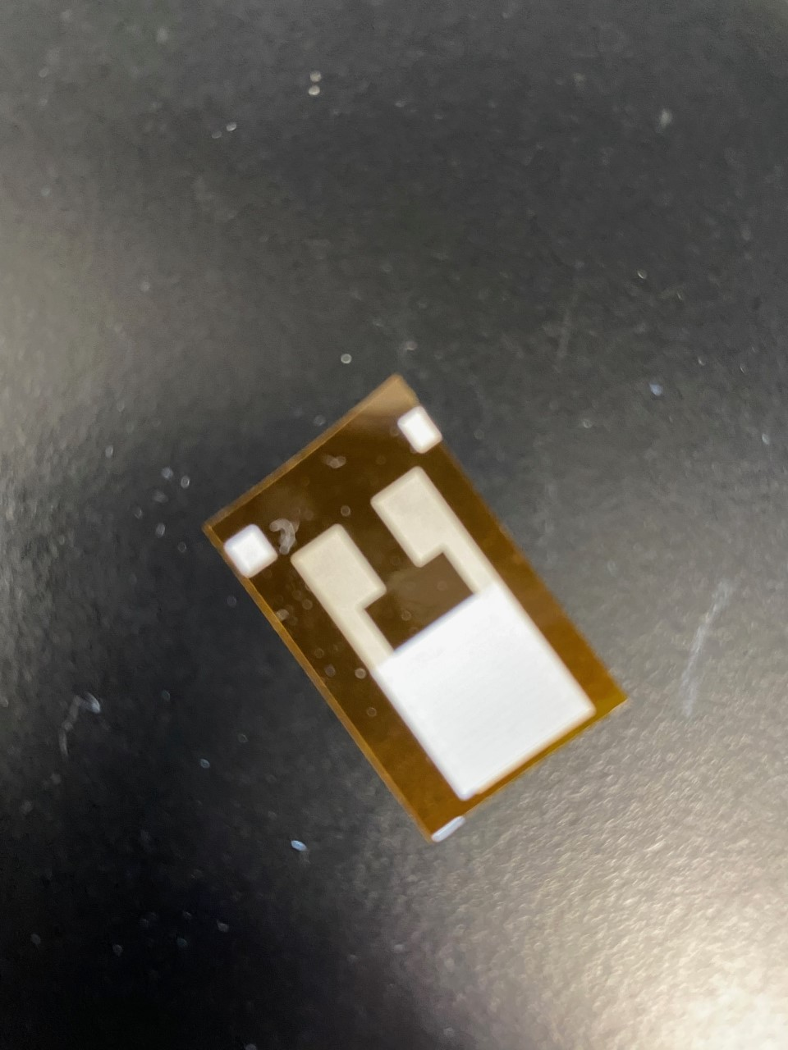
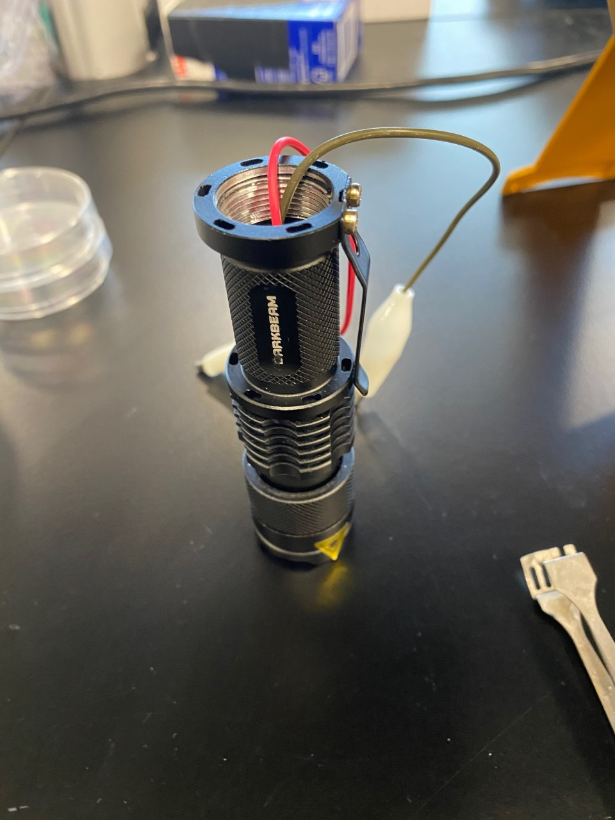
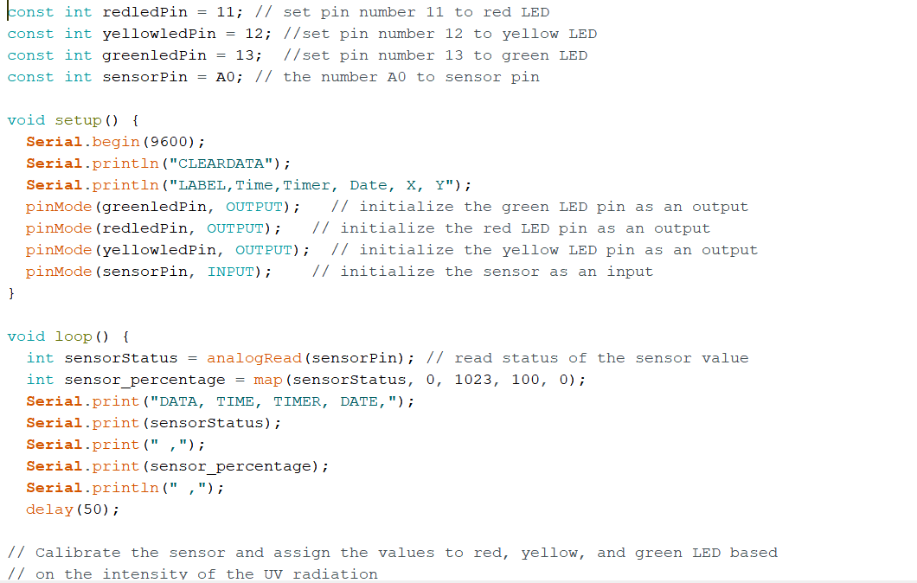
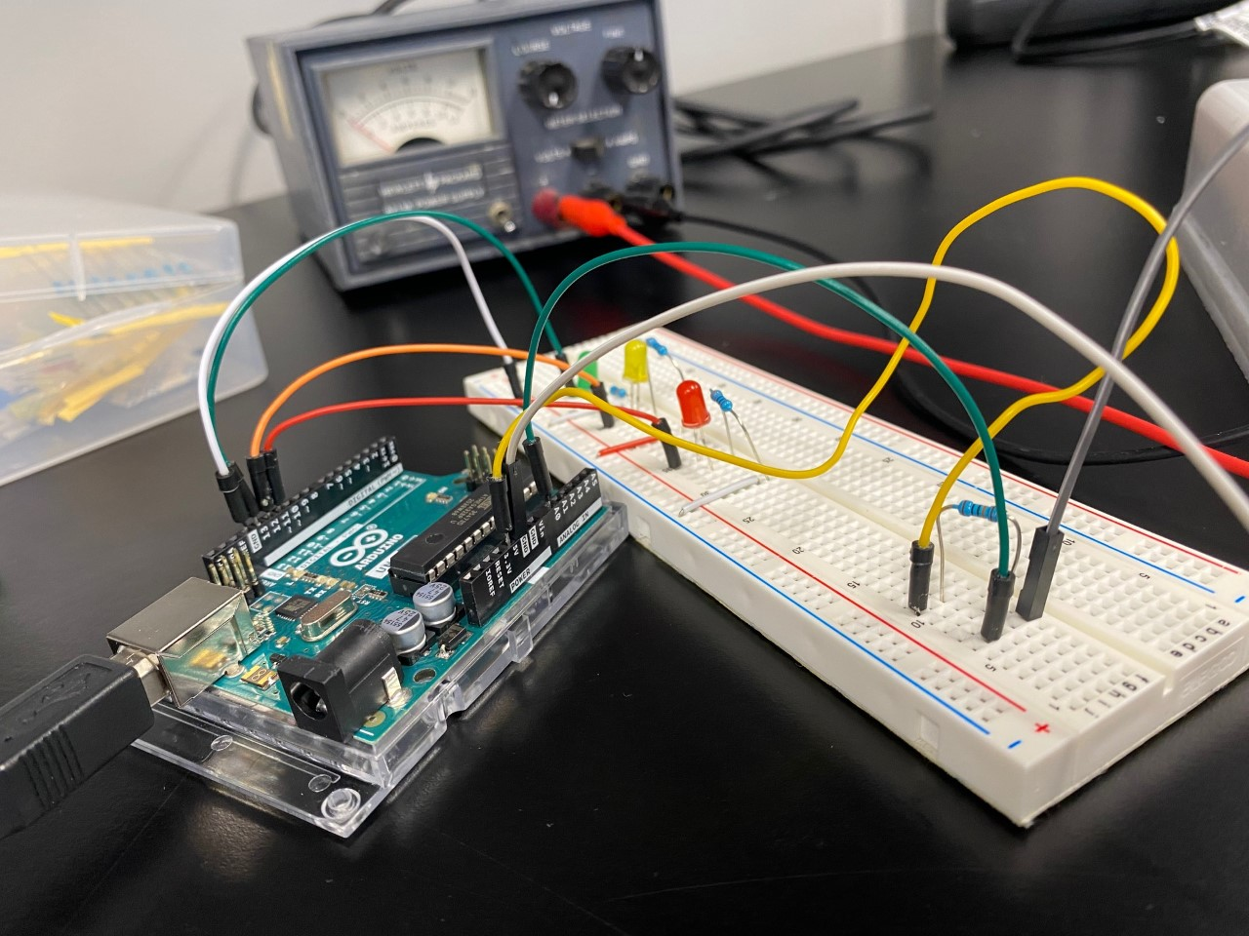
Initial Experimental Setup
NSF REU Research Experience on Internet of Things 2021

