Slide 1
Project 3: Designing a mobility model using large-scale data REU Students: Leah Kazenmayer and Gabriela Ford Faculty mentor(s): Samiul Hasan and Damla Turgut
Week 2 (Monday May 24th – Friday May 28th, 2021)
NSF REU Research Experience on Internet of Things 2021

Slide 2
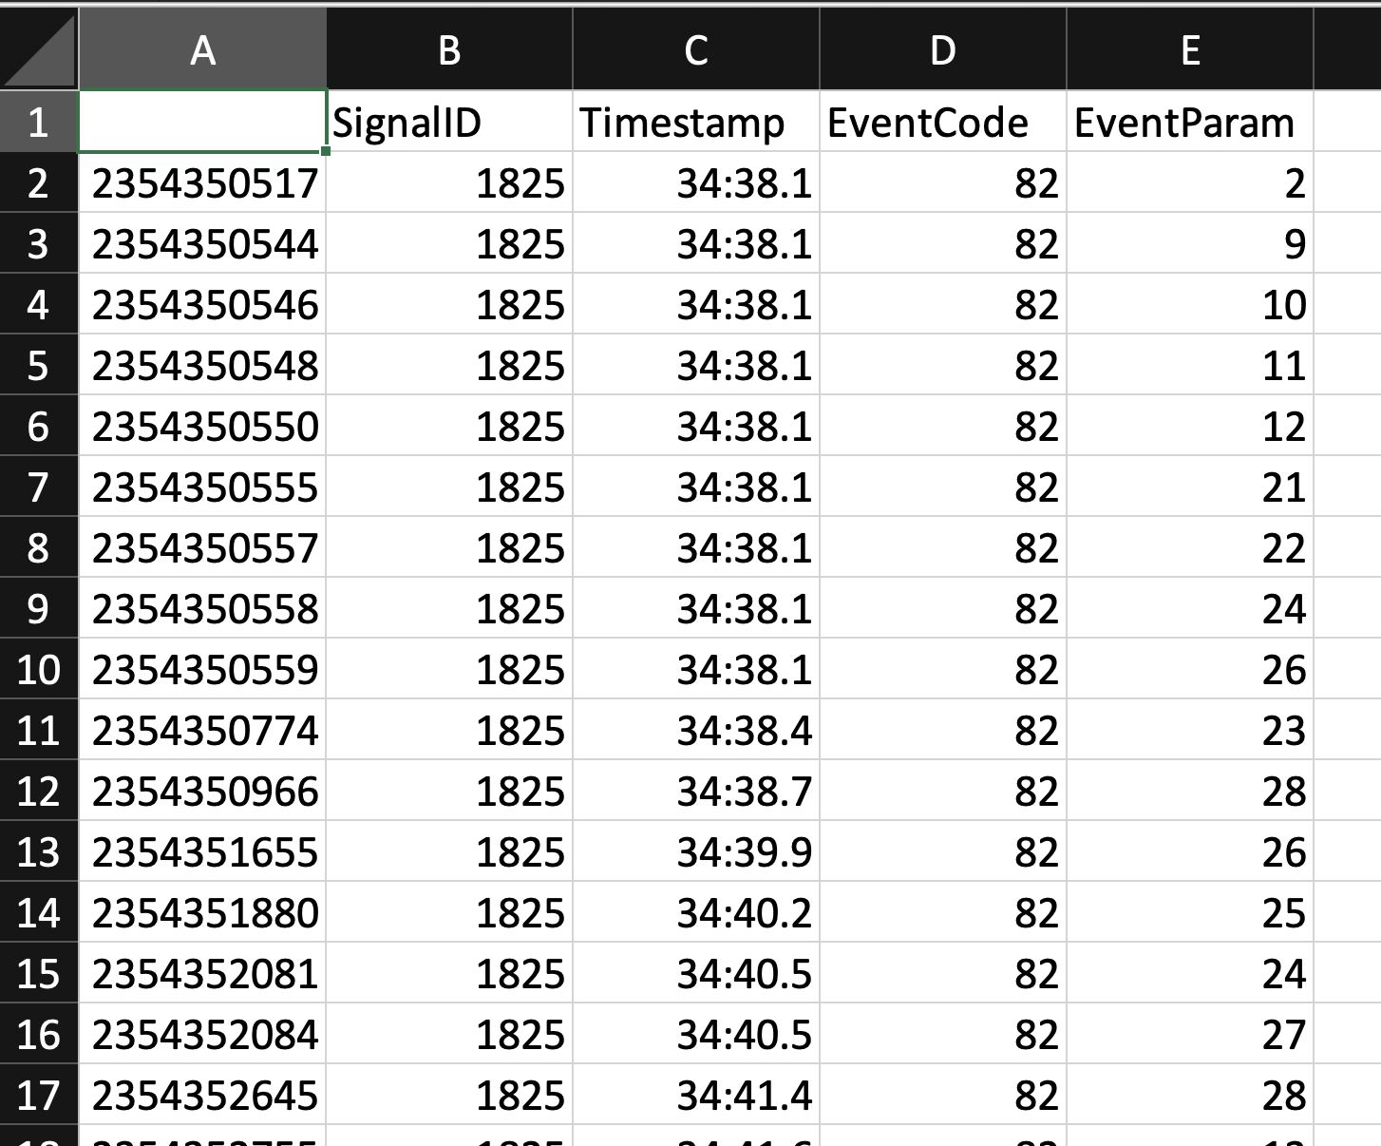
Background
NSF REU Research Experience on Internet of Things 2021

Slide 3
Accomplishments:
Wrote a program to determine the volume of cars that went through an intersection grouped by day (on approx 760,000 data points).
It was hand coded (not using any libraries) because we were not aware of libraries that contained specific functions to complete those tasks for us
NSF REU Research Experience on Internet of Things 2021

Slide 4
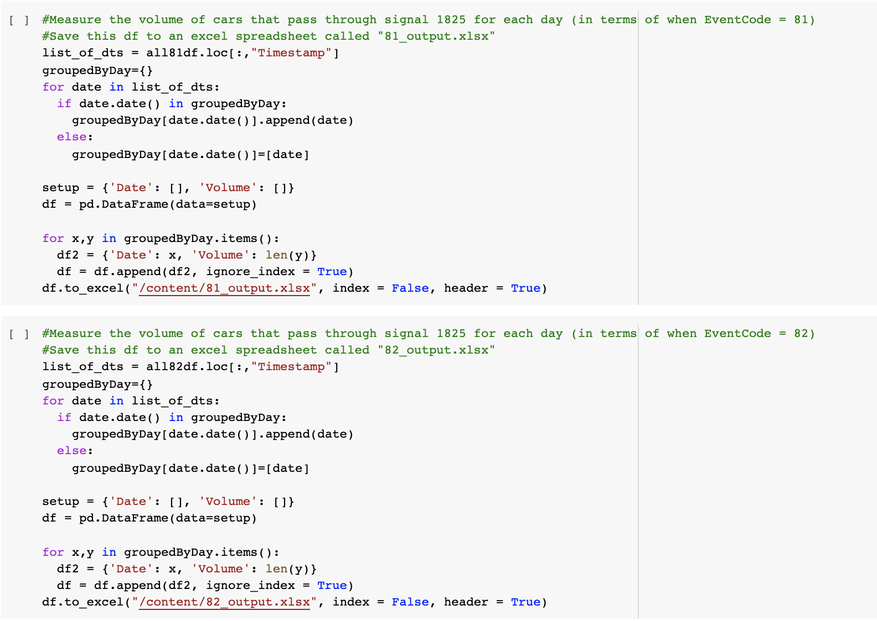
Section of VolumeOfCars.py (hand coded)
NSF REU Research Experience on Internet of Things 2021

Slide 5
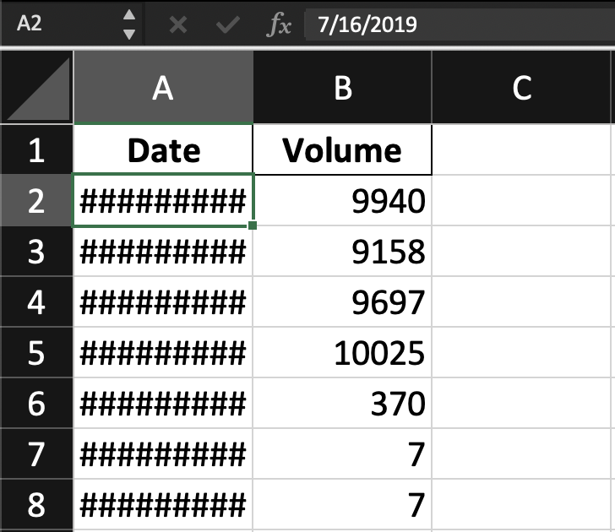
81_output.xlsx
(hand coded)
NSF REU Research Experience on Internet of Things 2021

Slide 6
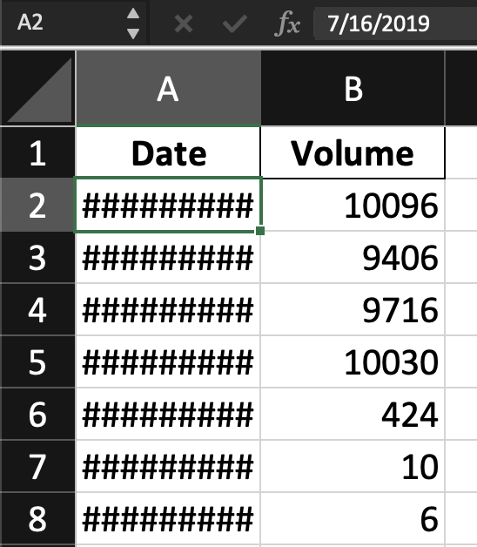
82_output.xlsx
(hand coded)
NSF REU Research Experience on Internet of Things 2021

Slide 7
Accomplishments:
Wrote a program to determine the volume of cars per event code, year, month, day, event parameter, etc. but with libraries, which turned out to be easier and more intuitive for bigger data sets (85,000,000 data points).
NSF REU Research Experience on Internet of Things 2021

Slide 8
Reformatting our data
SignalID | Year | Month | Day | Hour | EventCode | EventParam
... | ... | ... | ... | ... | ... | ...
We wanted the dates and times to be easily seen when looking at the dataset
NSF REU Research Experience on Internet of Things 2021

Slide 9
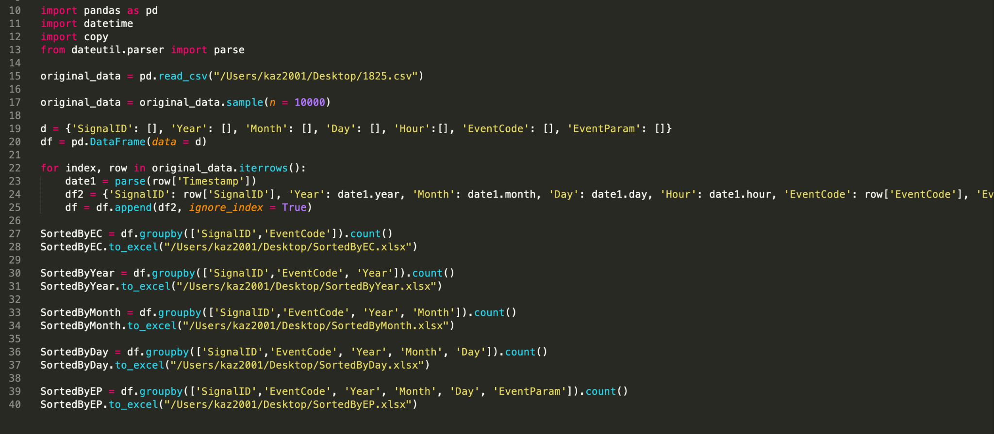
Code (with libraries)
NSF REU Research Experience on Internet of Things 2021

Slide 10
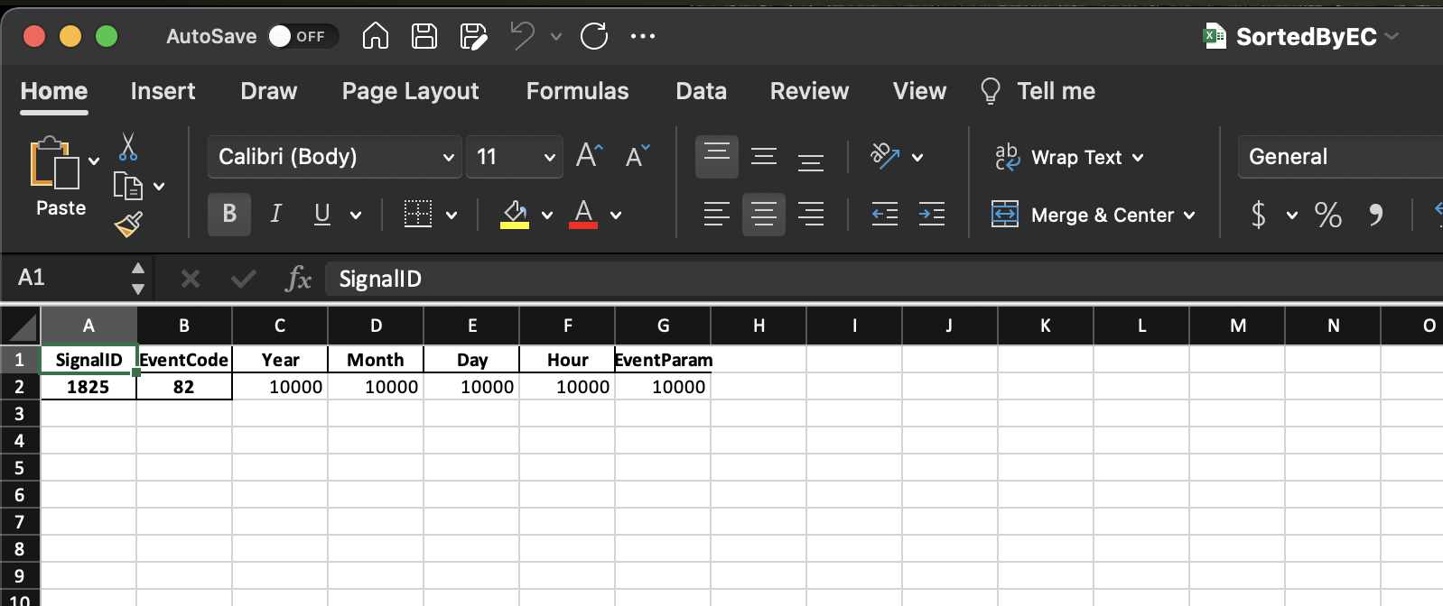
SortedByEC.xlsx
(with libraries)
NSF REU Research Experience on Internet of Things 2021

Slide 11
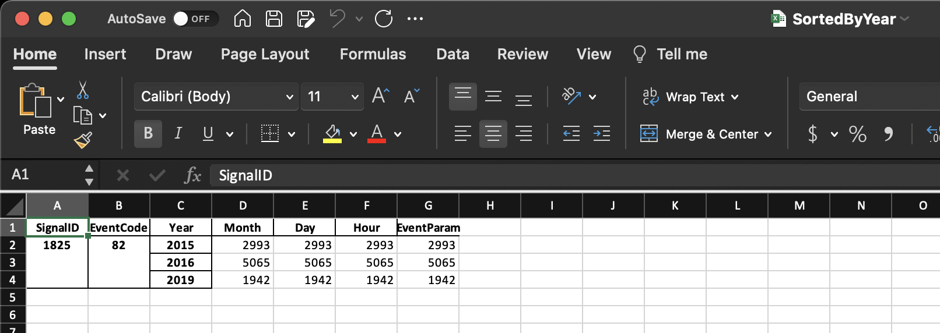
SortedByYear.xlsx
(with libraries)
NSF REU Research Experience on Internet of Things 2021

Slide 12
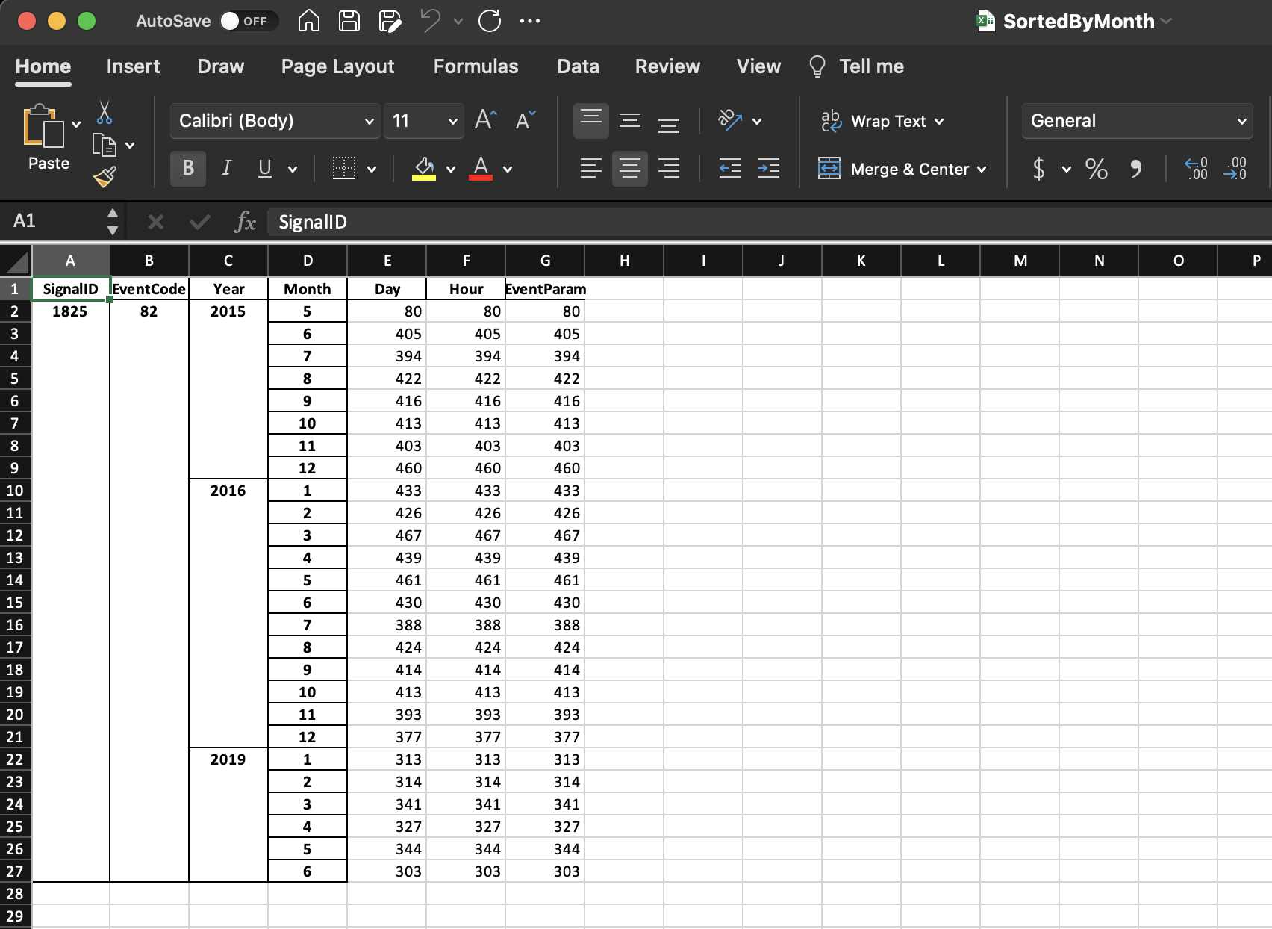
SortedByMonth.xlsx
(with libraries)
NSF REU Research Experience on Internet of Things 2021

Slide 13
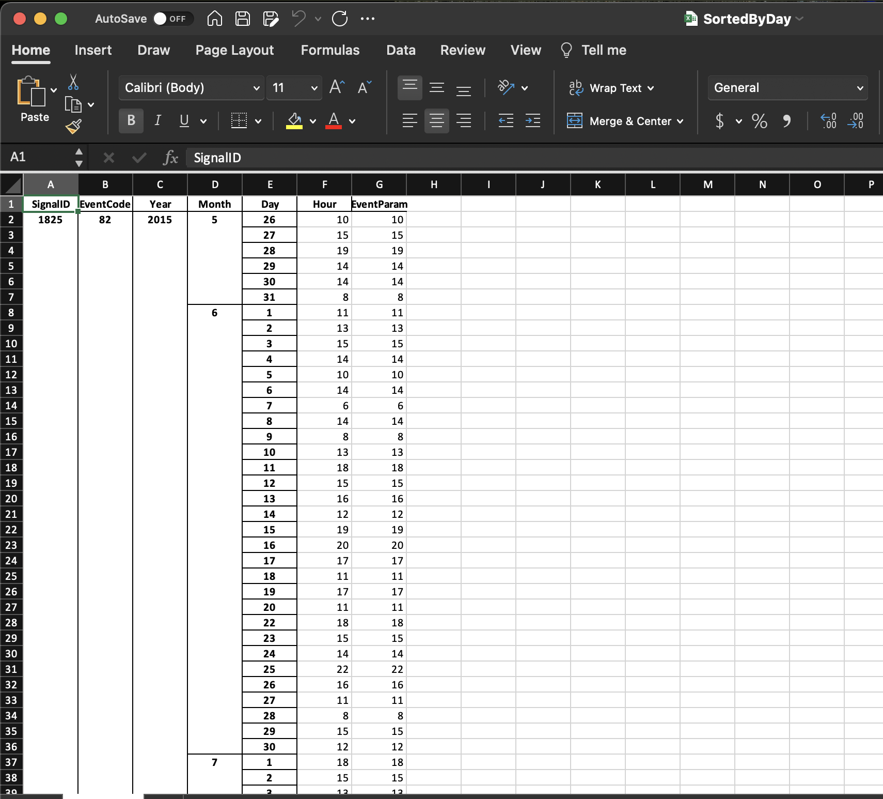
SortedByDay.xlsx
(with libraries)
NSF REU Research Experience on Internet of Things 2021

Slide 14
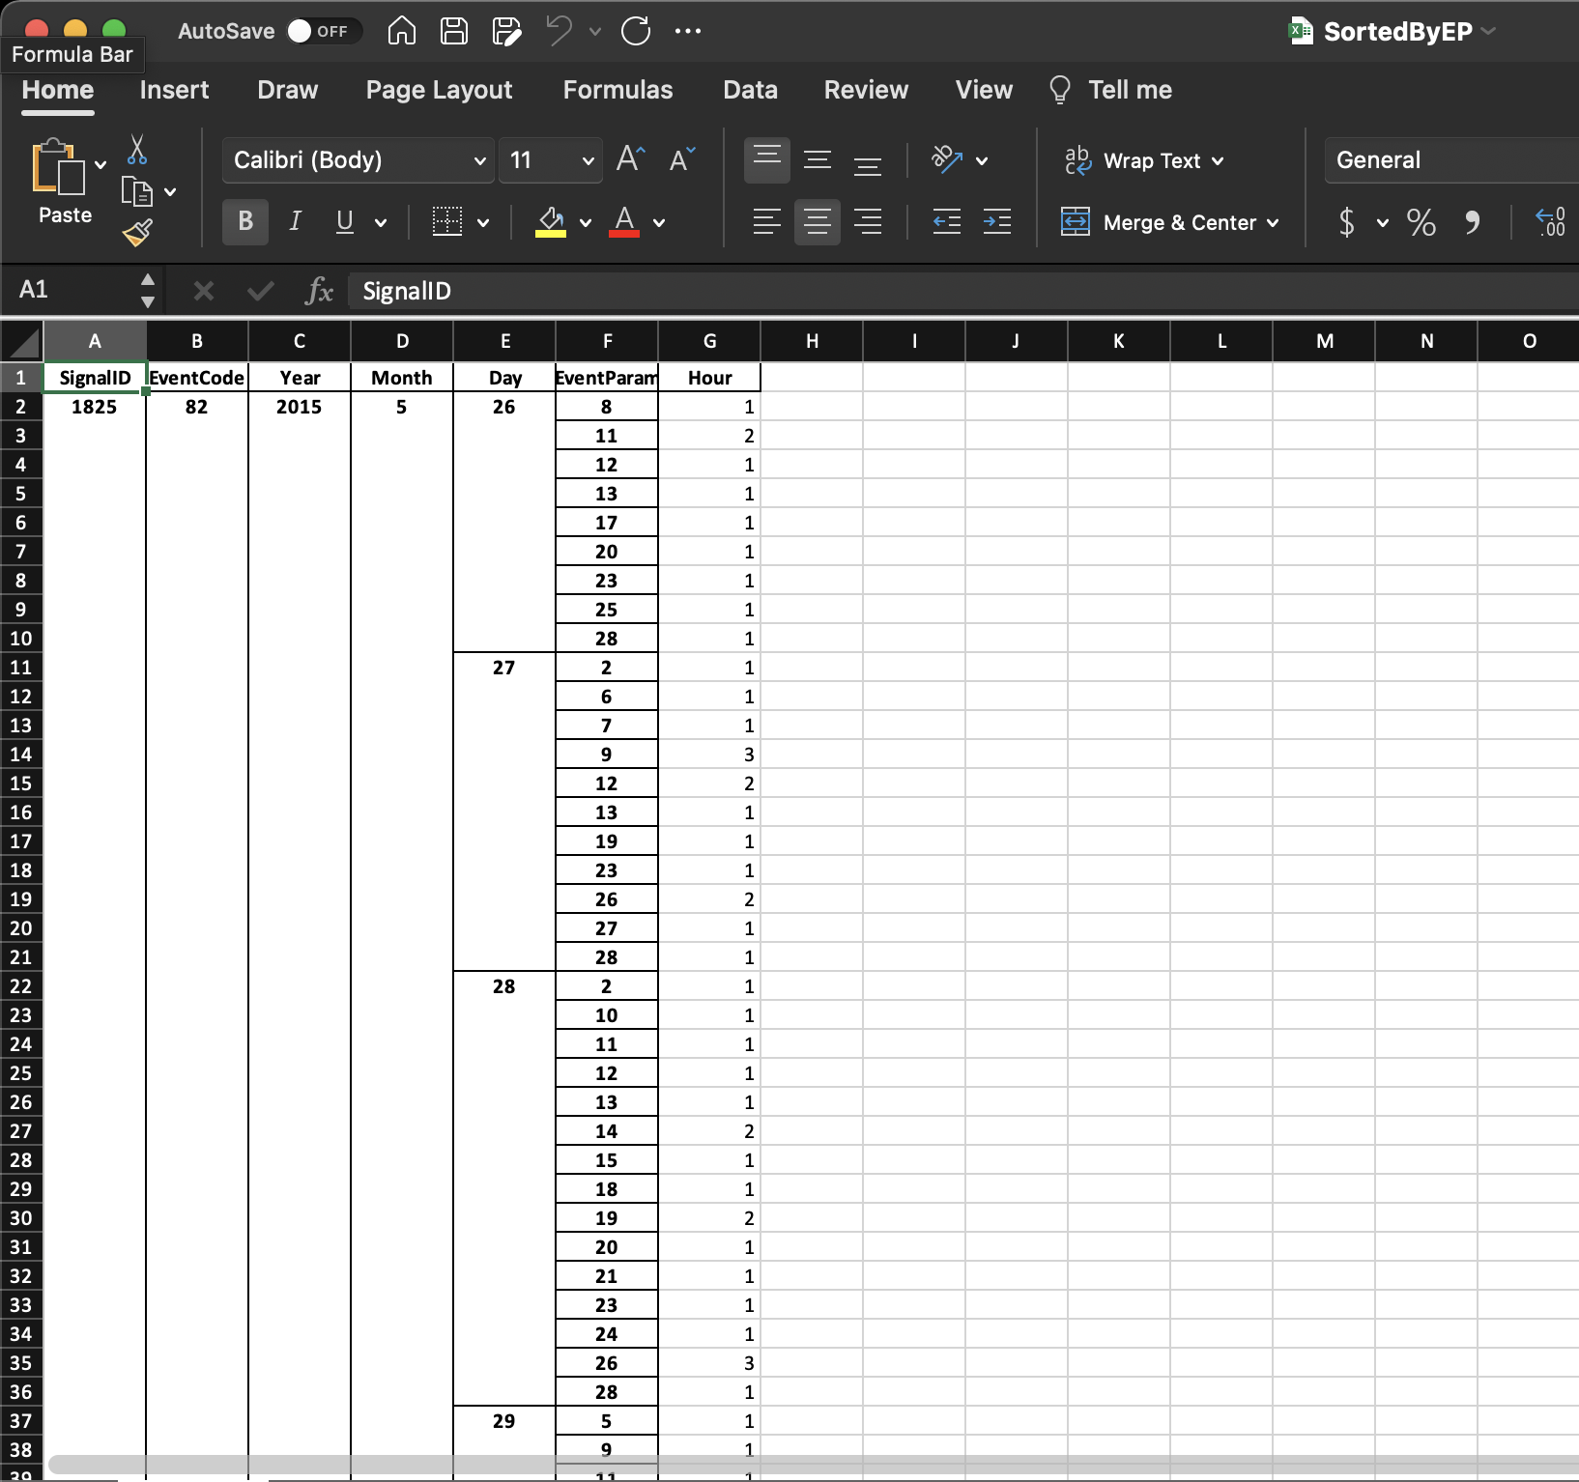
SortedByEP.xlsx
(with libraries)
NSF REU Research Experience on Internet of Things 2021

Slide 15
Accomplishments:
Had a team meeting with Dr. Hasan and Dr. Turgut to update everyone on the development of the project
Selected a corridor to perform our analysis on (Alafaya Trail - 434)
NSF REU Research Experience on Internet of Things 2021

Slide 16
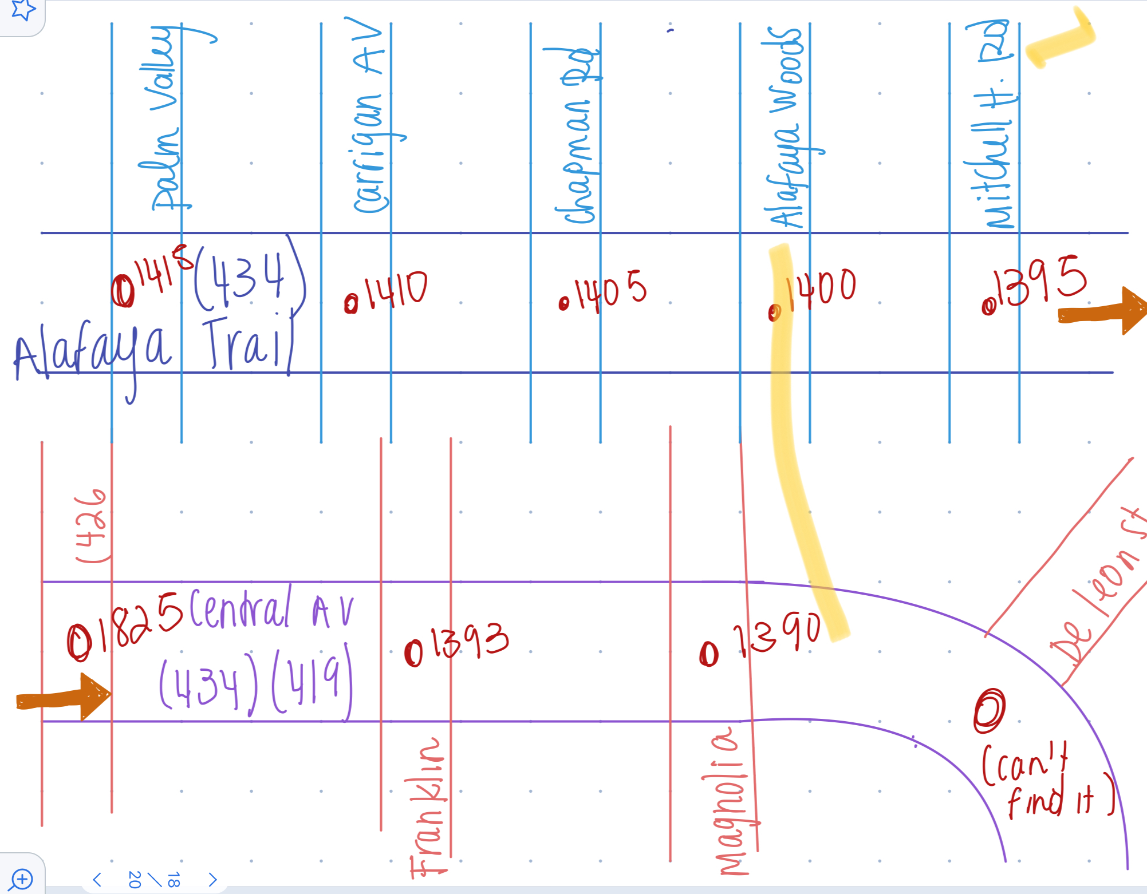

Slide 17
Problem & Solutions
We had a little trouble understanding the detectors and how they worked.
Solution: Dr. Hasan explained how there are stop bar detectors and advanced detectors, and some lanes have one and some lanes have both.
Some timestamps had inconsistent formatting; some timestamps just contained times (i.e. 12:43:00 PM) and some timestamps contained datetimes (i.e. 07/16/2019 12:43:00 PM).
Solution: The sample file was a subset of the whole dataset for signal 1825; there were problems converting it to a smaller file: data loss.
NSF REU Research Experience on Internet of Things 2021

Slide 18
Problem & Solutions
Found the function parse() which extracts the day, month, year, etc from a pandas timestamp. This helped group the data by those specific time attributes.
We needed to narrow down what we were going to do, how was the project going to be structured and which factors were we going to take into account.
We decided to work on a specific corridor and create a model that is based on past data (volume of cars) but also include outside factors that would influence the volume of cars on a specific day, month or year (weather, density of cars, roads feeding a main road, among others).
NSF REU Research Experience on Internet of Things 2021

Slide 19
Plans for next week:
Finalize the code for volume of cars and make some graphs to have a more visual context.
Get into the UCF server in order to run code on large datasets.
We need a supercomputer to be able to run massive amounts of datasets in a reasonable amount of time (because both of us have macbook pro laptops, which aren’t quick)
Figure out ways to make the data analysis more efficient
Be able to start our model development by taking into account the volume of cars calculated and how do these vary depending on several factors.
Start more in depth learning of machine learning for model development.
NSF REU Research Experience on Internet of Things 2021

