Slide 1
Project 3: Designing mobility services using large-scale data from a smart city testbed REU Students: Leah Kazenmayer and Gabriela Ford Faculty mentor(s): Samiul Hasan and Damla Turgut
Week 1 (Monday May 17th – Friday May 21st, 2021)
NSF REU Research Experience on Internet of Things 2021

Slide 2
Accomplishments:
Met with Jiechao Zhang and Dr. Hasan that laid out the background of the research they were and are currently working on.
Received the OneDrive shared folder that contained documents that included an ATSPM-related dataset, 4 different .csv files to help understand said dataset, a paper written on the topic that we are working on written by UCF mentors and grad students, and a PowerPoint presentation that briefly explained how to read the dataset.
Pored through the given material on the drive, specifically reading through the paper and combing through the data to get an understanding of what we will work with in the coming weeks.
NSF REU Research Experience on Internet of Things 2021

Slide 3
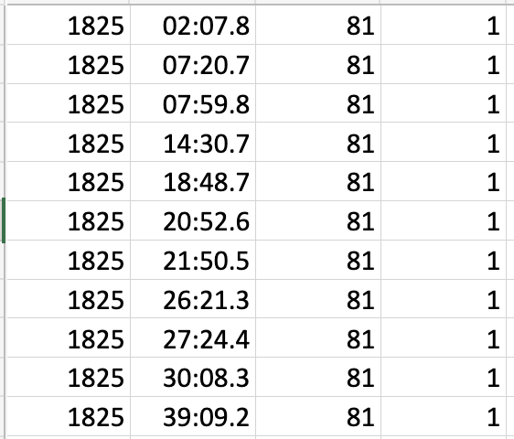
1825_sample.csv
NSF REU Research Experience on Internet of Things 2021

Slide 4
Detectors.csv
NSF REU Research Experience on Internet of Things 2021

Slide 5
Approaches.csv
NSF REU Research Experience on Internet of Things 2021

Slide 6
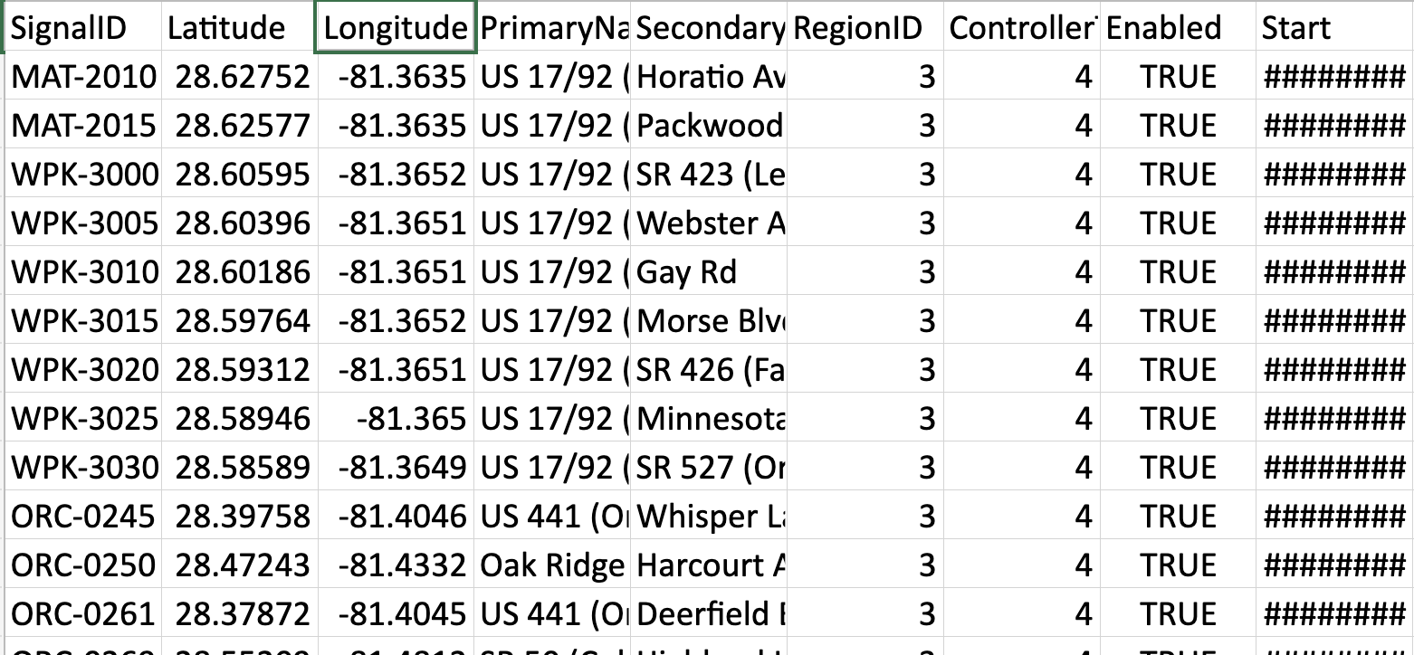
Signals.csv
NSF REU Research Experience on Internet of Things 2021

Slide 7
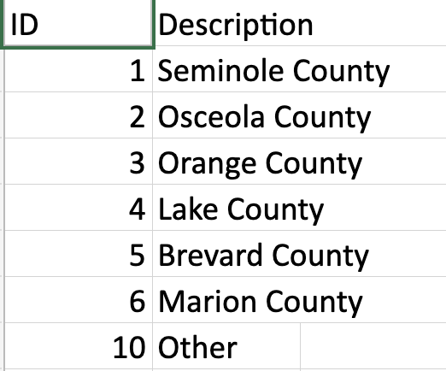
Regions.csv
NSF REU Research Experience on Internet of Things 2021

Slide 8
Problem & Solutions
We had trouble connecting how all the data in the spreadsheets are related to each other. We solved this problem by:
Drawing illustrations for a deeper understanding
Researching articles and videos online that relate to the ATSPM topic
Reading all the material given to us on the OneDrive
Another problem we ran into was the design of the ATSPM system, as well as how and where the detectors work.
Additionally, we also need to narrow down which columns/attributes in each .csv file are the most pertinent to our research.
NSF REU Research Experience on Internet of Things 2021

Slide 9
Plans for next week:
Focus on the problems that are solvable for us within the given timeframe and brainstorm ideas on how to solve these issues, which will constitute our project.
Specifically, we want to figure out how our model development is going to be carried out while focusing on Seminole County and traffic light stops within the area.
Possible project idea:
Organizing and processing past data from traffic light signals in Seminole County to predict future traffic.
NSF REU Research Experience on Internet of Things 2021

