Slide 1
Project 7: IoT Augmented Physical Scale Model of a Suburban Home REU Students: Estefanía Sánchez and Caitlin Petro Faculty mentor(s): Damla Turgut and Ladislau Bölöni
Graduate mentor(s): Safa Bacanli and Furkan Cimen
Week 1 (Monday 17 – Friday 21, 2021)
Accomplishments:
Constructed a roof for the smart home.
Made plans for an enclosure around the home for environmental simulation.
Wrote a function to individually test door and window motors
Problem & Solutions:
Narrowing down our focus for the project.
We came up with a lot of initial ideas but after speaking with Dr. Trugut and Dr. Boloni we decided to focus on improving the humidity aspect of the simulations
Finding a proper enclosure that would allow us to regulate the humidity of the house
We could not find a premade enclosure that would fit the house, so we decided we would build one ourselves.
One of the windows won’t open.
Plans for next week:
Come up with different scenarios for data collection.
Purchase habitat simulation enclosure materials.
Begin data collection.
NSF REU Research Experience on Internet of Things 2021

Slide 2
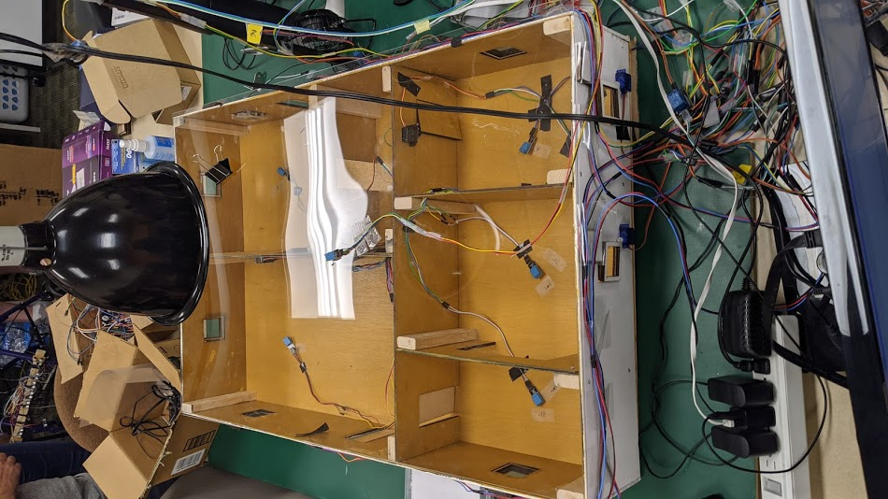
Starting Home (Sumer 2020 Work)
Labels
Wiring
NSF REU Research Experience on Internet of Things 2021

Slide 3
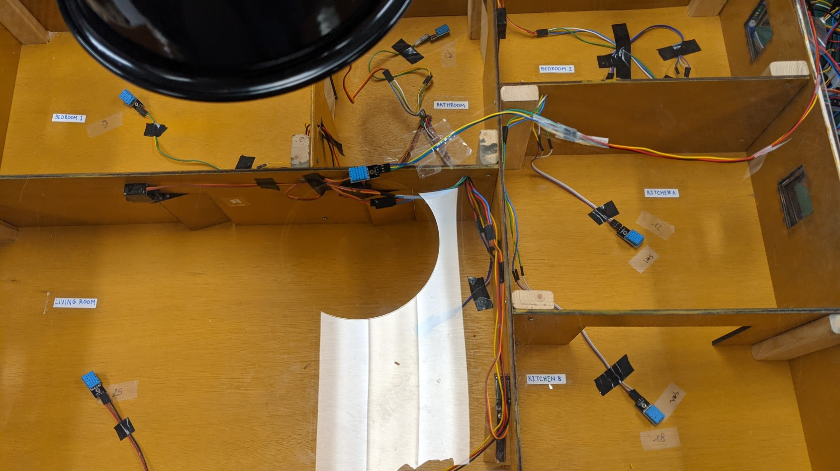
Interior with Labels
NSF REU Research Experience on Internet of Things 2021

Slide 4
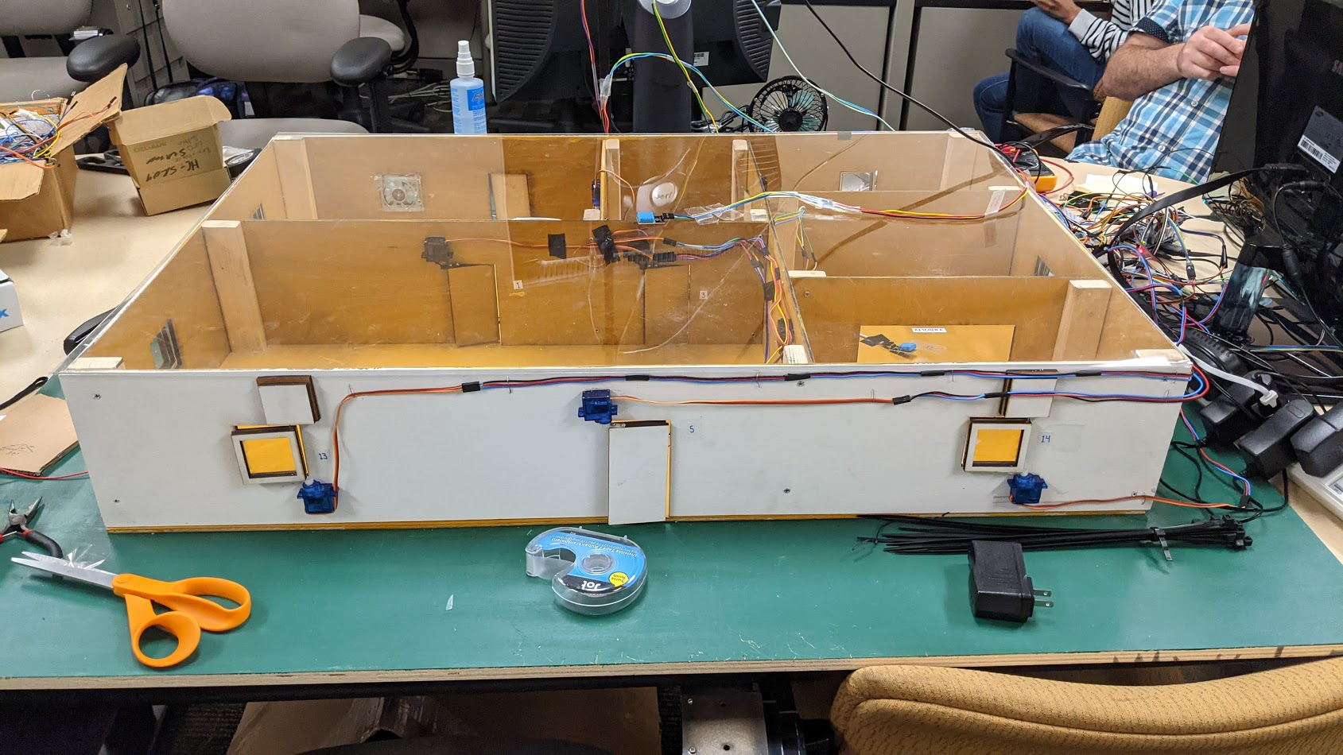
Window and Door Labels
NSF REU Research Experience on Internet of Things 2021

Slide 5
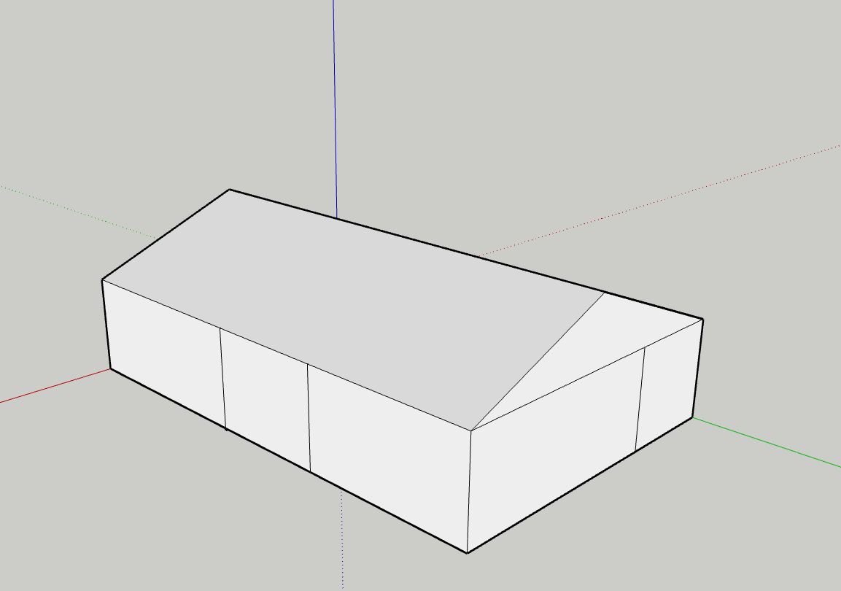
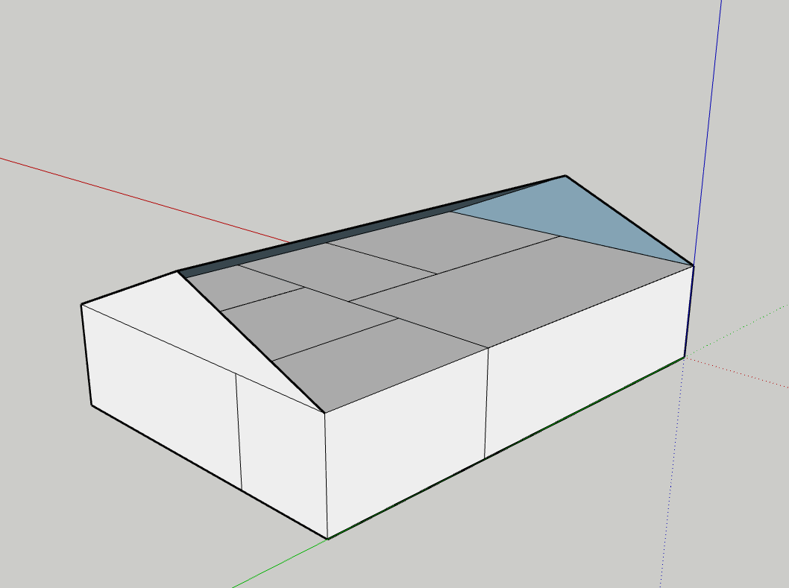
Model of Home with Roof
NSF REU Research Experience on Internet of Things 2021

Slide 6
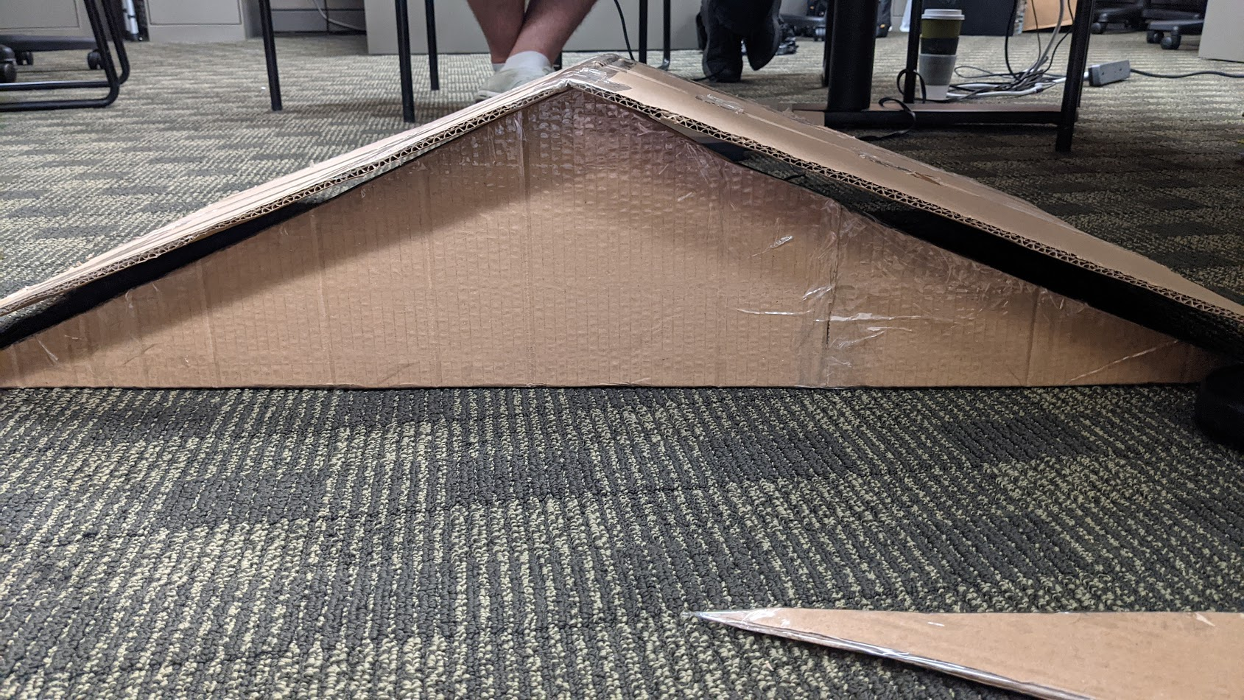
Rough Draft of Roof
NSF REU Research Experience on Internet of Things 2021

