Slide 1
Project 6: Processing data from a visual IoT sensor of fluid/structure interactions with machine learning REU Students: Pete Orkweha & Alexis Downing Graduate mentors: Nick Smith & Sharare Zehtabian Faculty mentor(s): Dr. Andrew Dickerson & Dr. Damla Turgut
Week 5 (June 24 – June 28, 2019)
Accomplishments:
Applied ensemble method to improve accuracy
Features Engineering
Scrubbing (smoothing) data
Literature research (cont.)
Problem & Solutions
Problem: We have outlier that drags down algorithm performance as well as Polynomial algorithm giving drastically wrong answer with the new dataset
Solution: We manually pick out outlier data. We eliminate Polynomial algorithm and use Gradient Boosting algorithm instead.

Slide 2
Key Terms
Random Forest Regression (RFR)
Multi-Layer Perceptrons (MLP)
Gradient Boosting (Gboost)
Relative Error (RE)
$$RE=\frac{predicted −true}{true}∗100$$
Root Mean Squared Error (RMSE)
$$RMSE= \sqrt{\sum_{i=1}^{n}{\frac{{\left(predicted_{i}−true_{i}\right)}^{2}}{n}}}$$
Bending Stiffness (BS)
$$BS=Area Moment of Inertia ∗Modulus of Elasticity$$

Slide 3
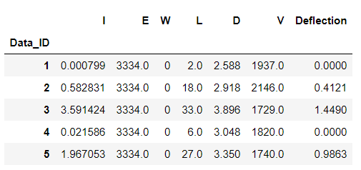
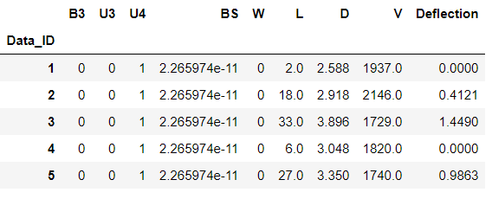
Old vs New dataset
Old dataset which includes mass moment of inertia, modulus of elasticity, wettability, length, drop diameter, drop velocity, and result max. deflection.
New dataset which includes one-hot encoded of fiber type, bending stiffness, wettability, length, drop diameter, drop velocity, and result max. deflection.

Slide 4
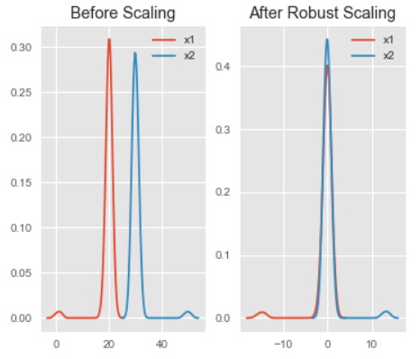
Feature Scaling
Feature Scaling is method that scales features down so they would have a similar or same scaling range. This helps algorithm learn easier and more accurately.
Ex: D(2.25,4.00) and V(1400,2600) → Feature Scaling → D(-1,1) and V(-1,1)
For Random Forest Regressor and Gradient Boosting we used Robust Scaler
Link: http://benalexkeen.com/feature-scaling-with-scikit-learn/

Slide 5
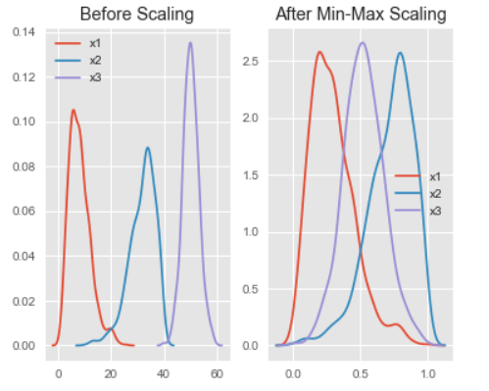
Feature Scaling
Feature Scaling is method that scales features down so they would have a similar or same scaling range. This helps algorithm learn easier and more accurately.
Ex: D(2.25,4.00) and V(1400,2600) → Feature Scaling → D(-1,1) and V(-1,1)
For Multi-Layer Perceptrons we used Min-Max Scaler
Link: http://benalexkeen.com/feature-scaling-with-scikit-learn/

Slide 6
Ensemble learning
Ensemble learning is a method that combines multiple different or same algorithms outputs to improved overall prediction.
There are many ensemble learning method, we decided to go for weighted average method
Weighted average ensemble learning
Each algorithm would have its own weight (or level of confidence). This weight decides how much does each algorithm prediction matter.
$$Final Rating=\left(5∗0.23\right)+\left(4∗0.23\right)+\left(5∗0.18\right)+\left(4∗0.18\right)+\left(4∗0.18\right)=4.41$$
Link: https://www.analyticsvidhya.com/blog/2018/06/comprehensive-guide-for-ensemble-models/

Slide 7
Non-Negative Least Square
This is a method that finds $ω$ vector such that the function results in a minimum possible output.
In our case, we could use this to find weights for each algorithms.
Publicly available under scipy.optimize package
Variable explain:
A is a matrix which contains each algorithm predictions
$ω$ is a unknown vector
b is a vector of observed measurements

Slide 8
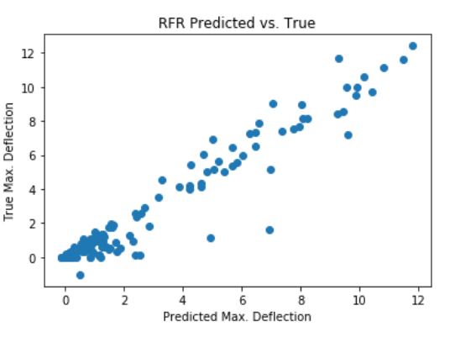
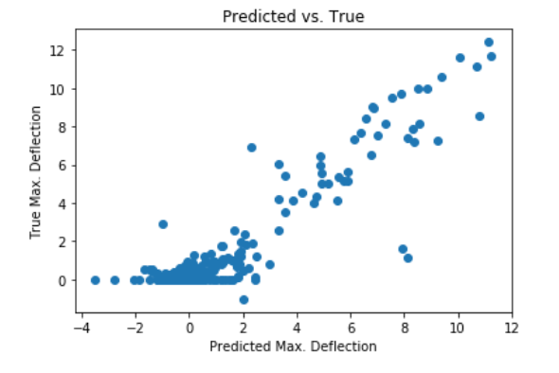
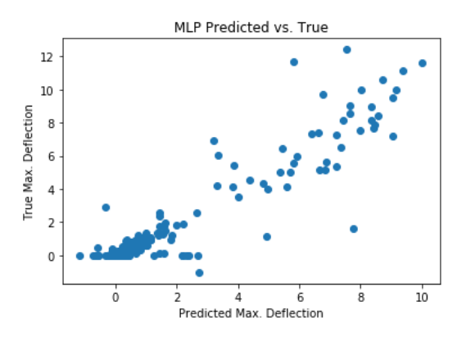
Previous Algorithm Accuracy
Poly-Regression

Slide 9
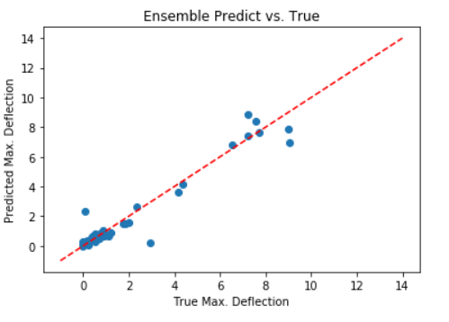
Current Algorithm Accuracy
Test data = 20%
Random state = 120
Weight vectors:
RFR = 0.168
MLP = 0.2597
Gboost = 0.584

Slide 10
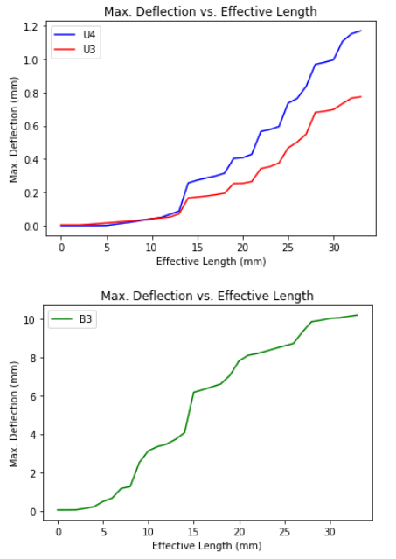
Max. Deflection vs Effective Length

Slide 11
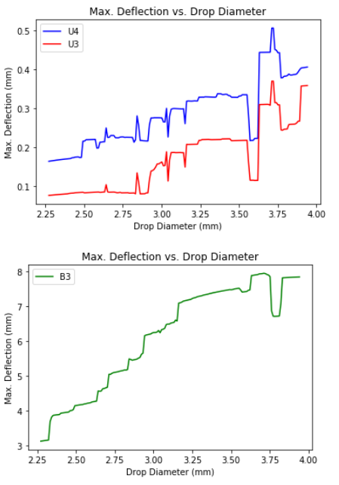
Max. Deflection vs Drop Diameter

Slide 12
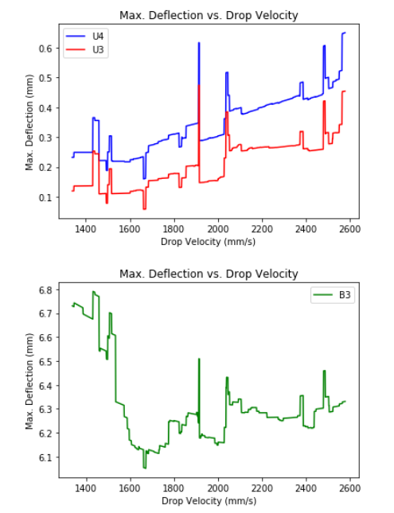
Max. Deflection vs Drop Velocity

Slide 13
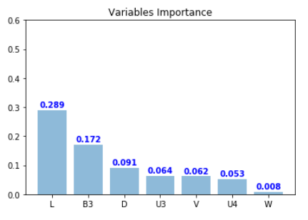
Variable Importance

Slide 14
Project 6: Processing data from a visual IoT sensor of fluid/structure interactions with machine learning REU Students: Pete Orkweha & Alexis Downing Graduate mentors: Nick Smith & Sharare Zehtabian Faculty mentor(s): Dr. Andrew Dickerson & Dr. Damla Turgut
Week 5 (June 24 – June 28, 2019)
Plans for next week:
Collect 120 more data.
Continue literature research
Continue to smooth out data
Do a more focus analysis on Max. Deflection vs. Drop velocity

