Slide 1
Project 6: Processing data from a visual IoT sensor of fluid/structure interactions with machine learning REU Students: Pete Orkweha & Alexis Downing Graduate mentors: Nick Smith & Sharare Zehtabian Faculty mentor(s): Dr. Andrew Dickerson & Dr. Damla Turgut
Week 3 (June 10 – June 14, 2019)
Accomplishments:
Data collection progress: 327/375 (87.2%)
Data analysis progress: 215/375 (57.33%)
First attempt on implementing machine learning on existing data
Problem & Solutions
Problem: Low $R^{2}$ score on some algorithm (<0.5)
Solution: Applying techniques that improve accuracy to algorithm such as feature scaling/normalization, scrubbing data, and algorithm tuning.

Slide 2
Machine learning algorithm result
B3 Fiber (45 data):
Linear regression
RBF regression (Radial Basis Function)
Random Forest Regressor
Multi-layer Perceptrons

Slide 3
Machine learning algorithm result
U3 Fiber (27 data):
Linear regression
U4 Fiber (40 data):
Linear regression

Slide 4
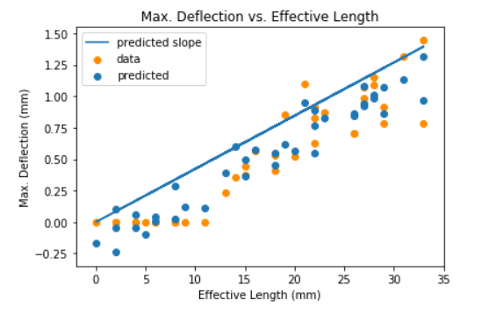
U4 Fiber result

Slide 5
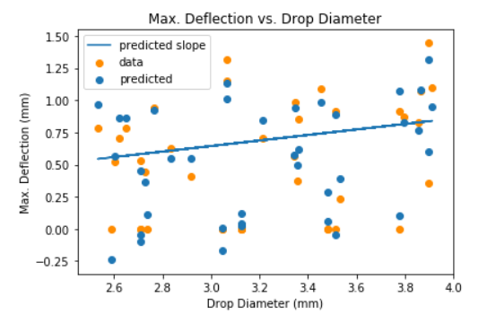
U4 Fiber result

Slide 6
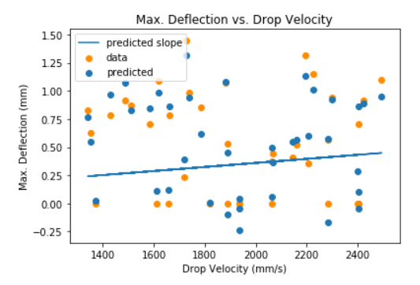
U4 Fiber result

Slide 7
Project 6: Processing data from a visual IoT sensor of fluid/structure interactions with machine learning REU Students: Pete Orkweha & Alexis Downing Graduate mentors: Nick Smith & Sharare Zehtabian Faculty mentor(s): Dr. Andrew Dickerson & Dr. Damla Turgut
Week 3 (June 10 – June 14, 2019)
Plans for next week:
Artificially inflate dataset using particle filter and use inflated data to test for regression improvement.
Look into possibility of applying Ensemble method to improve regression performance
Improve accuracy of regression algorithm

