Slide 1
Project 7: IoT augmented physical scale model of a suburban home REU Students: Thomas Burns and Gregory Fichthorn Graduate mentors: Safa Bacanli and Sharare Zehtabian Faculty mentors: Damla Turgut and Ladislau Bölöni
Week 3 (June 9 – June 14, 2019)
Accomplishments:
House built (support ‘beams’ + walls + base screwed together)
Tested door/window motor + temp sensor with RPi (video) with extra supplies
Windows -> Finalized design, cut, screwed to motors, glued frame to pane
Doors -> Cut, ready to glue (once more motors arrive)
Fixed, edited old code, created new code
Problem & Solutions
Problem: Connecting the two RPi’s to run concurrently. Solution: Master/slave
Problem: Wires from outside(RPi) to inside of enclosure(yard). Wires from yard to inside house. Solution: Base is two 2ft. x 4ft. pieces of wood, slide them slightly apart, a gap (roughly 1’’ x .5’’) runs laterally underneath the house. Will cut hole in floor of living room to feed into hole.
Plans for next week:
Additional wires + motors arrive Friday/Monday, start laying out wires + attaching doors to motors.
Glue motors + sensors onto wall in final location
Test all motors and sensors, ensure all work properly
Develop “scenarios” for environment of the house (manual, random, comes home, etc.)

Slide 2
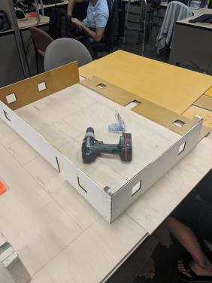
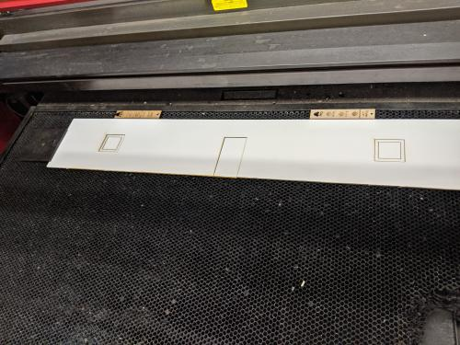
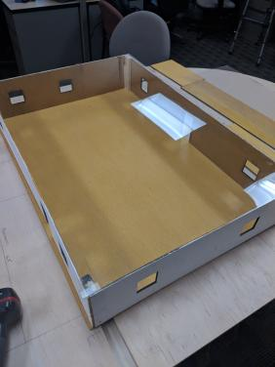
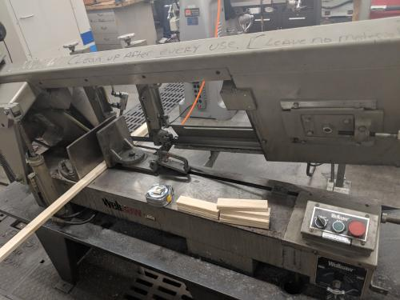
Construction (1)

Slide 3
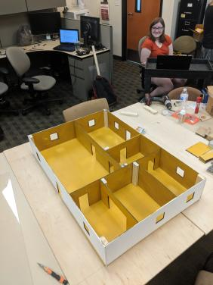
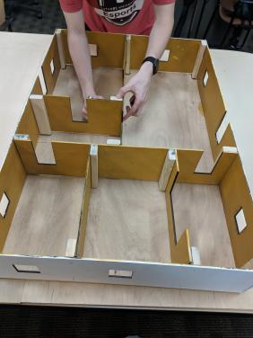
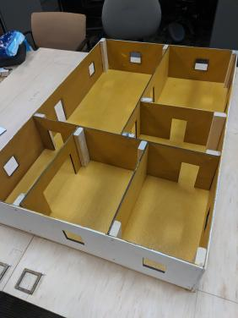
Construction (2)

Slide 4
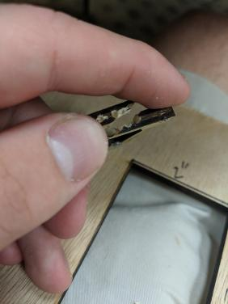
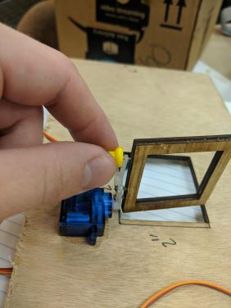
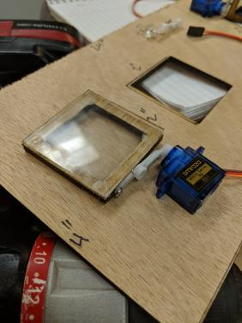
Design (1)

Slide 5
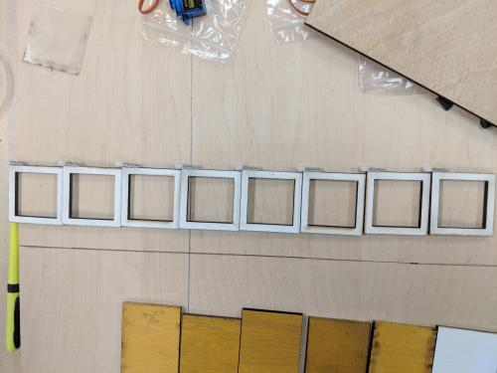
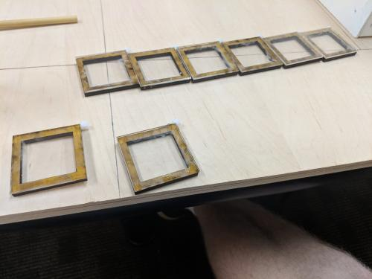
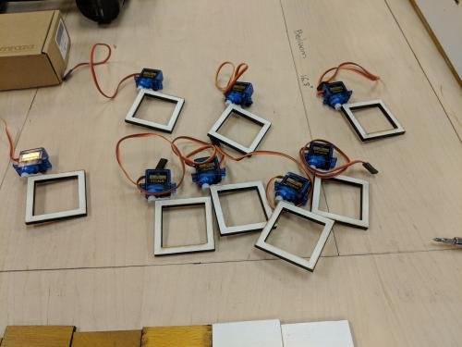
Design (2)

