Slide 1
Project 7: IoT augmented physical scale model of a suburban home REU Students: Thomas Burns and Gregory Fichthorn Graduate mentors: Safa Bacanli and Sharare Zehtabian Faculty mentors: Damla Turgut and Ladislau Bölöni
Week 7 (July 8– July 12, 2019)
Accomplishments:
Gathering data sets
Ready to train/test AI(should be trained/tested by late Friday)
Problem & Solutions
Motors overheating (before lamp); Had to manually loosen. Replaced a burnt out motor
Had to put electrical tape at all connection points to ensure integrity of wiring (if wires touched metal to metal bad stuff happens)
Lamp only worked sometimes. Had to unscrew/re-screw bulb and wait longer in between turning it on.
Wires don’t fit under ‘cage’. We tried to gently push them down, then put the ‘cage’ on; but many wires fell out of place. We’ve put it off to the side for now
Plans for next week:
Test our AI with plausible scenarios
Interpret data and draw conclusions

Slide 2
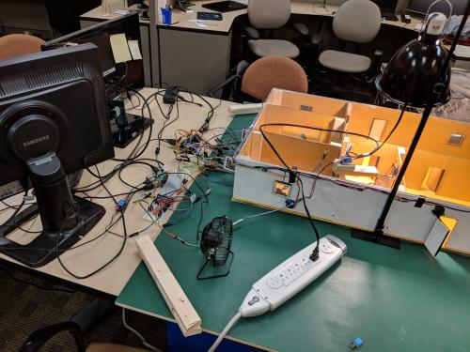
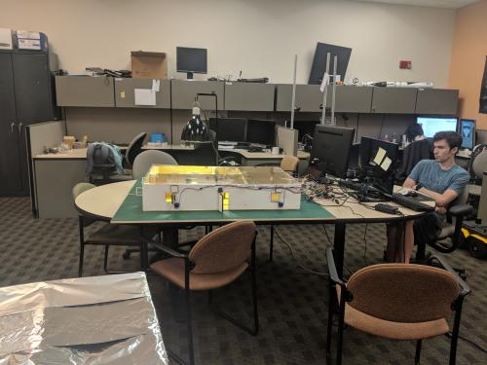
Final Setup

