Slide 1
Project 2: IoT and augmented reality: agents with pervasive awareness, appearance, and abilities
This project allows students to perform research on both the hardware side of IoT as well as on research on human-subject experiments enabled by the IoT devices. For the hardware aspects, the students will perform research on embedded controllers and sensor/actuator systems to support AR awareness and abilities (output/actuation). For the human-subject experiment, the students will design and run an experimental study on a specific aspect of AR agent awareness, appearance, and abilities. This will include the investigation of the effects of the characteristics of a visual manifestation of an agent on the interacting humans. One such example is the effect of age, gender, and race on the interacting human, for example in a setting where the human is a patient in a hospital and the agent is a healthcare aide that controls IoT devices in a smart environment

Slide 2
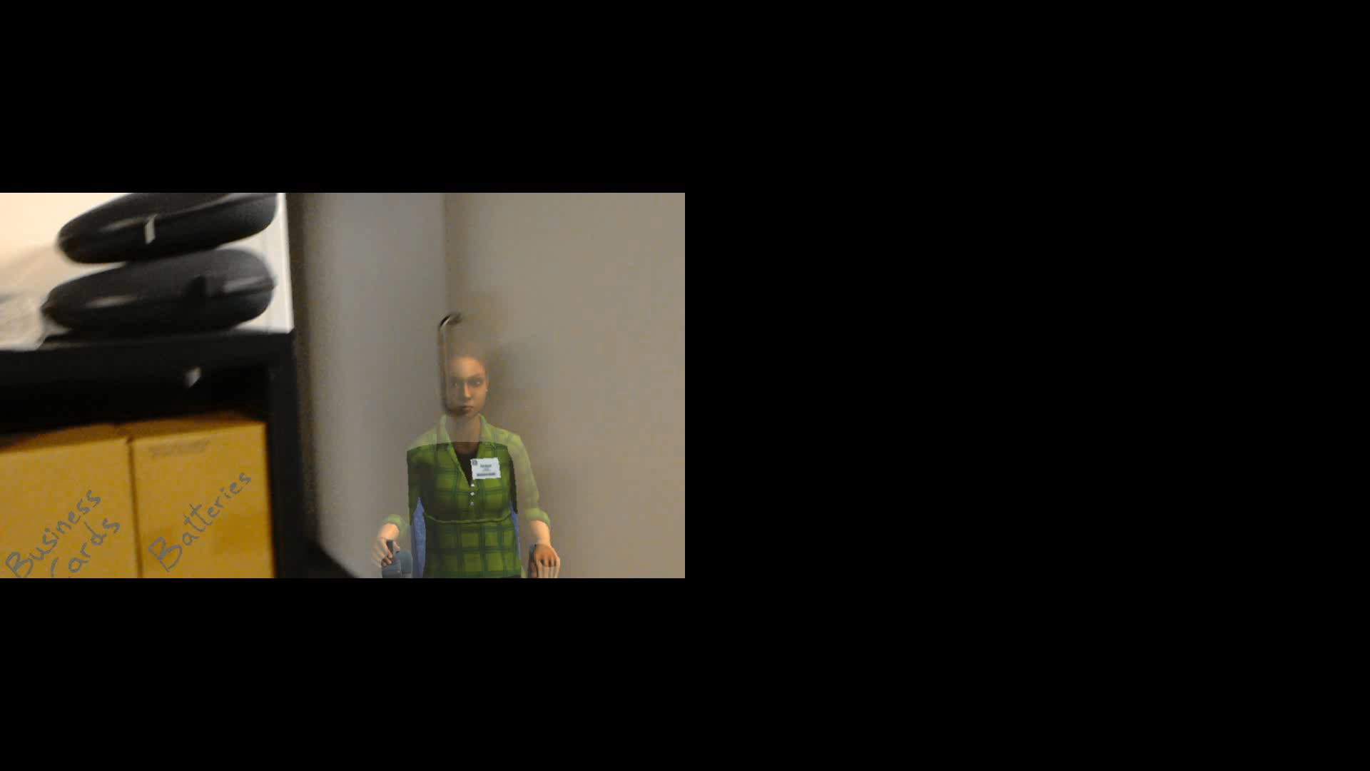
Kitty Box Game Demo

Slide 3
Project 2: IoT and augmented reality: agents with pervasive awareness, appearance, and abilities
REU Students: Kendra Richards, Nikhil Mahalanobis
Graduate mentors: Dr. Kangsoo Kim, Dr. Salam Daher
Faculty mentor(s): Dr. Gerd Bruder, Dr. Gregory Welch
  Week # (May 27 – May 31, 2019)
  Accomplishments:
  Narrowed down the selection of the project to 2-3 different possibilities
    Kitty Box
    Virtual Trainer
    IoTeddy
  Problem & Solutions
  Ran into problem when coming up with project ideas initially:
    Focus was more on application of a cool idea, rather than trying to find new, fundamental data
  To fix this, we sat down with our mentors and discussed, and came up with the projects above
  Plans for next week:
  Narrow down to one idea, and begin running experiments and collecting data

