Slide 1
Project #6: Processing data from a visual IoT sensor of Fluid/Structure interactions with Machine Learning REU Students: Alexis Downing and Pete Orkweha
Graduate mentor(s):Safa Bacanli and Sharare Zehtabian Faculty mentor(s): Andrew Dickerson and Damla Turgut
Week #1 (May 27 – May 31, 2019)
Accomplishments:
Brief knowledge of Machine learning with Python training and testing Data
Met faculty mentors and Lab partner
Learning the lab and testing lab equipment
Initial design setup for the experiment
1st trial run of experiment
Problem & Solutions
Finding methods for the setup
Plans for next week:
Review materials on machine learning and fluid structures in-depth

Slide 2
Summary
The conducting research involves finding the maximum deflection of different fiber structures. We will use the bending energy formula as a guideline. The key features to be observed are the initial sag of the fiber, the droplet’s velocity, radius, and diameter. The elastic modulus of the fiber structures, moment of inertia, and length of the fiber are other factors that could affect the maximum deflection. This is something we want to discover the resulting behavior of the maximum deflection.

Slide 3
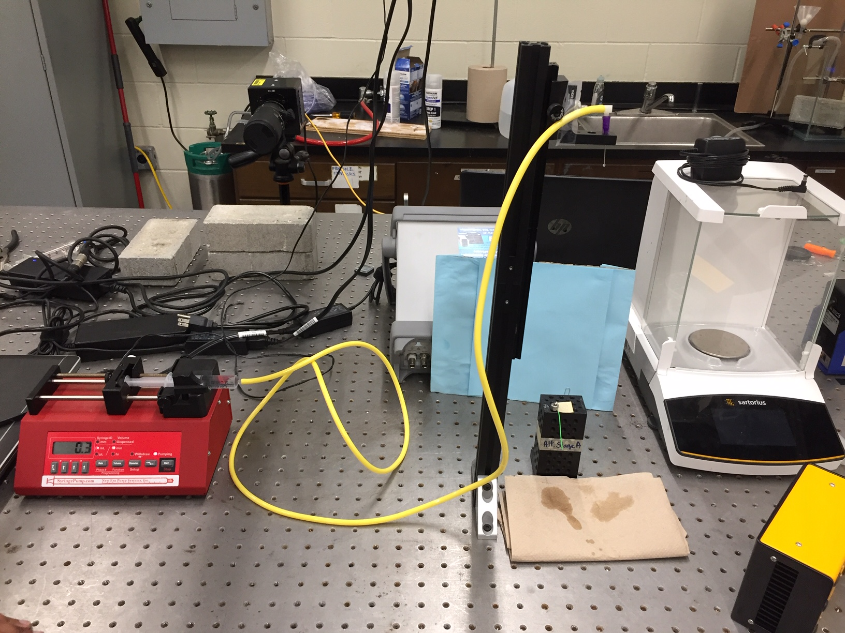
Initial Setup Photo

Slide 4
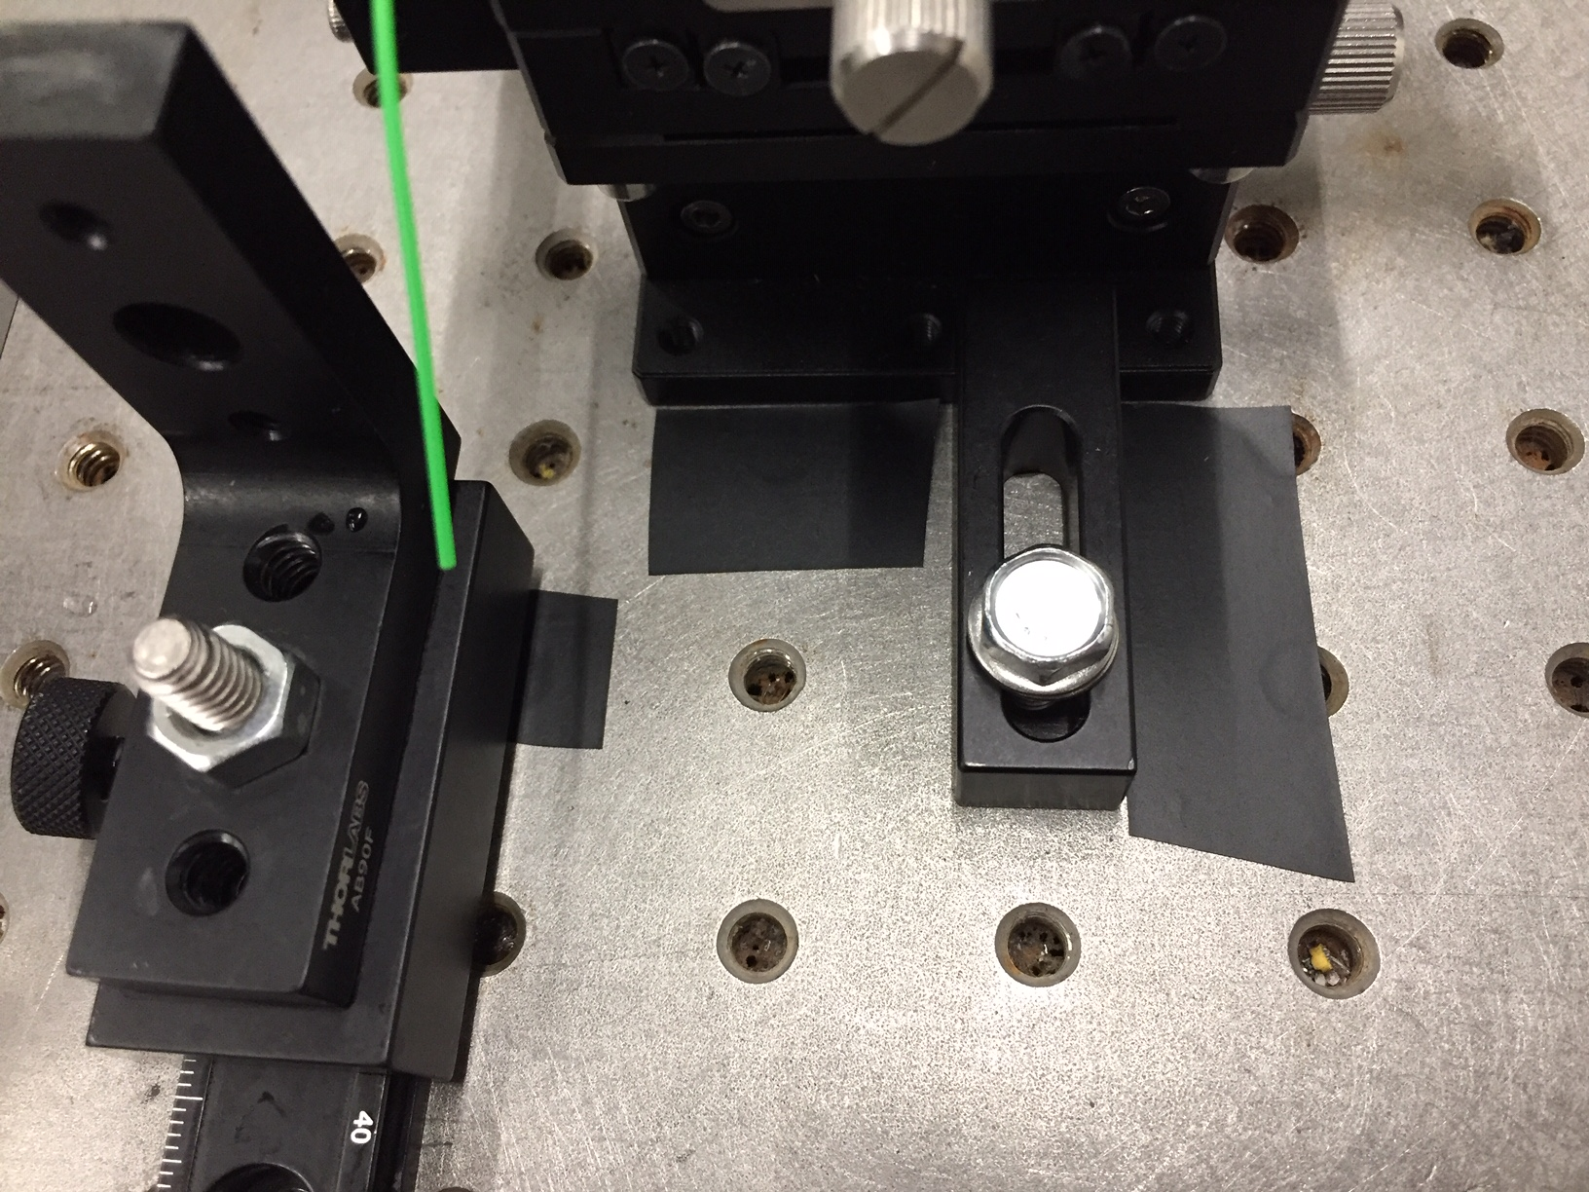
Markings of the Setup

