Slide 1
Project 7: IoT augmented physical scale model of a suburban home REU Students: Thomas Burns and Gregory Fichthorn Graduate mentors: Safa Bacanli and Sharare Zehtabian Faculty mentors: Damla Turgut and Ladislau Bölöni
Week 3 (June 17 – June 21, 2019)
Accomplishments:
Finished design and implementation of windows. Windows close accurately and completely
Familiarized with related works and their purpose in the previous year’s paper
Problem & Solutions
Problem: one set of clamps, takes about an hour for glue to dry
Problem: cluttered dirty workspace. Solution: cleaned workspace and sorted items that weren’t being used out of the way and into storage
Problem: We still need to buy/make a cover
Plans for next week:
On track to finish all motors(doors), wiring, sensors by mid next week
Once all wiring is complete, able to test our ‘scenarios’
Data collection for our simulated environments

Slide 2
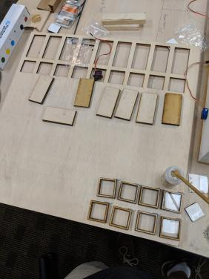
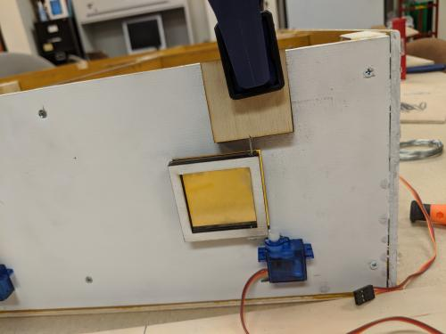
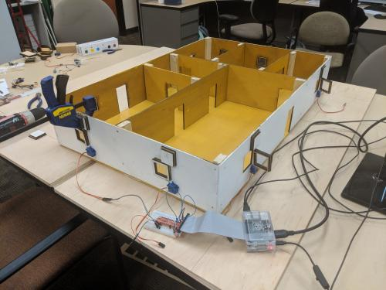
Finalizing Window Design

Slide 3
Windows in Motion
https://www.youtube.com/watch?v=XfcPdr2VoJA

