Slide 1
Project 7: IoT augmented physical scale model of a suburban home REU Students: Thomas Burns and Gregory Fichthorn Graduate mentors: Safa Bacanli and Sharare Zehtabian Faculty mentors: Damla Turgut and Ladislau Bölöni
Project Description:
Design and build an IoT augmented physical scale model of a suburban home.
Design and assemble Raspberry Pi 3-based sensor packs that can be deployed in every room and actuators that implement the opening and closing of doors and windows.
This architecture will allow the performance of accelerated experiments in hypothetical external circumstances in a variety of environments that would be prohibitively expensive to do with real world homes.
Project Goals:
Use data science to process the data collected through the environment.
Use AI techniques to implement a smart-home behavior that reads the sensors and automatically reacts to environmental events.

Slide 2
Project 7: IoT augmented physical scale model of a suburban home REU Students: Thomas Burns and Gregory Fichthorn Graduate mentors: Safa Bacanli and Sharare Zehtabian Faculty mentors: Damla Turgut and Ladislau Bölöni
Week 1 (May 27 – May 31, 2019)
Accomplishments:
Smart house floor-plan/blueprint
Preliminary list of materials and hesitant budget
Problem & Solutions
Building the home – tools and ability to cut materials accurately
Lowes/Home Depot can measure and cut our materials
Raspberry Pi and sensors – how to wire and configure sensors both inside and outside of the house
Thread wires through small holes (drillbit), leave doorways empty inside the house
Plans for next week:
Purchase materials and begin construction of model
Familiarize, analyze, and optimize code from previous year’s project

Slide 3
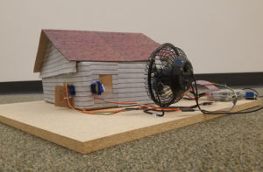
Last Year's 'ScaledHome'

Slide 4
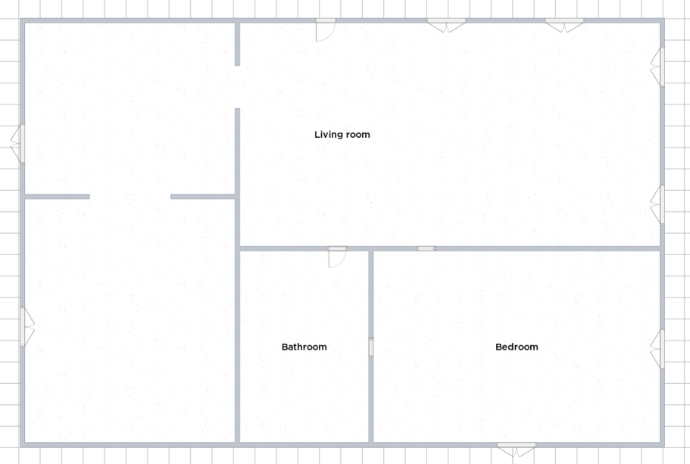
Floorplan (subject to change)

Slide 5
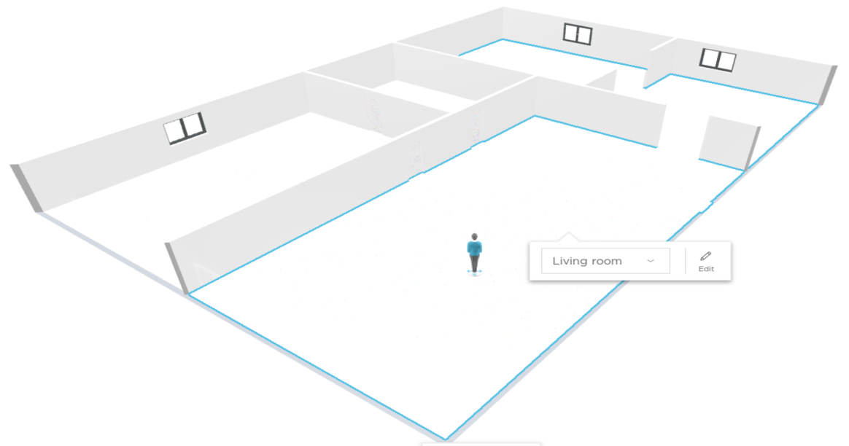
Model (subject to change)

